Slide 1
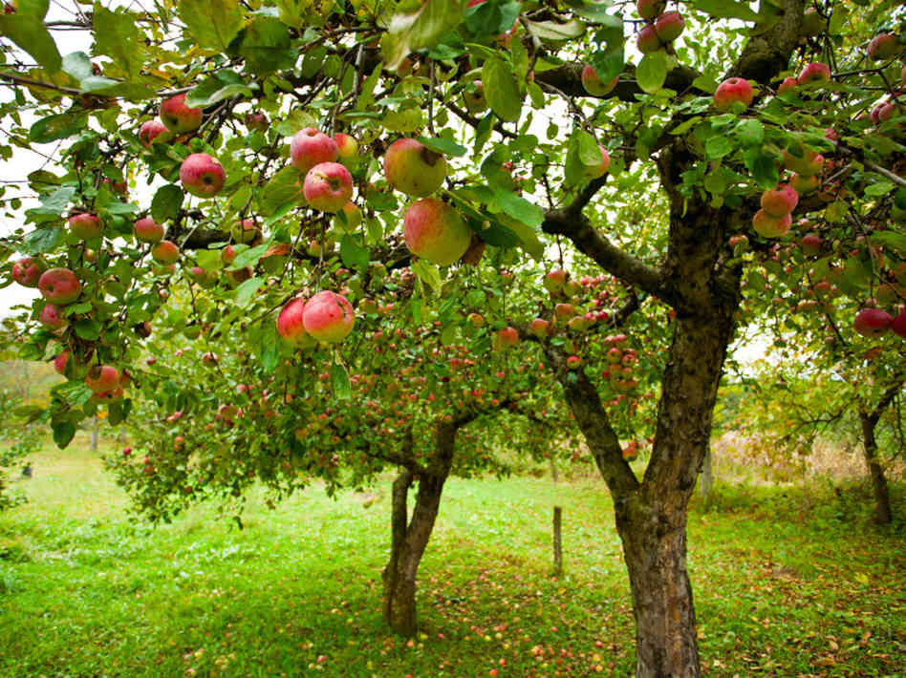
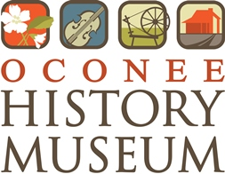
edible history apples in oconee
Leslie Hagerty
Director/Curator
Oconee History Museum

Slide 2
apple origins
Apples have been grown for thousands of years, originating in Central Asia. Alexander the Great is credited with finding dwarfed apples in Kazakhstan in Asia in 328 BCE.

Slide 3


Slide 4
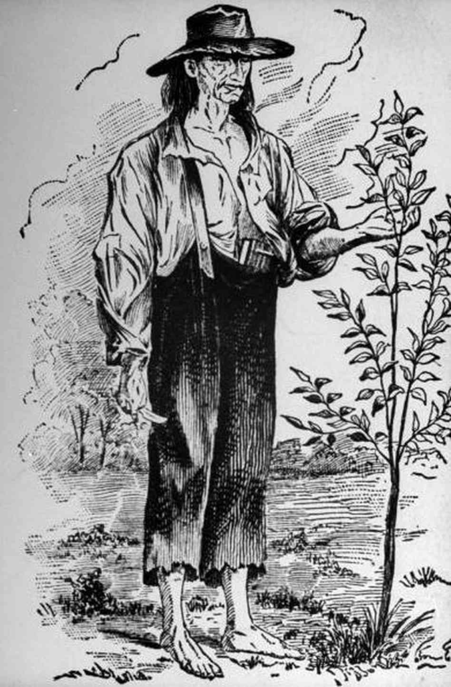
apples in america
Apples were first introduced to North America by 17th-century colonists.
Reverend William Blaxton established the first orchard in Boston c.1625
Only native species of apple is the crab apple.
Colonists brought apple seeds, which spread along Native American trade routes and throughout colonial farms.
By 1845, a plant nursery catalog sold 350 of the “best” varieties of apple trees.
John Chapman (“Johnny Appleseed”) was responsible for extensive apple tree plantings in the Midwest.
Early apples were primarily popular for apple cider, brandy, vinegar, butter, and drying.
Notes:
Apples varieties proliferated quickly across the United States. Apples had numerous uses and hardy varieties could be stored throughout the winter. According to pomologist Creighton Lee Calhoun Jr., author of Old Southern Apples, 1800 apple varieties were grown in the Southern United States. Only 500 remain in existence today.

Slide 5
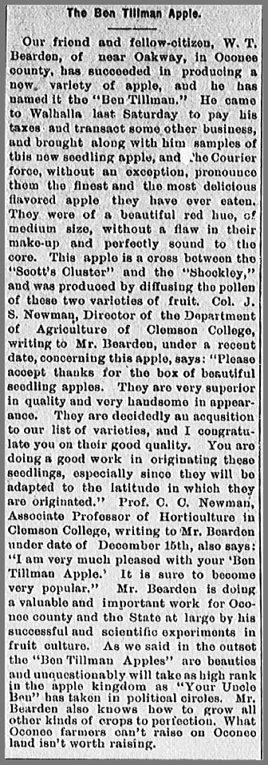
apples in oconee
Notes:
Early references to apple growing in Oconee indicate that small orchards were part of many family farms. Some farmers, like W.T. Bearden, used their small orchards for learning and experimentation, resulting in varieties unique to Oconee. This article from 194 describes W.T. Bearden’s “Ben Tillman” apple, which is a cross between the “Scott’s Cluster” and the “Shockley” varieties.

Slide 6
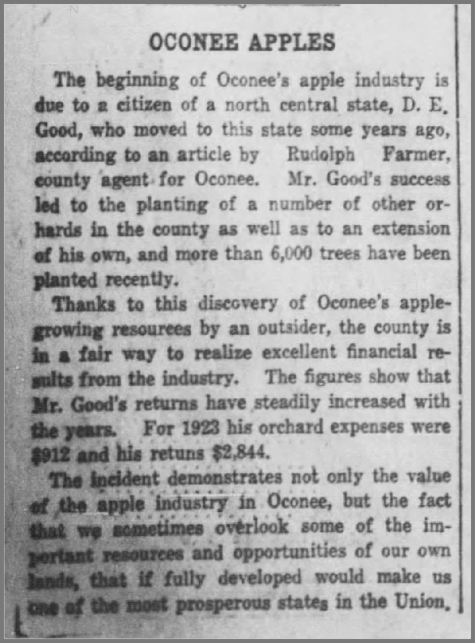
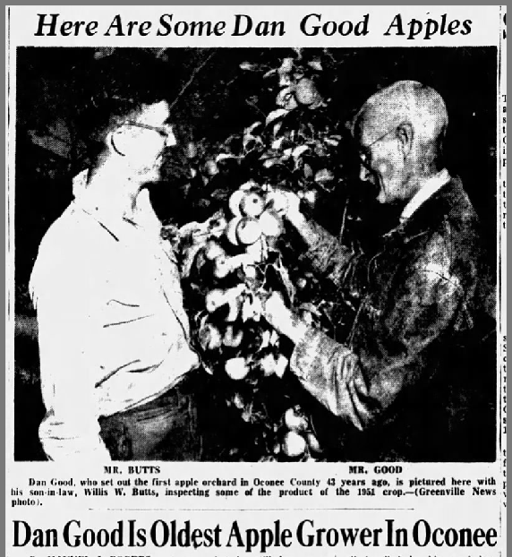
seeing potential
Notes:
In the early 20th century, several Oconee farmers began to recognize the potential for huge success with apple growing in Oconee’s northwestern mountains. Dan (D.E.) Good is credited with being the first “apple grower”. Certainly he was not the first to grow apples in Oconee, but he was one of the first to dedicate most of his farm to large-scale apple production. He saw the potential for Oconee farmers to move beyond growing a few trees for personal use to growing large orchards for quantities that could be sold at markets. Dan Good encouraged his fellow local farmers to set out apple trees, and he enthusiastically shared the secrets to his success.
Apple growing provided an opportunity to diversify farms, and as the boll weevil decimated cotton crops throughout the 1920s, more and more Oconee farmers turned to their efforts toward apples.

Slide 7
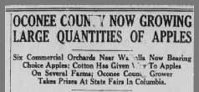
emerging industry
Notes:
Oconee apples proved to be attractive in both taste and appearance, making them very marketable in the region. Reports of desirable income spurred more interest and tempted many farmers into adding orchards to their properties. In response to so much interest, growers formed the first Oconee Apple Growers Association in the early 1920s. This group worked to educate and support new and existing apple growers in the County. By the mid-1920s the scale of apple growing in Oconee was approaching “industry” levels.

Slide 8
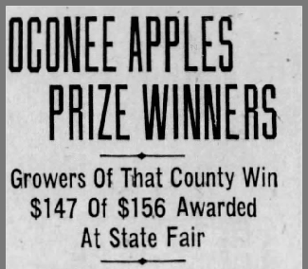
a spotless reputation
Notes:
Oconee apples earned early and frequent acclaim throughout the state and surrounding areas. Many times Oconee growers claimed all prizes for apples at the SC State Fair.

Slide 9
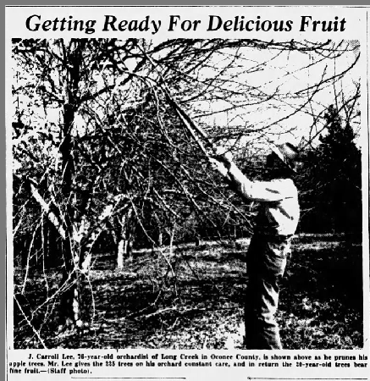
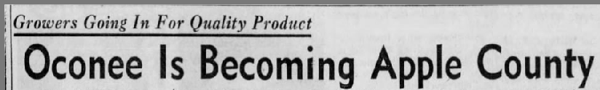
an apple a day
Notes:
Oconee’s apple industry took a backseat as Oconee and the nation turned its attention to the fighting abroad during World War 2. However, many soldiers returned home to family farms and the promise of a successful career growing apples. Demand for apples exploded during the post-war years as society experienced the Baby Boom, and social programs like the National School Lunch Act worked to fight hunger and poverty by providing access to nutritious fruits and vegetables. Oconee growers were eager to meet this demand, and they were armed with a secret weapon – Oconee’s unique climate, which allowed apple growers to harvest apples and get them to market 2-4 weeks earlier than other apple producing regions like Washington state.

Slide 10
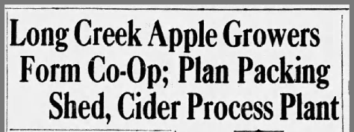
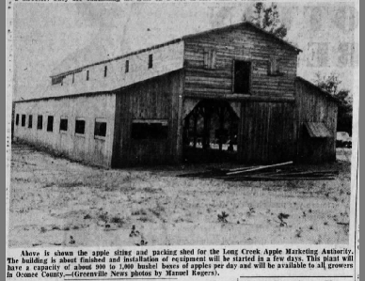
innovative cooperation
Notes:
Scientific and mechanical advancements also allowed apple growers to meet this new demand, and Oconee apple growers were not afraid to improvise, adapt, and help each other. Oconee growers immediately saw the advantage of working together to pack, market, and ship their apples. The newly established Long Creek Apple Marketing Authority quickly erected an apple grading and packing house (shed) in 1952, which utilized professional equipment and trained labor to size, grade, pack, and ship apples throughout the United States.

Slide 11
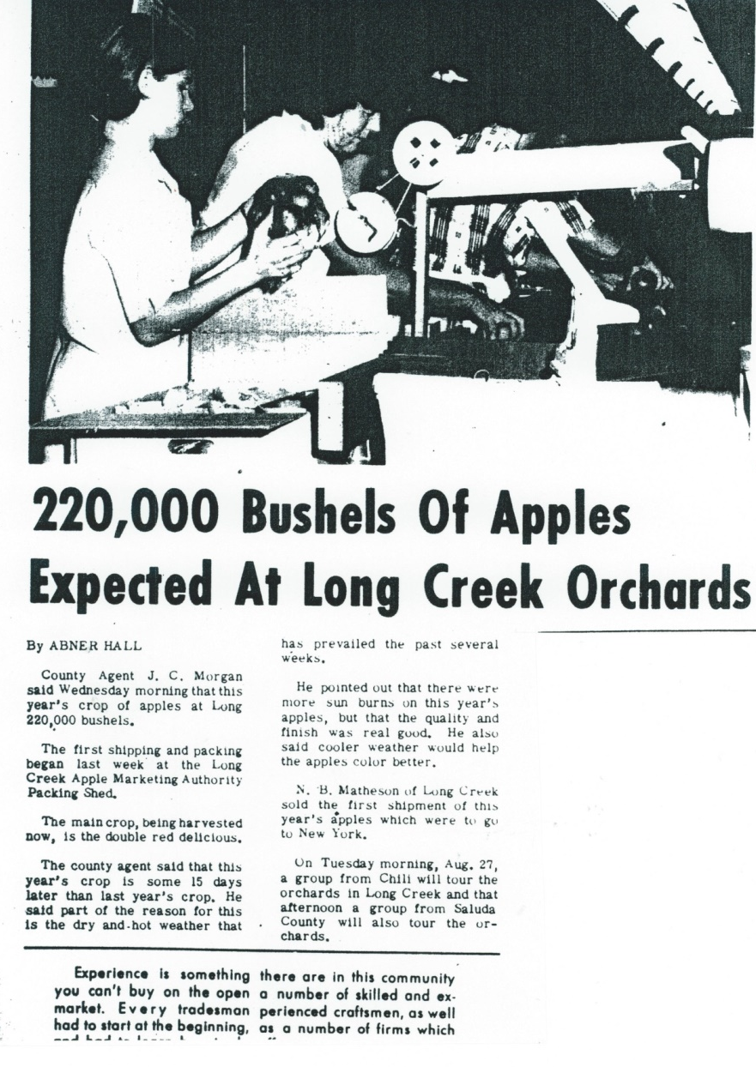
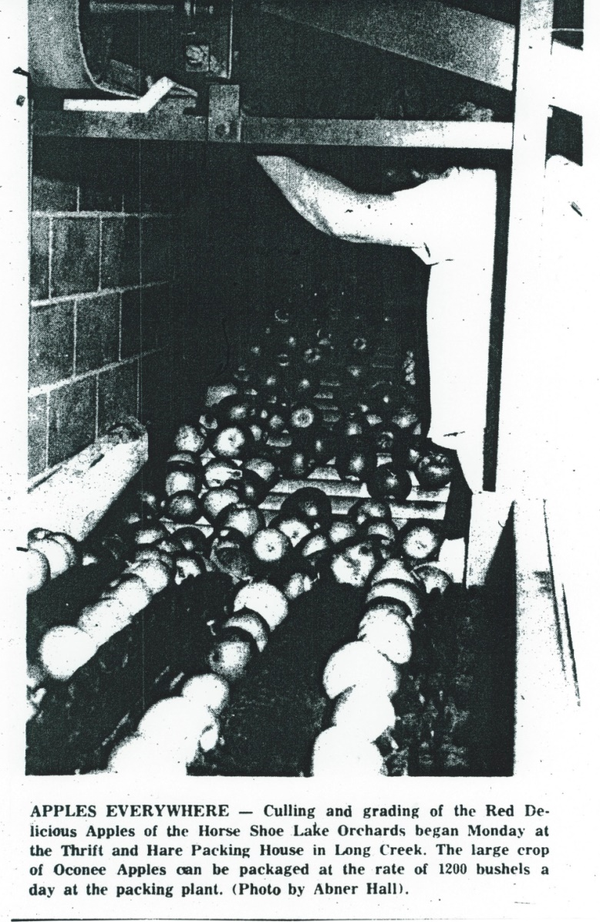
success
Notes:
By the 1960s Oconee’s apple industry was in full swing. Oconee’s growers, agricultural extension agents, and state politicians were “all in”, projecting record-breaking harvests and incomes for decades to come as Oconee became a leader in South Carolina apple production.

Slide 12
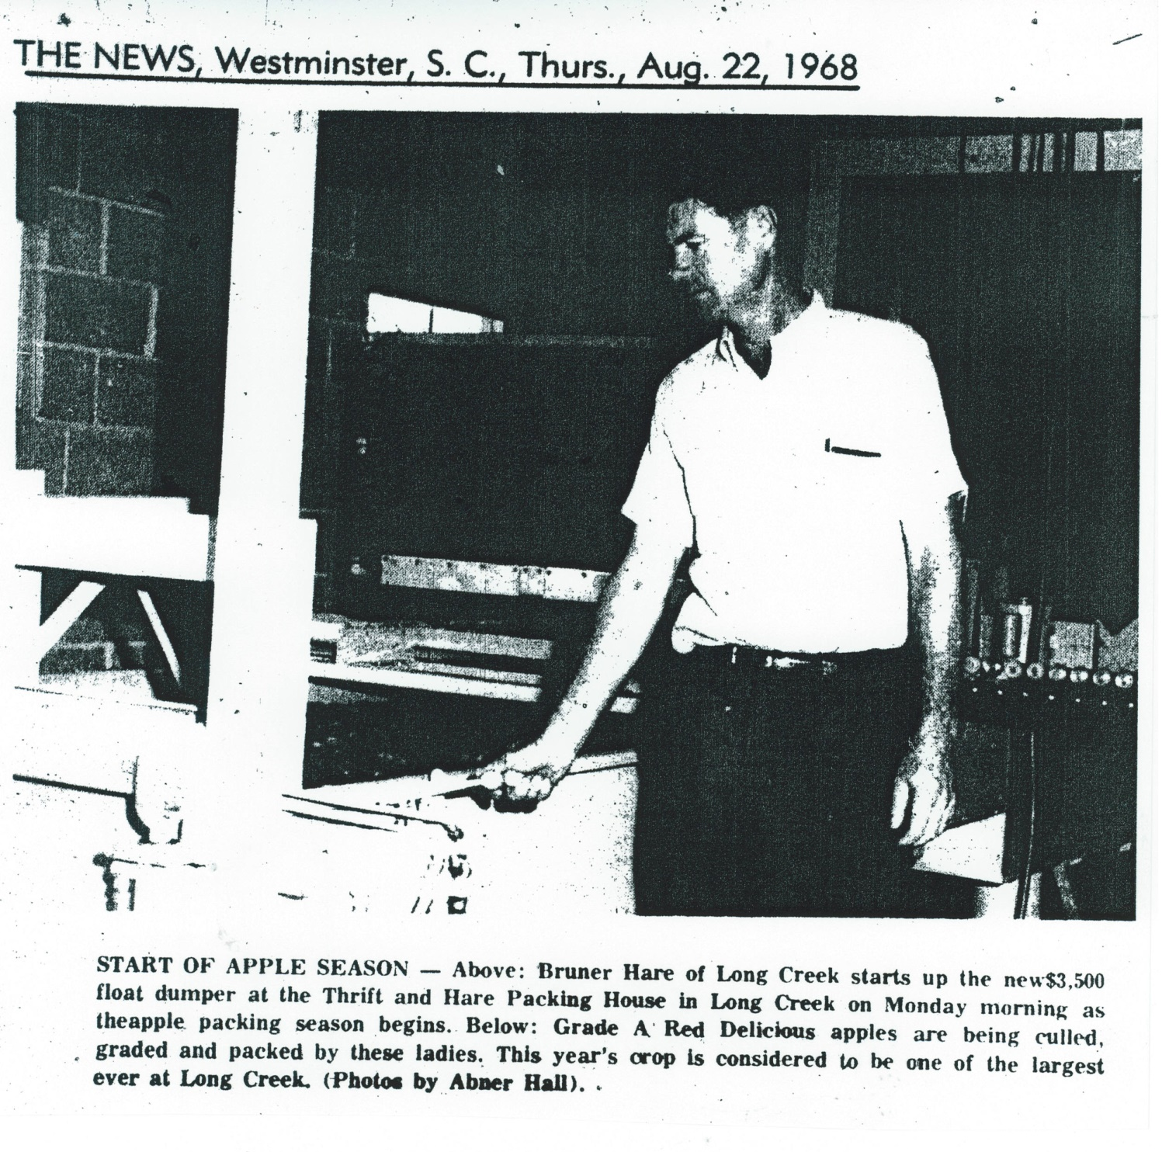
Notes:
Growers continued to adopt the latest technologies and growing practices.

Slide 13
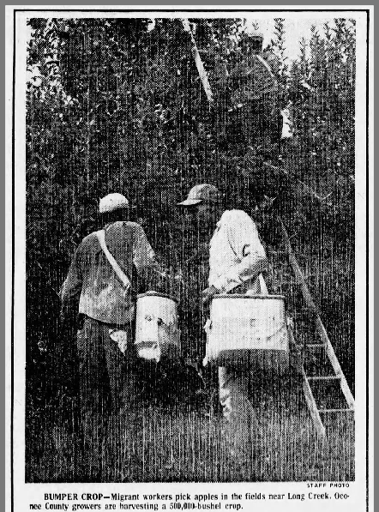
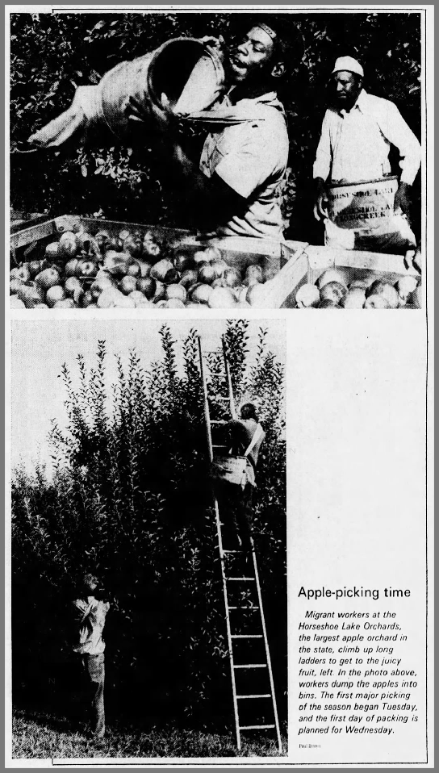
migrant labor
Notes:
The success of Oconee’s apple industry soon outgrew its local labor force. To meet the need for labor during the apple picking season, many growers began employing migrant labor.

Slide 14
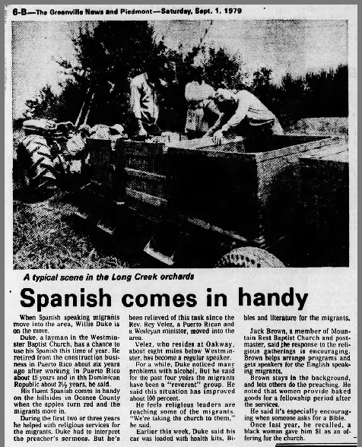
Notes:
Many migrants were of Hispanic origin, but many were also African-American as well. Migrant labor crew leaders would travel ahead to verify how much migrant labor would be needed for the apple picking season. Research indicates that there were up to 78 migrant camps across Oconee, Spartanburg, Greenville, Cherokee, and York Counties. Temporary housing was often provided by the apple growers, and migrants who found the conditions and pay to be good would return season after season. Apple picking also became generational work for many migrant families.

Slide 15
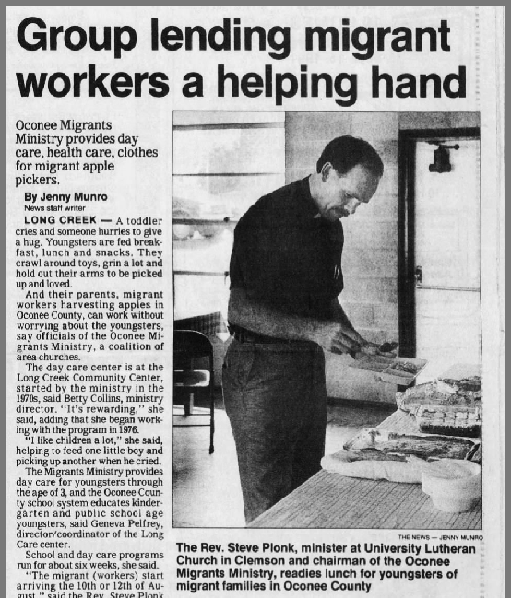
Notes:
Oconee County’s apple industry, like much of South Carolina’s fruit industries, absolutely depended on this migrant labor force. Life was difficult for migrant workers and their families. Childcare and education was necessary for migrant children. Healthcare was important for workers who often lived in close quarters and performed difficult and dangerous work. The State government implemented some social programs aimed at supporting migrant workers, but much of the support for migrant families came from local church ministries and community efforts.

Slide 16
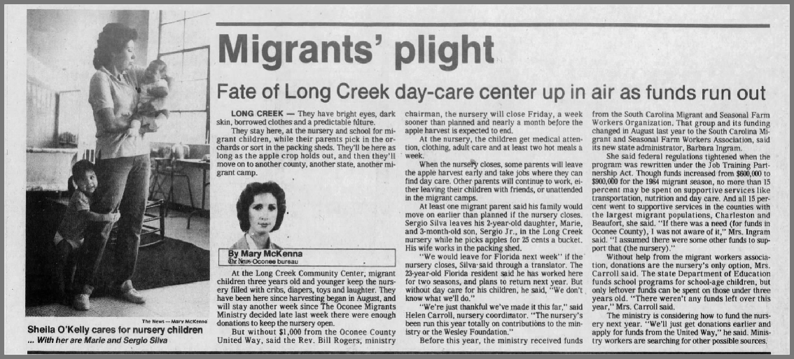
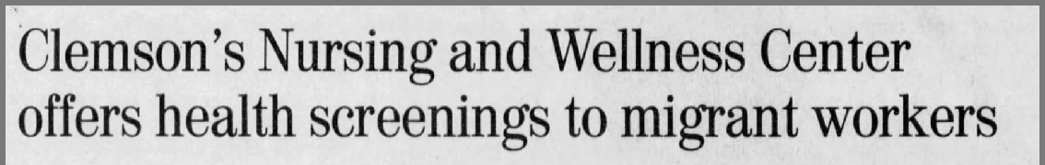
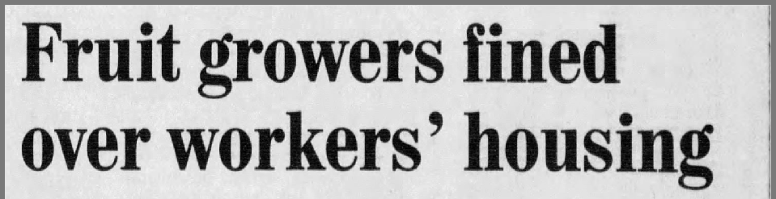
Notes:
Funding for social programs and charities aimed at supporting migrant workers was often threatened by political budget cuts and economic forces.

Slide 17
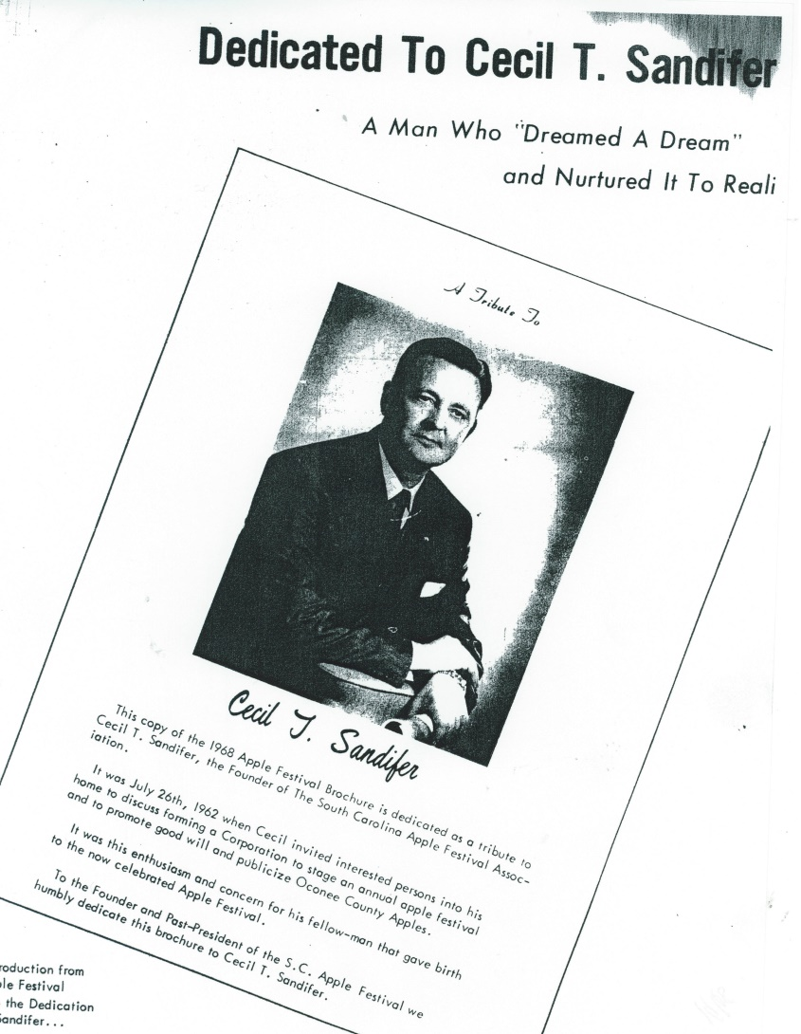
the fruits of labor: apple festival
Cecil Sandifer, then mayor, proposed the idea in 1961.
Idea was to promote good will and Oconee County apple growers.
Notes:
Oconee’s blossoming apple industry made its mark on local character and culture. In 1961 Westminster Mayor Cecil Sandifer proposed his idea for the South Carolina Apple Festival in order to promote Oconee County apple growers and good will in the community.

Slide 18
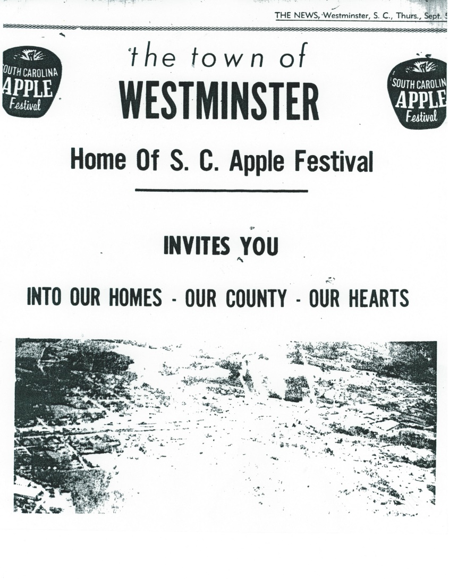


Slide 19
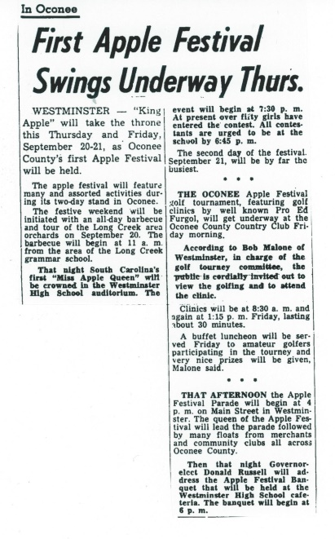
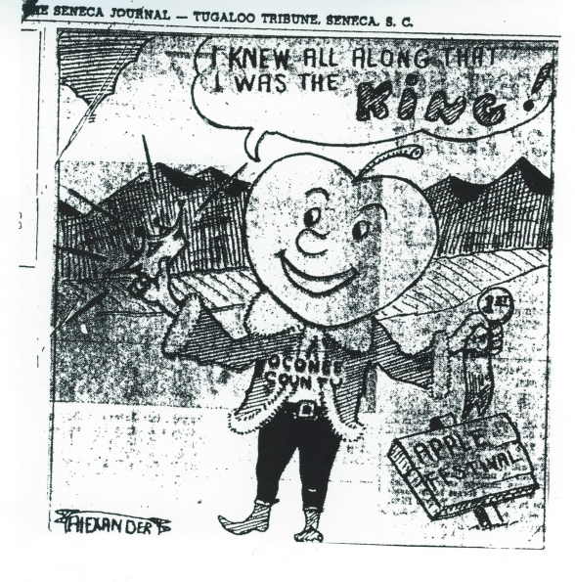
Notes:
South Carolina Apple Festival events have changed from year to year, although many are now traditions. Festival events have included Long Creek orchard tours, community barbecues, pageants, golf tournaments, civic luncheons, parades, banquets, rodeos, street vendors, music performances, races, Chattooga River floats, baking contests, and much more.

Slide 20
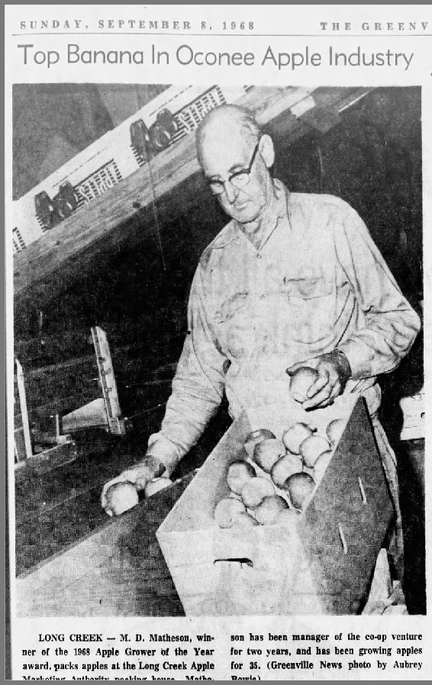
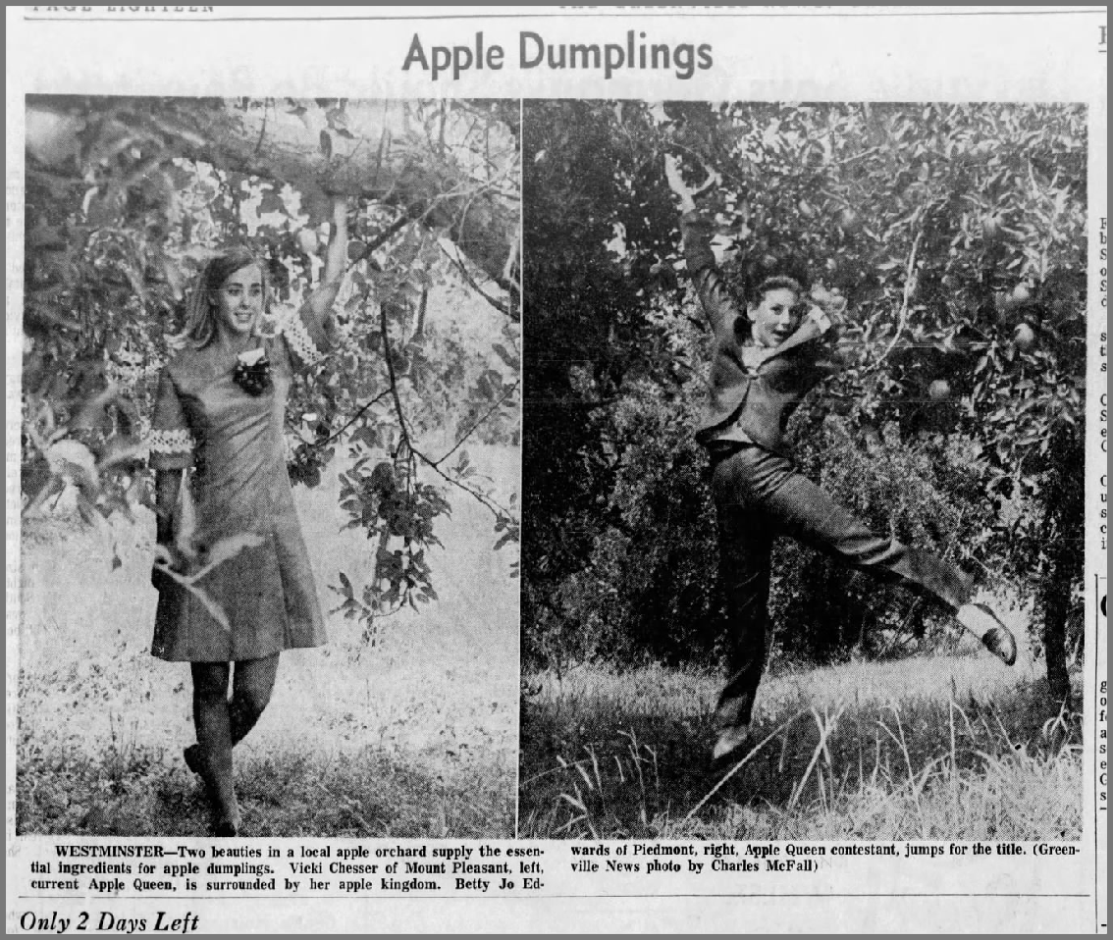
Notes:
Each year Oconee apple growers would award the Apple Grower of the Year. A annual pageant was also held to name an Apple Queen.

Slide 21


Notes:
Although Westminster is the epicenter of the South Carolina Apple Festival, all of Oconee County’s towns supported the festival and the apple industry.

Slide 22
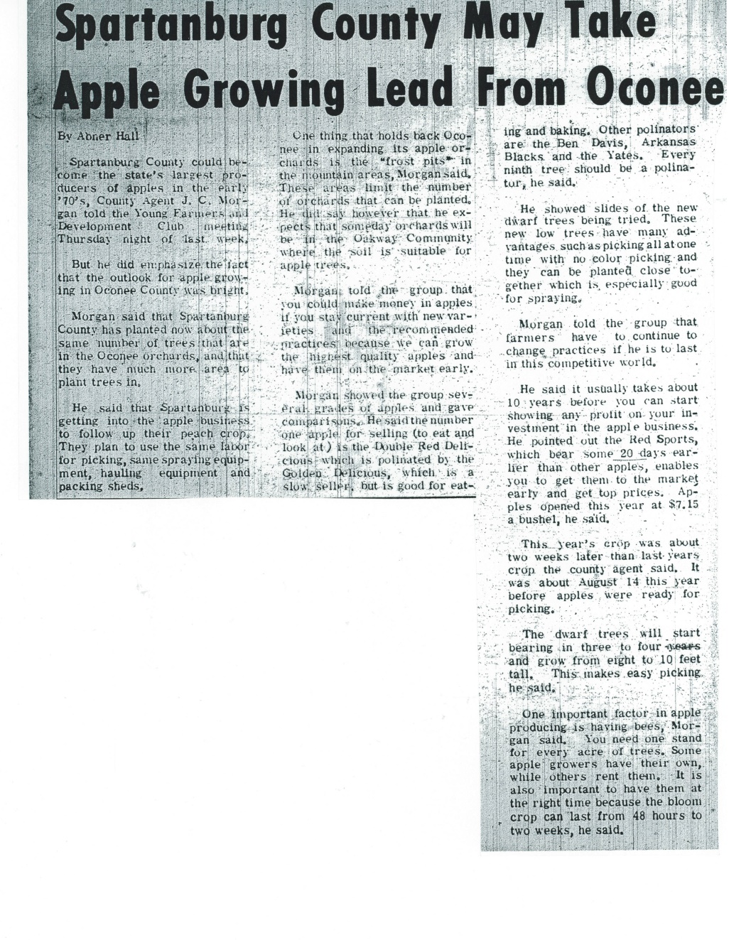
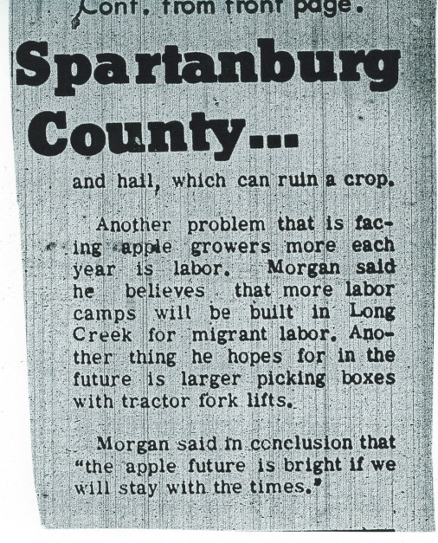
the decline
Notes:
By the late 1980s and early 1990s the apple industry in Oconee had begun to decline. Several seasons of freezing weather significantly damaged crops and reduced incomes for growers. Local growers also began to feel pressure from global producers who could flood the market and cause unsustainable price fluctuations.

Slide 23
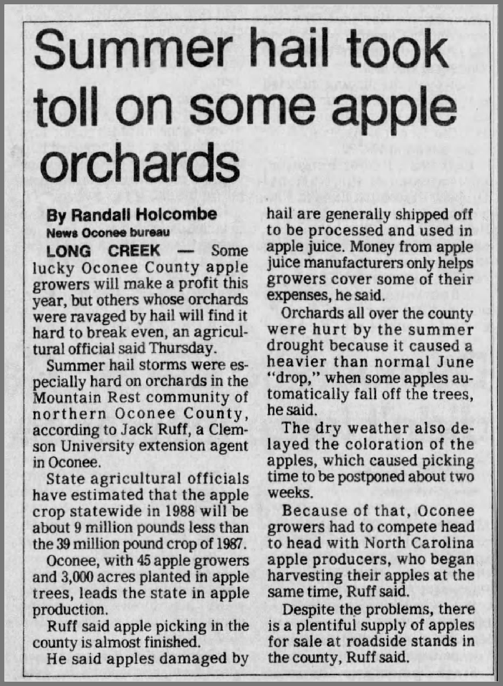
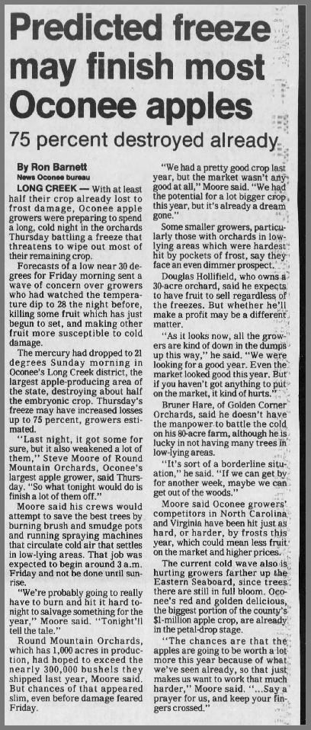
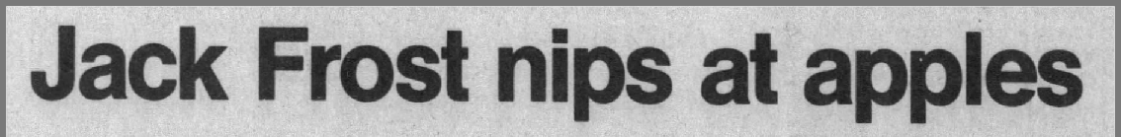
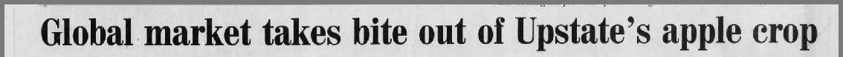
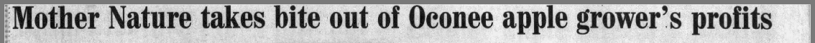

Slide 24
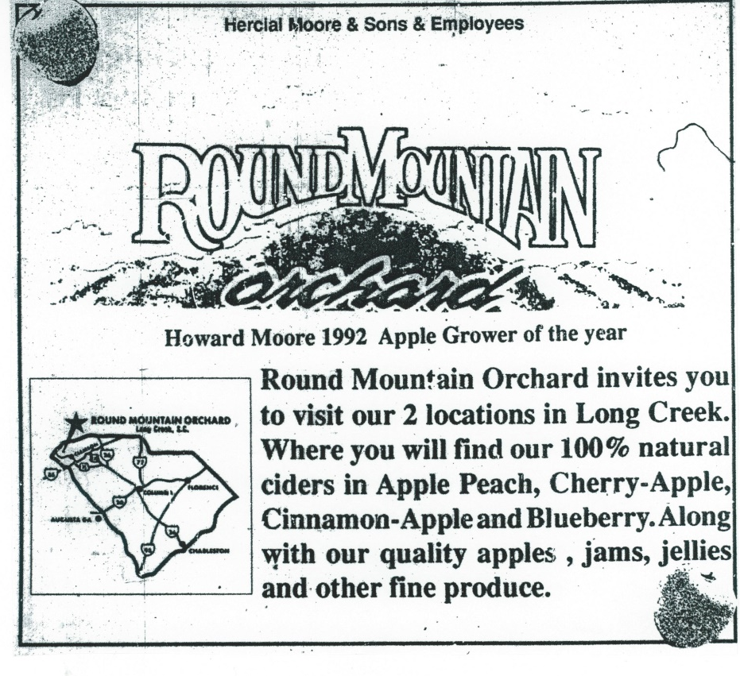
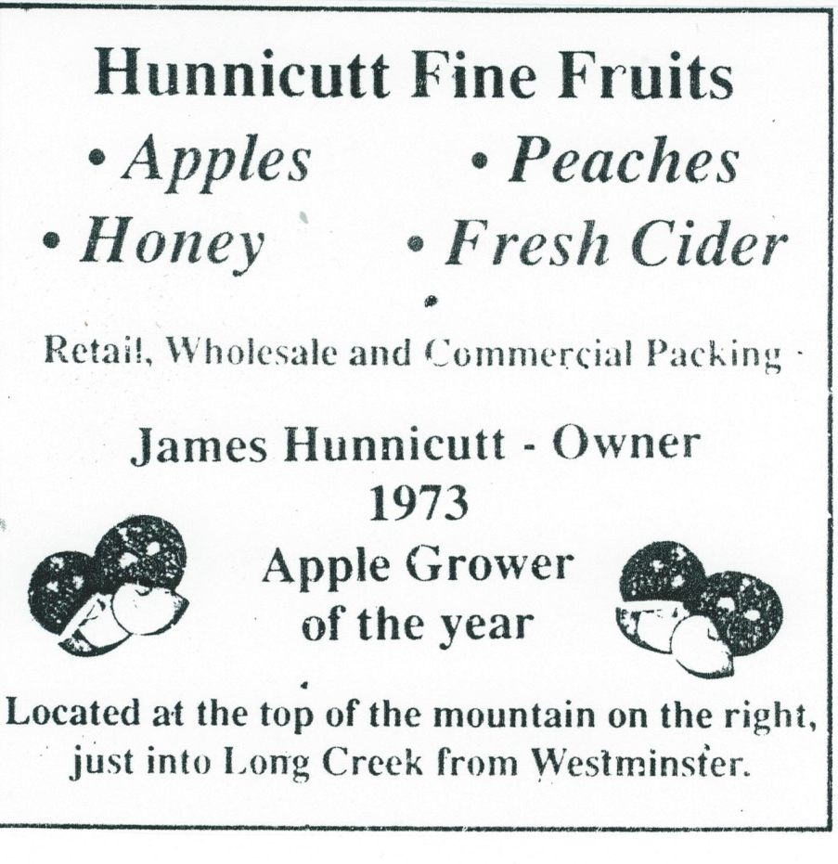
diversification
Notes:
Just as Oconee farmers had turned to apples as way to diversify after losing their cotton crops, many apple growers began diversifying orchards to include other fruits like peaches, and many began offering other processed and packaged products like cider, jams, jellies, relishes, sauces, candies, and honey at their roadside stands. This diversification of helped create new sources of revenue, offsetting the financial impact of lost apple harvests.

Slide 25
the facts
The number of apple farms in SC decreased from 390 in 1982 to 205 by 2007.*
The acreage of apples produced in SC was 4,780 in 1987. By 2007 it was 566.*
“Farming is tough. You have to be a chemist, a mechanic, a bee keeper…you gotta do everything.” – Doug Hollifield, Long Creek orchard manager.
*USDA statistics
Notes:
Apple growing techniques have continued to evolve and change over time, but the risk and difficulty of farming has never diminished. Subsequent generations of apple growing families were not always attracted to the intense workload and risky business of the apple industry, especially as new job opportunities became available in a more global world.

Slide 26

outlook
~6 growers remain in Oconee County
Agricultural Tourism
Local support
  Farmer’s Markets
  Repeat customers
Future generations
Notes:
Apples are still an important part of Oconee County’s agricultural heritage. Today’s apple growers continue many of the same traditions, but many are embracing the benefits of “agri-tourism”. Many orchards now offer “U-pick” apple picking experiences for visitors. Many also offer their orchards for rent as wedding venues. Roadside apple stands continue to dot Oconee’s mountain highways, offering a variety of apples and homemade products for visitors.

Slide 27
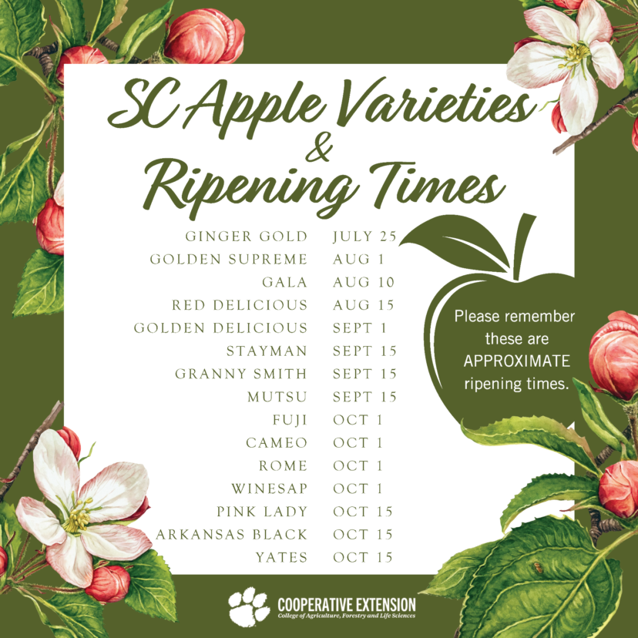

Slide 28
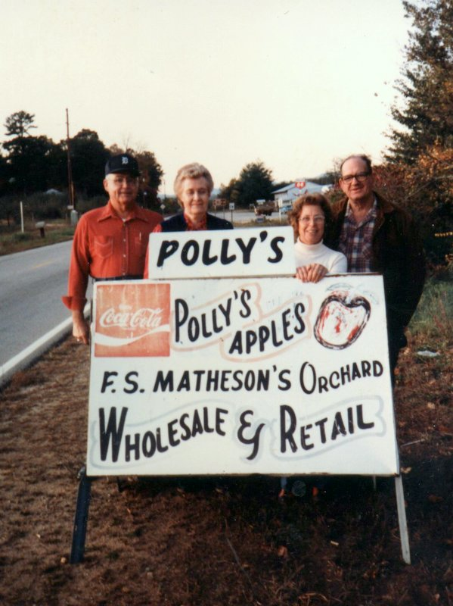
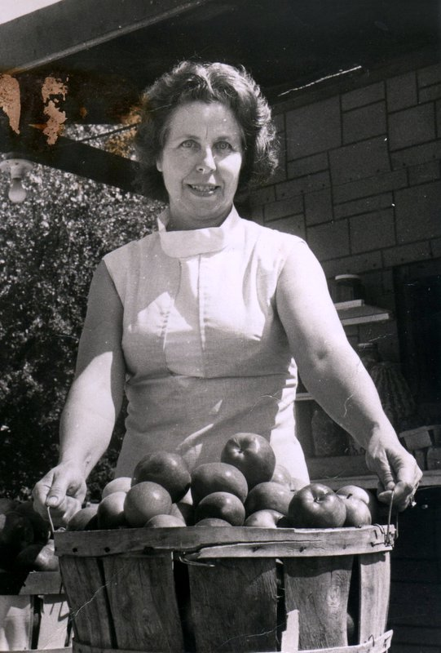
fond memories
Polly’s Apple Stand – Long Creek
Polly Matheson
Notes:
Polly’s Apple Stand of Long Creek is a great example of Oconee’s many family-operated apple orchards and roadside apple stands.

Slide 29
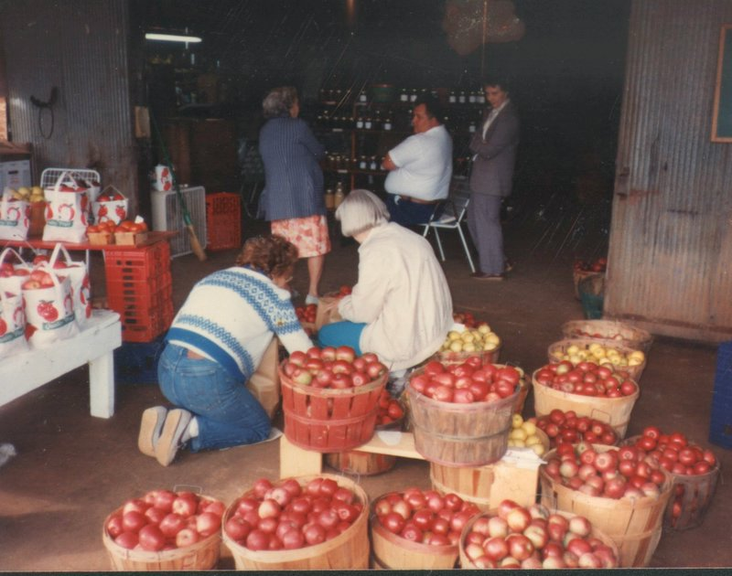
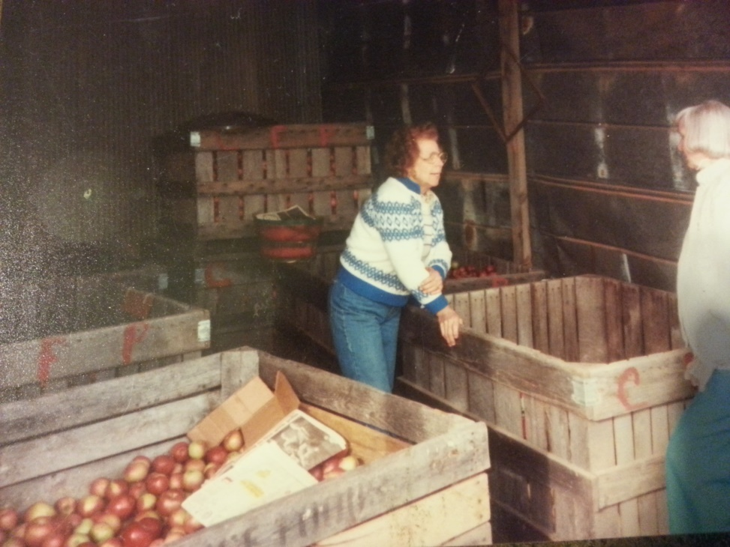
fond memories

Slide 30
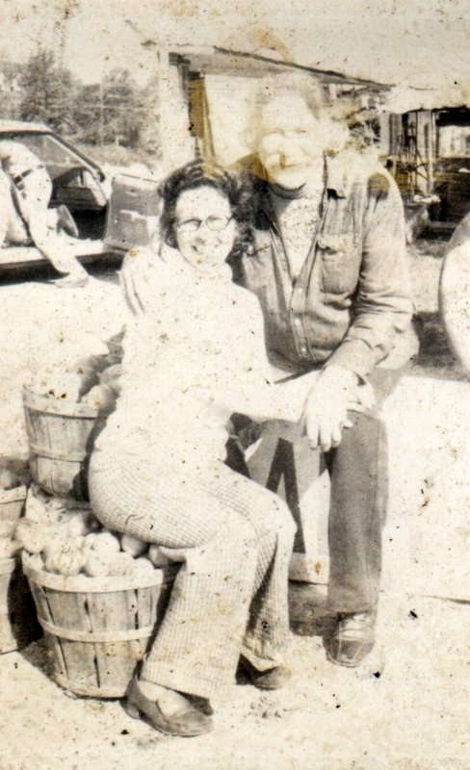
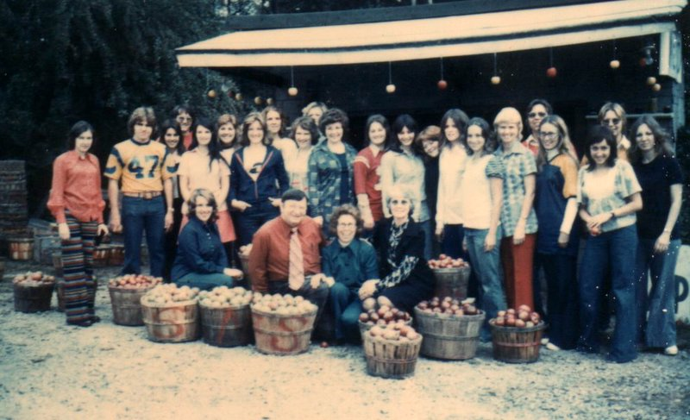
fond memories
Polly and Grandpa Walton
Lee College Chorus

Slide 31
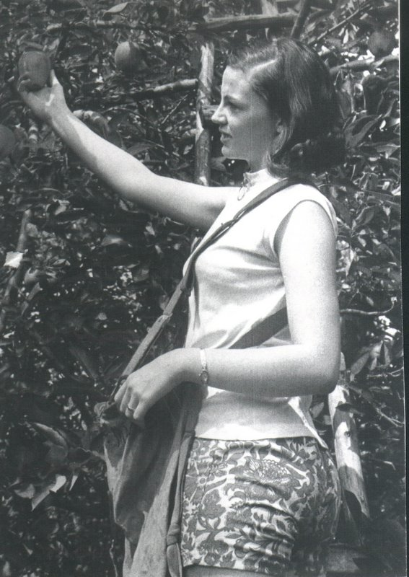
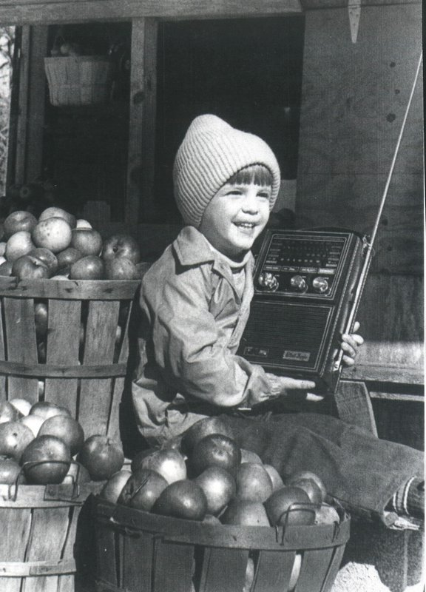
fond memories
Janice Matheson picking apples
Kevin Matheson

Slide 32
thank you
For more information about Oconee County apple orchards visit www.visitoconee.com

