Slide 1
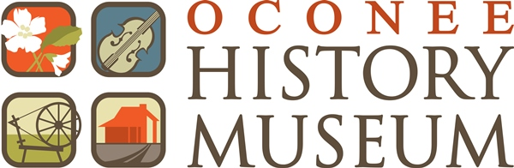
What’s In A Name?
A Guide to Oconee County’s unique and wonderful place names

Slide 2
The Cities
Walhalla, West Union, Seneca, Westminster, and Salem

Slide 3
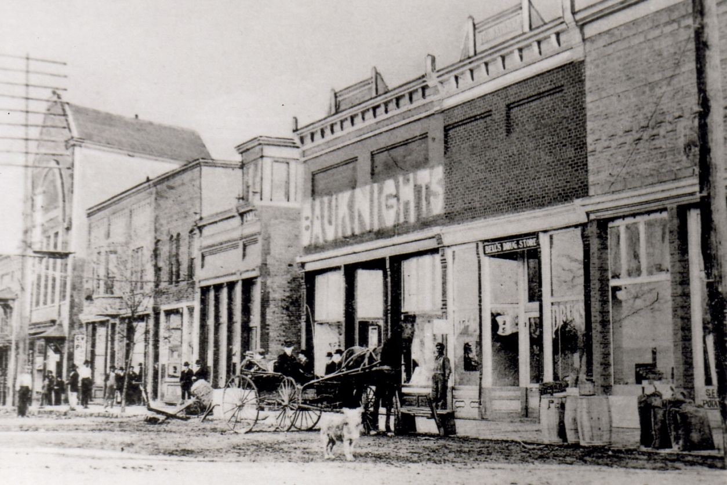

Walhalla
Notes:
Named after Norse mythology’s Valhalla, it’s defined as Garden of the Gods. Founded in 1850 by the German Colonization Society out of Charleston.

Slide 4
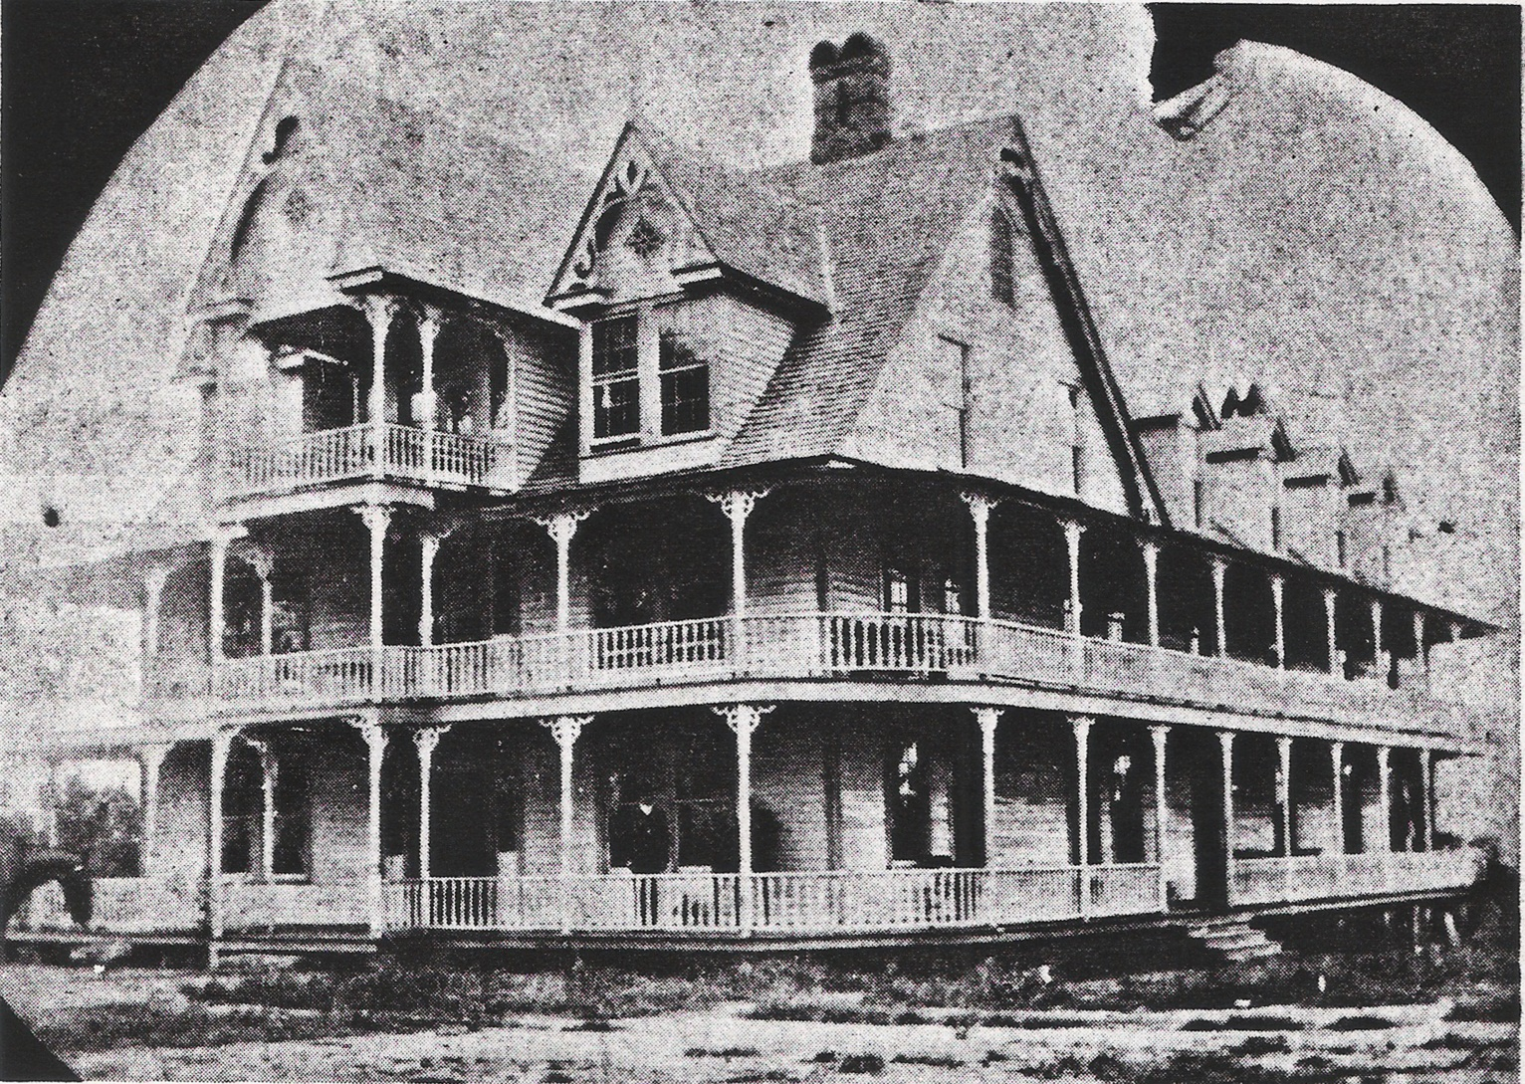
West Union
Notes:
Founded as a temperance union by Joseph Gresham. He formed a temperance union and when he moved his residence he formed another temperance union which he called West Union because it was west of the first temperance union. He later formed another temperance Union and called it South Union.

Slide 5
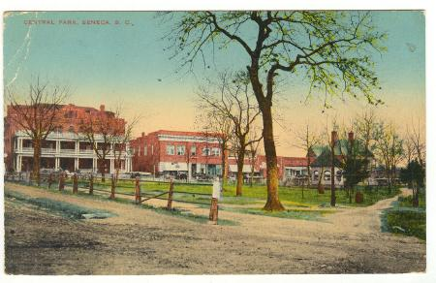
Seneca
Notes:
Originally named “Seneca City”, Seneca is named after the Cherokee Village of Esseneca that was located not too far from the city today. The Seneca River also contributed the City’s naming.

Slide 6
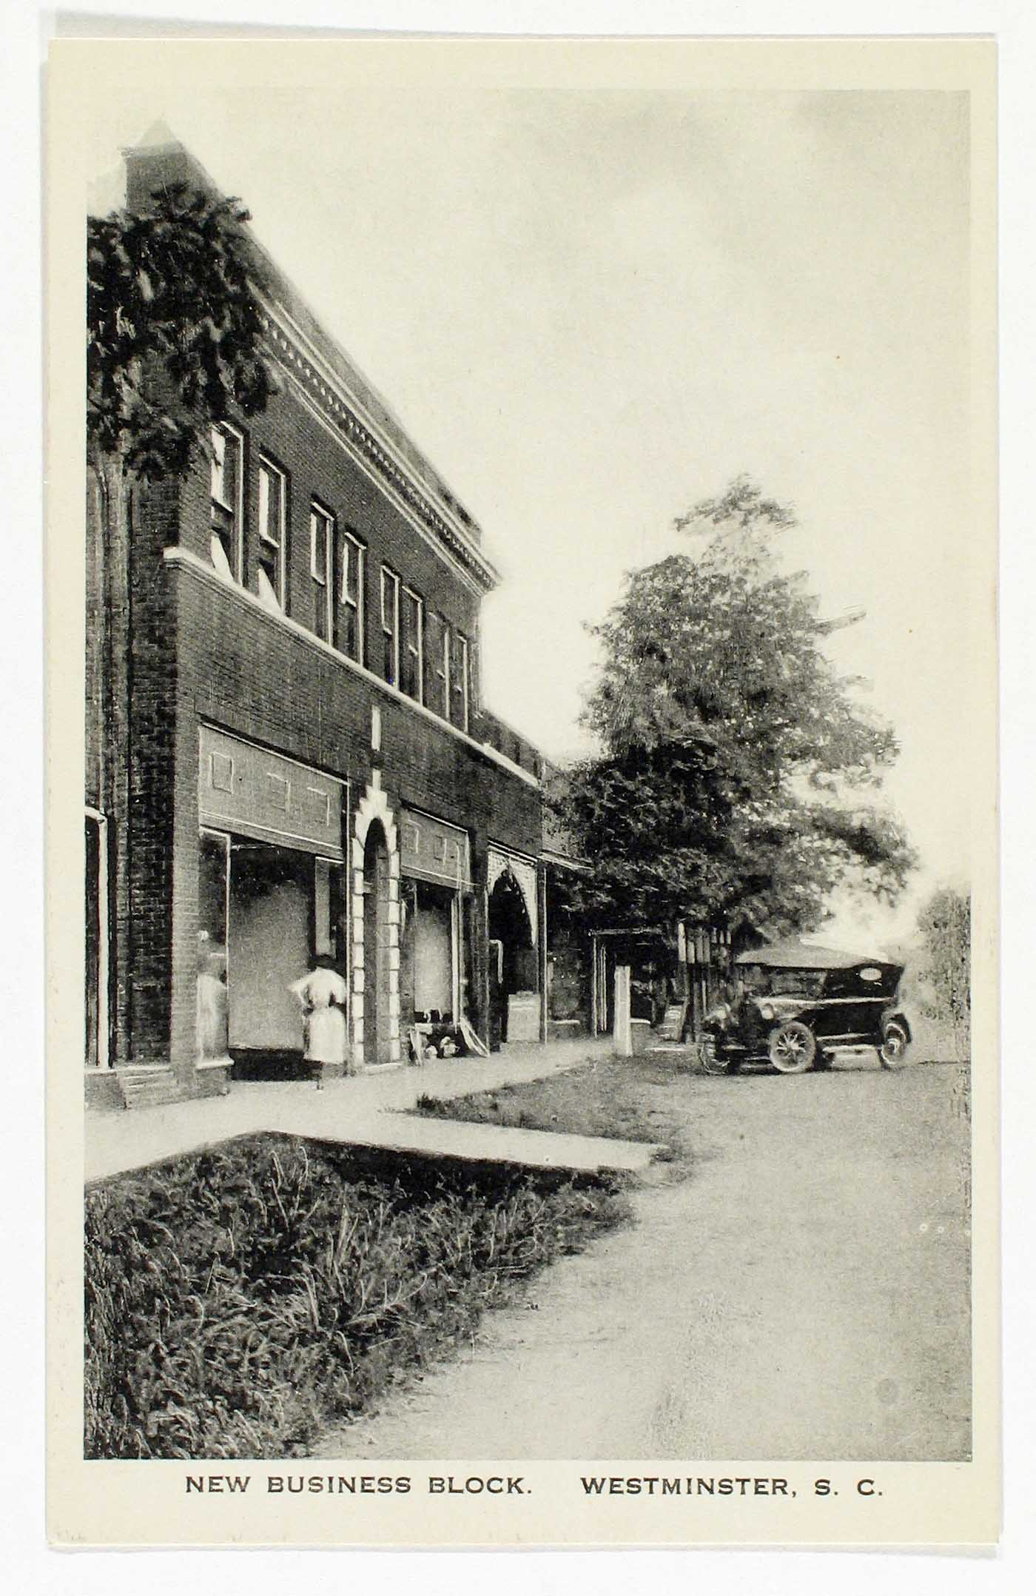
Westminster
Notes:
In 1803 a missionary Reverend Andrew Brown established a Presbyterian church in a log building on 7 acres of land donated by Oliver Green. The located is in the approximate area of First Baptist Church. He named it Westminster Presbyterian Church after Westminster Abbey in England.

Slide 7
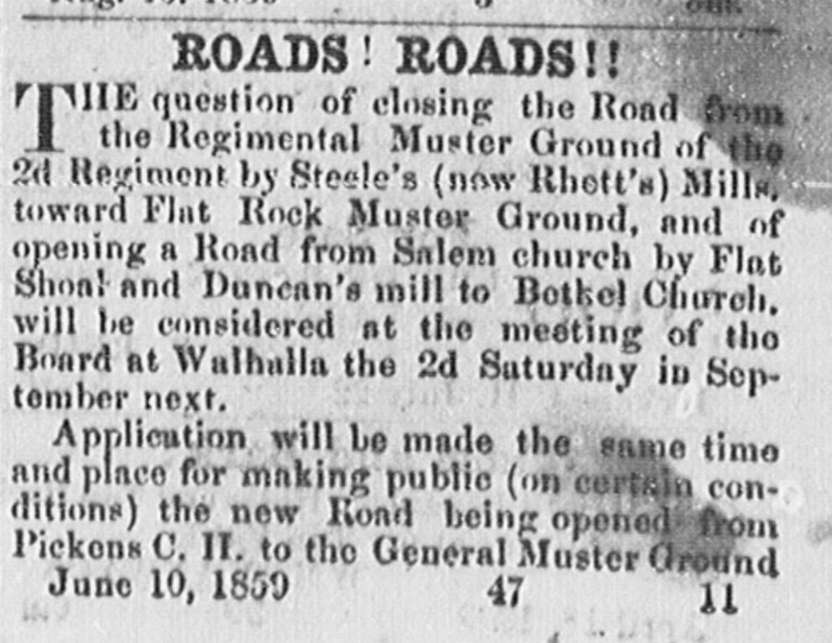
Salem
Notes:
Arabic/Hebrew word meaning peace or perfect.
Mid-1850s-Keowee Courier mentions roads to Salem Church near Flat shoals.
Town was officially established in 1907.
Election Precinct.
Recommended place for meeting for Keowee Township 1879.
Post Office established 1883.

Slide 8
Communities
Tamassee, Mountain Rest, Oakway, Fair Play, Madison/Cleveland, Newry, Long Creek, Richland, Bountyland

Slide 9
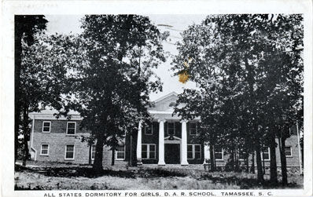
Tamassee
Notes:
Cherokee Village. Roughly translates to “Place of Sunlight of God”
Many years ago in the mountain village of the Cherokee there lived a famous fire prophet. His great wisdom and his power of healing were attributed to the possession of an unusually large ruby. The Cherokees called this glowing ball of fire “The Sunlight of God”. At his death the Cherokee obeyed his parting injunction and buried him with the stone clasped to his breast.

Slide 10
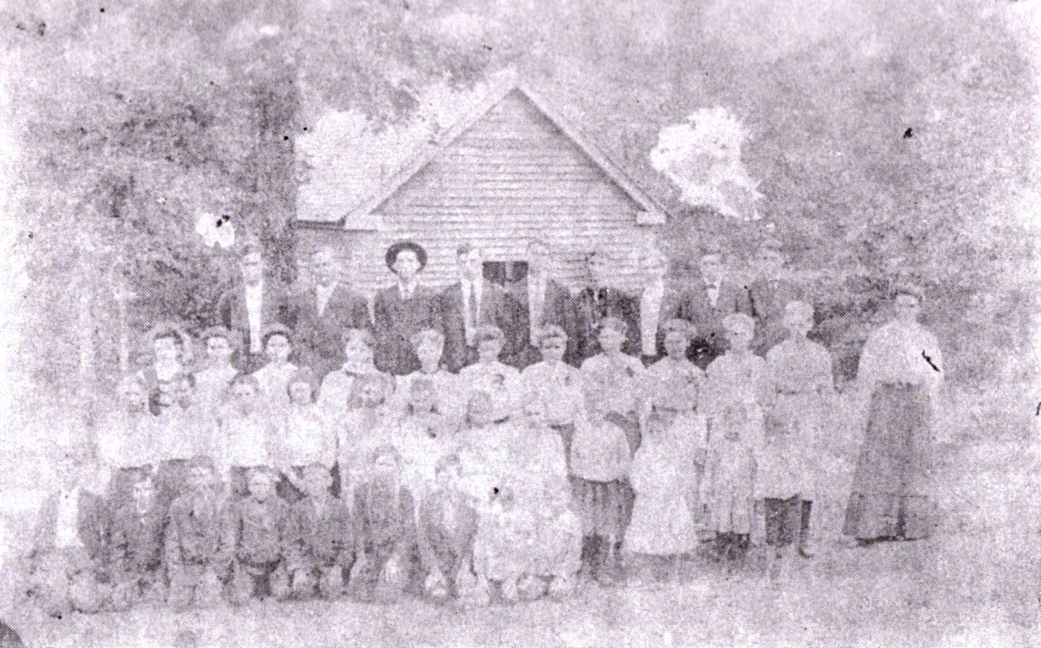
Mountain Rest
Notes:
Named so because it was a rest point on the stage coach route to Highlands and Cashiers

Slide 11
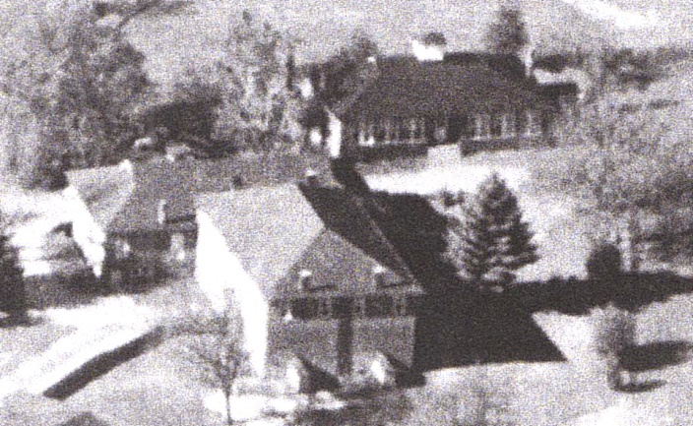
Oakway
Notes:
Originally named Nubbin Ridge because the farmers there grew nubbin corn. Later called Oakway because there were beautiful oak trees that lined the main road into the community.

Slide 12
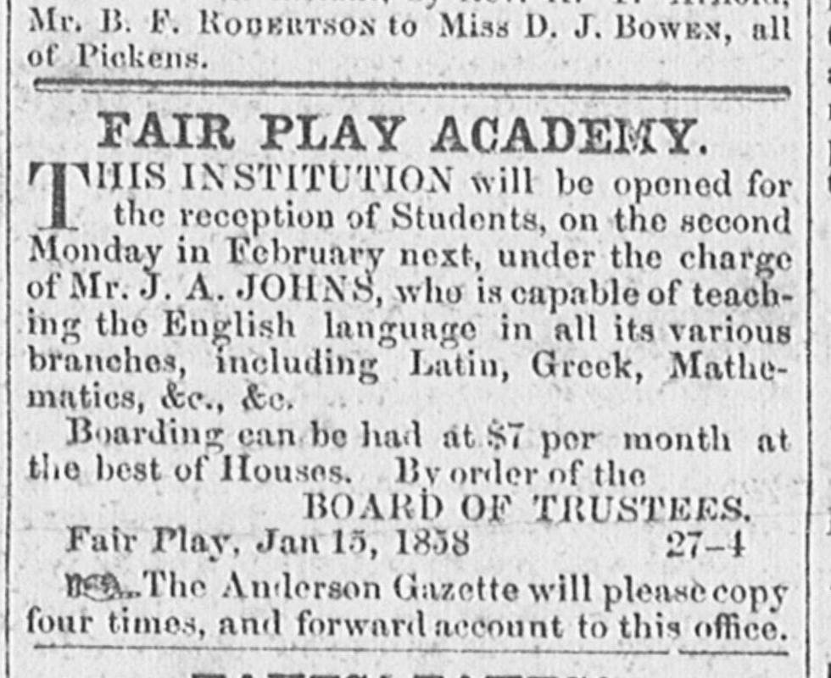
Fair Play
Notes:
In Mary Cherry Doyle’s book “Historic Oconee in South Carolina” indicates that the name of the town evolved from a militia muster in the area, during which a fight broke out and the by-standers shouted “Fair Play” to the participants.
More likely the origin of the name Fair Play came form the early merchants of the village itself. Samuel Brown, the grocer; Benjamin F. Sloan and David Sloan Jr., the owners of the dry goods store; along with their clerk, Jacob R. Cox all wanted to promote their new businesses. When the time came to chose a name for the little village, they and the other residents probably chose Fair Play as a marketing ploy to attract locals and travelers to their stores. What better place to receive fair and honest goods and services in a town called Fair Play?

Slide 13
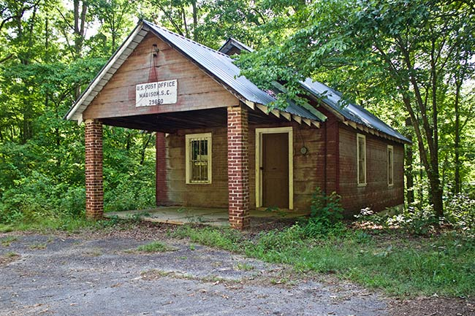
Madison/Cleveland
Notes:
Originally called Fort Madison, but it was not military action but first used by James A. Doyle to designate his plantation on the Tugaloo River. Madison historically important because it became the home of Colonel Benjamin Cleveland, hero of the Battle of King’s Mountain. Madison also served as a stop along the railroad

Slide 14
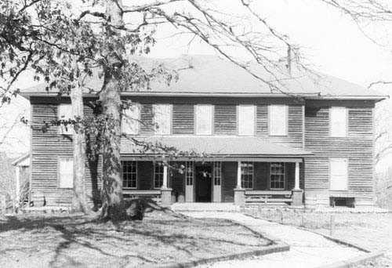
Long Creek
Notes:
Community is named after a creek called Long Creek

Slide 15
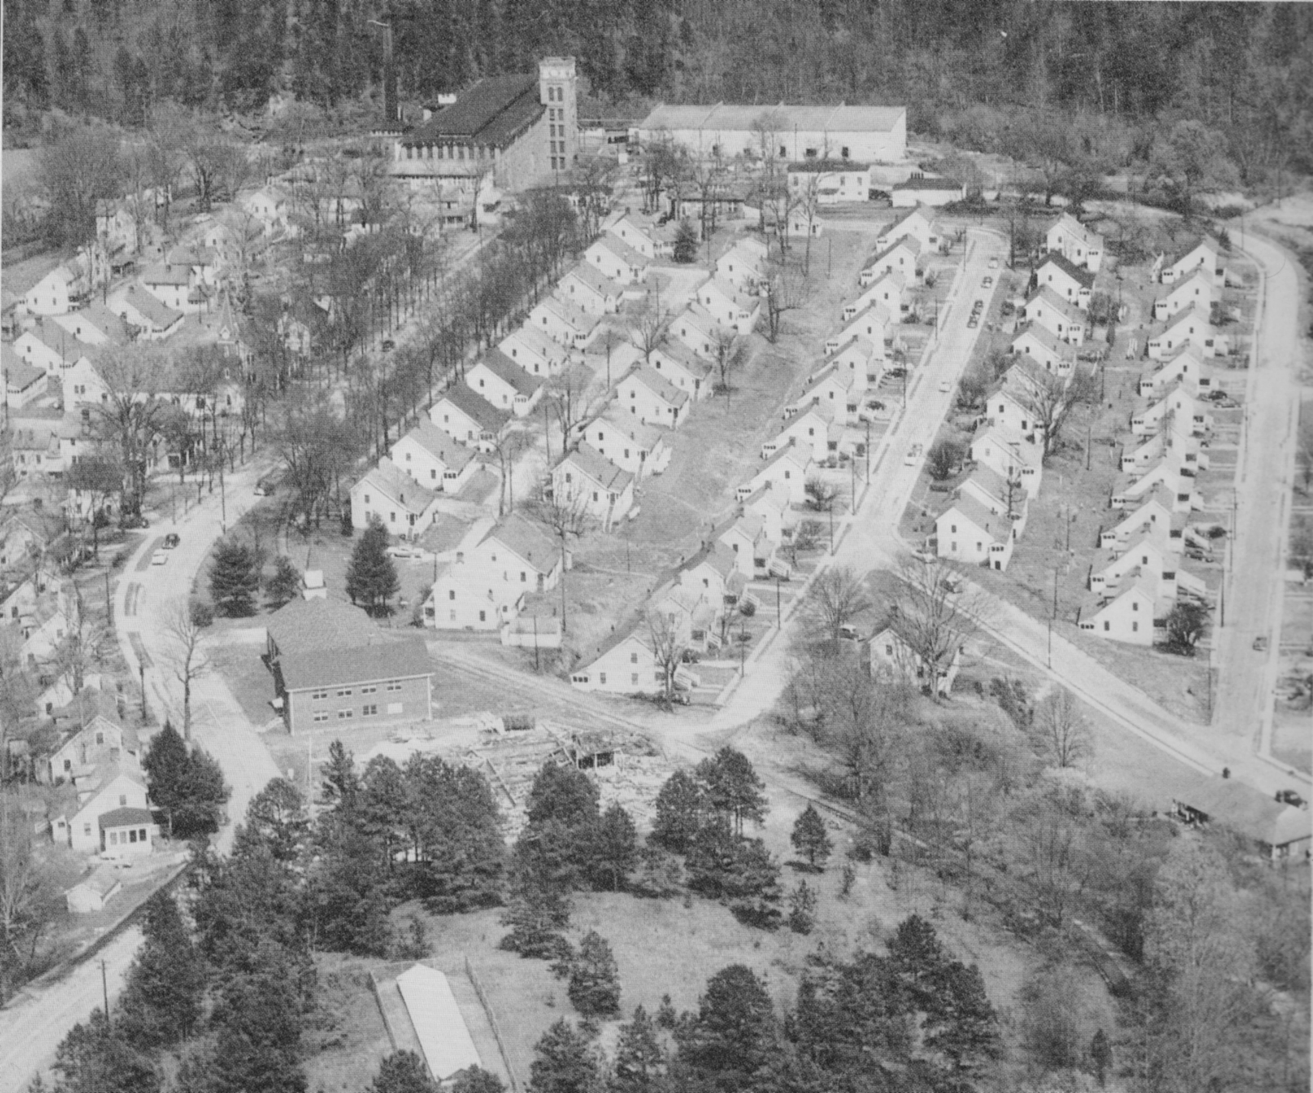
Newry
Notes:
Named for Newry, Ireland the ancestral home of William Ashmead Courtenay, the founder of the mill.

Slide 16
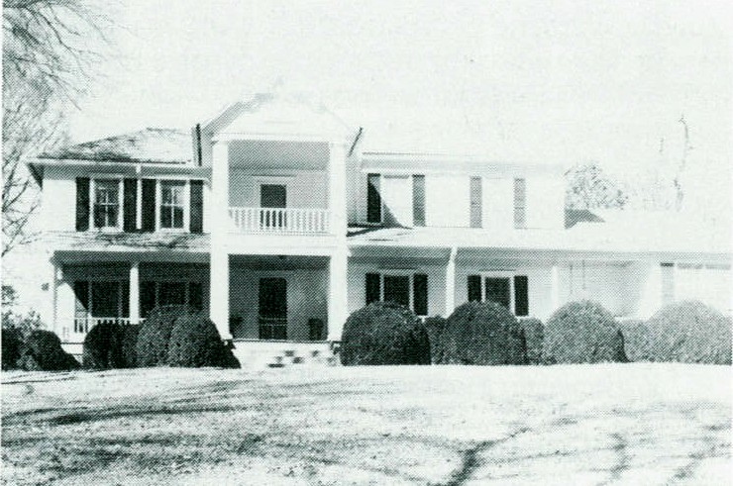
Richland
Notes:
Rich land and area of farming in the bottoms of the creek.

Slide 17
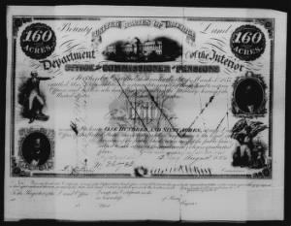
Bountyland
Notes:
Bountyland was named after just that, bounty land given to soldiers who served during the revolutionary war.

Slide 18
Lakes & Rivers
Chattooga, Tugaloo, Keowee, Jocassee

Slide 19
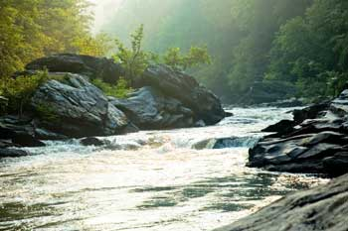
Chattooga
Notes:
Has a couple different meanings in Cherokee “he drank by sips” or “he has crossed the stream and came out upon the other side”.
Chattooga Town is documented to be a town that was existing when white explorers arrived, which was located near the Russell Homestead along Highway 28.

Slide 20
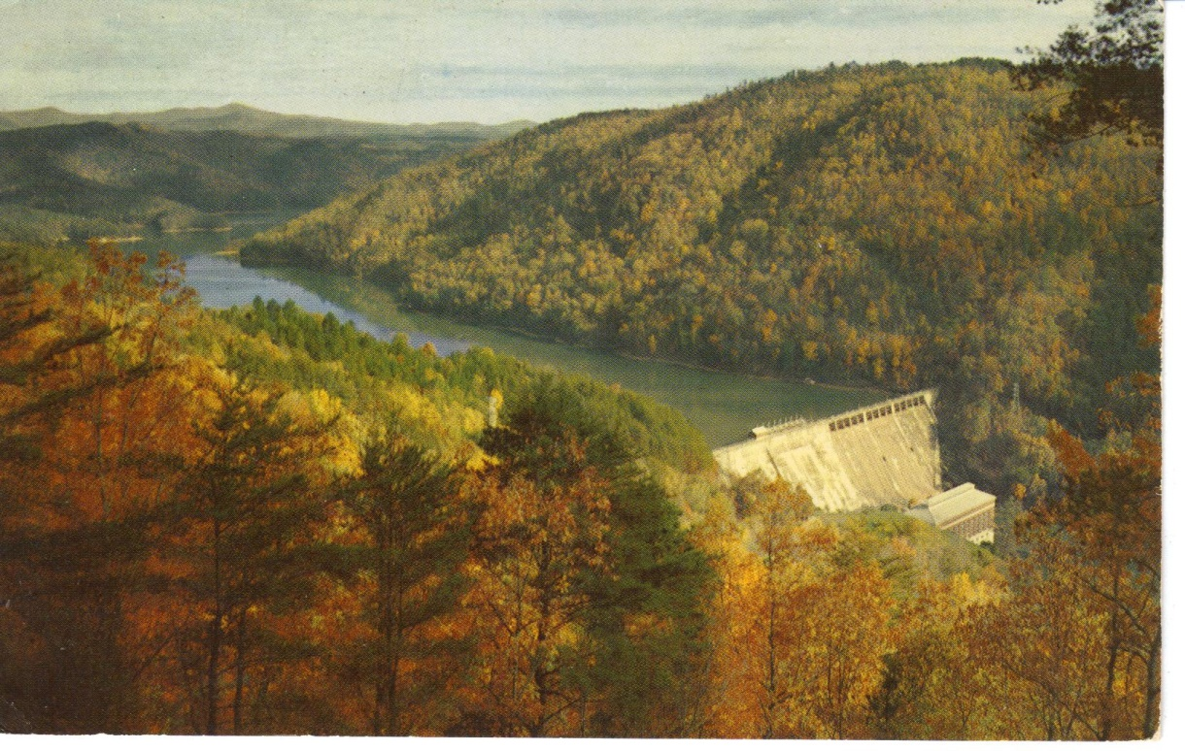
Tugaloo
Notes:
From the Cherokee for “freckled or spotted people.” Was an older important town in the Lower Towns. The British established a trading storehouse along the Tugaloo because of its fine geographic location. In 1776, Colonel Andrew Williamson and his militia campaign came through and burnt the village and all of its corn.

Slide 21
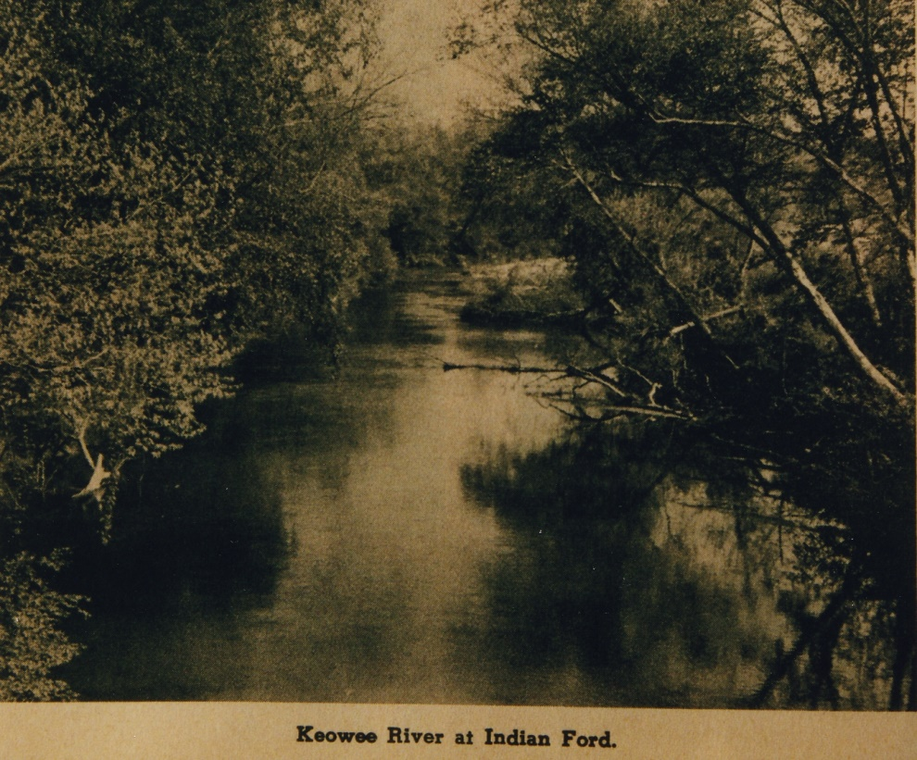
Keowee
Notes:
Place of the Mulberry in Cherokee. It was the mother town or capital of the Cherokee Lower Towns. The River was named after the village.

Slide 22
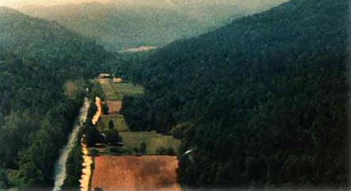
Jocassee
Notes:
“Place of the Lost One” in Cherokee. There was a town located in the Jocassee Valley named Jocassee but there is not a lot of historical information about it. William Gillmore Simms in 1856 penned the legend of Jocassee. Supposedly the daughter of Attakullakulla.

Slide 23
Others
Stumphouse, Issaqueena, Oconee

Slide 24
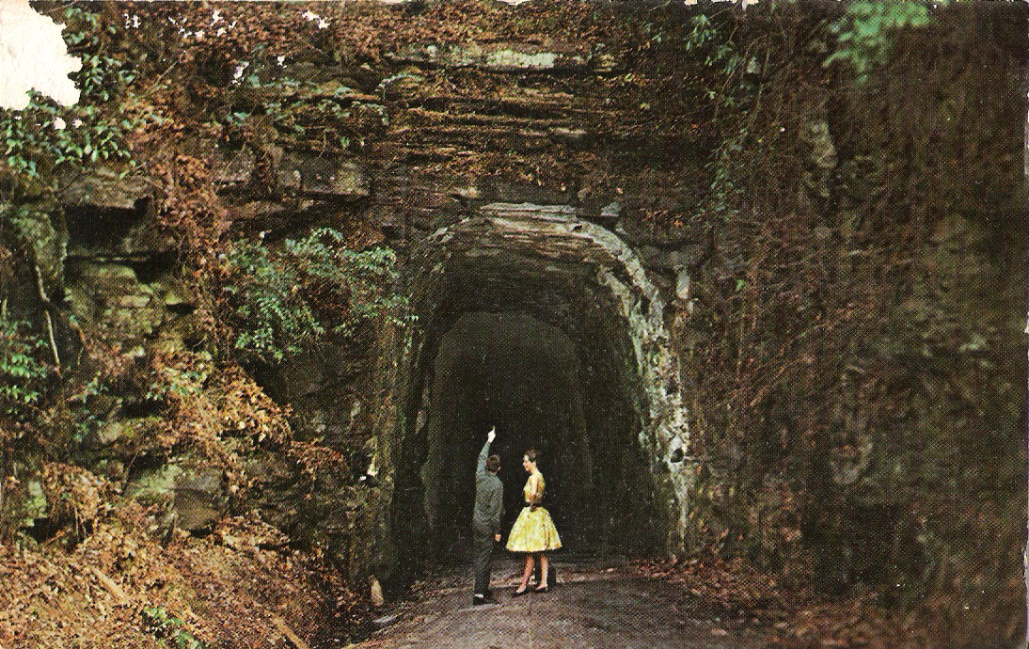
Stumphouse
Notes:
A legend says that it was Issaqueena (aka Cateechee) and her husband lived for a while in a hollow stump on the mountain. Another legend tells of a white settler building his home on the mountain using a large stump as a pillar for his house.

Slide 25
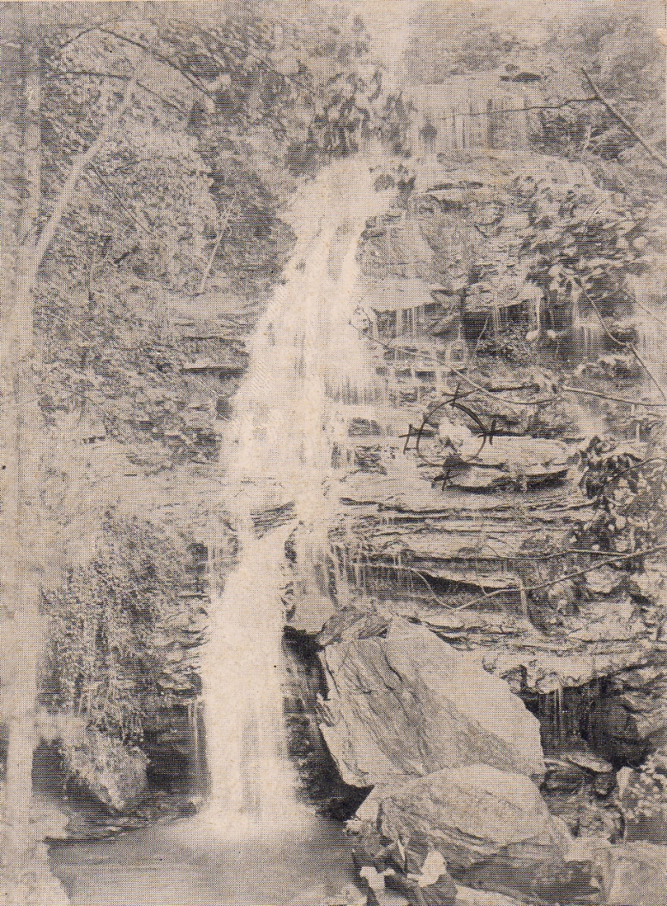
Issaqueena
Notes:
Indian maiden also known as Cateechee. She had a lover who was white stationed at Ninety-Six. She overheard there was to be an attack on the settlement by the Creeks. She went to warn her lover but she was found out. She leapt over the falls. Thinking she had perished, the attack party went on but Issaqueena had jumped and hid under one of the vales. She went on to warn her lover while naming all the creeks and points along the way

Slide 26
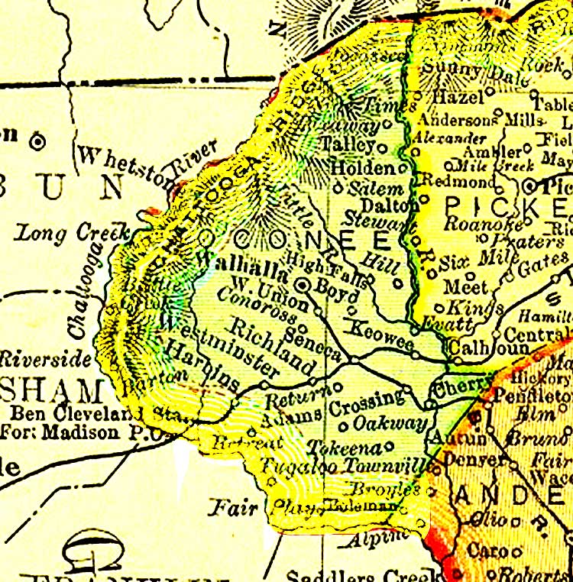
Oconee
Notes:
“Land Beside the Water” or “watery eyes of the hills”. Named for a Cherokee village that was located in the area of Oconee Station.

Slide 27
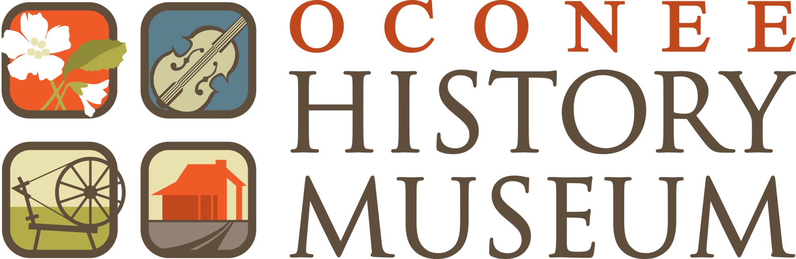
www.oconeehistorymuseum.org

