Slide 1

History of Seneca, SC
Jennifer Moss
Assistant Curator/Education Specialist
Oconee History Museum

Slide 2
Before the City of Seneca…
Notes:
Village of Esseneca
Located along the lower Keowee River at the mouth of Coneross Creek and Seneca Creek, near Clemson University
William Bartram visited in May 1775. He documented that there was a population of 500 and had a granary containing 6000 bushels of corn.
In 1776, a colonial militia under the command of Colonel Andrew Williamson destroyed the town including the granary.
It has been said that Seneca was named after the Seneca Indians, a branch of Iroqouis who lived in the Northeast, but this possibility is highly unlikely.
A lot of what has been determined as Native American historical “truths” for the area have been based on outdated research with biases of the 19th century.
Before establishment of the city, the general area which surrounded Seneca was known as Seneca Township which was a tax district.

Slide 3
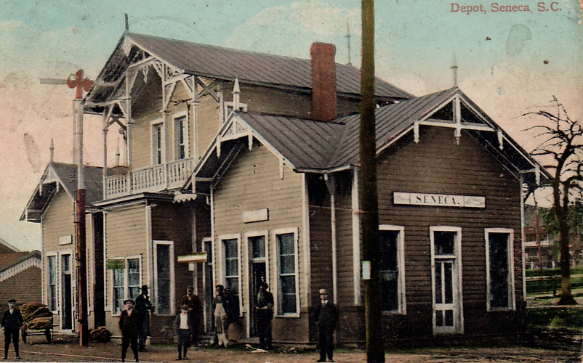
The Coming of the Railroad
Notes:
The Blue Ridge Railroad was a spark that would eventually lead to the establishment of the City of Seneca. The railway was chartered in 1852 and construction began in 1854. By 1861, 24 miles of the railroad from Anderson to Perryville (near current Utica community) had been completed. The Civil War and other business concerns halted construction of the railroad. The railroad eventually would be completed to Walhalla, but went no further.
In 1873 plans were formed for the construction of a railroad from Charlotte to Atlanta called Atlanta and Richmond Air Line Railway.

Slide 4
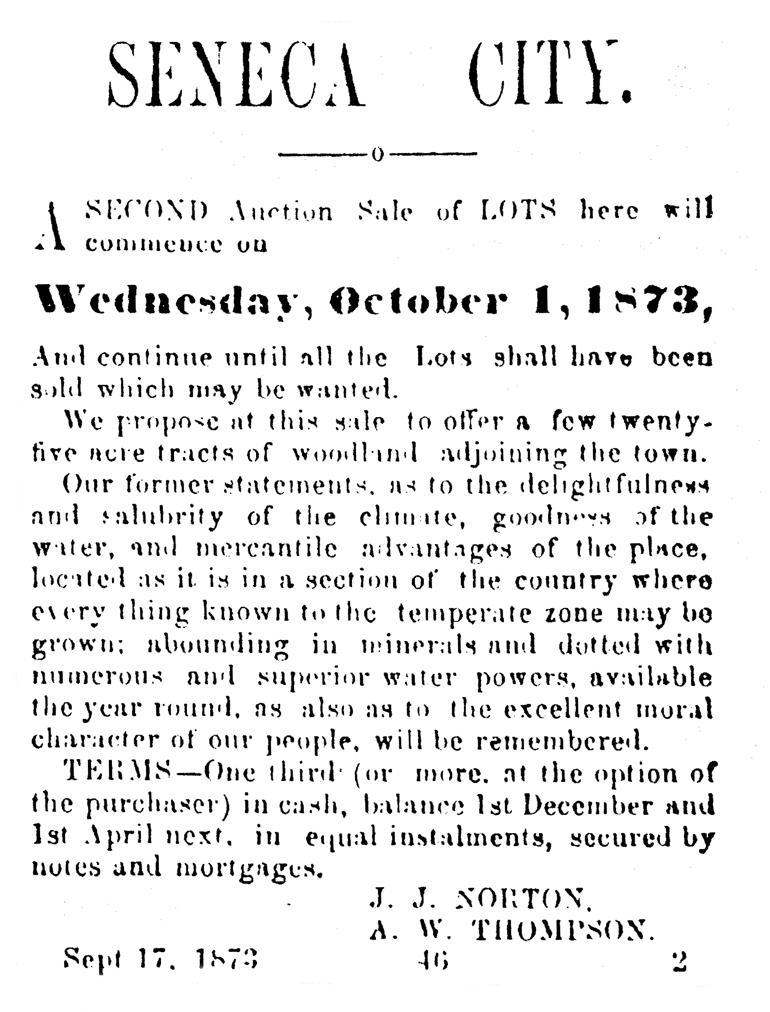
The City of Opportunity…
Notes:
The site where Seneca City was to be formed was at the junction of the two railroads.
Seneca City site was divided into 659 lots of 1 ¼ acres each and 16 surrounding farms of 15 to 20 acres each.
To mark the site an iron spike was driven in the middle of the railroad near where it intersects Townville Street.
Some of the first buyers of lots were John Dumas, M.W. Coleman, Ben Lowery, J.W. Livingston and Alfred Thompson at a lot sale on August 30, 1873
One month after the sale of lots the Atlanta and Richmond Airline Railroad made its first passenger train run to Seneca City around September 28, 1873
On March 14, 1874 Seneca City was incorporated. On February 19, 1908 the charter was changed to the Town of Seneca
In 1874 Seneca’s incorporated limits were about 1,054 acres roughly 1 1/2 square miles. Currently Seneca’s limits is close to 8 square miles

Slide 5
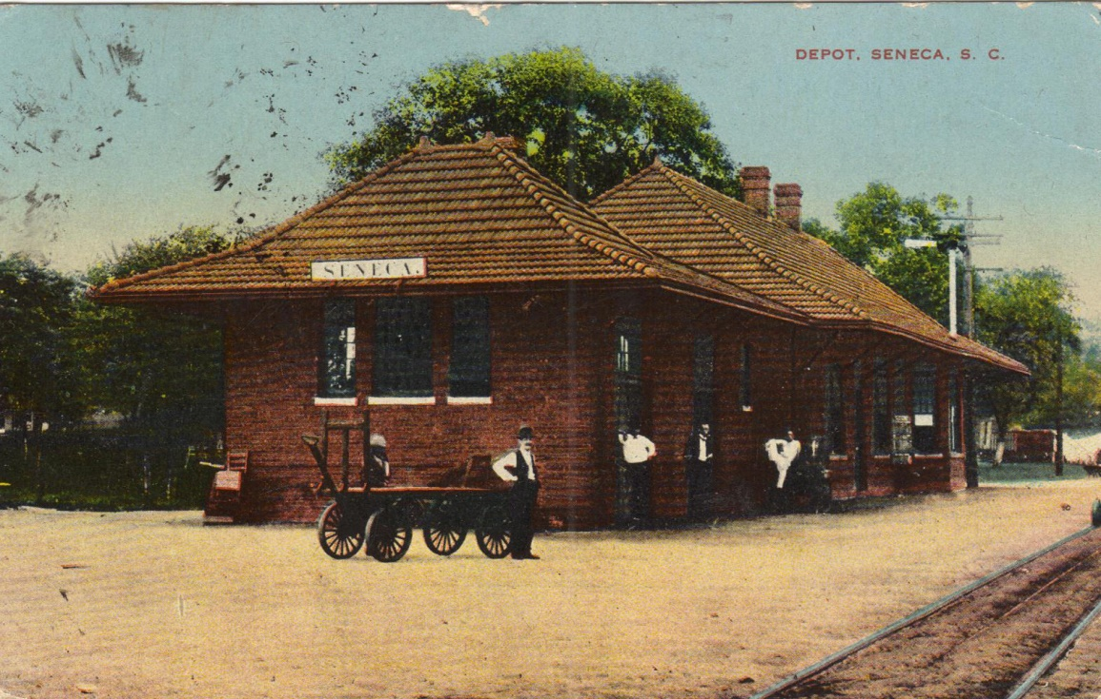
Freight Depot
Notes:
This building still stands as remnant of Seneca’s railroad history

Slide 6
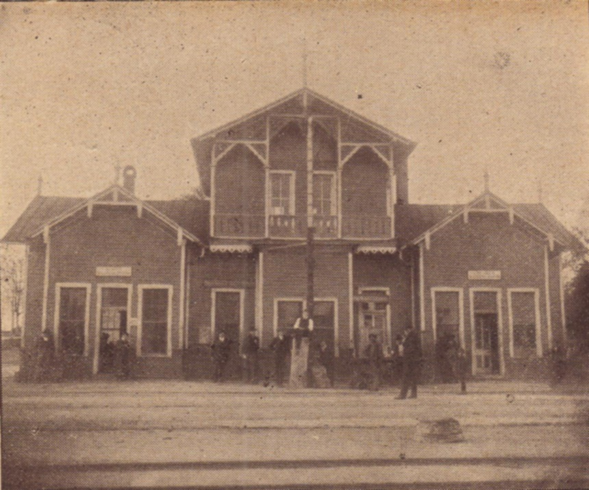
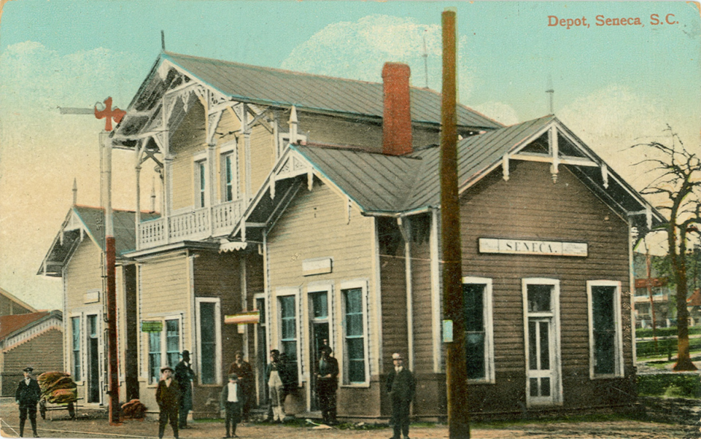
Seneca Passenger Depot
Notes:
Seneca’s first depot, with its Tudor-style architecture, was erected soon after the town’s founding by the Atlanta and Richmond Airline Railroad.
Soon after the railroad went bankrupt and the line was purchased by the Southern Railway Company in 1894.
This depot burned down in the early 1900s.

Slide 7
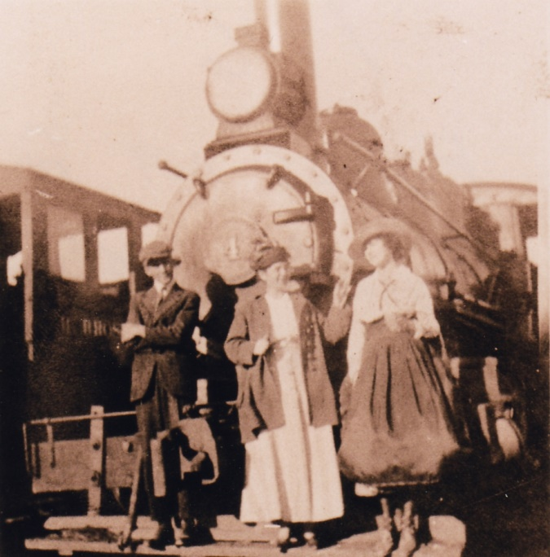
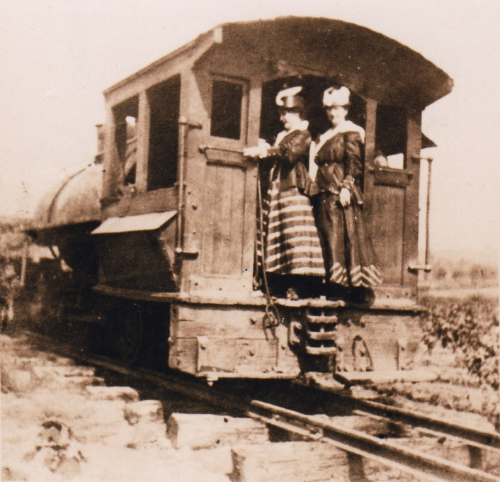
Riding The Rails
Notes:
Locals could make a quick trip to Walhalla on the Blue Ridge line or a longer trip to Georgia or North Carolina or Virginia on the Airline /Southern Railroad.
First diesel train to come through Seneca was in 1941.

Slide 8
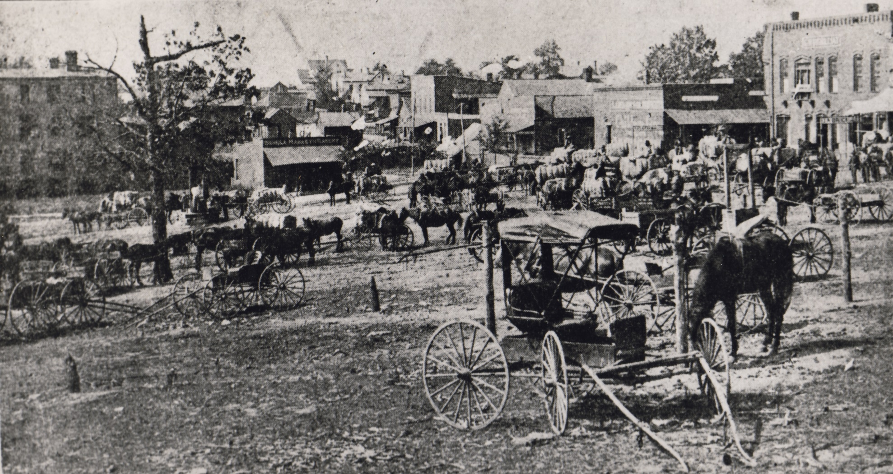
Town Development
Notes:
Many of the first businesses were established to serve local farmers. G.W. Gignilliat established the first fertilizer plant in Seneca which was purchased later on by W.P. Nimmons. Local farmers also organized the first oil mill.
The Keowee Hotel served as Seneca City’s first overnight establishment for passengers along the railroad. It was owned by John C. Cary and was located near the intersection of Railroad and Townville Streets.

Slide 9
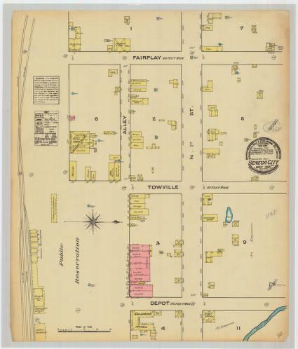
Sanborn Map of Seneca
Notes:
Seneca, in its early years, valued libraries. The first library boasted 350 volumes and was located in a home. The first librarian was a volunteer. Eventually the community and patrons agreed to have a paid librarian. Fees proved inadequate and the women finally grew tired of the service and the books were scattered. Later, another library was developed by a civic association and later a branch of the Oconee County library was located in Seneca.
The first paper in Seneca was the Seneca Free Press and it didn’t last long .Seneca’s next paper was “Farm and Factory” published on a small hand press by Mr. John Phillips. Eventually it grew and expanded. After failing health, Mr. Phillips sons took it over and changed its name to the Seneca Journal.

Slide 10
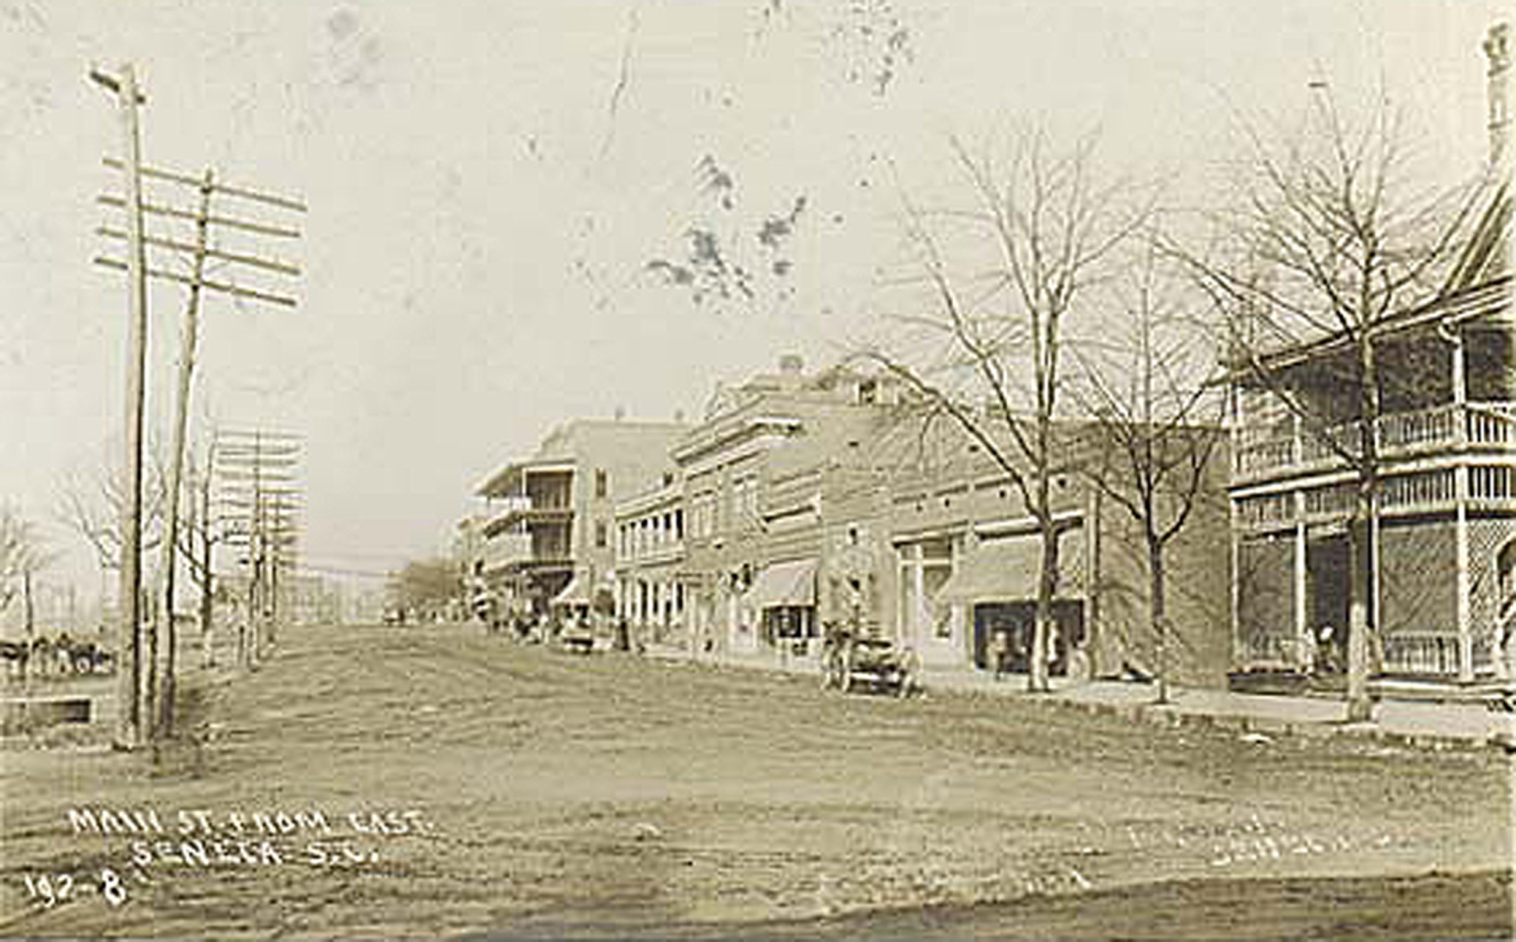
Main Street Seneca
Notes:
Seneca Firsts
First automobile was owned by Mr. Simpson around 1912/1913. For a small fee he would take people around in it.
First electric lights were installed in 1908.
First fire equipment was hand-drawn water wagons. First fire truck was bought in 1935.
First telephone was in the Oconee Inn in 1898.
John Dumas was first Postmaster

Slide 11
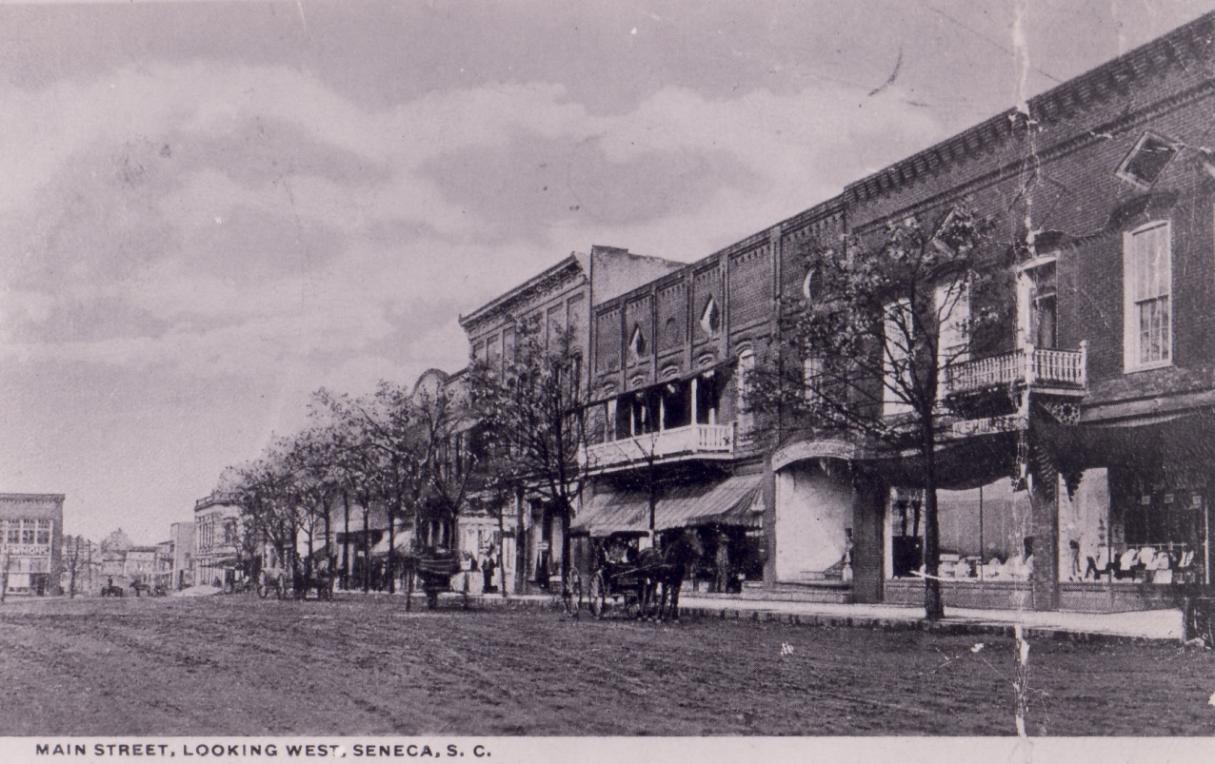
Main Street

Slide 12
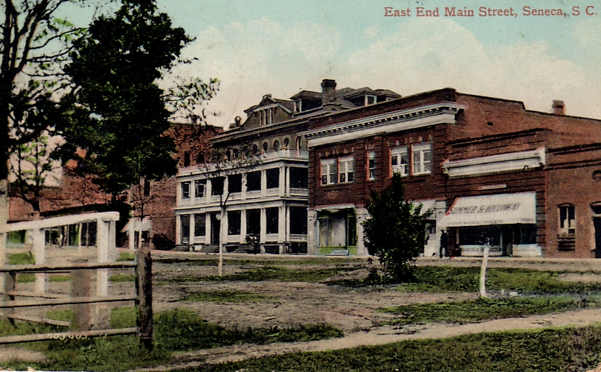
Main Street
Notes:
First fire was in the fall of 1890 and destroyed much of the east end of town.

Slide 13
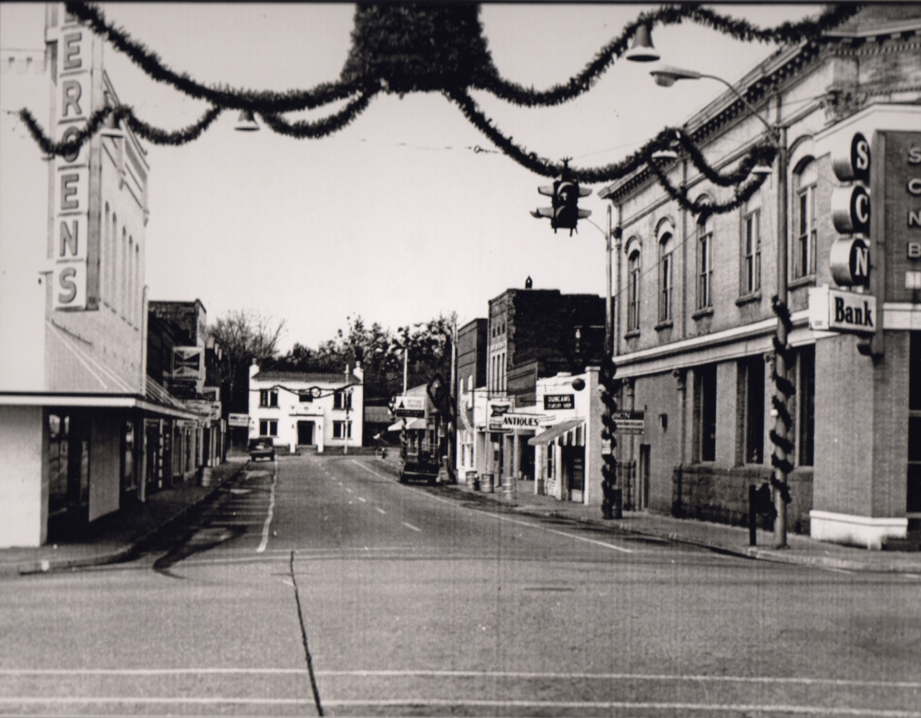
Ram Cat Alley
Notes:
In early Seneca, many of the local grocers were located along Ram Cat Alley. The meats would perfume the air and that attracted feline friends. It was once said that you couldn’t ram another cat in the alley that it was so full. The name stuck!

Slide 14
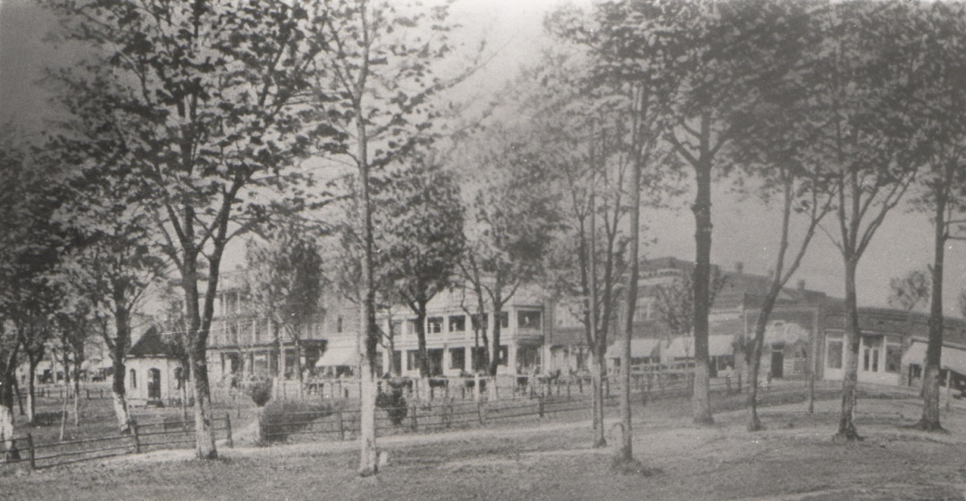
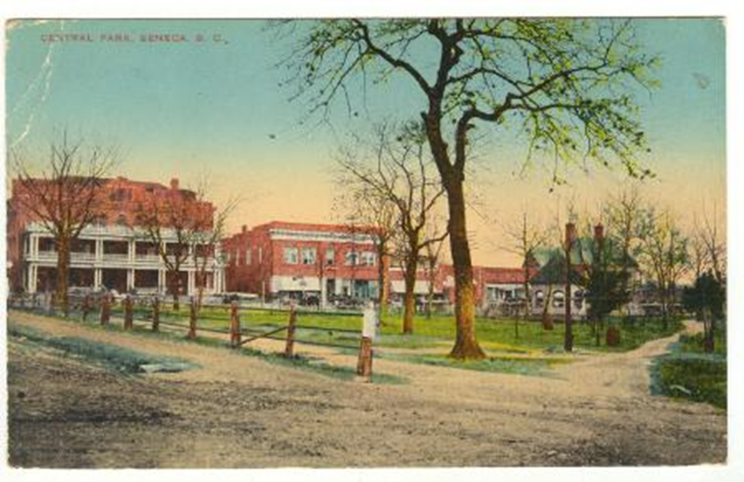
Norton-Thompson Park
Notes:
Norton-Thompson Park was one of the central features over the years
There was once a mineral spring where people loved to “take the waters”. Early on someone was blasting nearby to make a well and the blasting caused the spring to divert course and eventually dry up. The site is now covered by railroad tracks.
A citizen thought it would be a good idea for prairie dogs to live in the park as an attraction. He brought them from out West to the park. We had a particularly cold winter and prairie dogs, not yet acclimated to the weather froze to death.

Slide 15
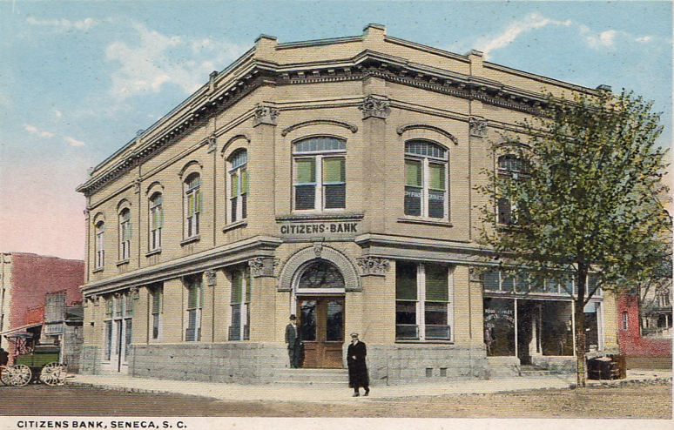
First Banks
Notes:
The Seneca Bank was established in the early days of the city with a capital stock of $20,000. Dr. O.M. Doyle was the first President and J.W. Stribling was the founder and served as first cashier.
The second bank to serve Seneca was the Citizens Bank and that started off with a capital stock of $50,000.
Both banks were forced to liquidate during the Great Depression.

Slide 16
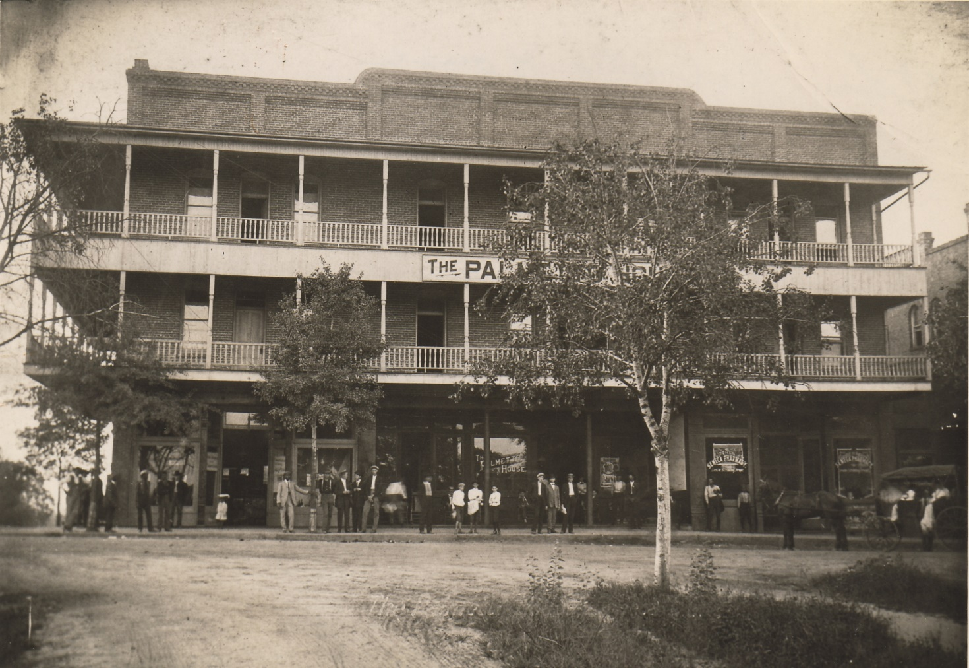
The Palmetto Hotel
Notes:
Burned in 1906 then was razed in the 1970s
For more information about disasters in Oconee view the “Oconee Disasters” presentation.

Slide 17
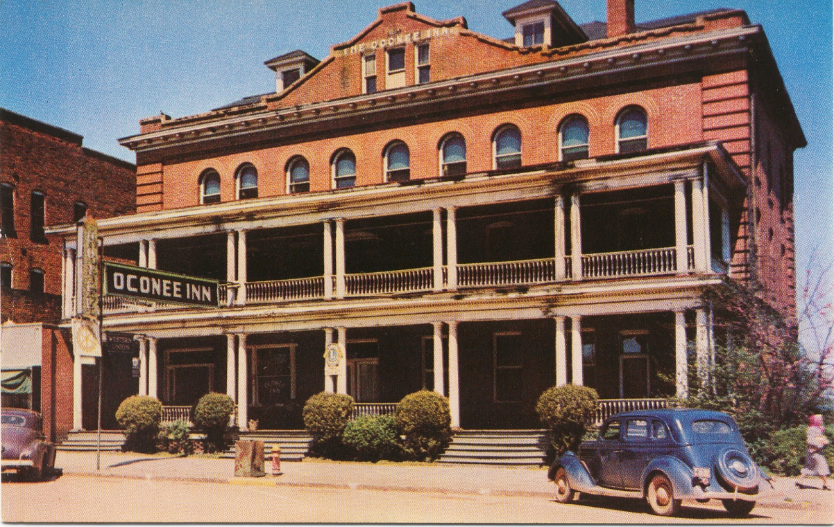
Oconee Inn
Notes:
Next to Palmetto. Both burned down and rebuilt. Located where Wells Fargo is now.
A disastrous fire in October 1906 destroyed the hotels along with several surrounding businesses and a residence in downtown. This cost $75,000 in damages.

Slide 18
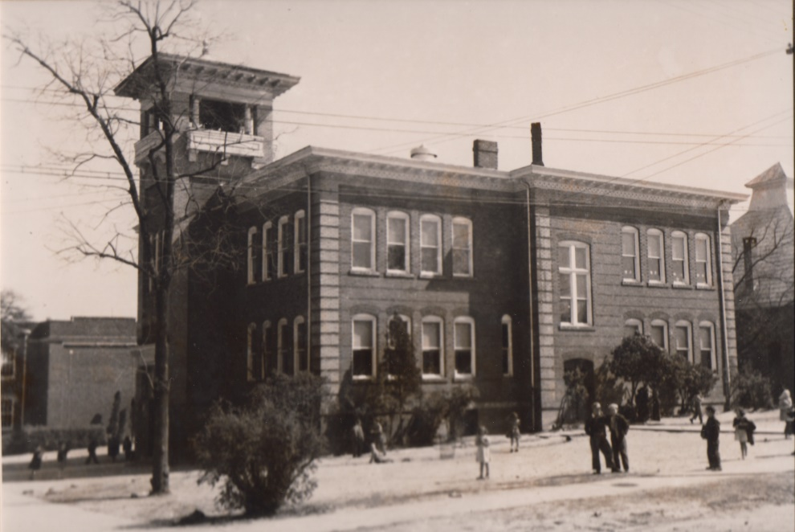
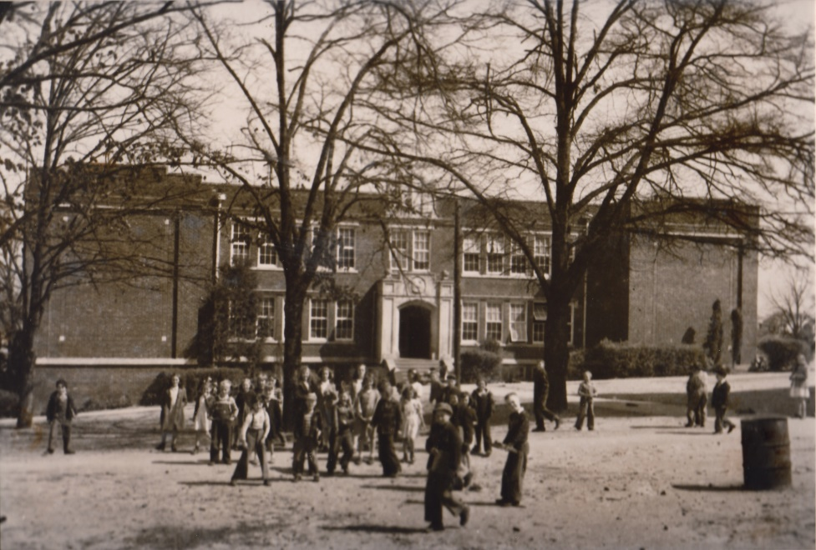
Education
Notes:
The first formal school house was built in 1874, later that school burned.
The subsequent schools were built on a lot near the railroad (where the current Seneca library now stands)
The picture on the left was built in 1908 and served as the graded school. Eventually another building had to be constructed to serve as a high school in 1923
The photo on the right was the high school that was constructed in 1924

Slide 19
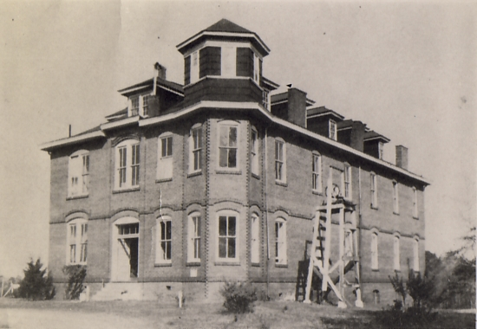
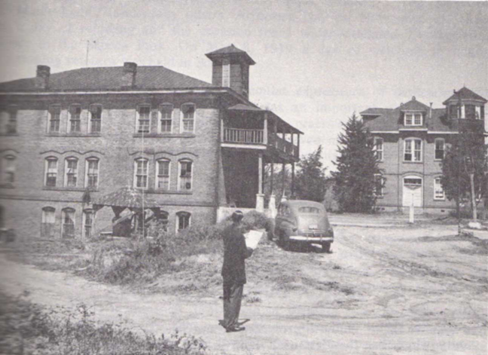
Seneca Institute/Seneca Junior College
Notes:
W.J. Thomas started the first school for African-Americans in Seneca at Mazyck Chapel, a Methodist church. This church was located where Mountain View Cemetery is currently. W.J. Thomas eventually became a trustee for the Seneca Institute.
Seneca Institute was constructed in 1899 as a school for African-Americans. In 1926, the name was changed to Seneca Junior College. School was closed in 1939 and the building was razed shortly thereafter. The only thing that remains is the Faith Cabin Library which is located at the Family Life Center.
Oconee County Training School served as school for African-Americans from 1925-1955
In the 1950s all the African-American schools were consolidated and all African-American high school students attended Blue Ridge High School from 1955-1969, when schools were integrated.

Slide 20
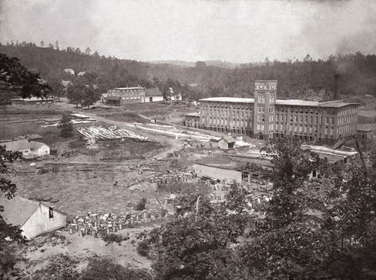
Newry
Notes:
In 1894, William Ashmead Courtenay built a mill a short distance from Seneca along the Little River. This mill brought people, goods, and more railroad traffic to the city of Seneca.

Slide 21
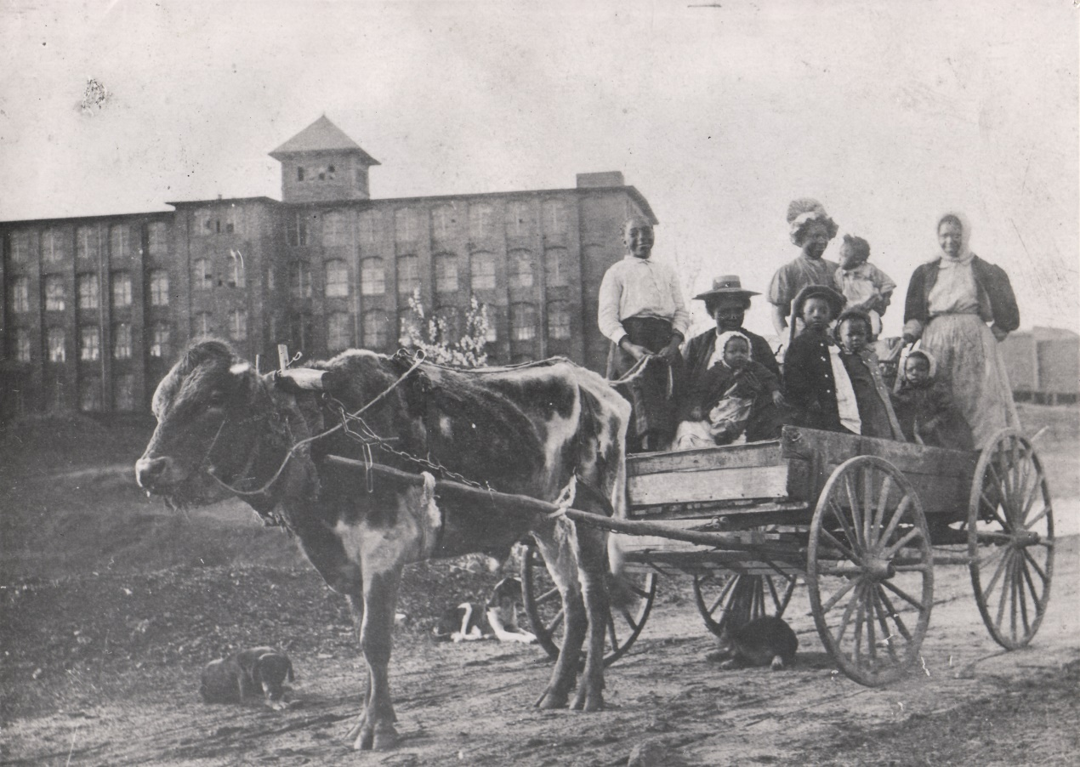
Utica Mill
Notes:
After Newry Mill started production, L.W. Jordan organized and constructed a mill near Seneca. It was first known as Jordania. Eventually it would be called Lonsdale and more recently Utica and West Point Stevens. The mill became a vital part of the greater Seneca area.
For more information about the textile industry in Oconee County view the “Textiles in Oconee” presentation.

Slide 22
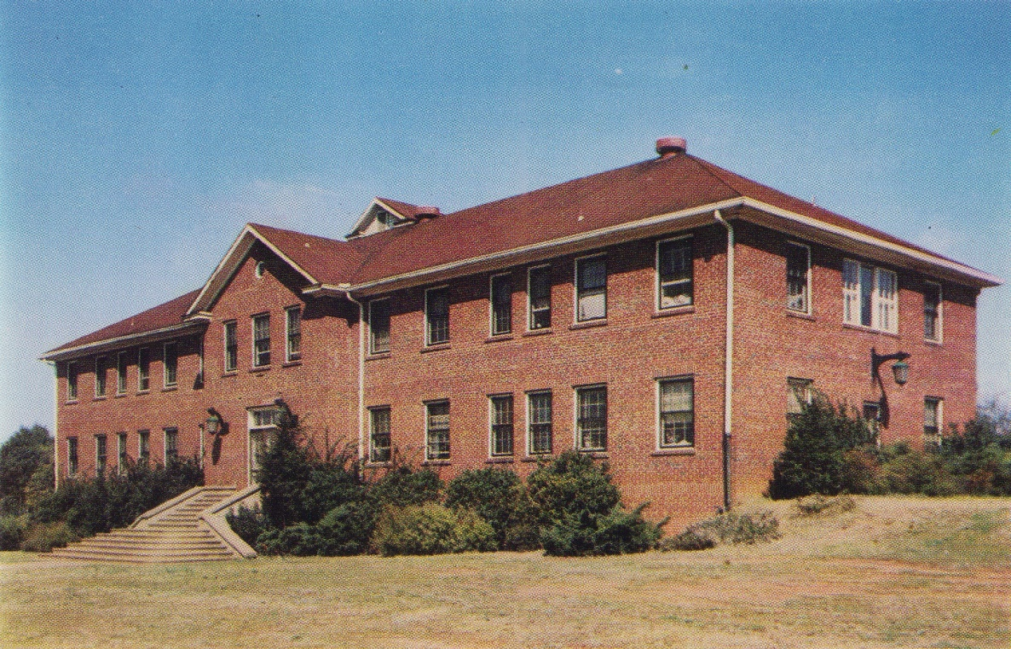
Oconee Hospital
Notes:
In 1939 the first Oconee County hospital was opened. Committee chose the spot since it was centrally located to most of the county. This hospital was where Lila Doyle is now. The main part to where the hospital is currently was constructed in 1963

Slide 23
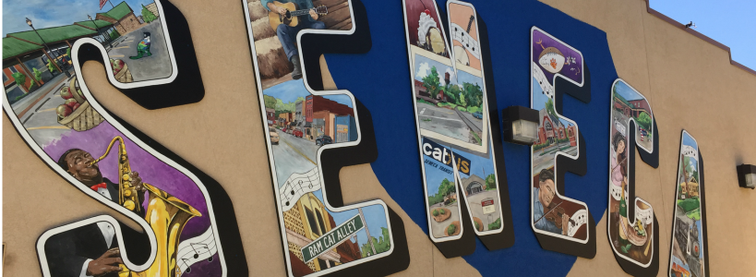
Seneca Today
Notes:
Seneca today is growing. Seneca is one of the top performing micropolitan in the United States. We are having an influx of people moving here due to a great quality of living.
The population of Seneca itself is around 8,340 and climbing
Seneca is getting some great new businesses and trying to create new ordinances to better help businesses coming into the town.

Slide 24

www.oconeehistorymuseum.org

