Slide 1
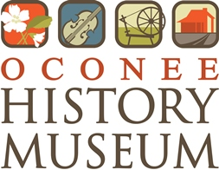
TEXTILES
IN OCONEE COUNTY

Slide 2
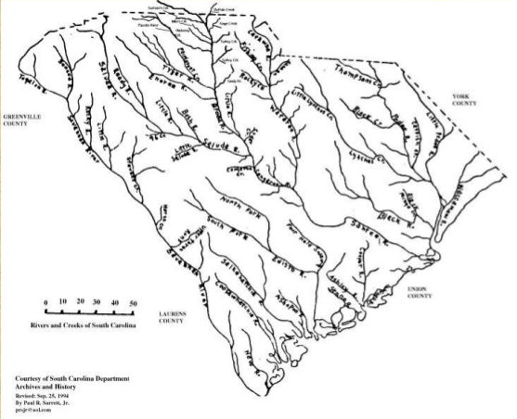
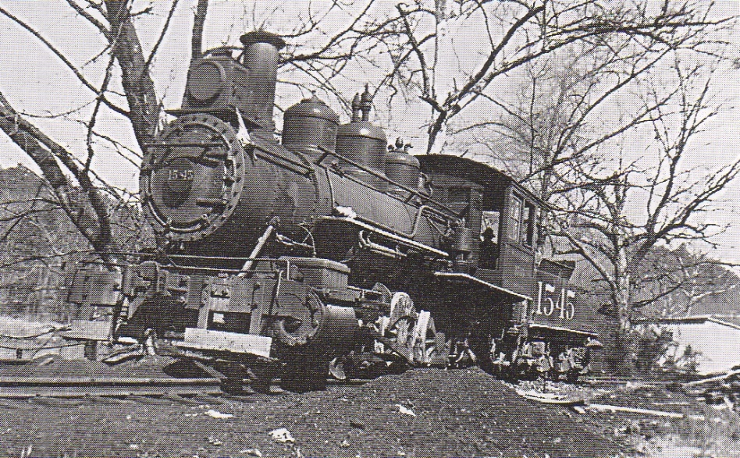
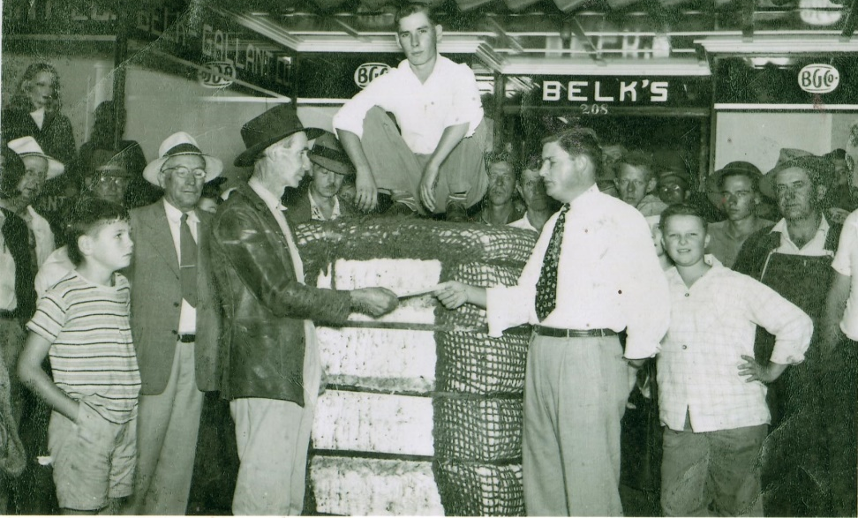
The Recipe for Success
Water
Cotton
Railroads
Cheap labor
Notes:
The textile industry grew out of the Industrial Revolution, beginning first in the United Kingdom, then arriving in New England, and finally moving into the American South. Oconee County had all of the ingredients for success in the textile industry – plentiful rivers to generate power for textile plants, close proximity to cotton farms, good railroad service to transport raw cotton to the plants and finished textiles from the plants, and plenty of cheap labor. In fact, workers in the American South were willing to work for 25% less than their counterparts in New England.

Slide 3
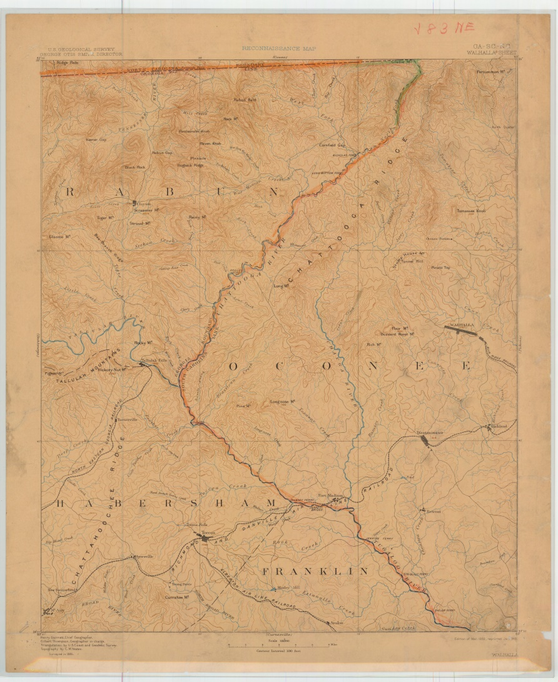
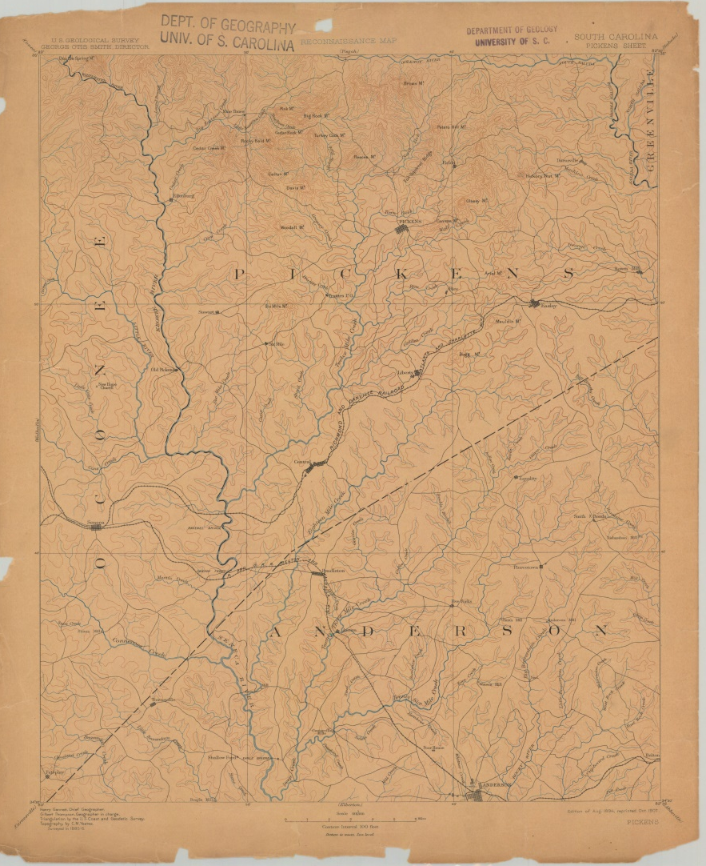
Land Beside the Water
Notes:
Examine this map to see that Oconee County truly is the “Land Beside the Water”. Prior to the creation of our modern lakes, Oconee was crisscrossed with rivers and large tributaries. This landscape was attractive to those businessmen seeking to capitalize on the textile industry by starting new companies powered by water-generated electricity.

Slide 4
Labor Force
Oconee County = 1868
Population in 1870: 10,536
Population in 1880: 16,256
Population in 1890: 18,687
Population in 1900: 23,634
Presidential Elections 1896/1900
  William McKinley (R) v. William Jennings Bryan (D)
  Oconee results: Bryan 85% in 1896, 92% in 1900
Notes:
Oconee County was officially formed in 1868 when the Pickens District was divided into Pickens County and Oconee County. Following Reconstruction, Oconee County’s population increased steadily, providing an expanded labor force and new economic opportunities as population centers like Walhalla, Seneca, and Westminster transformed from agrarian communities to more industrialized towns. Many families who had barely scraped by as farmers moved to town to take advantage of textile mill’s steady wages and reliable work.

Slide 5
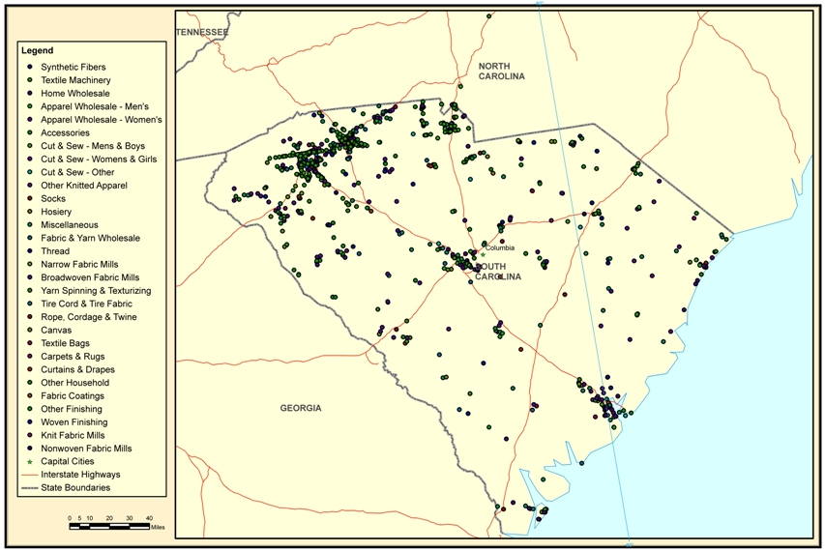
Notes:
This map of South Carolina illustrates the locations of textile mills in the state. Notice that the industry was most prevalent in the Upstate.

Slide 6
Cotton Mill Jobs
http://www.andrewalston.co.uk/cottonindustryjobs.html
Notes:
Use the link to examine a list of textile mill jobs. It is important to note that many women and children were employed in textile mills, especially early on. Smaller hands were useful for accessing the small parts of looms and other mill machinery. This work was extremely dangerous and caused many injuries. Eventually, this led to the establishment of child labor laws, which protected small children and prioritized education over work in their young lives. Textile mills also provided labor opportunities to minorities, but people of color were mainly only given menial jobs and were not allowed to live in the company-owned housing.

Slide 7
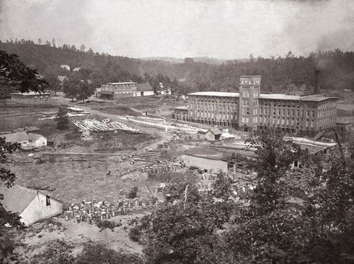
Mills of Oconee – Newry
Courtenay/Abney – est. 1894
Notes:
In 1894, Courtenay Manufacturing was the first textile mill to open in Oconee County. The company’s founder, William Ashmead Courtenay, was a Confederate veteran, a successful businessman, and the Mayor of Charleston during great earthquake 1886. Courtenay named the mill village Newry after his ancestral homeland in Ireland. Newry is the best example of the mill and mill village. The large manufacturing plant was located beside the Little River, which was harnessed to generate power for the plant. Company-owned housing, the company-owned store, schools, and churches were built adjacent to the mill so that all aspects of life centered around the textile mill. The mill paid wages in currency known as “mill script”, which was only accepted at the company-owned store. Company-owned housing was only made available to employees and their families. To save on costs, the workers’ houses were mostly identical, and built in the “saltbox” architectural style. Mill supervisors’ homes were somewhat larger, and Mr. Courtenay lived in a “mansion” known as “Innisfallen”. The factory’s bell tower regulated community life. The bell rang to signal shift changes and also nightly curfews. The bell at Courtenay Manufacturing bears this inscription: “I arouse the slothful, I call the people to work. I announce the Sabbath Day. I warn ye how time passes away. Serve God, therefore, while life doth last. And say, “Gloria in Excelsis Deo.” Courtenay Manufacturing would later by purchased by Abney Mills. It remained Abney Mills until the mill’s closing in the 1970s.

Slide 8
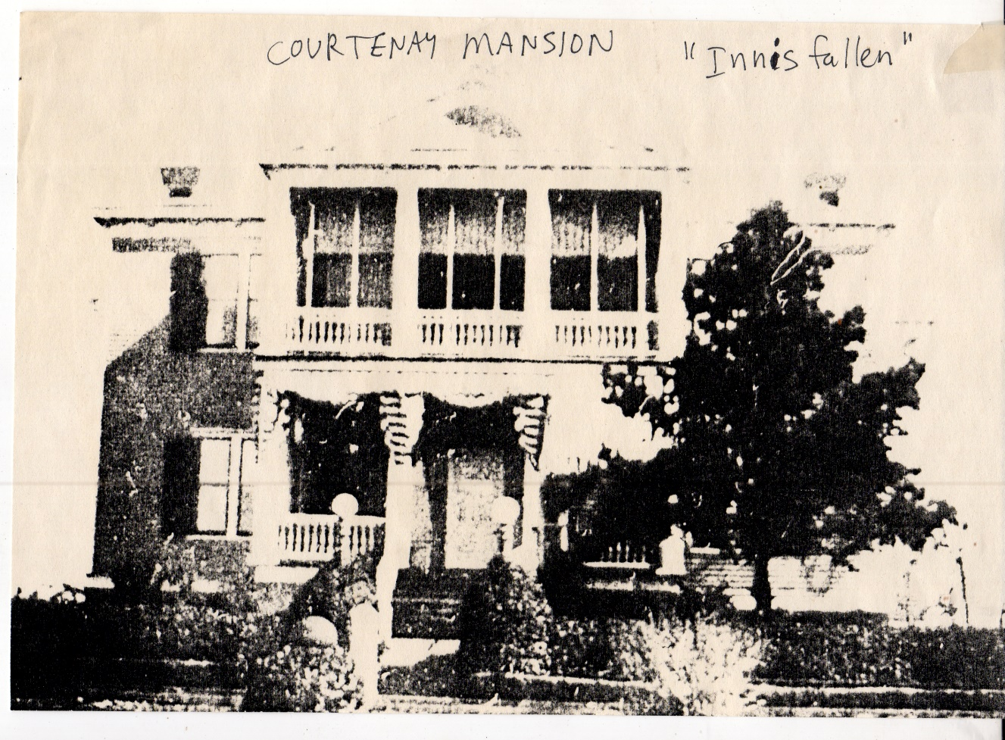
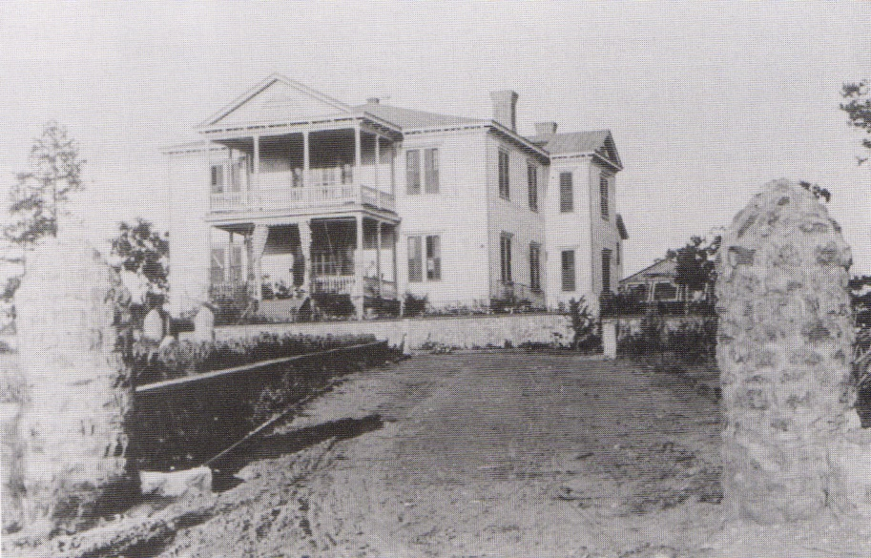
Notes:
These photos show Mr. Courtenay’s mansion Innisfallen, which means “by the water”. According to Bob Chambers, there was a 9-hole golf course behind Innisfallen at one time.

Slide 9
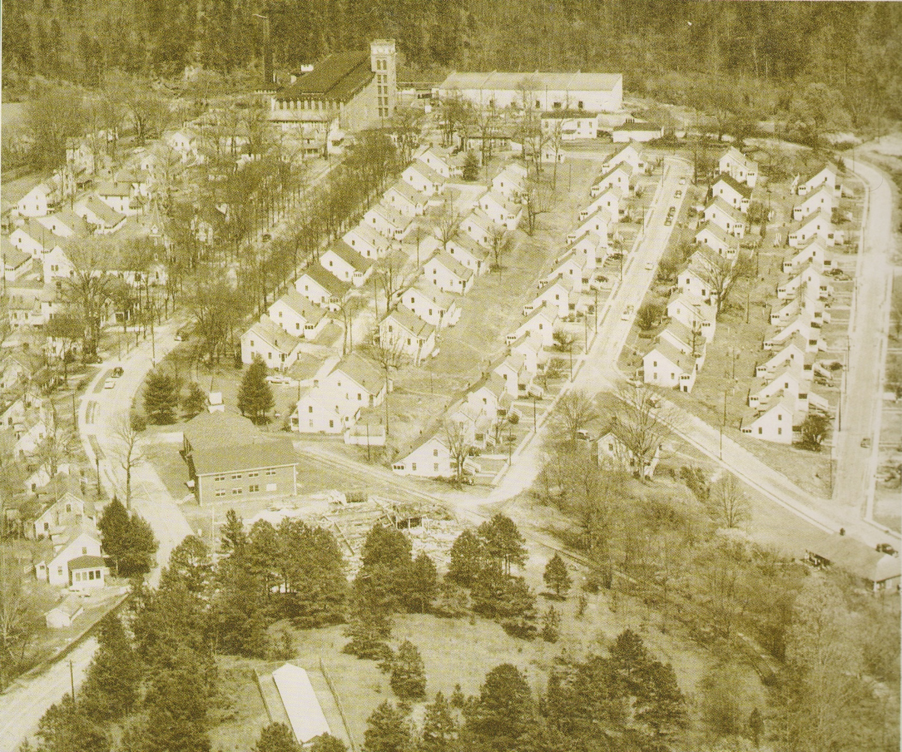
Notes:
This aerial photo of Newry shows the entire mill and mill village. The saltbox architecture of the homes reflects the textile industry’s roots in New England. The mill village was very insular and all aspects of life were provided by the mill, including school, medical treatment, church, accommodations for visitors, stores, post office, police, civic groups, and sports. For the company, this arrangement reduced employee absences and allowed for more consistent and skilled labor to develop. This type of company-centered community created a tightly knit society, but it also created a lot of indebtedness to the company. Songs like “I Sold My Soul to the Company Store” reflect the extent to which workers’ lives were tied to the manufacturing company for which they worked.

Slide 10
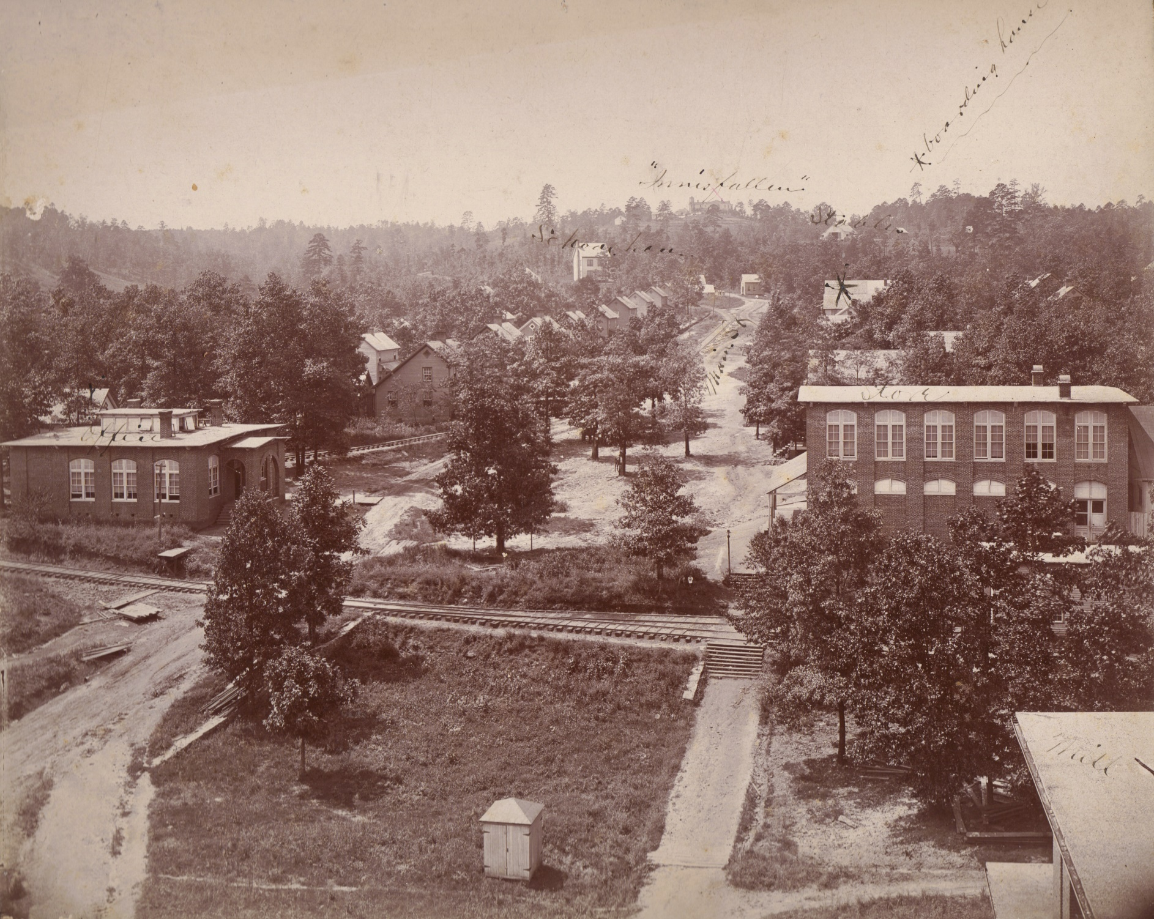
Notes:
In this photo you can see the mill office (left) and the mill store/post office (right). The mill village extended uphill from the mill. Innisfallen was at the top of the hill. A spur train known as the “dummy” served Newry. The rail can be seen in the foreground.

Slide 11
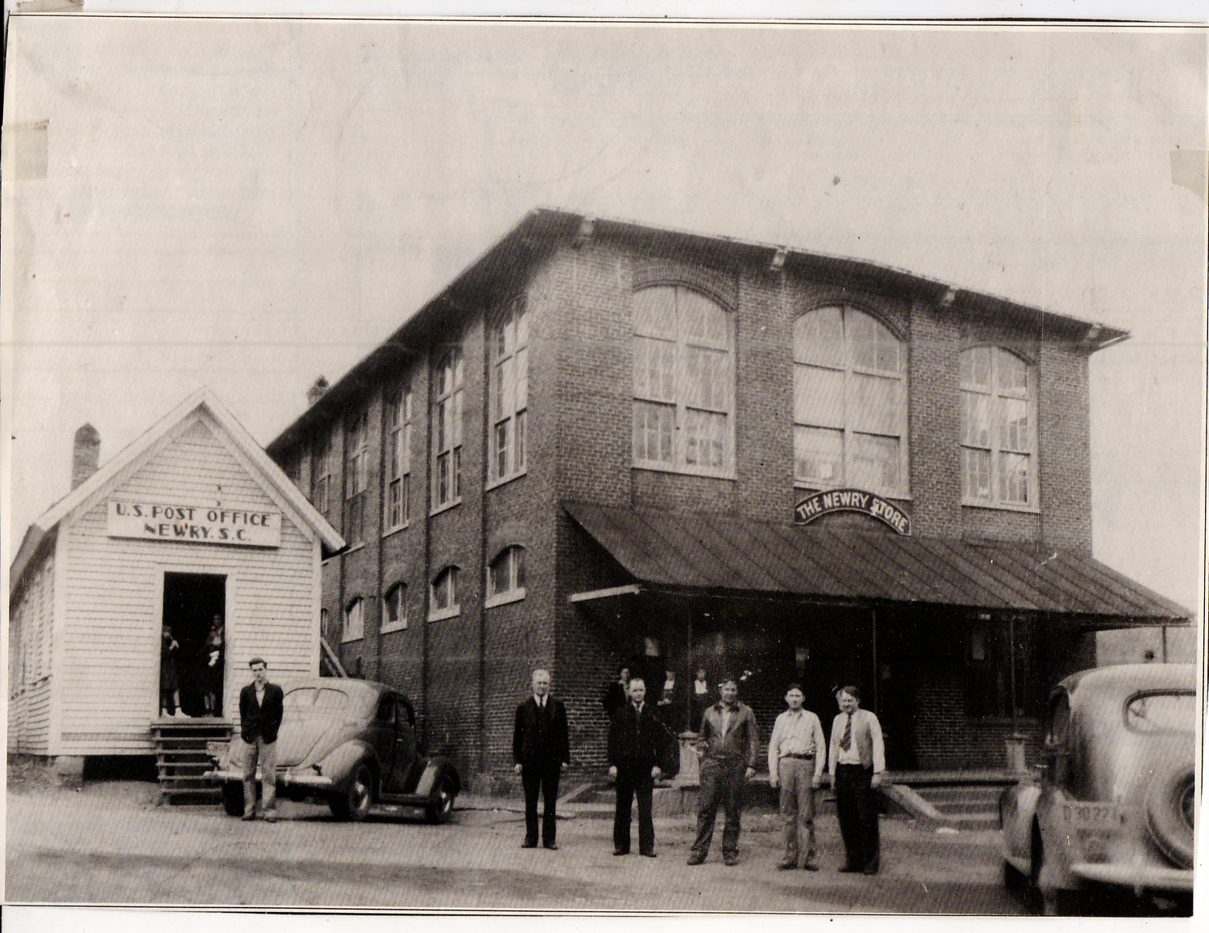
Notes:
The Newry Store and Newry post office were centers of mill village life. The mill script paid by Courtenay Manufacturing was commonly called “Loonies”.

Slide 12
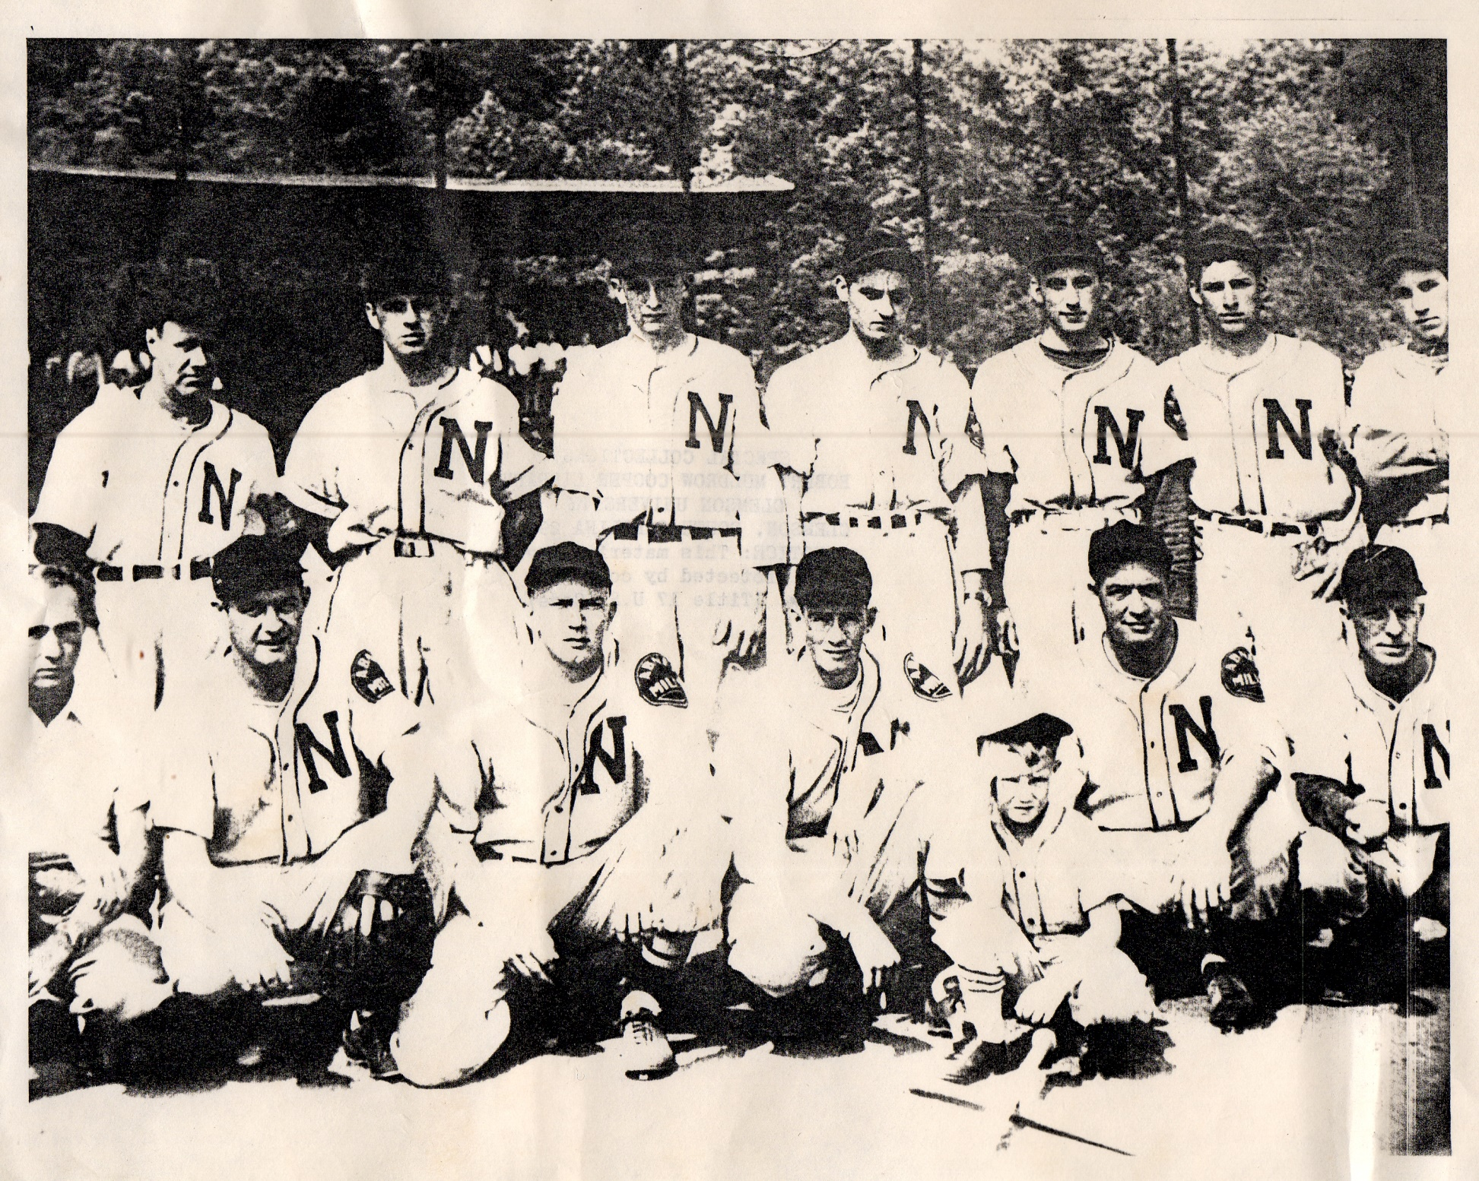
Notes:
Recreation was an important part of life for mill workers and their families. Baseball was a popular past time, and teams like the Newry Mudcats would play against teams from other textile mills. Many of these textile-league players would become professional athletes, such as Shoeless Joe Jackson of Greenville, SC.

Slide 13
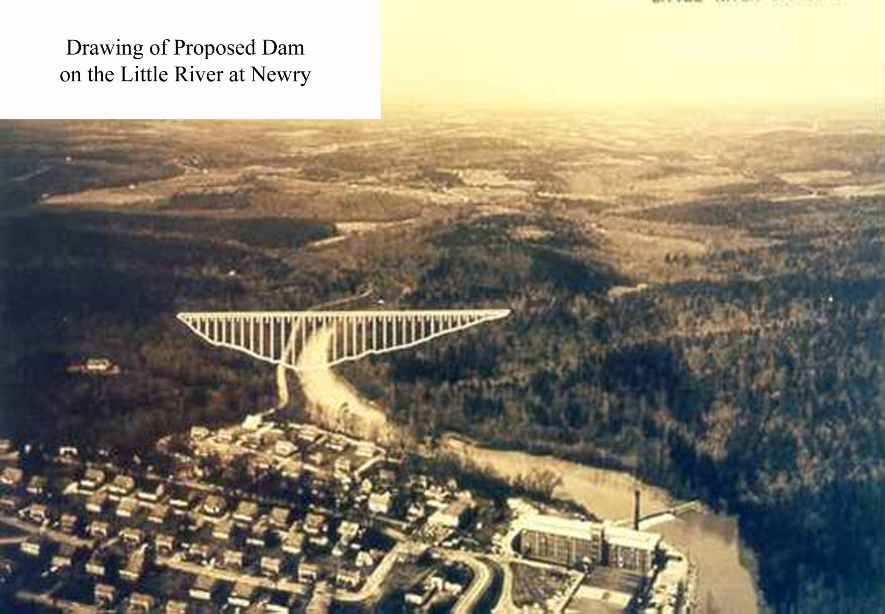
Notes:
Duke Power’s Keowee-Toxaway project to build Lake Keowee encroached on the village of Newry. The Little River dam was constructed adjacent to the village and some parts, such as the baseball field, were cut off by it. Today, the mill itself remains, although it has been subjected to fire and much neglect. Many of the original mill houses and other structures still remain. Efforts to purchase and repurpose the mill are underway.

Slide 14
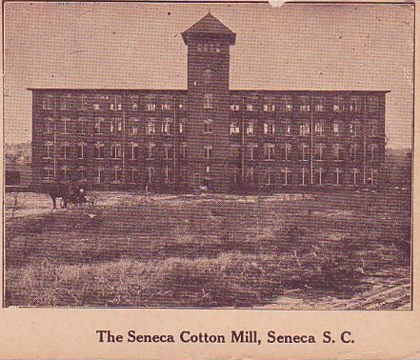
Mills of Oconee - Seneca
Jordania/Lonsdale/Utica - 1898
Notes:
In 1898, the Seneca Cotton Mill opened just east of the City of Seneca. As you can see, the mill looks very similar to that of Newry and that of mills across the East Coast. Cotton mills were especially prone to fire. Insurance companies approved of these brick structures with numerous windows for ample air flow, and so mill owners readily built these “safe” and cost effective designs.

Slide 15
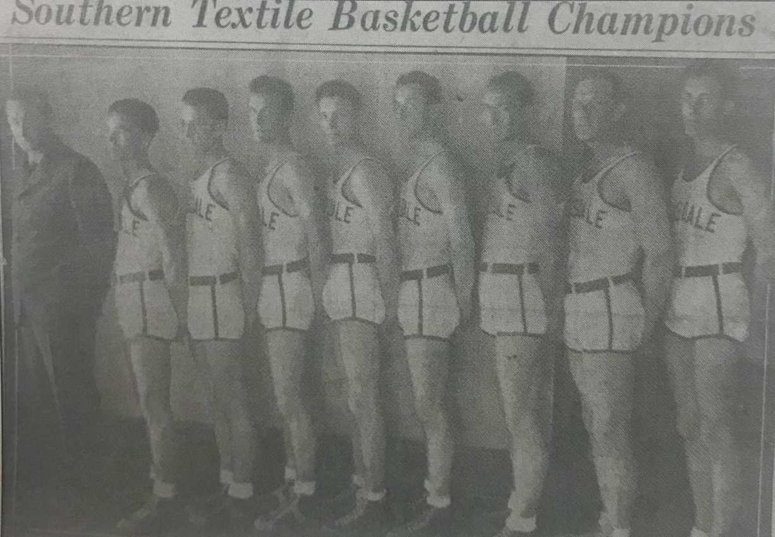
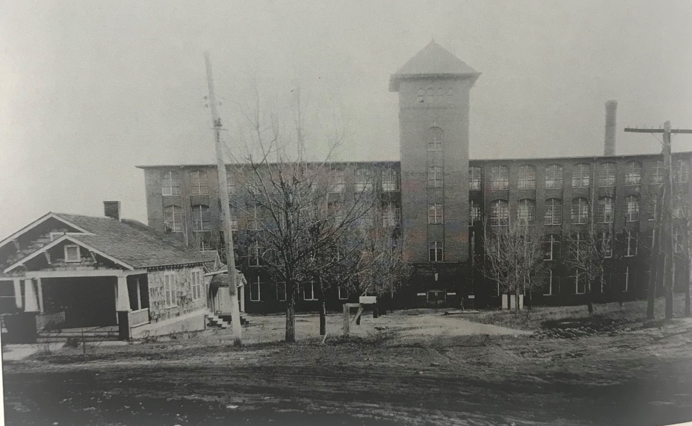
Notes:
The Seneca Cotton Mill also changed hands several times throughout its history – becoming Jordania, Lonsdale, and Utica. Workers at this particular mill enjoyed basketball for recreation, which was also played against other textile mill teams in the area. Today the Utica Mill sits empty and has also suffered from neglect. Many of the mill village houses are still there. Efforts at community revitalization are also underway.

Slide 16
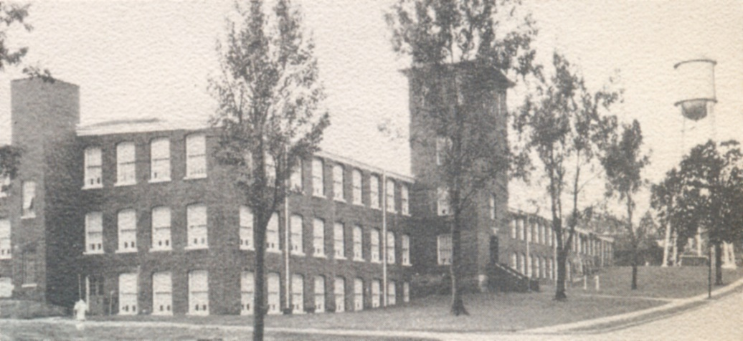
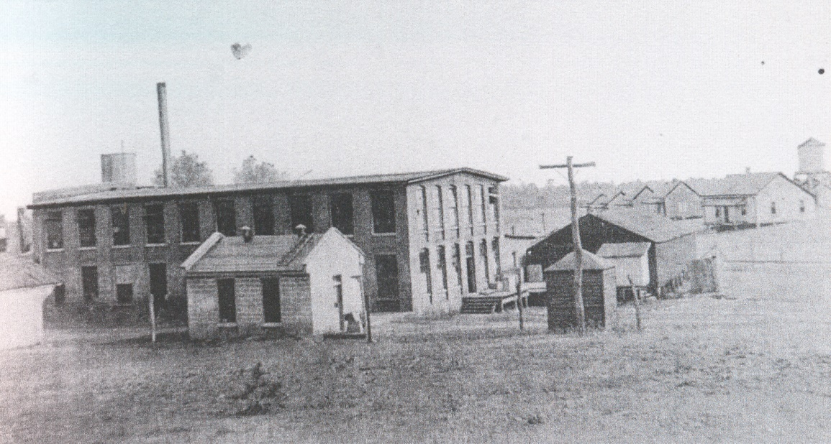
Mills of Oconee - Walhalla
Walhalla Cotton Mills/Victor-Monaghan/Chicopee/Avondale - 1895
Oconee Knitting/Hetrick/Keowee Yarn/ Oconee/Kenneth/Cone - 1904
Notes:
Walhalla was home to 2 cotton mills that also opened around the turn of the 20th century. Walhalla Cotton Mills, later known as Victor-Monaghan, Chicopee, and Avondale, began in 1895. It was located on the corner of East South Broad Street and South John Street. This mill operated in diminishing capacities until the early 2000s. Just a few blocks further east, Oconee Knitting Mill, also known as Hetrick, Keowee Yarn, Kenneth, and Cone mills, was located at the corner of Earle Street and Kenneth Street. It was a much smaller mill than Walhalla Cotton Mills. Both mills were easily accessed by the railroad. Today, both mills have been demolished.

Slide 17
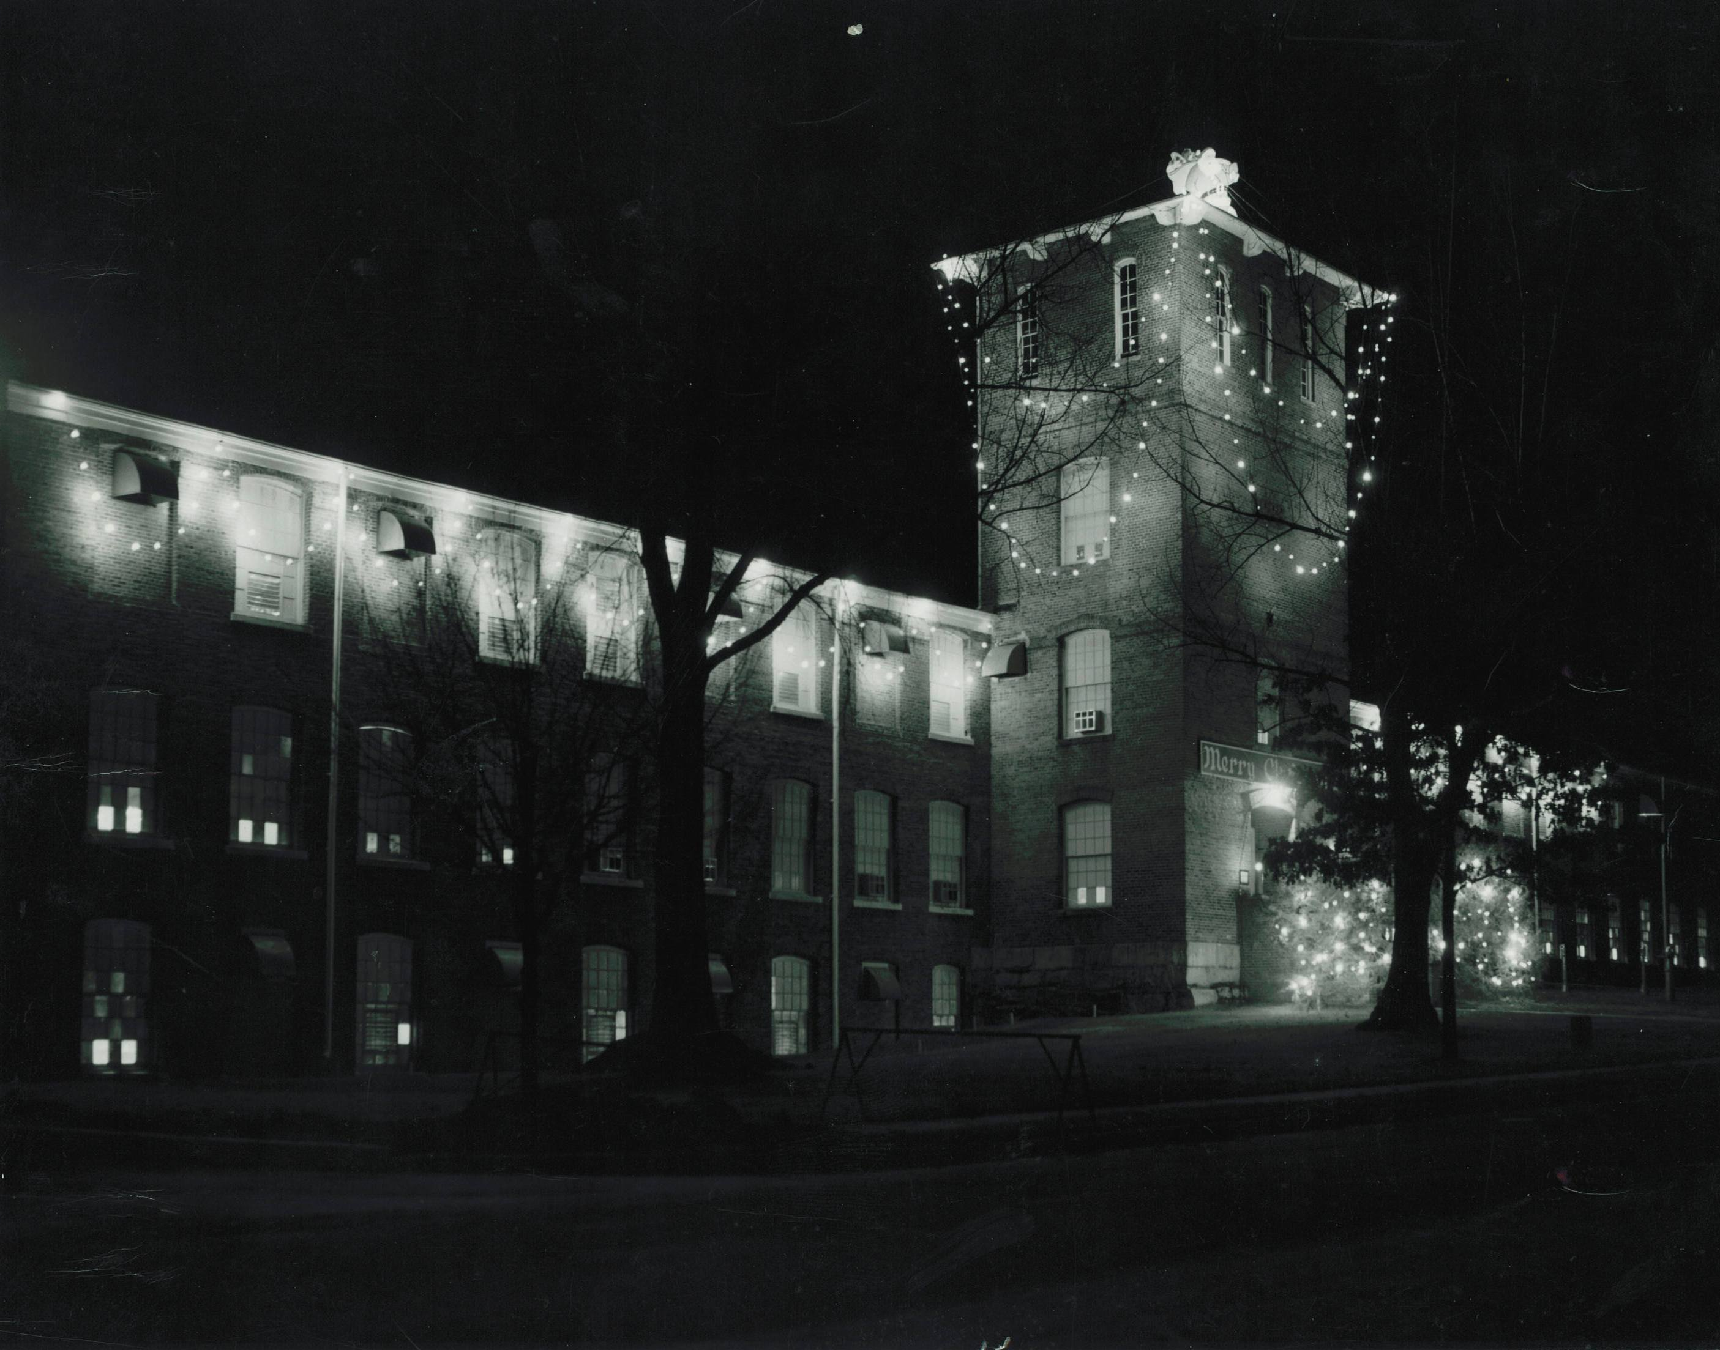
Notes:
The mill was the center of the community. In this photo you can see Chicopee Mill of Walhalla decorated for the Christmas holiday. During years of economic success employees were gifted whole hams at Christmas time.

Slide 18
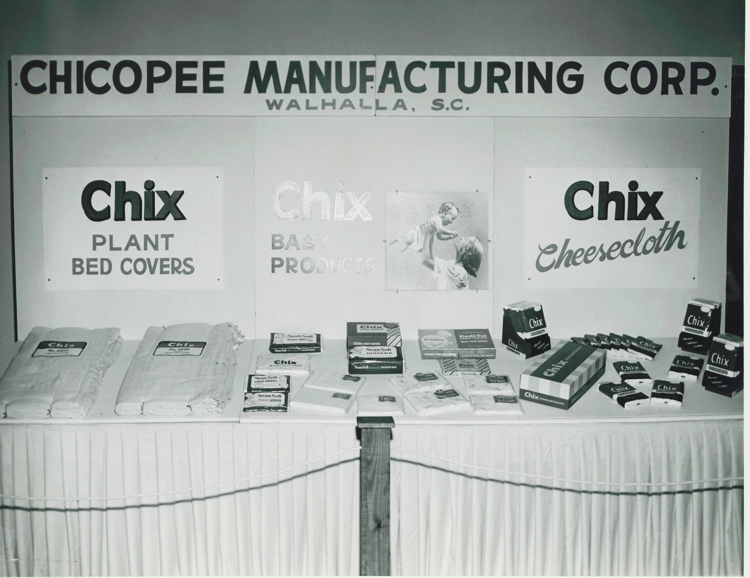
Notes:
Workers took much pride in producing materials used throughout the nation. Bedding, cheesecloth, and medical gauze were just some of the products produced in Oconee County and sold in a national and global marketplace.

Slide 19
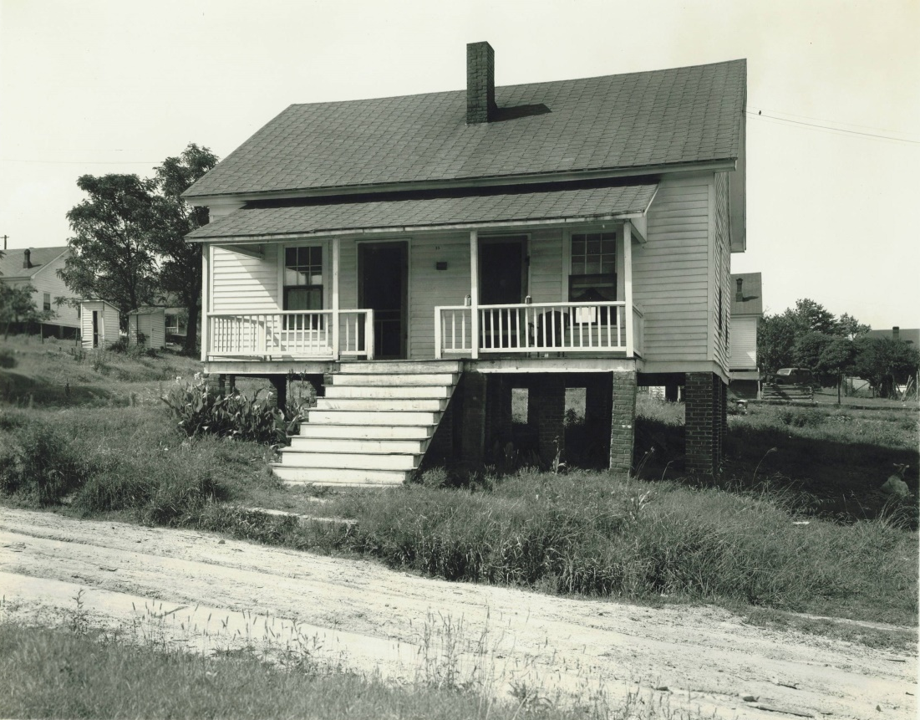
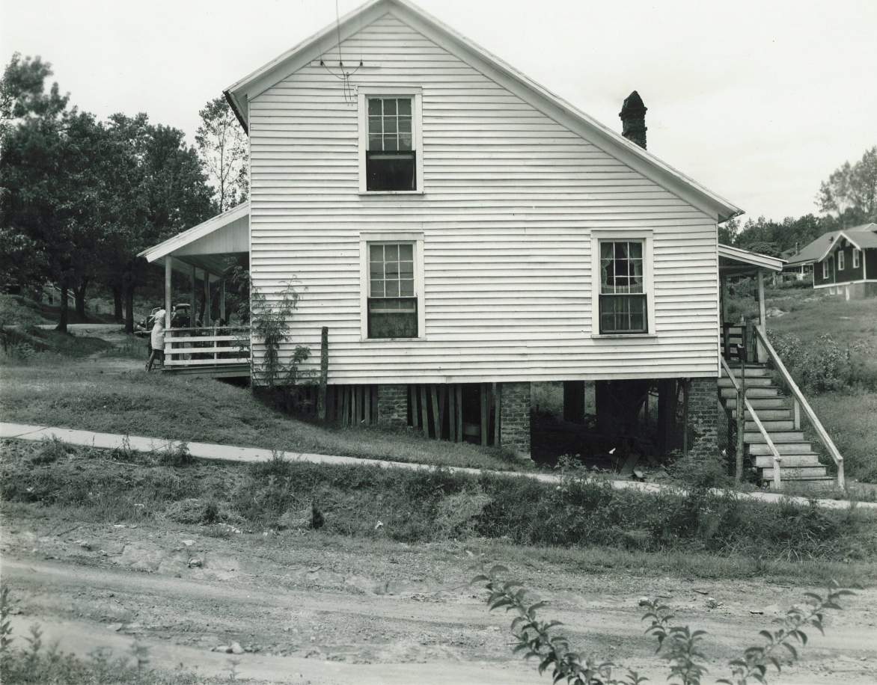
Notes:
Again, the saltbox style architecture of mill village homes is a remnant of the textile industry’s beginnings in New England. In many cases these homes were “duplex”, housing 2 families per unit. Initially, outhouses were located in the rear of the homes. Running water and electricity were added later.

Slide 20
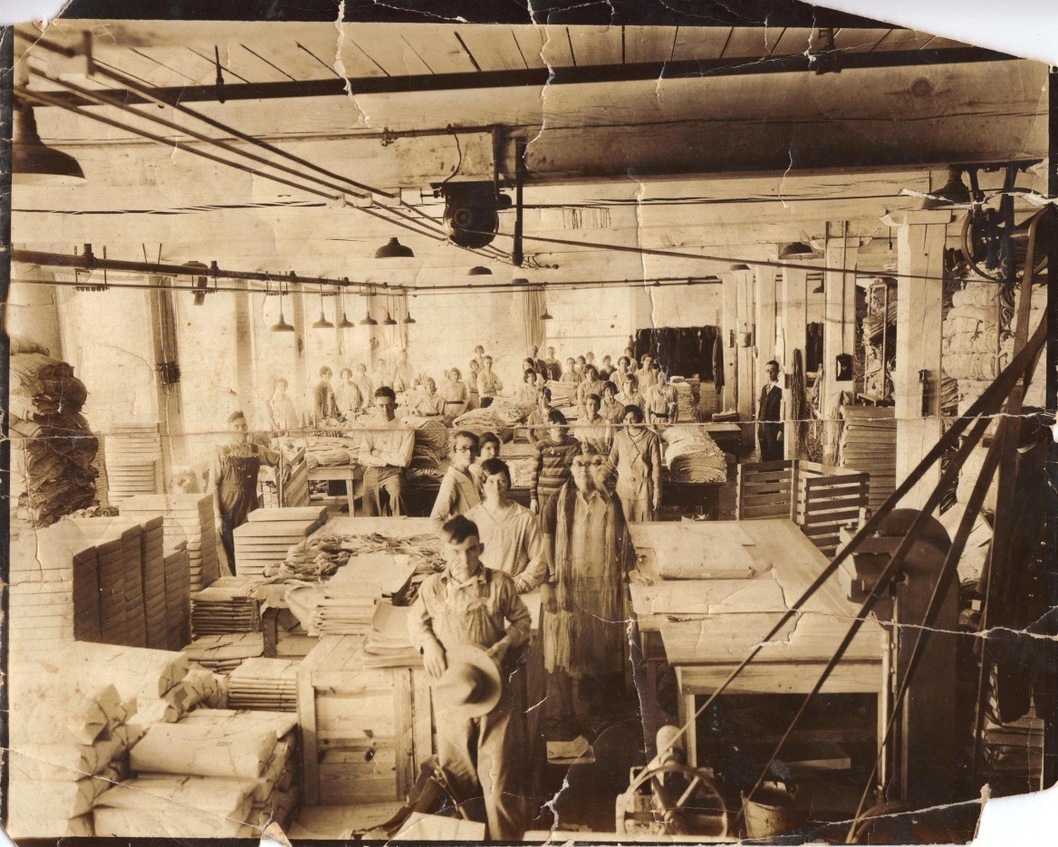
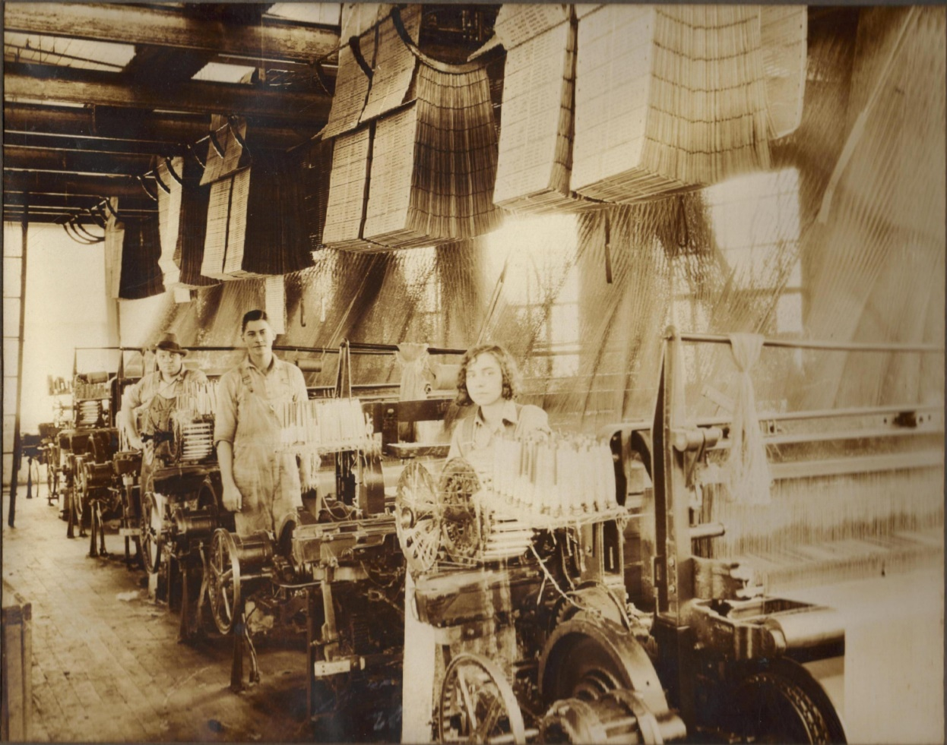
Notes:
These photos show workers inside the Hetrick Mill of Walhalla. Notice many are very young.

Slide 21
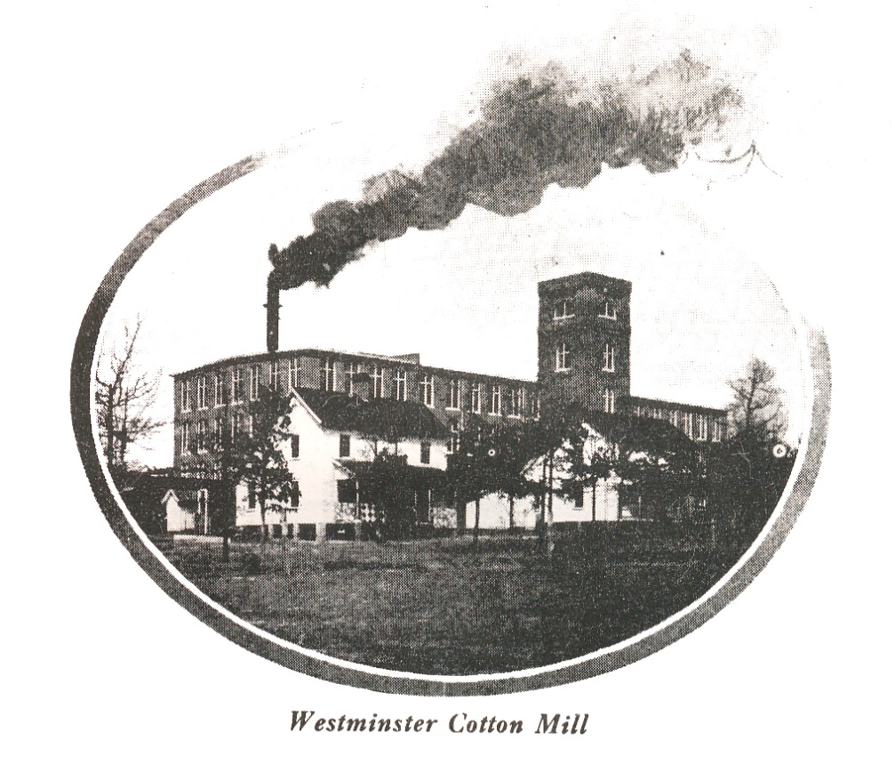
Mills of Oconee - Westminster
Westminster Knitting Mill – 1905
Cheswell Mfg/Oconee Mill/Beacon Mfg - 1900
Notes:
Much like the rest of Oconee County, the textile industry also found a home in Westminster around the turn of the 20th century. Cheswell Manufacturing opened in 1900. Mr. Cheswell had managed Courtenay Manufacturing in its early days, and the same contractor who had built mill village homes for the Seneca Cotton Mill also built the mill village homes in Westminster. As you can see, the design of both the mill and the mill village homes is the same.

Slide 22
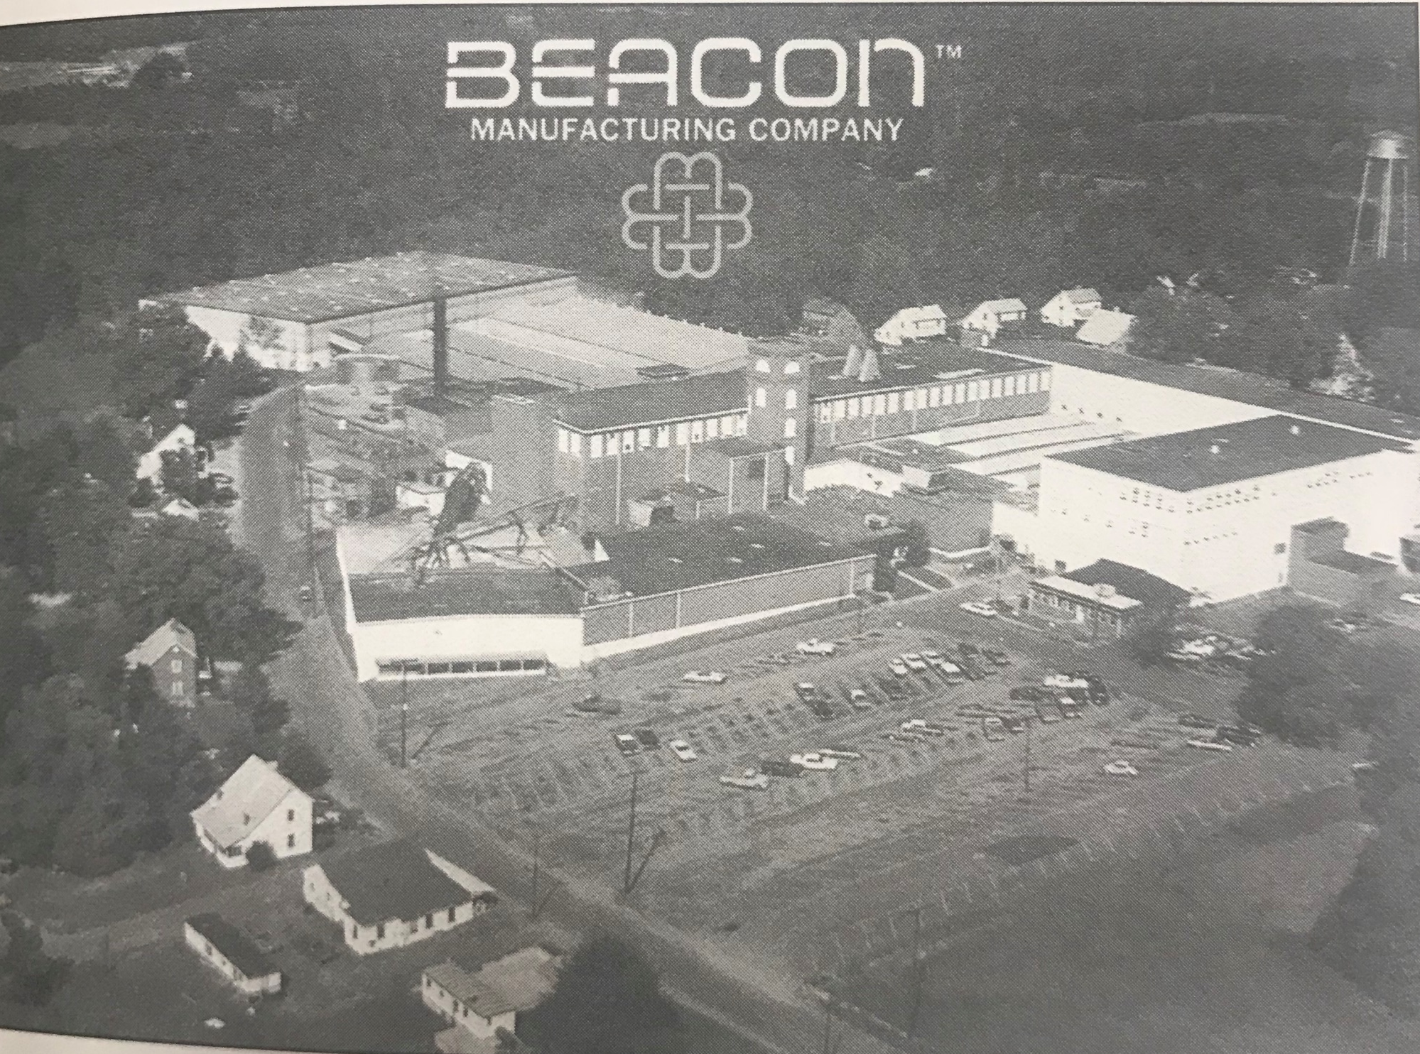
Notes:
The Westminster Cotton Mill became most commonly known as Beacon Manufacturing, which operated in diminishing capacity until the 2010s. The company added a golf course and also pasture land for mill worker’s livestock. Beacon also added the first modern ball field for its team, the Oconee Mountaineers. This aerial photo shows how the facility modernized and added on over time to expand production and utilize new technologies. “Beacon blankets” became popular around the world. Today, this mill has been demolished.

Slide 23
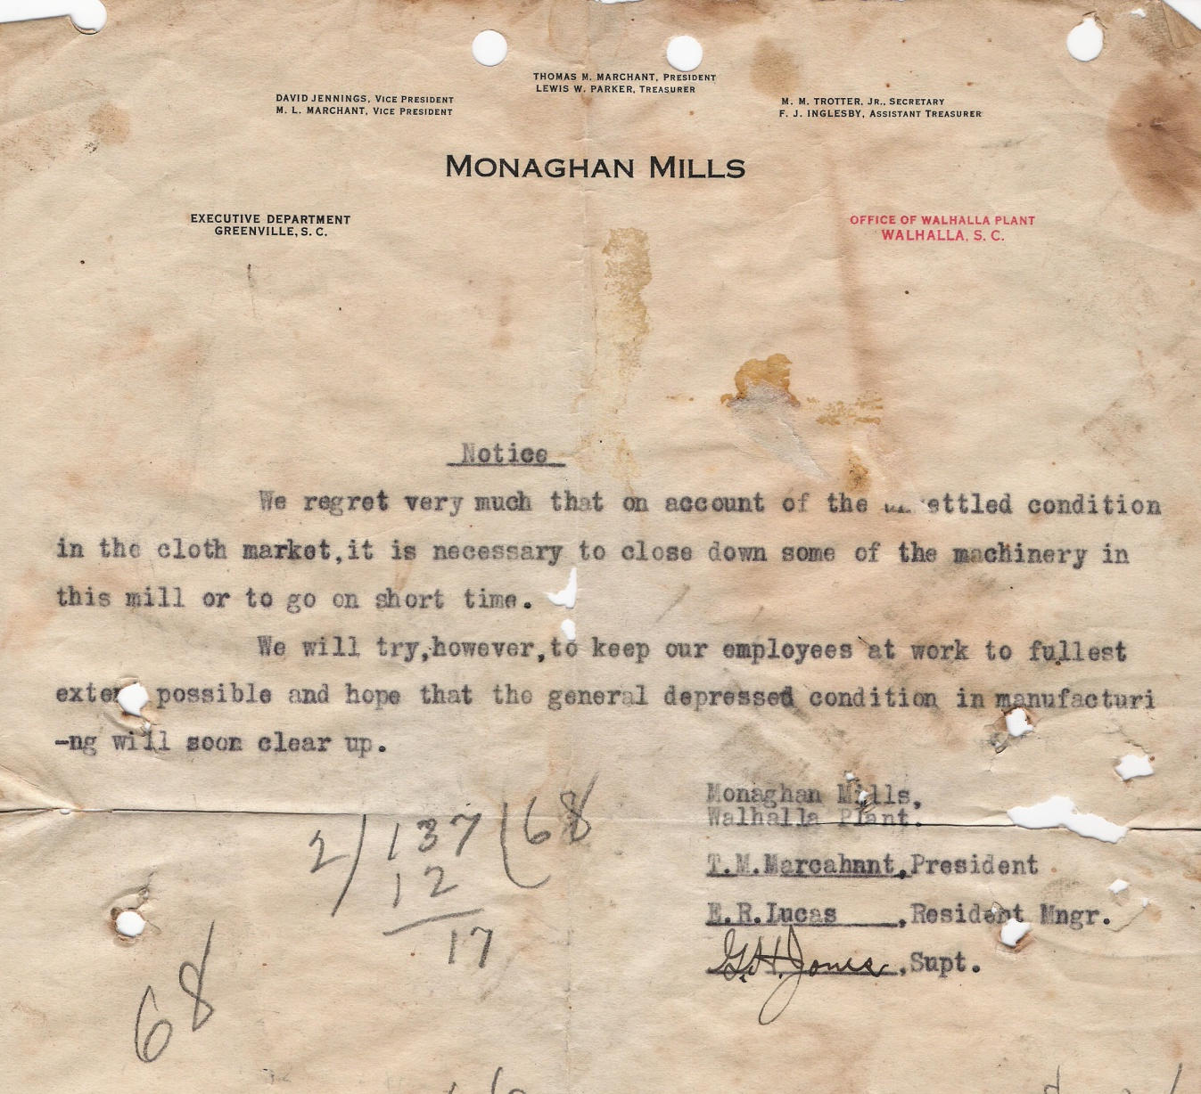
Where Did They Go???
Notes:
The strong sense of community created by mill work and mill village life meant that employees were given priority and significant consideration during times when companies changed ownership, reduced operations, and ultimately closed.

Slide 24
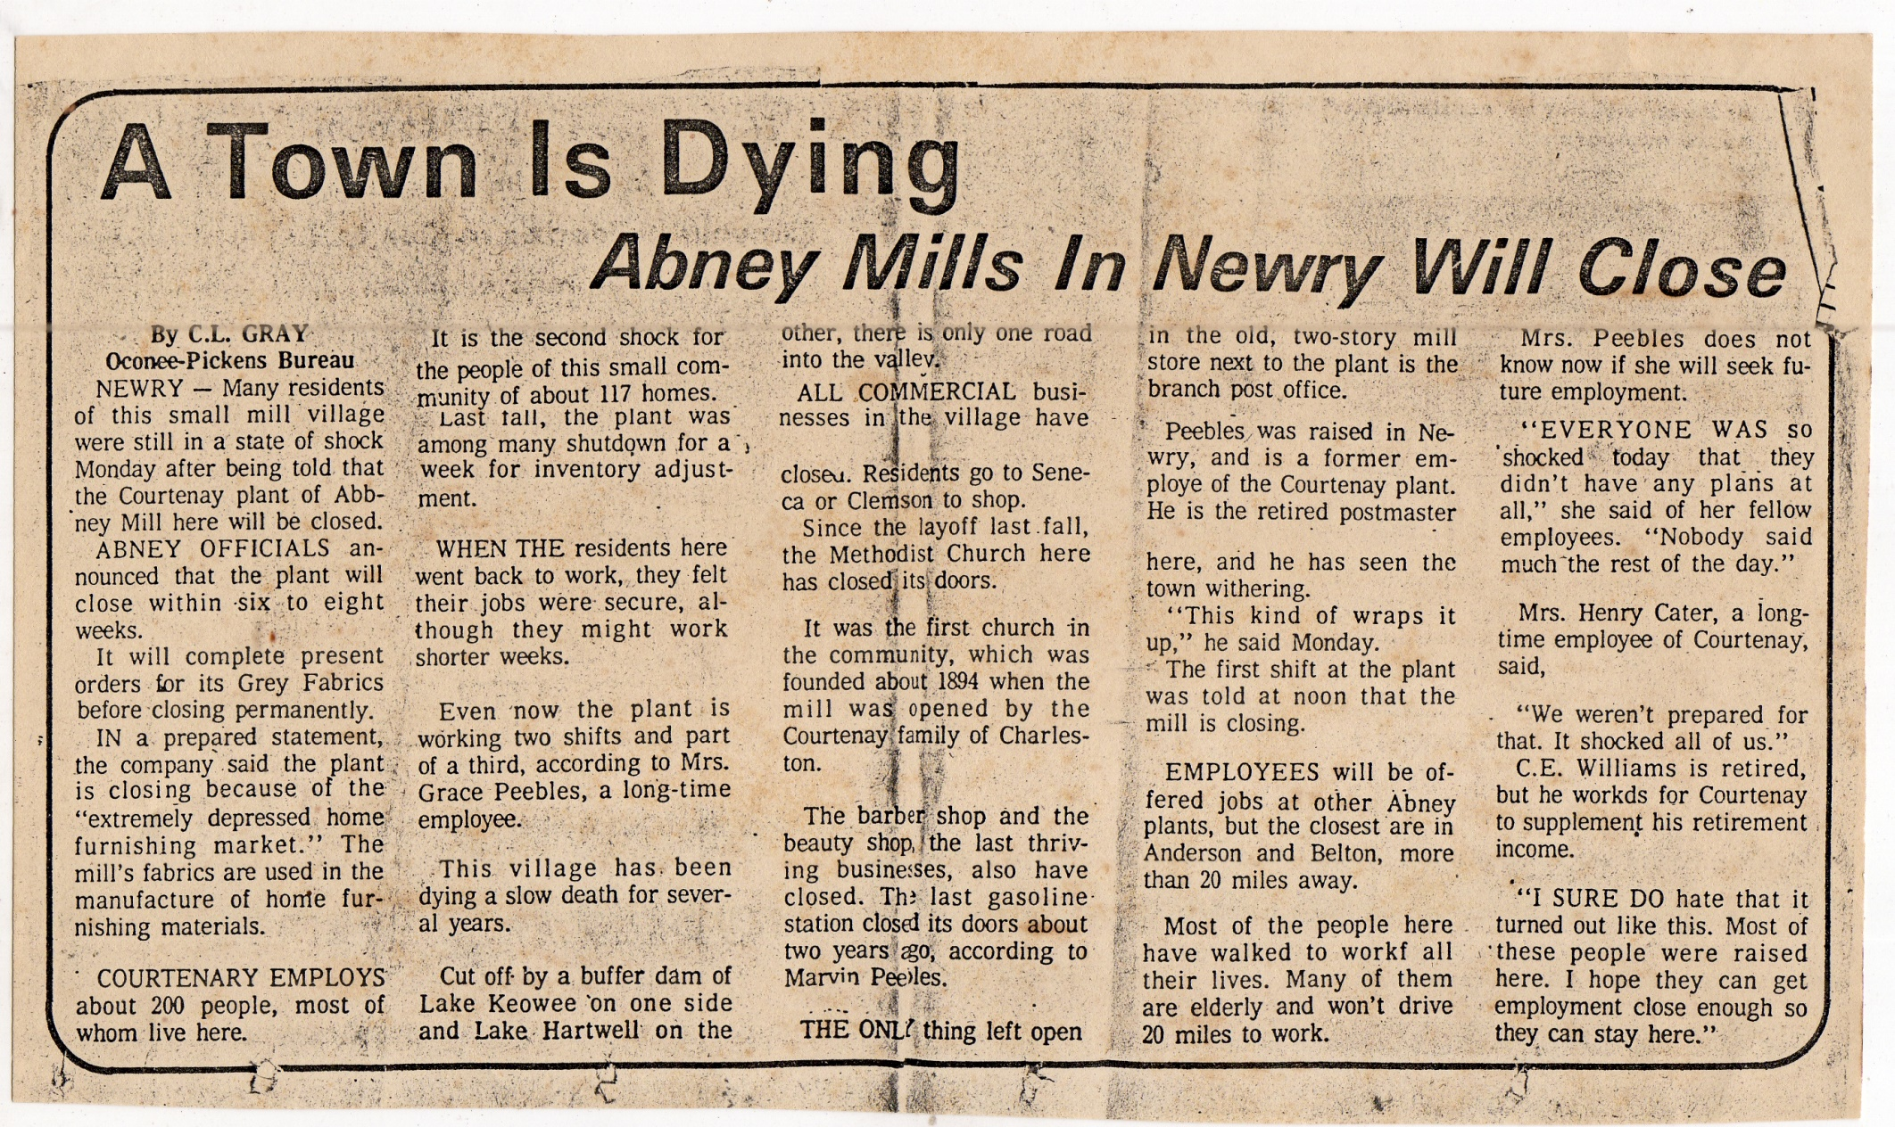
Notes:
As you have seen, many mills and mill villages were the heart of their towns and surrounding areas. The closing of a mill had dramatic and far reaching social and economic effects on the surrounding towns. Many of these effects are still felt today, as towns work to find new industries and new ways to foster community.

Slide 25
Help us preserve
Sign up for oral history interviews
Donate artifacts/archival materials
Notes:
The experiences of Oconee’s former textile workers need to be recorded for posterity. If you know anyone who can be interviewed, or if you have any artifacts or archival materials related to any of these mills, please contact Oconee History Museum.

