Slide 1
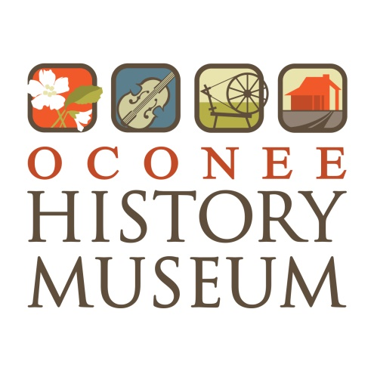
Oconee Disasters
Leslie Hagerty
Director/Curator
Oconee History Museum

Slide 2
Fire

Slide 3
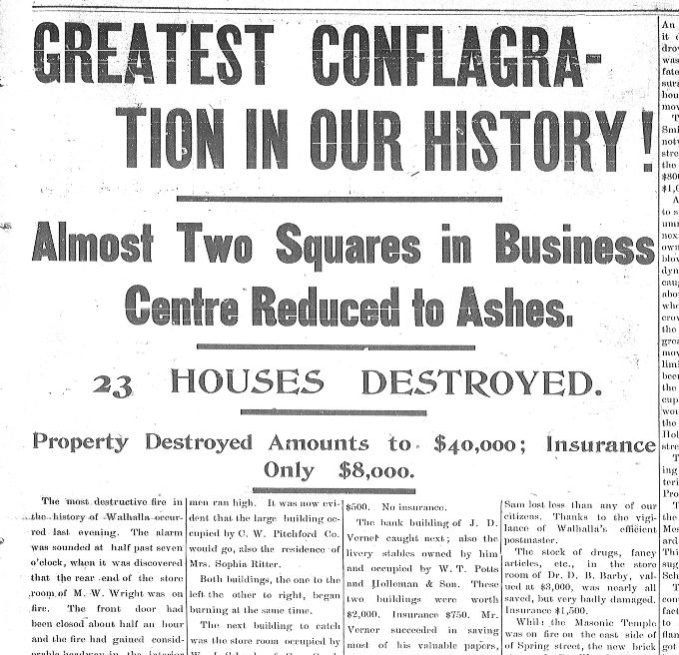
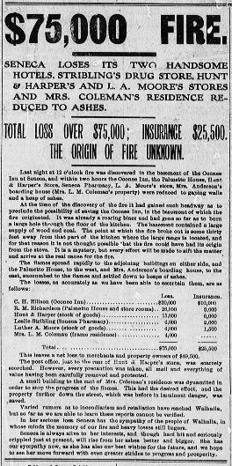
We Didn’t Start the Fire
Notes:
Many cities are at high risk for damage by fire. Historically, most business buildings were wood construction, situated very close together (if not conjoined). Many were located very close to railroads, which create sparks, and many were also heated by woodstoves and furnaces.
The City of Seneca was subjected to 3 major fires downtown. The first occurred in the fall of 1890 and affected the street to the East of the town square (today Norton-Thompson Park). The fire originated in the Post Office, destroyed store rooms, & Miss Ribbon Phillips’ dress shop, including someone’s wedding dress 2 days before the wedding. The second was on the main block near Lunney’s Drug Store and Gignilliat’s Corner (corner of N. Townville St. and Main St.). This fire cleared many of the then wooden buildings on Main Street. The third fire occurred in 1906 in the basement of the Oconee Inn, which then spread to the neighboring Palmetto Hotel and several other adjacent buildings (near present-day Wells Fargo).
Walhalla suffered a catastrophic fire in 1898. Again, most of the businesses and homes at the time were made entirely of wood and were situated very close together. As you can see from the Keowee Courier article, “the greatest conflagration in our history” destroyed 23 houses and decimated 2 blocks of the Main Street business area.
In both instances, the damage was incredible and insurance coverage was very insufficient.

Slide 4
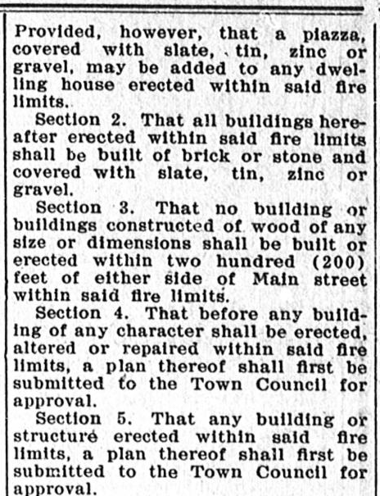
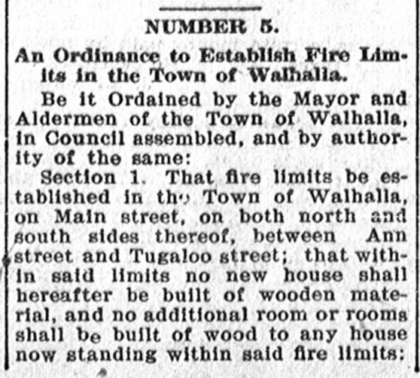
Notes:
Theses fires taught residents, business owners, and city officials many hard lessons. In response to this devastation, ordinances were put in place requiring more brick construction, particularly in downtown areas with adjoining buildings. Public fire service improved as more fire stations and fire squads developed.

Slide 5
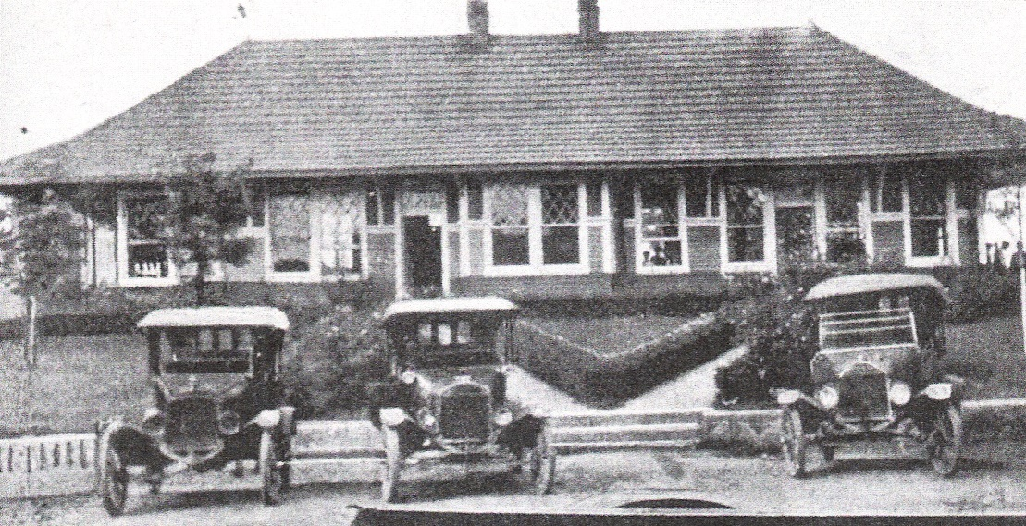
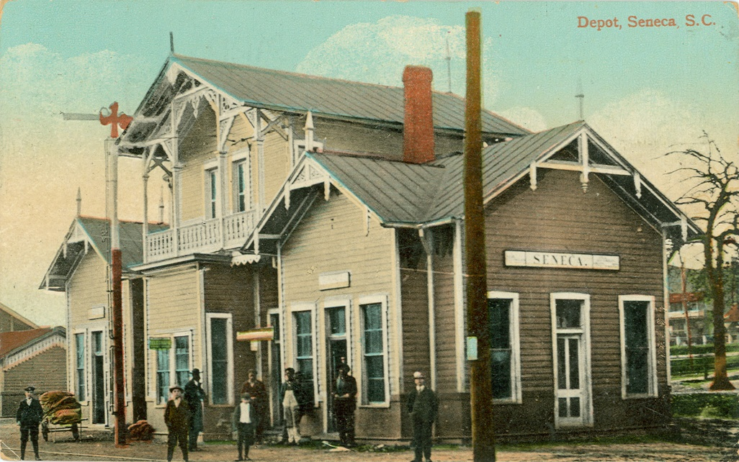
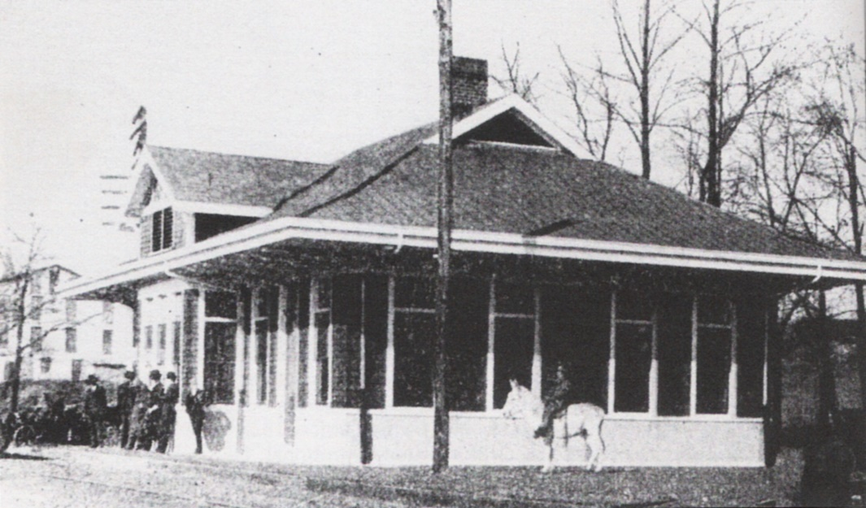
Westminster Depot
Walhalla Depot
Seneca Depot
Notes:
Oconee County has lost many other historic structures due to fire (intentional and unintentional). Adger College of Walhalla burned in 1888. Classes resumed in unoccupied brewery buildings nearby. The West Union train depot burned due to a spark from the railroad. 30 bales of cotton ($4,500 value) were destroyed. Walhalla, Seneca, and Westminster all lost their passenger train depots due to fire/arson at various times.

Slide 6
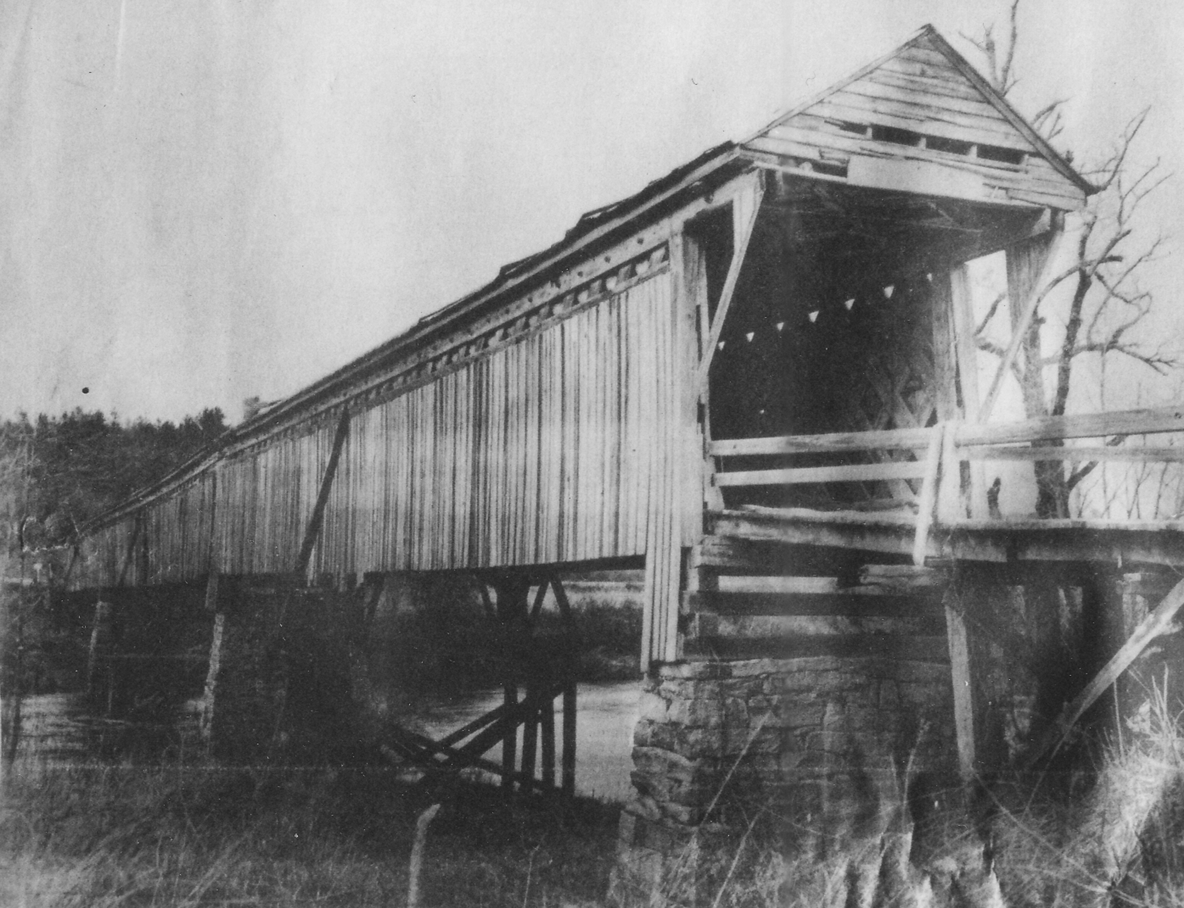
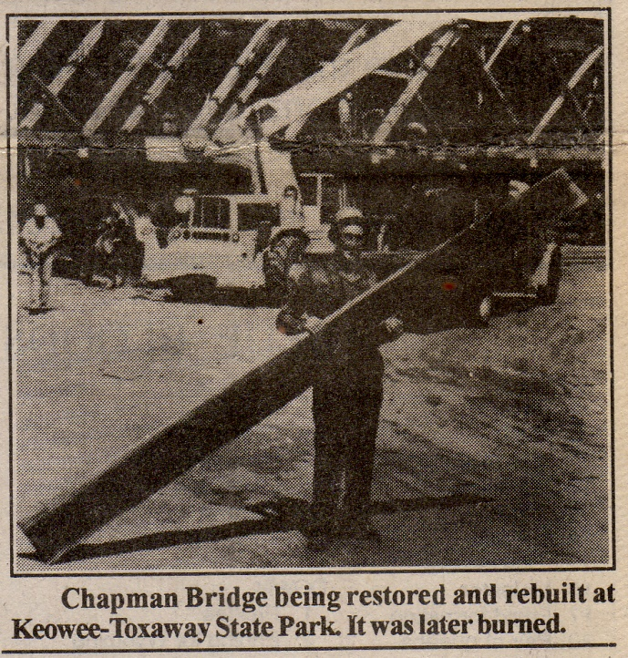
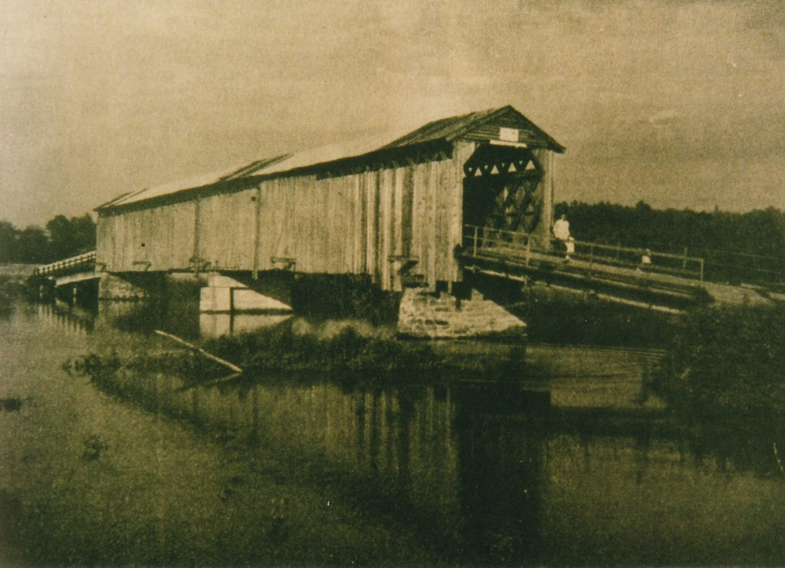
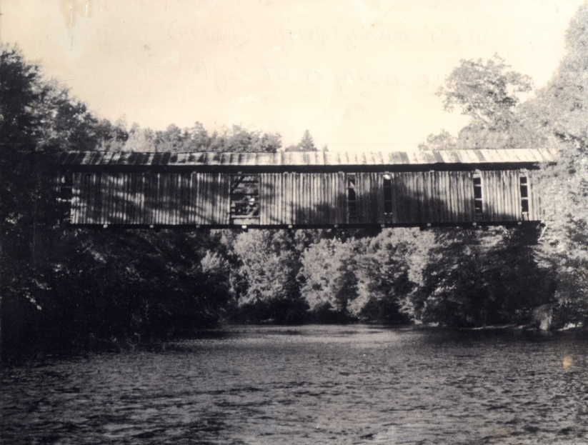
Knox Bridge
Prather’s Bridge
Chapman’s Bridge
Notes:
The West Union lumber mill experienced a fire in the 1940s that resulted in $20,000 of damaged. The fire originated in the boiler room, and several thousand feet of lumber that had been loaded into freight car was saved by Walhalla & West Union firemen. Other losses include the Salem lumber yard (1954), Oconee Community Theater (1989), Seneca Oil Mill (1950s), Knox Bridge, Prather’s Bridge (burned intentionally during Civil War, then washed away in flood, then rebuilt, then arson), and Chapman’s Bridge (arson).

Slide 7
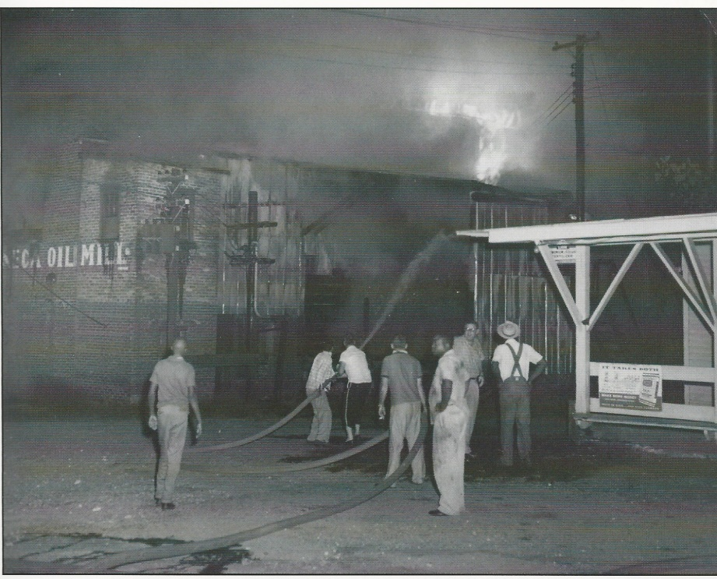
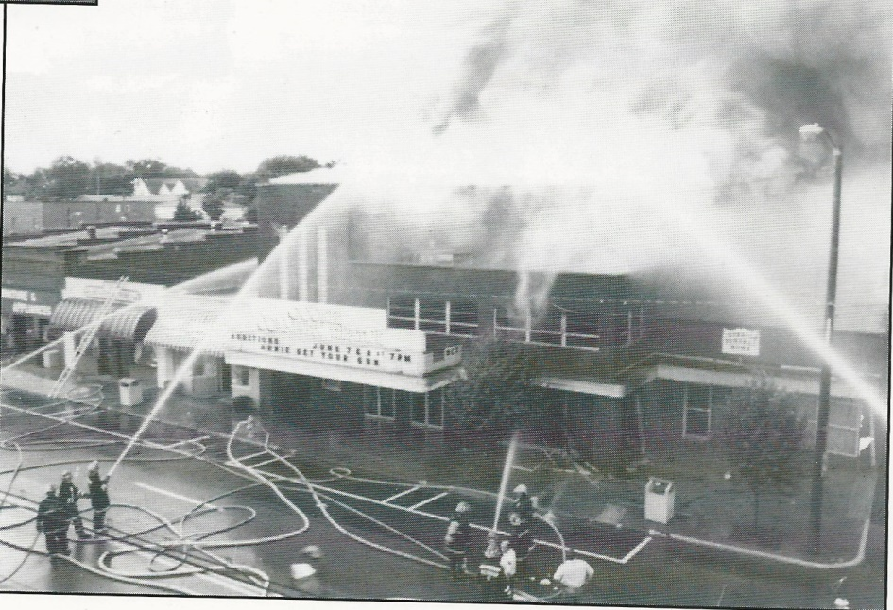
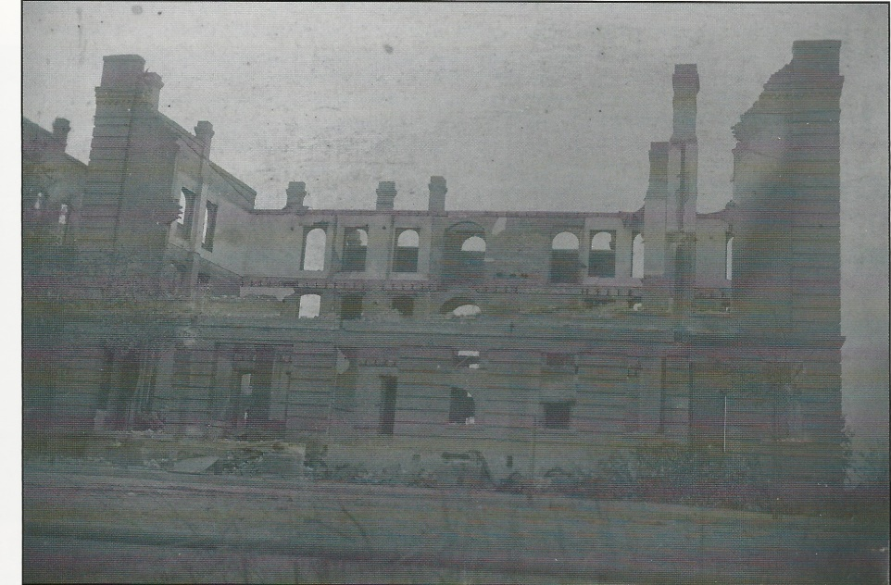
Seneca Oil Mill fire 1950s
Oconee Community Theater fire 1989
Oconee Inn - 1906

Slide 8

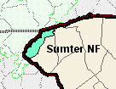
Fire On The Mountain
Notes:
Oconee is also home to the Sumter National Forest, which has been subject to many wildfires (arson and accidental). Some of the larger fires include the Brasstown fire (1953), the Callas Mountain Fire (Easter Sunday 1963), which burned 400 acres, and the Jumping Branch fire of April 5, 1978, which burned 2,856 acres. In 1979, following the Jumping Branch fire, it was reported that blueberries were growing “like crazy” in the area where fire had been. The US Forest Service periodically performs prescribed burning to manage the forest floor’s fire load (downed wood that accumulates and acts as an accelerant during a wildfire). Nearly 85% of wildfires in the US are caused by humans (accident or arson).

Slide 9
Drought

Slide 10
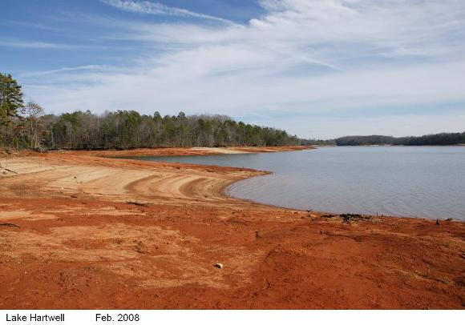
Have You Ever Seen the Rain?
Notes:
Drought is an enormous contributing factor to wildfire, and Oconee has experienced regular periods of drought throughout its history. Oconee’s record high temperature was 108F on September 7, 1925. The drought of mid-1920s was severe, and resulted in too little water in Cane Creek to supply the local power plant. Farmers suffer greatly during drought without water for their crops, but droughts today also significantly impact our lake-oriented tourism industry as lake levels become too low for adequate boat access. Other detrimental summer weather includes hail. In 1924 severe hail damaged resulted in a call for donations to support farmers who lost crops.

Slide 11
Wind

Slide 12
Blowin’ In The Wind
http://www.tornadohistoryproject.com/tornado/South-Carolina/Oconee/1973/May/map
http://www.tornadohistoryproject.com/tornado/South-Carolina/Oconee/1994/map
https://www.nytimes.com/1994/08/17/us/35-are-injured-by-a-tornado-in-s-carolina.html
Notes:
Like much of the Southeast, Oconee has experienced its share of tornadoes. On May 27, 1973 a tornado in Mountain Rest destroyed a chicken house near Earl’s Ford. On March 27, 1994 an F3 tornado hit Long Creek & Tamassee. This tornado was a result of strong winds coming off Tropical Storm Beryl. This tornado resulted in $3 million in damage to property, $2.5 million in damage to crops (mainly apple orchards) and timber, 60 homes were lost, and 12 people were injured. On June 27, 1994 a tornado started in Pickett Post (approximately in the same location where the previous tornado ended), and moved north to Jocassee.

Slide 13
Flood

Slide 14
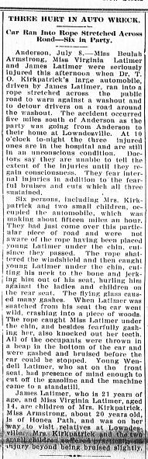
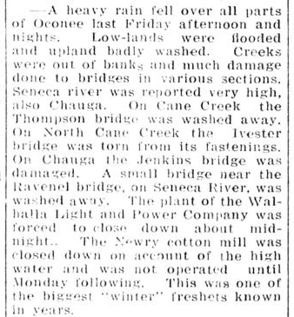
Rainy Days & Mondays
Notes:
In an area covered by rivers and streams, it is no surprise that Oconee has experienced flash flooding and other detrimental effects of severe storms. The record precipitation for 24-hours in Oconee County was 9.65” on September 20, 1924. The “Great June freshet” of 1903 in Salem left 4 dead. Just as drought is bad for farms, so is flooding. Thunderstorms also produce lightning, which can cause fires. On April 5, 1951, lightning struck Pleasant Ridge Baptist Church, and in 1911 I.W. Henry of Whetstone was struck by lightning in his store (due to the telephone line). He survived. Rains and flooding in 1918 caused power outages (for those lucky enough to have electricity in their homes at this time).

Slide 15
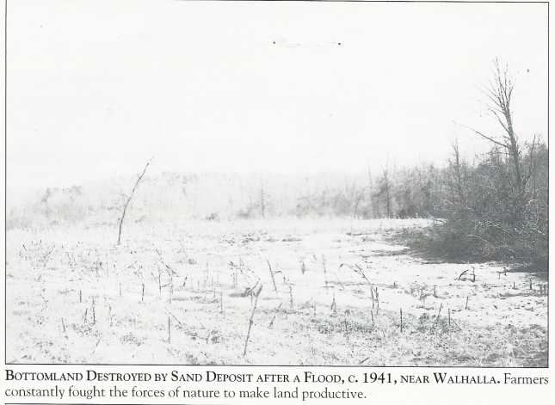

Slide 16
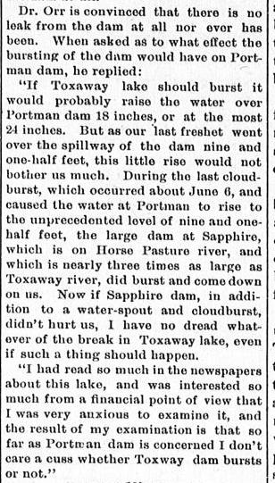
When the Levee Breaks
http://nchistoryroom.blogspot.com/2016/07/1916-flood.html
http://nchistoryroom.blogspot.com/2014/08/lake-toxaway-dam-failed-in-1916.html
Notes:
Severe flooding is also a threat to earthen dams. In 1903 the Toxaway Dam (just across the state line in North Carolina) failed. Use the links to read more about this devastating event. Today, large amounts of rain can make local rivers dangerous as water levels become unsafe for swimming, fishing, rafting, kayaking, etc… On April 9, 1975 19 deaths occurred on the Chattooga as a result inexperienced rafters attempting to raft the river popularized by the movie Deliverance.

Slide 17
Snow

Slide 18
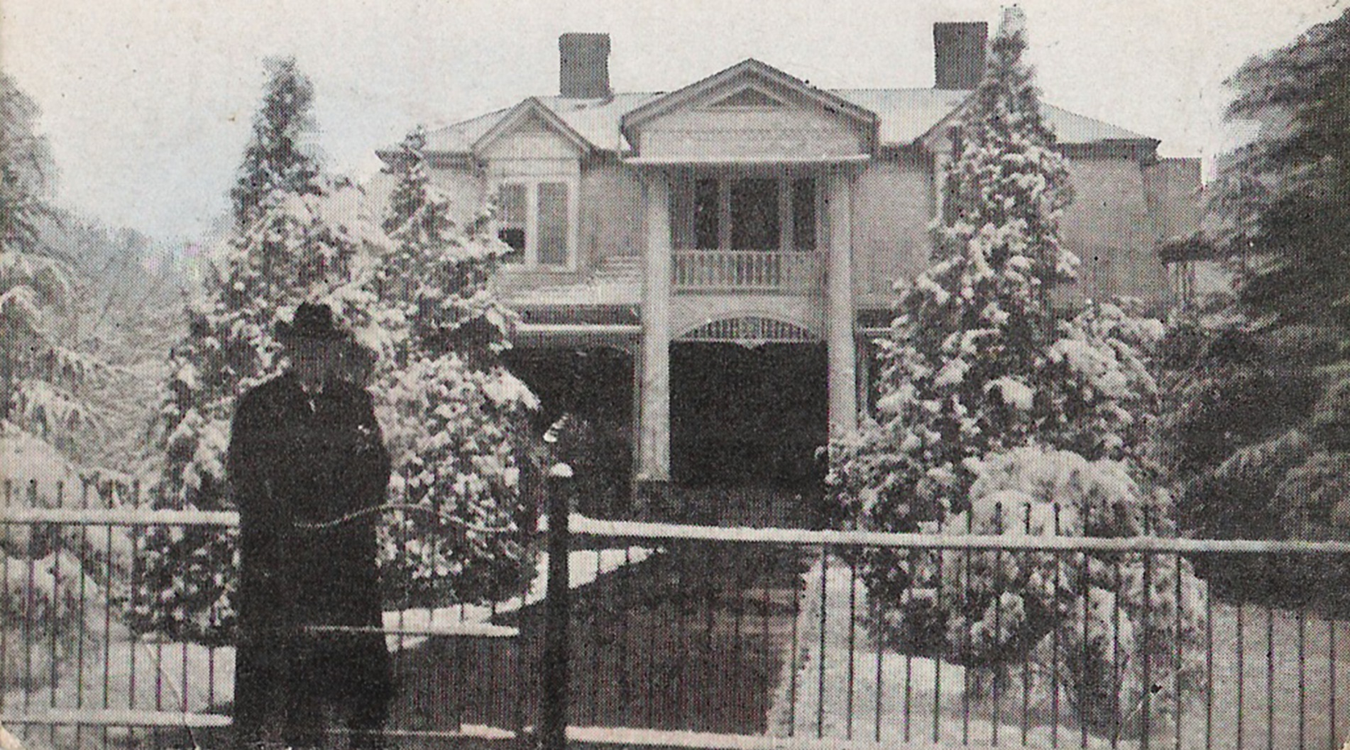
Ice, Ice, Baby
Notes:
Today, Oconee rarely experiences snow, but severe winter weather has been recorded. The record low temperature in Oconee County was -8 on January 21, 1985 in Long Creek. The record for 24-hour snowfall was 15” on January 7, 1988 also in Long Creek (11” for Walhalla). On March 8, 1978 the local newspaper reported on a 17-foot-tall snowman made by a group in Mountain Rest.

Slide 19
Frosty, the Snowman
https://www.youtube.com/watch?v=HjVVVunWd2k

Slide 20
Wrecks
Notes:
Like much of the United States, car accidents have occurred all too often in Oconee. Almost as soon as cars began appearing in Oconee, the local newspaper began reporting on car-related deaths and injuries. The 1st fatal car wreck in Oconee occurred in the New Hope area in 1918. George Wyatt flipped his car, throwing 7 passengers out and killing Miss Zella Boggs aged 14. In 1911 “Don” the Collie belonging to MC Long, Esq was hit by a car.

Slide 21
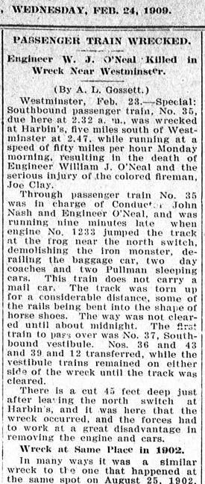
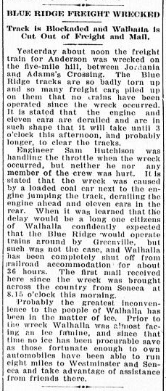
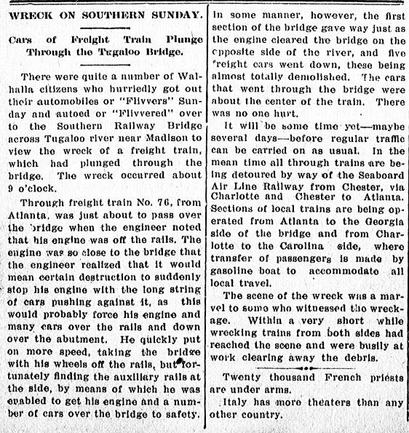
Runaway Train
Notes:
Trains are still very much a regular sight in Oconee County, although fewer train crossings exist today than did early on. Local news is filled with reports of train wrecks and unfortunate instances like that of Frederick Schneider who was killed riding a train car for fun in 1888.

Slide 22
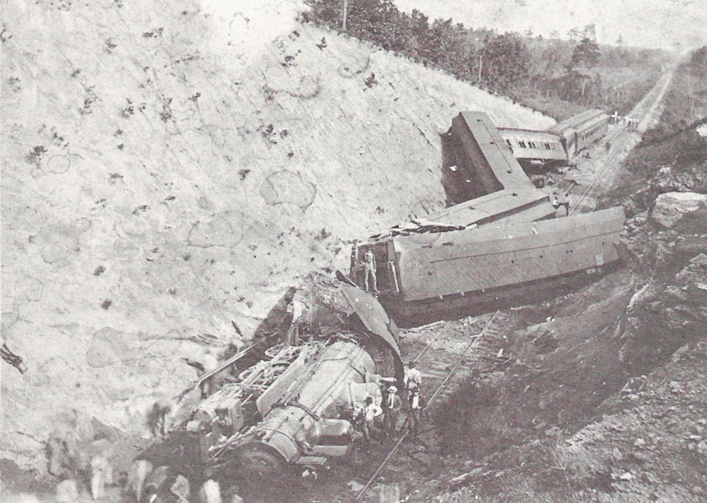
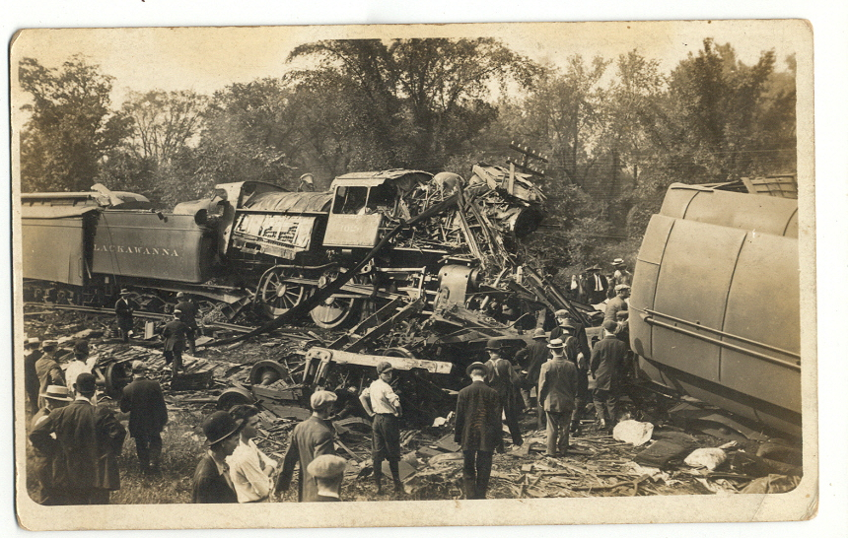
Crazy Train

Slide 23
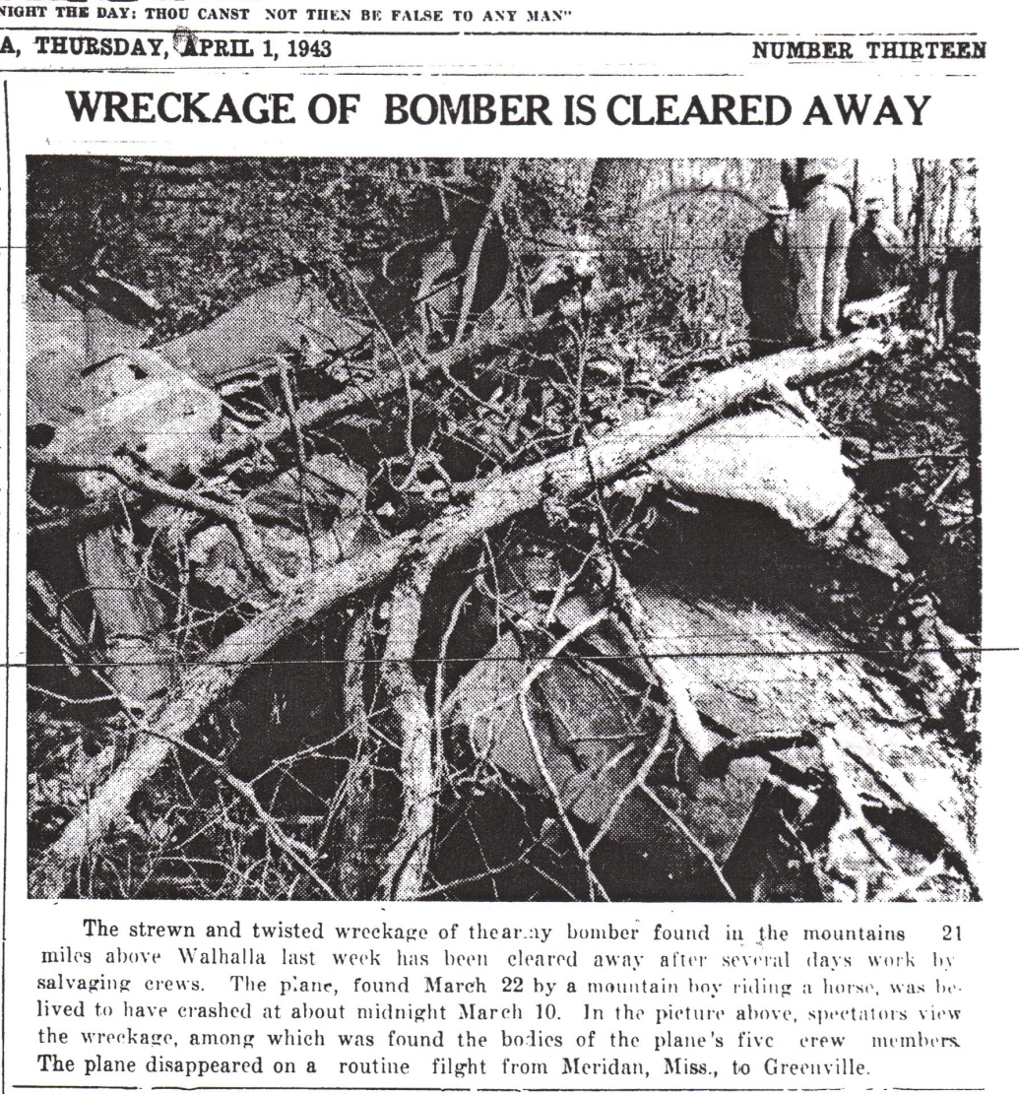
Leaving On A Jet Plane
Notes:
Oconee also has some notable air traffic accidents. The news article above describes the crash of an army bomber in Mountain Rest (1943). In the 1970s a private charter plane also crashed in Oconee’s mountains. A 1979 hot air balloon race from Helen GA to Atlantic Ocean resulted in a crash in the treetops near Whetstone.

Slide 24
Unclassified

Slide 25
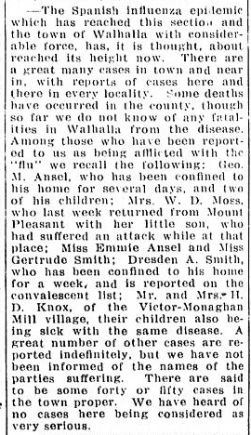
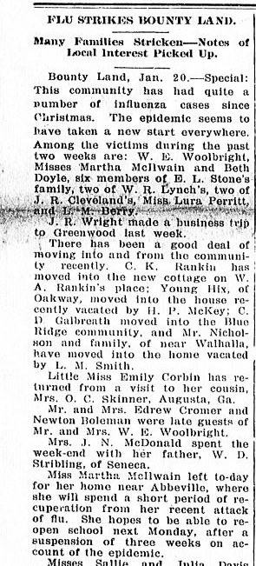
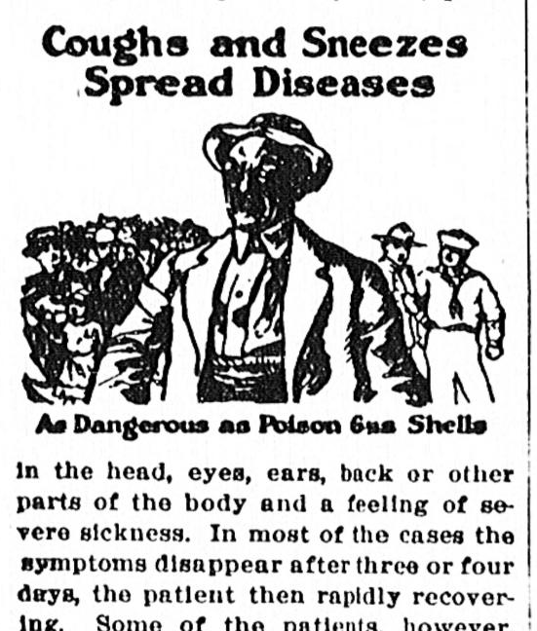
Rockin’ Pneumonia
& the Boogie Woogie Flu
Notes:
Oconee was not left out of worldwide pandemics. Influenza outbreaks were reported from many of Oconee’s small communities. Public health notices were also often found in the newspaper as a way to remind people how to take proper precautions to combat the spread of illness.

Slide 26
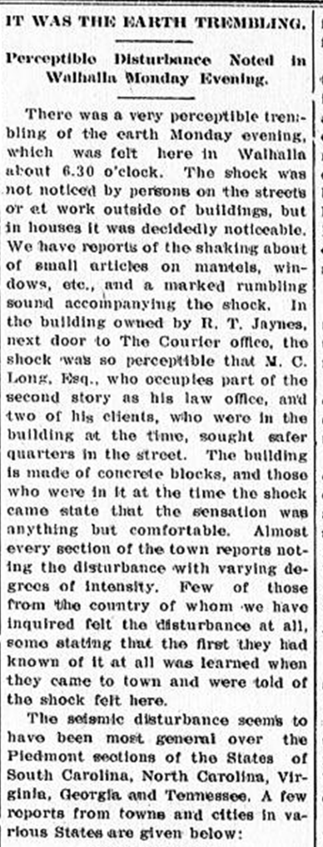
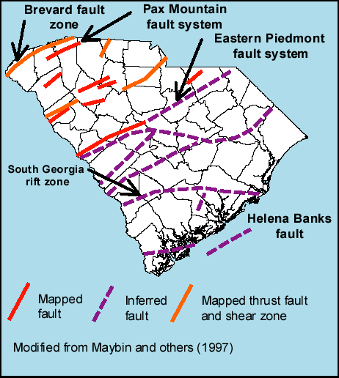
Shake It Off
Notes:
As the map indicates, Oconee County sits along a fault line, putting it at risk for earthquakes. Small earthquakes have been noted throughout Oconee’s history, and a few noticeable tremors have been felt in recent years.

Slide 27
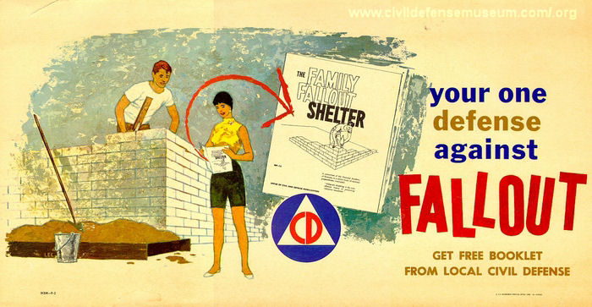
Eve of Destruction
Notes:
During World War 2 and the Cold War, Americans were on high alert for man-made catastrophe. Oconee County was no exception. In 1942 the South Carolina upstate prepared to accept lowcountry evacuees in the event of enemy attack. 375 people in Walhalla alone registered for civil defense work. 4 first-aid stations were established in Oconee to aid in response to an enemy attack. In 1966 it was reported that Oconee stocked shelter space for 17,500 people with another 3000 on the way.

Slide 28

Too Much Monkey Business
Notes:
In possibly the most bizarre disaster, a March 1963 report from the Keowee Courier indicated citizen sightings of loose monkeys on Stumphouse Mountain.

Slide 29
Be Prepared
For more information about disaster readiness visit Oconee County Emergency Services webpage
  https://oconeesc.com/emergency-services-home/emergency-management-home

