Slide 1
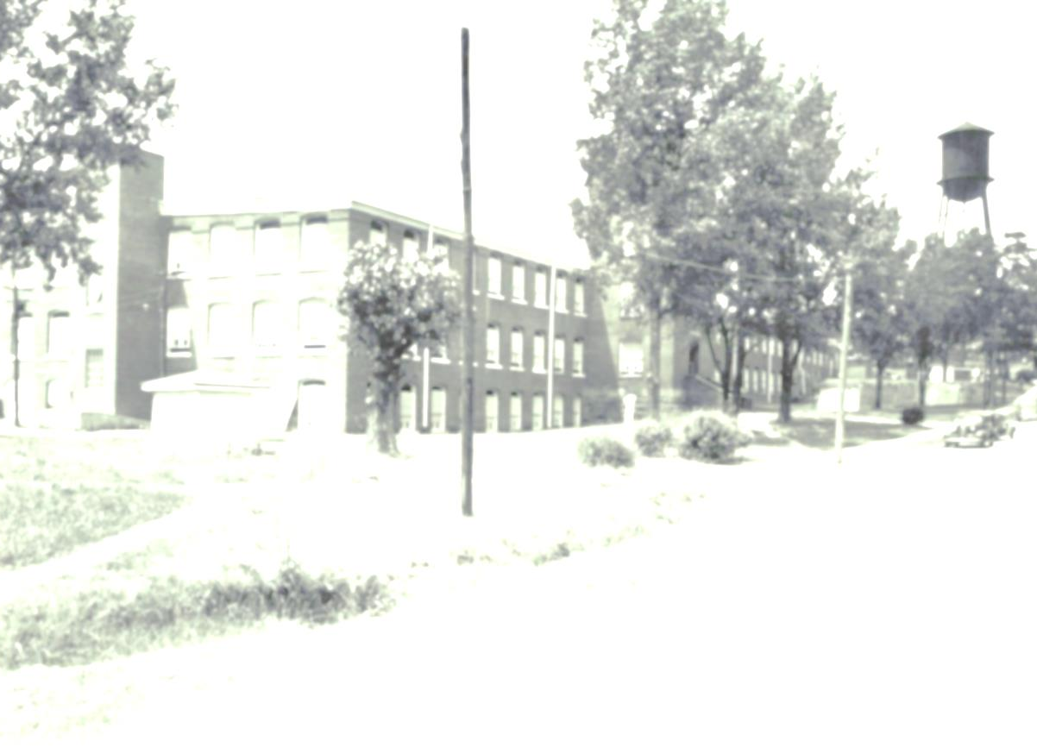
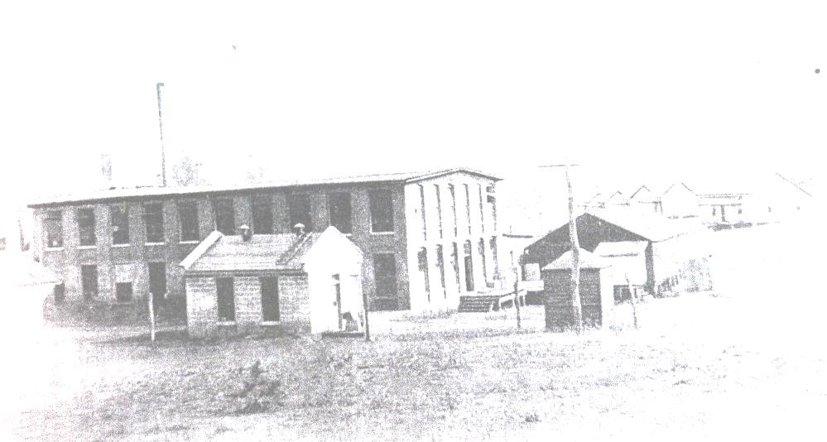
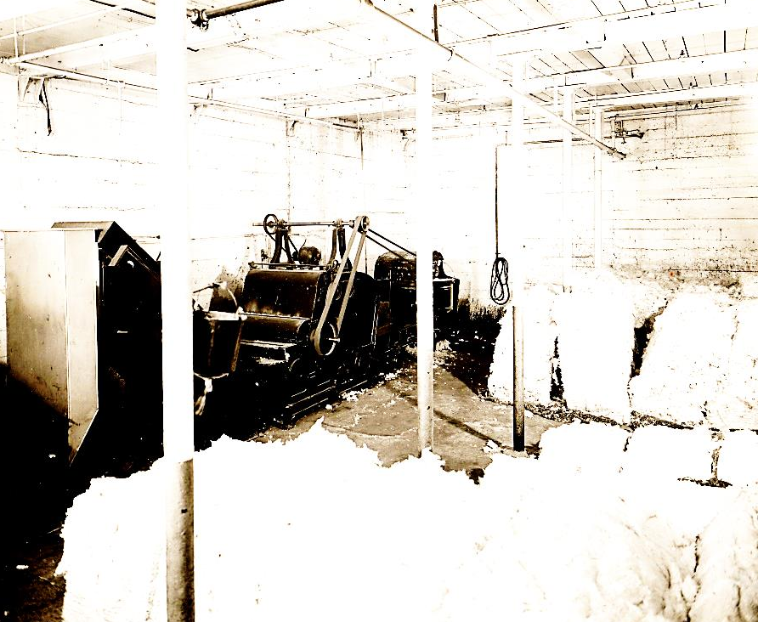

Life in the Cotton Mill

Slide 2
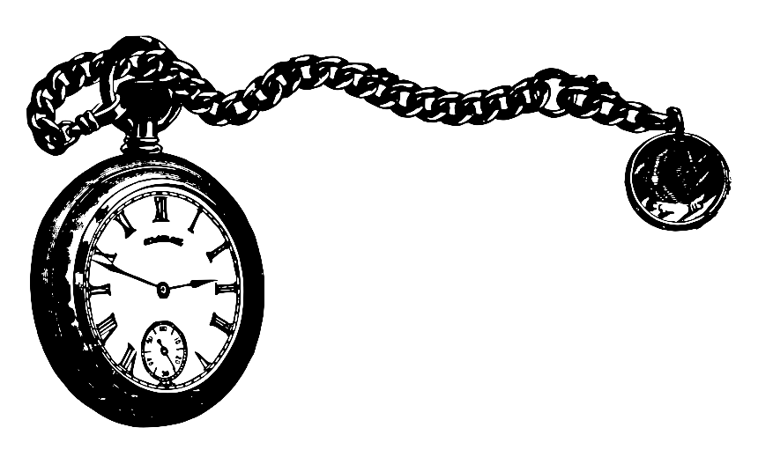
Let’s Take a Trip Back in Time…

Slide 3
Imagine if you lived in the 1890s…
What would you be doing for work?

Slide 4
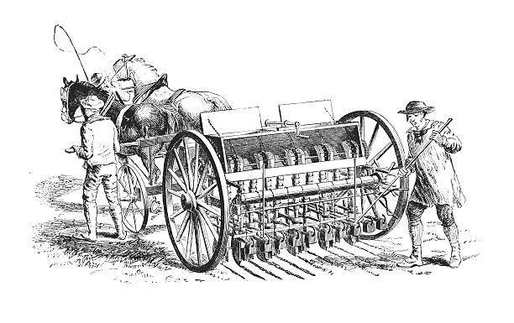
The Answer is..
You would most likely be a FARMER growing crops for yourself and taking the rest to market.

Slide 5
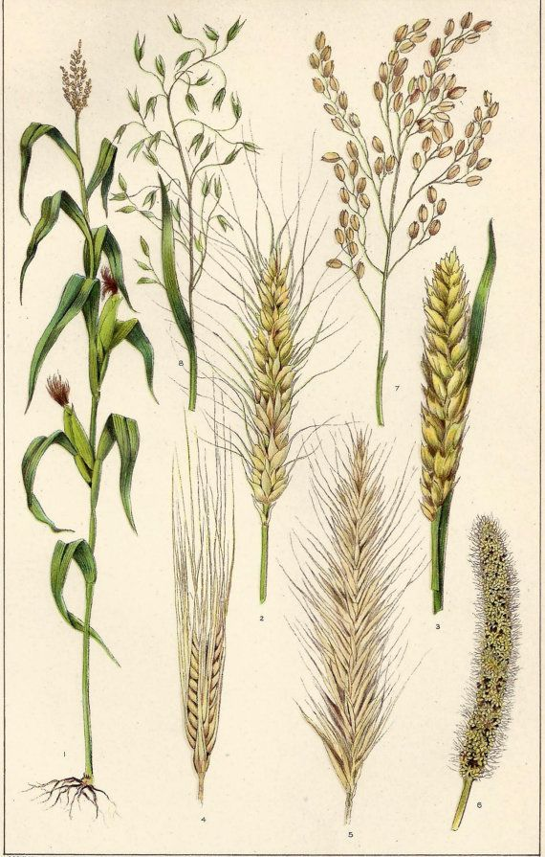
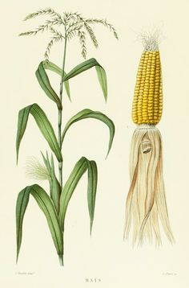
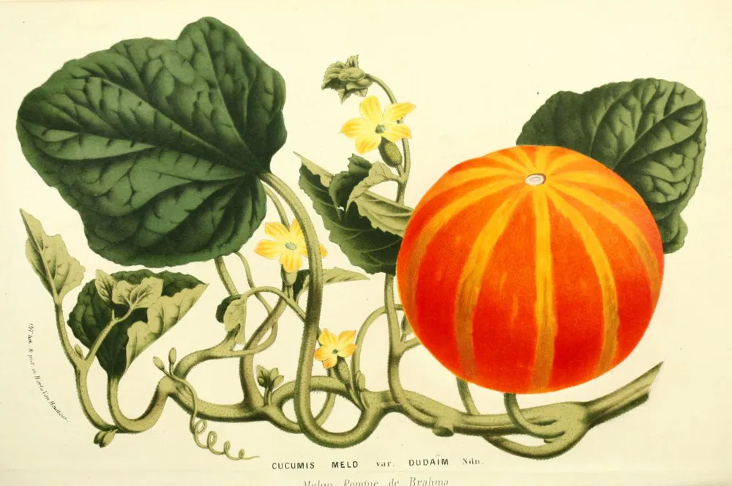
What Does It Take to Make Plants Grow?

Slide 6



If you guessed…

Slide 7
What if you experienced a drought?
What is a drought?

Slide 8
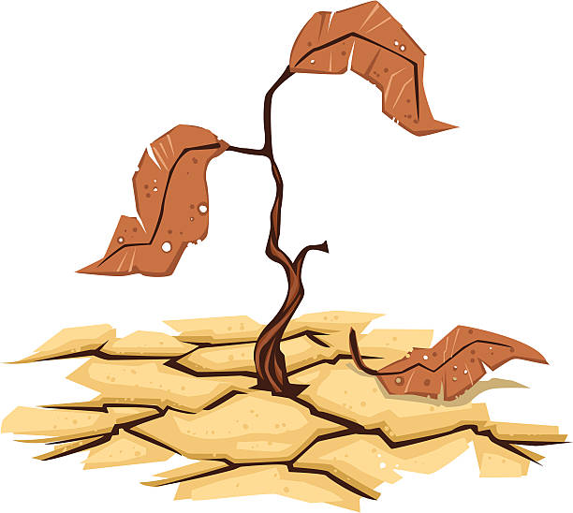
The Answer Is…
A long period with no rain.

Slide 9
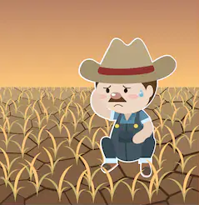
How would you feel?
Your crops didn’t grow, so you have nothing to sell to market. No money coming in.

Slide 10
What if…
Someone came to you and said “I’ll give you a steady job in my mill, weekly pay, and even a place to live!”
Would you take the job?

Slide 11
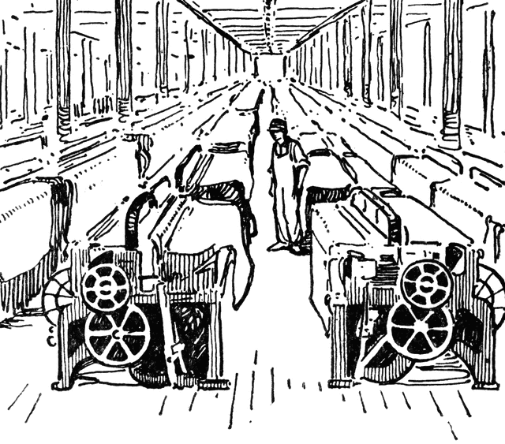
Working in the Mill

Slide 12


Listen to this song…
Working at a mill wasn’t easy…
This song is called “Cotton Mill Colic”

Slide 13
Wages in Cotton Mill
Occupation | Rate per week
Picker room
Opener | $4.50
Picker hand | $5.10
Card hand | $4.50
Boss carder | $12.00
Spinning room
Drawing frame | $4.50
Slubber hands | $5.40
Intermediate hands | $5.40
Speeder hands | $4.50
Spinners | $3.00 (a)
Head doffer | $3.60
Doffers | $2.40
Spoolers | $4.00
Twisters | $4.80
Warpers | $7.50
Overseer of spinning | $10.50
Section hand | $7.00
Overseer of twisting | $7.00
Band boys | $2.50
Sweepers | $3.60
Oiler and bander | $3.60
Weaving room
Filler | $3.90
Creelers | $4.00
Beam warper | $4.50
Slash tender | $6.00
Drawing-in girls | $6.00
Weavers | $5.40 (b)
Notes:
What are wages?
Wages are the weekly payment you receive in return for work.

Slide 14

Do you think people could survive on their wages?

Slide 15
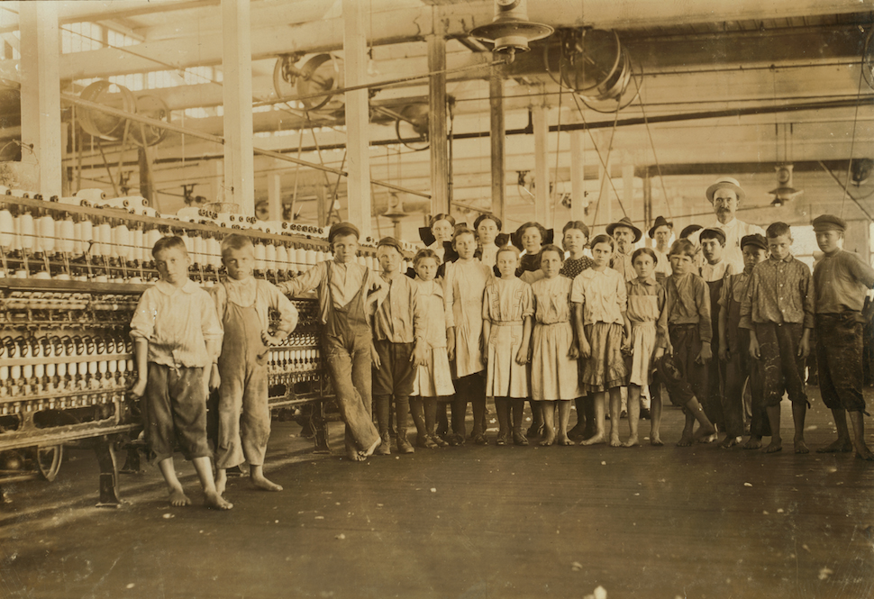
The Answer is…
Not really. A lot of times, all members of the family had to work to contribute to the family bills including children.

Slide 16
Children Working in the Mills
Take a listen as Flossie Durham describes her wage when she started work when she was just 10 years old

Slide 17
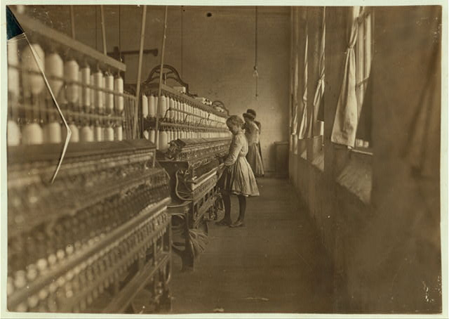
Children Working in Cotton Mills
Notes:
Many children started work in the mill at age 8 or 9
Because they are small, children were perfect for working in the tight factory spaces.
Their hands could fit in between the spools better than an adult and they could transport things at a quicker pace than adults
Did you know in 1900, 18% of all American workers were under the age of 16?

Slide 18
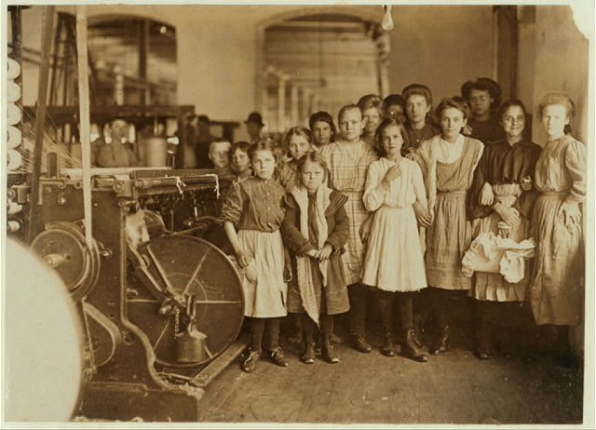
Children Working in Cotton Mills
Notes:
Children usually weren’t able to attend school while working in the mill, so they grew up uneducated.
Children would often be the victims of work injuries, some even losing limbs to the large machines.
During the period from 1902 to 1915, child labor committees emphasized reform through state legislatures. Many laws restricting child labor were passed as part of the progressive reform movement of this period. The gaps that remained, particularly in the southern states, led to a decision to work for a federal child labor law. Congress passed such laws in 1916 and 1918, but the Supreme Court declared them unconstitutional.
The Fair Labor Standards Act of 1938, which for the first time set national minimum wage and maximum hour standards for workers in interstate commerce, also placed limitations on child labor. In effect, the employment of children under sixteen years of age was prohibited in manufacturing and mining.

Slide 19
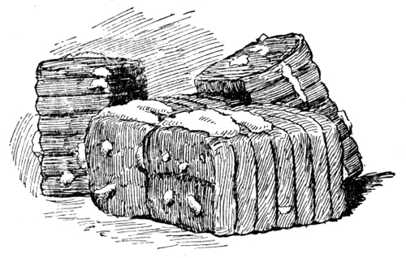
Oconee County Mills
Notes:
Almost every town in Oconee County had a textile mill at some point!
Oconee County’s first textile mill was Newry built by William Ashmead Courtenay. The mill started production in 1894.

Slide 20
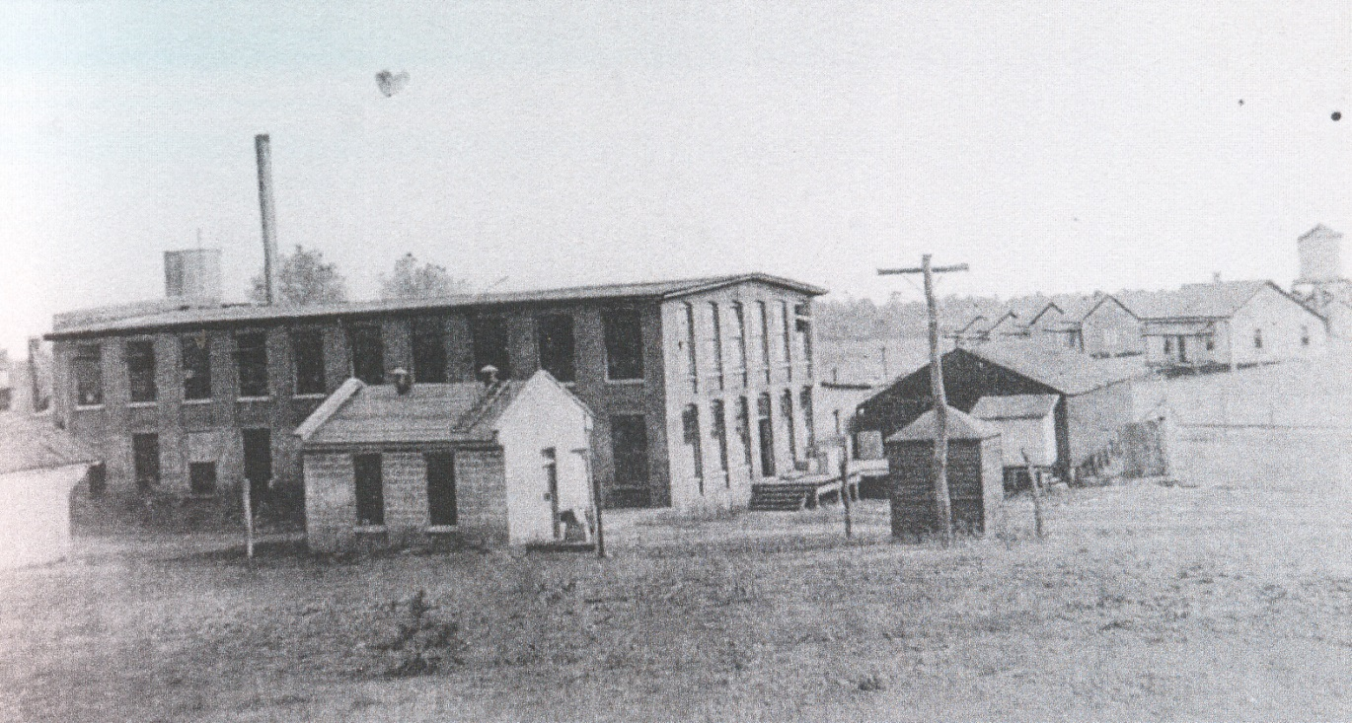
Hetrick Mill
Notes:
Located in Walhalla
Began as Oconee Knitting Mills in 1904. Eventually became Hetrick in 1909 and then Kenneth in 1948
Over the years it produced hosiery, yarn, and cloth

Slide 21
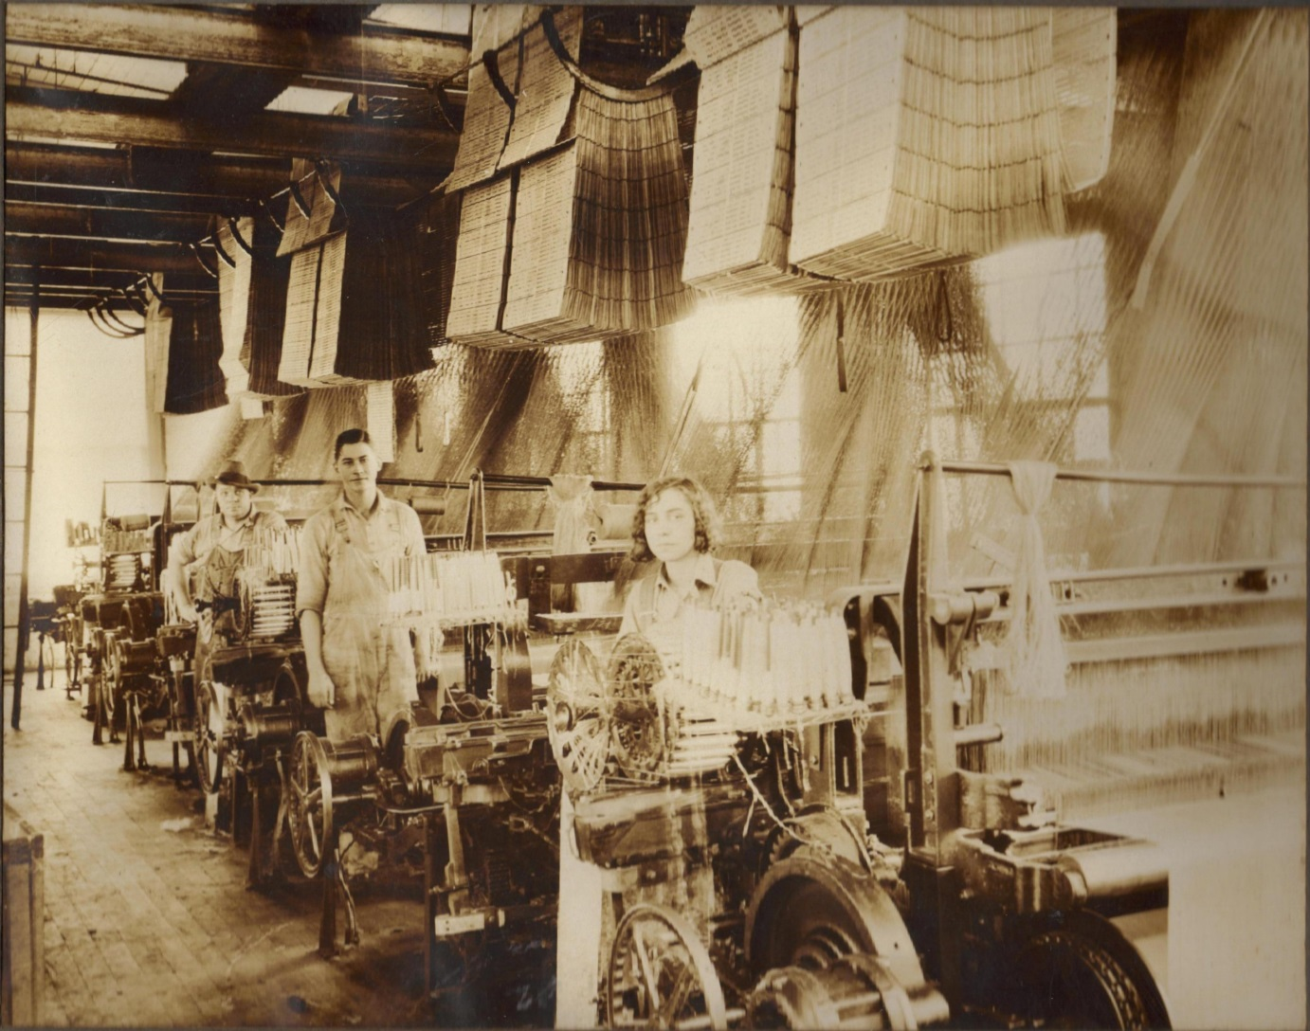
Workers at Kenneth Mill
Notes:
Located in Walhalla

Slide 22
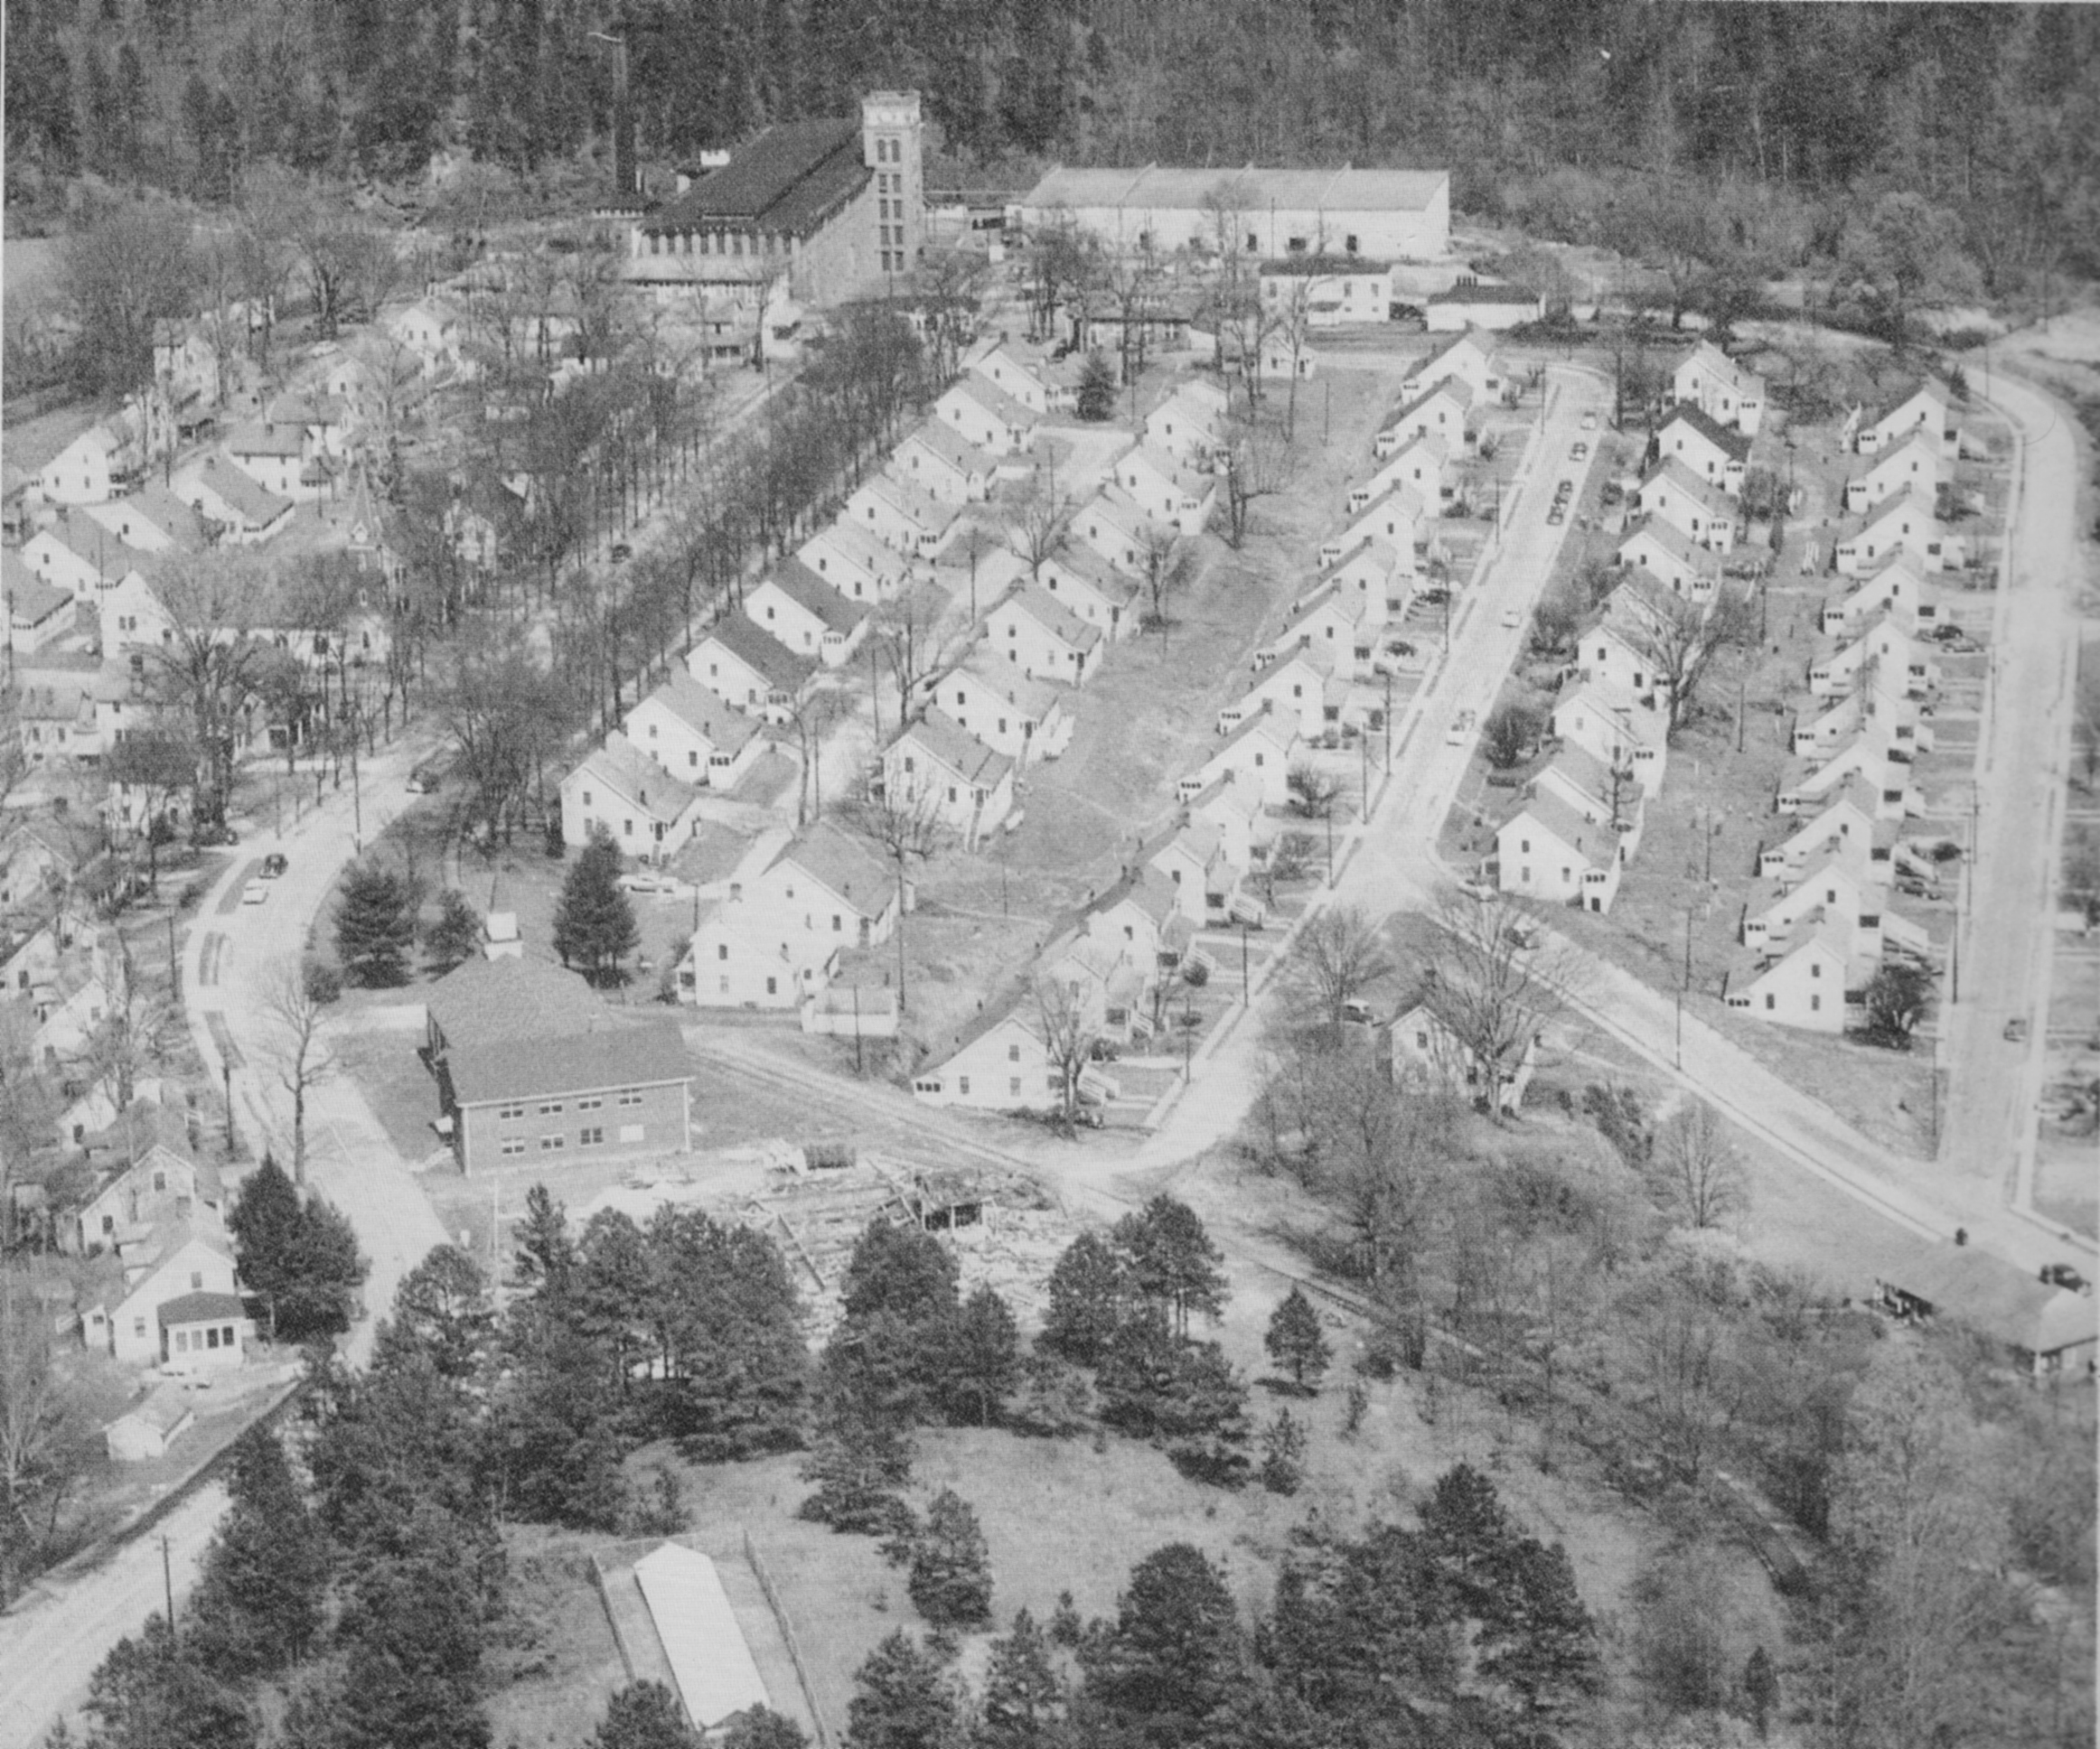
Newry Mill and Village
Notes:
One of the last complete mill villages left in the United States. This is due to the fact that it was more isolated in its location rather than taken up by urban sprawl.
The company built houses for their employees. Do you notice something about them? They are all the same! Why do you think they were built the same?

Slide 23
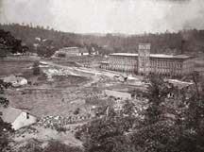
Newry Mill

Slide 24
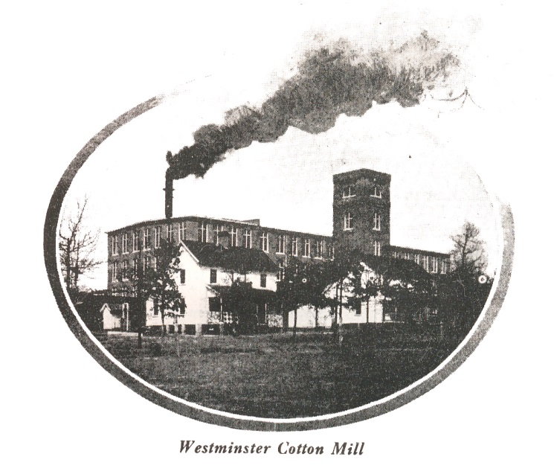
Westminster Cotton Mill
Notes:
Cheswell Manufacturing Company started its cotton mill business in 1900
W.E. Cheswell was superintendent at Newry at the same time he was founding his own mill in Westminster.
In 1908 Oconee Mill took up the operations of the Cheswell Mill.
Oconee Mill in operation from 1908-1937.
In 1938 Beacon industries took over production in the plant and remained an important employer in the town until 2002.

Slide 25
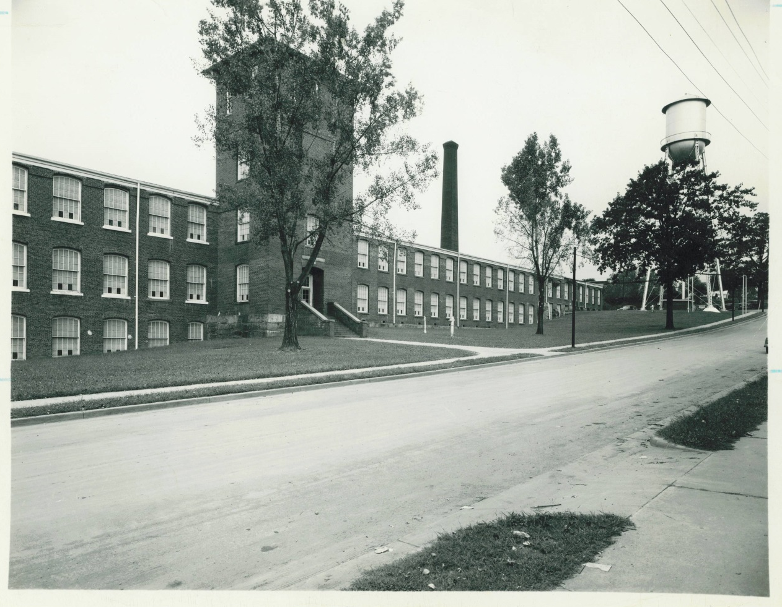
Chicopee Mill
Notes:
Located in Walhalla
Started as Walhalla Cotton Mills, then Victor-Monaghan, Chicopee, then Avondale
Started in 1895
Produced cloth and gauze

Slide 26
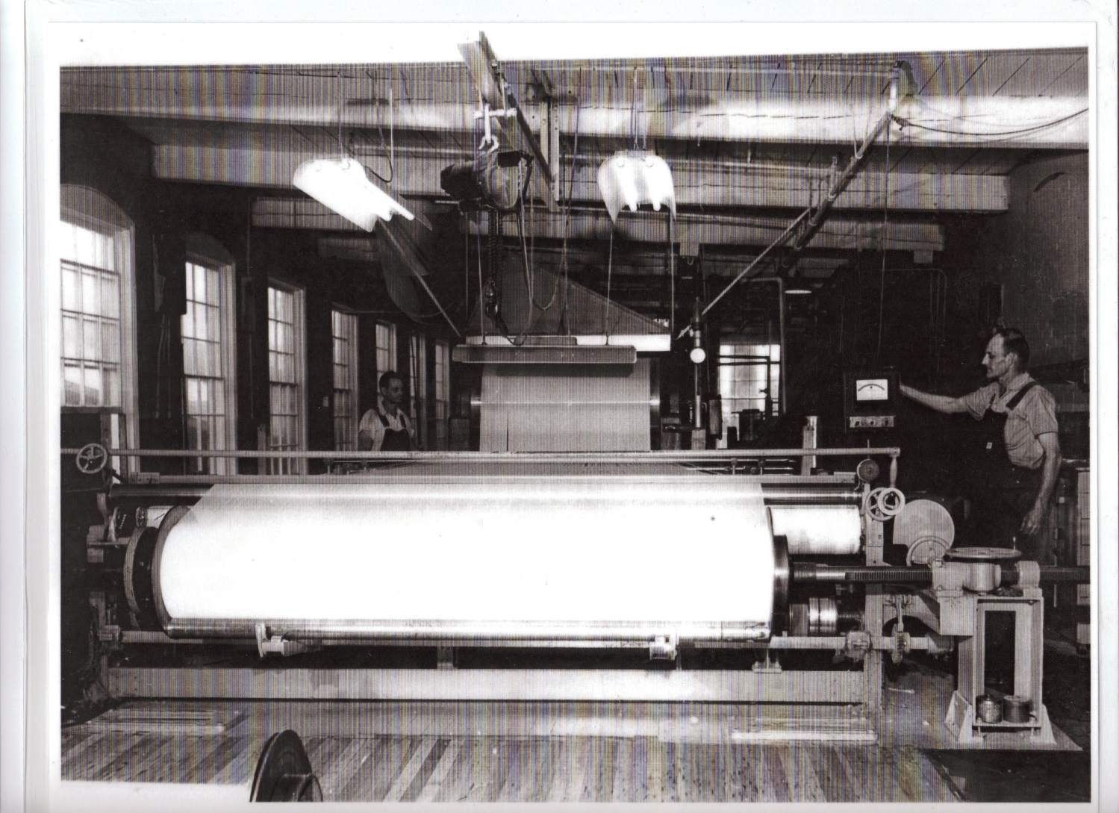
Inside Chicopee Mill

Slide 27
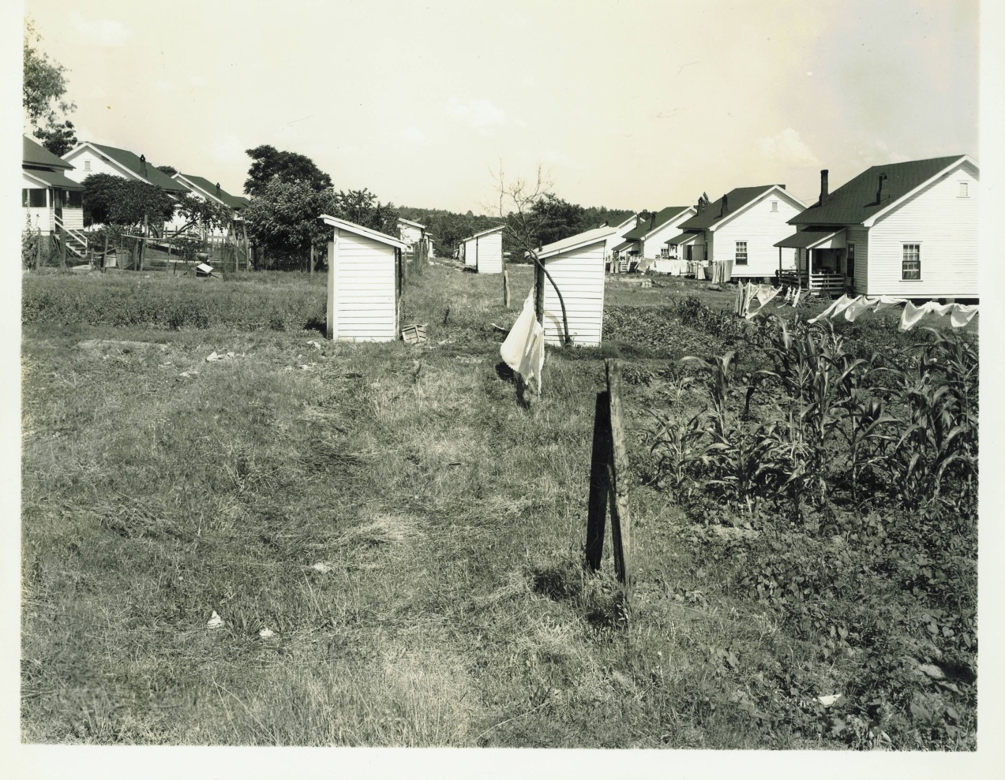
Chicopee Mill Village
Notes:
Mill houses had no indoor plumbing so these outhouses were necessary!

Slide 28
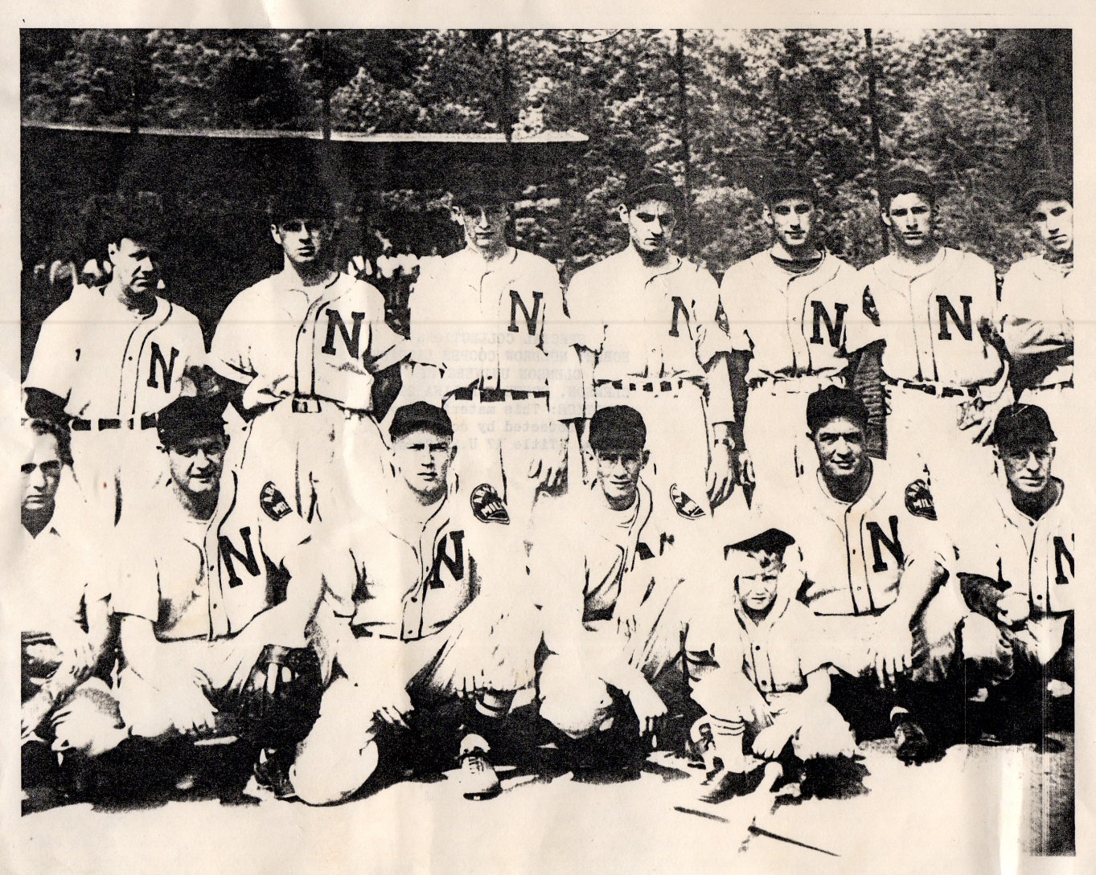
Newry Baseball Team
Notes:
Mill league baseball was an important part of life for the mill village
If you were good at baseball, you could get paid more at your mill jobs
Many famous Major League Baseball players in the early years were scouted from mill league teams
Shoeless Joe Jackson with the Chicago White Sox started out on a mill team in Greenville

Slide 29
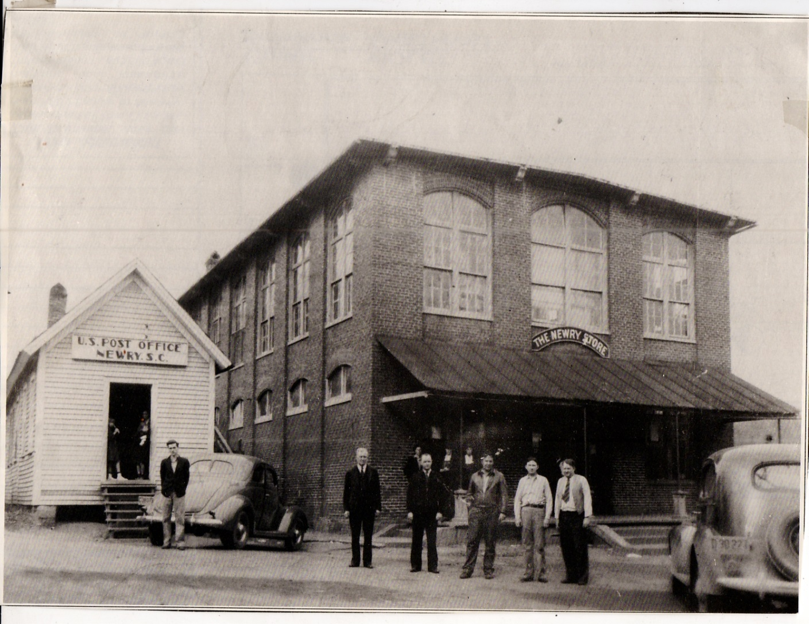
Newry Mill Store
Notes:
The mill store was a vital part of the village
Some mills would pay their employees in script (also called loonies), coins that would only work at the company store. Do you think you could’ve gotten out of the mill life if you were only paid in script?

Slide 30

www.oconeehistorymuseum.org
Notes:
For more information about the textile industry in Oconee County view the “Textiles in Oconee” presentation.

