Slide 1
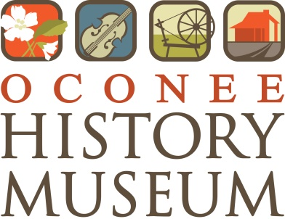
Walhalla
A History of Main Street to the Mountains
Leslie Hagerty
Director/Curator
Oconee History Museum

Slide 2
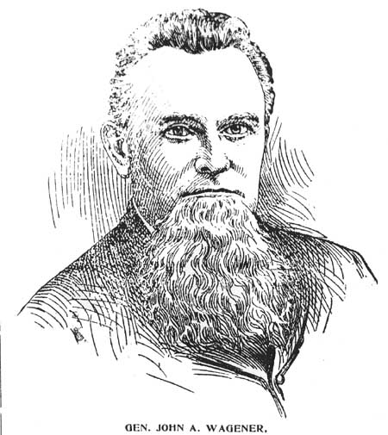
John Wagener
Arrived Charleston 1833 (age 16)
Founded 1st German-language newspaper in the South
Brigadier-General
Mayor of Charleston 1871-1873
Died in Walhalla 1876
Re-interred to Charleston 1877
Notes:
John Wagener is commonly referred to as the “founder” of Walhalla. At age 16, he arrived in Charleston as a German immigrant. He would lead a very accomplished life.

Slide 3
German Colonization Society
The German Situation
Hanover → Charleston
German Colonization Society was founded October 6, 1848 with 11 members
Quickly began discussing potential locations for a new settlement
Notes:
The German Colonization Society emerged in response to “the German situation”. An influx of German immigration to Charleston left many immigrants crowded and looking for better opportunities outside the city. Most members of the German Colonization Society came from the German kingdom of Hanover. The society was formed for the purpose of finding a new home for its German immigrant members. The society quickly began looking for potential locations for their new settlement throughout South Carolina.
“The immigrant today is leaving behind everything: home, customs, language, nation; not out of a fear of the weapons of his enemy; not because the heavens shine better someplace else than over his own hut; not even because the land is not repaid the effort he has put into it. No, he is leaving a world which has become an unbearable burden to him; a world from which there is no other way of escape.” – John Wagener to SC Governor Manning in 1853

Slide 4
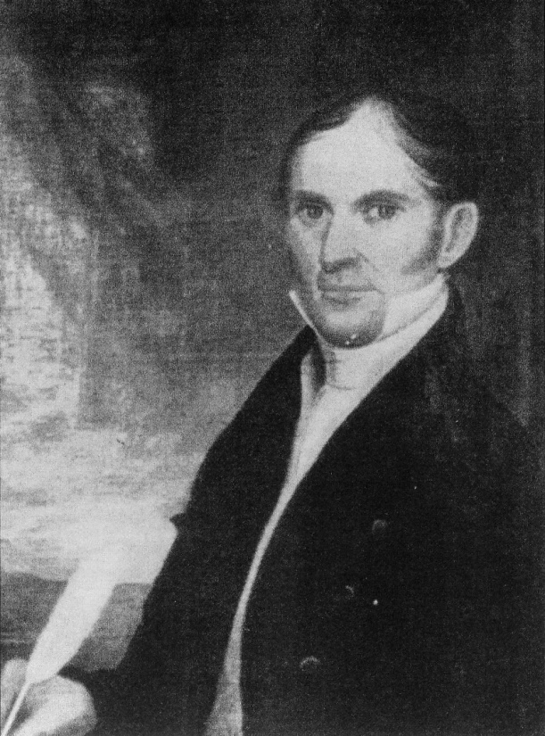
Reverend Joseph Grisham
Born 1789 to pioneers of Pendleton District
Temperance advocate
Organized temperance unions known as West Union and South Union
Ordained Baptist minister
Died Canton, GA, 1857
Notes:
Meanwhile, in the South Carolina backcountry, Reverend Joseph Grisham (Gresham) had organized temperance unions in the Pendleton District (modern day Oconee, Pickens, and Anderson Counties). The temperance movement was a movement during the 19th and early 20th centuries that sought to end the consumption and production of alcohol in the United States. The German Colonization Society approached Rev. Grisham and purchased 2 tracts of land from him, totaling over 17,000 acres. Members of the German Colonization Society would begin the slow process of building a town from the ground up on this land.

Slide 5

Garden of the Gods
Notes:
Members of the German Colonization Society were so struck by the beauty of their new land in South Carolina’s foothills that they decided to name the settlement Walhalla (Valhalla), the fabled paradise of Norse mythology.
Grimnismal
And amid their murmur it stands;
There daily do Othin | and Saga drink
In gladness from cups of gold.
8. The fifth is Glathsheim, | and gold-bright there
Stands Valhall stretching wide;
And there does Othin | each day choose
The men who have fallen in fight.
9. Easy is it to know | for him who to Othin
Comes and beholds the hall;
Its rafters are spears, | with shields is it roofed,
On its benches are breastplates strewn.
10. Easy is it to know | for him who to Othin
Comes and beholds the hall;
There hangs a wolf | by the western door,
And o'er it an eagle hovers.

Slide 6
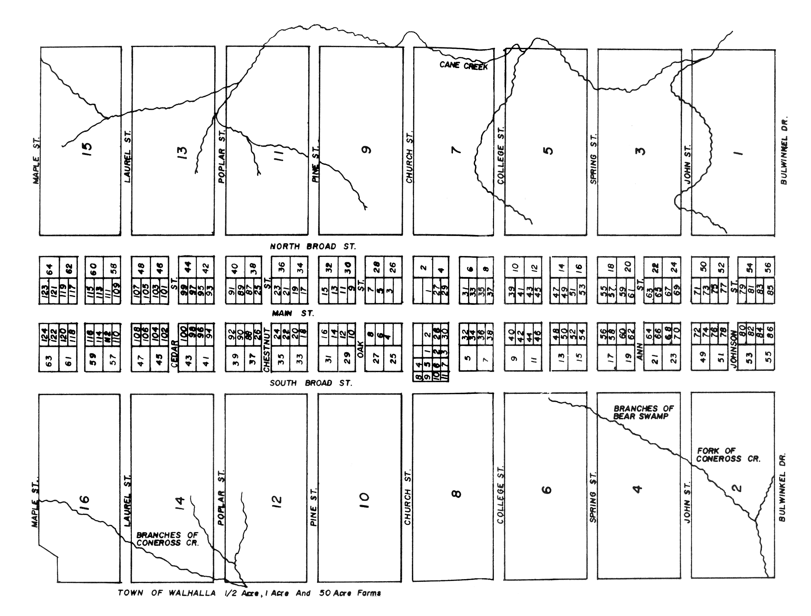
Building A Town
Notes:
Members of the German Colonization Society set about making plans to build a town in a very organized fashion. Having seen the unplanned growth of Charleston, they brought with them many lessons learned. A plan for residences and farms was laid out, and paid members of the German Colonization Society drew for lots that would become each individual’s residence and farm. Streets were to be arranged along a grid for easy navigation, and streets were to be made very wide to accommodate wagon traffic. These design elements remain in place today. Walhalla was officially established by 1850.

Slide 7
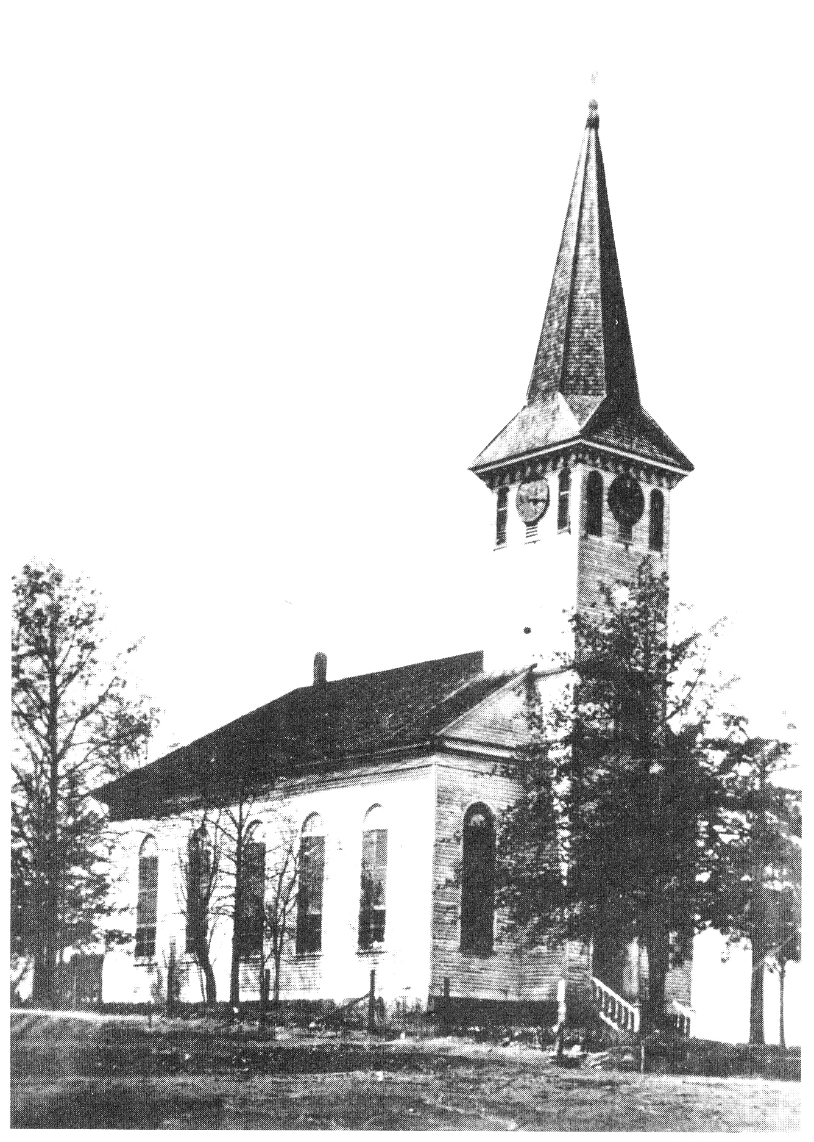
St. John’s Lutheran Church
Organized Nov. 1853 as The German Evangelical Lutheran Congregation in Walhalla, Pickens District, South Carolina
Built by John Kaufman
Church opened June 14, 1860 with guest priest Father J.J. O’Connell of Tunnel Hill
Notes:
Being very religious, members of the German Colonization Society began work on a church for the new town. The German Evangelical Lutheran Congregation was organized in November 1853. Master carpenter John Kaufman constructed the church using lumber from the site and peg construction. The architectural designs reflect many German influences. Unexpectedly, the first sermon at the church was delivered by Father J.J. O’Connell, a Catholic priest from nearby Tunnel Hill. Many members of the German Colonization Society occupy the church cemetery along S. Church Street.

Slide 8
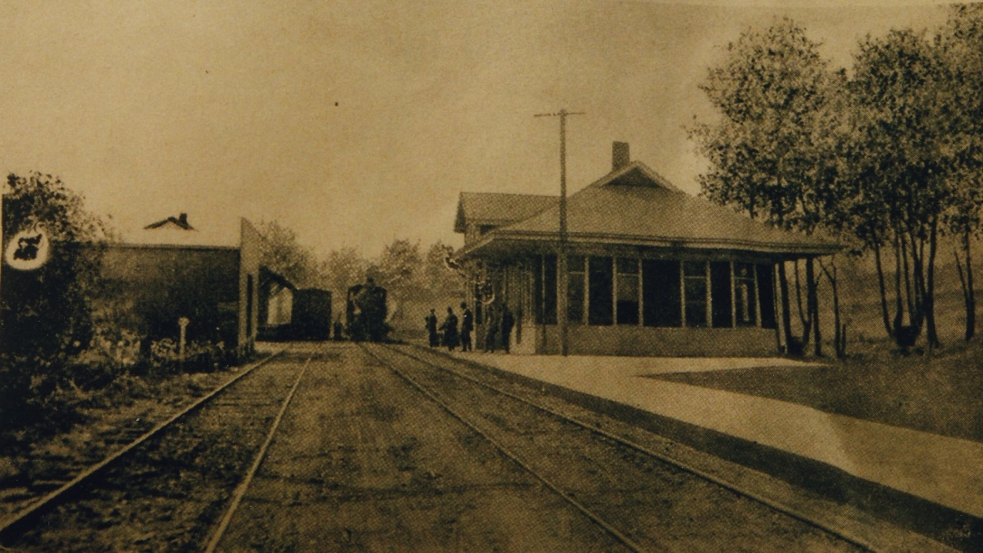
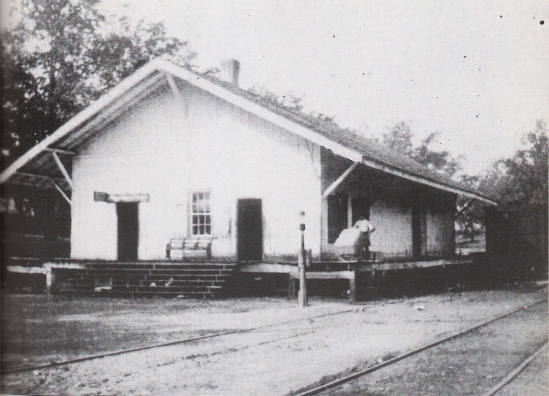
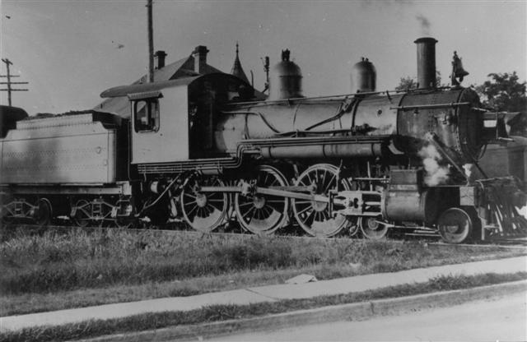
Roads & Rails
Notes:
Initially, the Blue Ridge Railroad only reached as far as West Union. Travelers would then board stage coaches to reach Walhalla. Soon the railroad expanded to serve the growing town of Walhalla and with it came more business, industry, tourism, and commerce.
Top photo: Walhalla passenger depot. Bottom left: Blue Ridge Railroad engine. Bottom right: Walhalla freight depot.

Slide 9
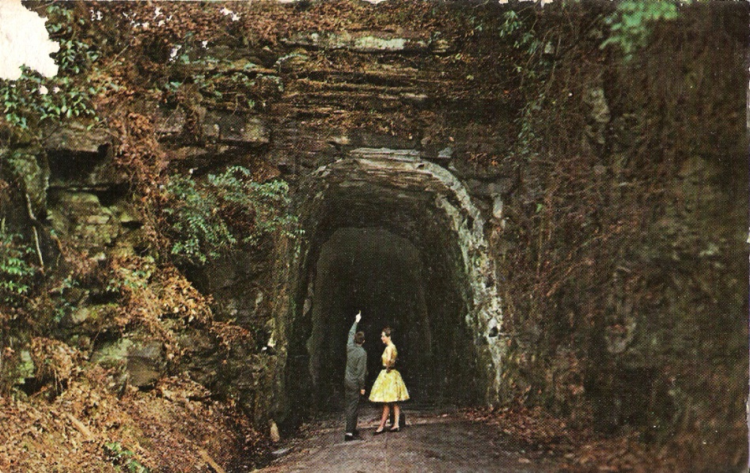
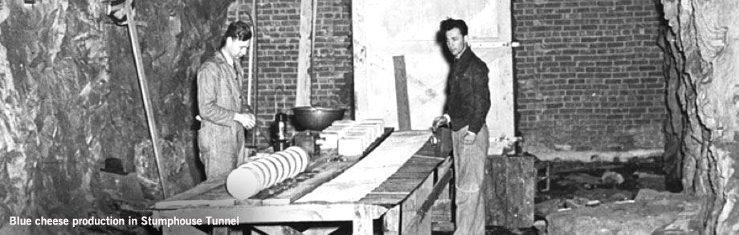
The Tunnel
Notes:
Unfortunately, the Blue Ridge Railroad would never make it beyond Walhalla. During the late 1840s and 1850s, many Irish immigrants found work on the project to expand the Blue Ridge Railroad through Stumphouse Mountain, into north Georgia, Tennessee, and eventually to its planned terminus in Cincinnati, Ohio. This plan involved a series of 3 tunnels around Walhalla - Stumphouse Tunnel, Middle Tunnel, and Saddle Tunnel, with Stumphouse Tunnel being the longest (nearly 1 mile). Work involved dangerous blasting and difficult excavation, causing many worker injuries and deaths. To accommodate the workers, a semi-permanent town was established just above the work site on what became known as Tunnel Hill. The town featured a Catholic church, cemetery, and basic accommodations for workers. As the project wore on, costs soared into the millions. Work ceased as the Civil War began in 1861. When the war was over the state reconsidered the feasibility of completing the project, but by that time other railroads had been completed and the opportunity had been lost. For years the partially completed tunnel sat empty. In the 1940s it was acquired by Clemson University and put into service as a “cheese factory” for Clemson’s famous blue cheese. Today, Clemson makes blue cheese on campus, and the tunnel is available for recreational visits by locals and tourists.

Slide 10
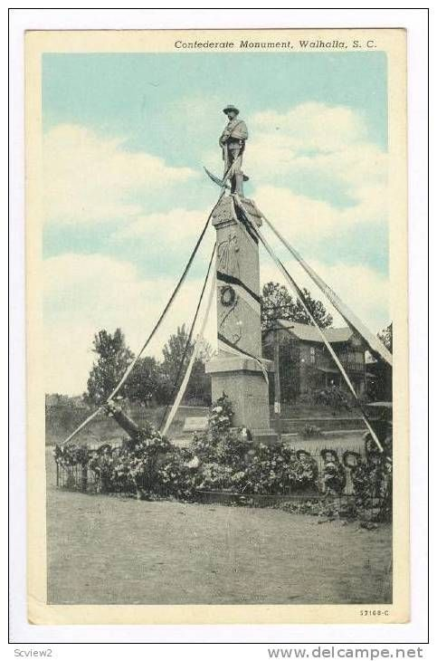
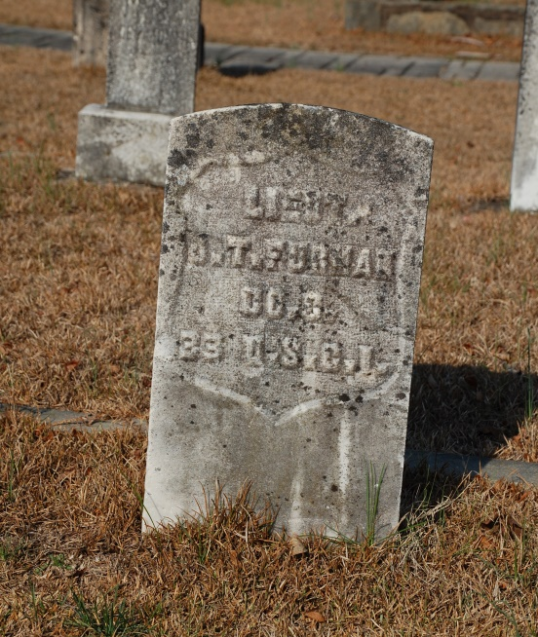
War, Occupation & Reconstruction
Notes:
Walhalla was largely spared from the worst of the Civil War. Many men joined local regiments and left home to fight, but the fighting never came to Walhalla. Following the war, Walhalla was occupied by a troop of African-American Union troops from the lowcountry. This resulted in a significant amount of community tension that boiled over and resulted in the murder of the troop’s white commander, Lieutenant J.T. Furman. Legend has it that citizens complained to Lt. Furman about the troop’s behavior, and he replied with a dismissive retort. He was shot and murdered as he was leaving Walhalla’s American Hotel on the east end of town. When word of his murder reached his commander, Captain Parker, the guilty party was demanded to come forward of the entire town would be burned to the ground. Fortunately, Lt. Furman was a member of the Masons and so the local Masonic Lodge had him properly buried in the church cemetery with full Masonic rites. Captain Parker was appeased and spared the town. Lt. Furman’s small and simple gravestone has ample space around it in the St. John’s cemetery since no one wanted to be buried close to him.
Photo left: Walhalla’s Confederate Monument erected c.1910. The monument has since been relocated further West along Main Street.

Slide 11
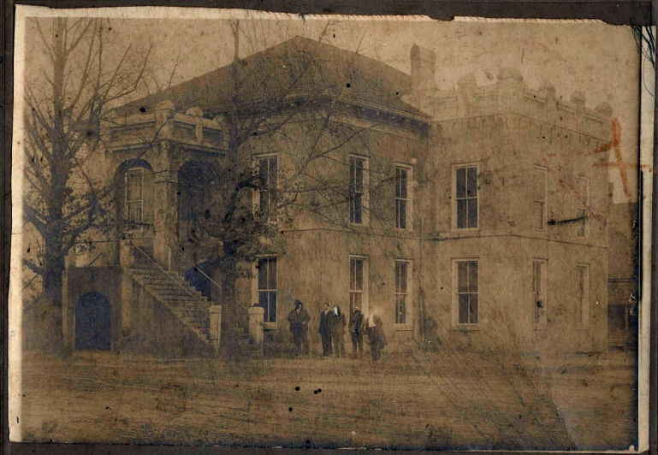
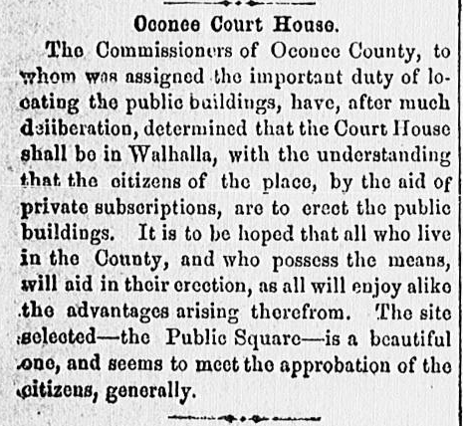
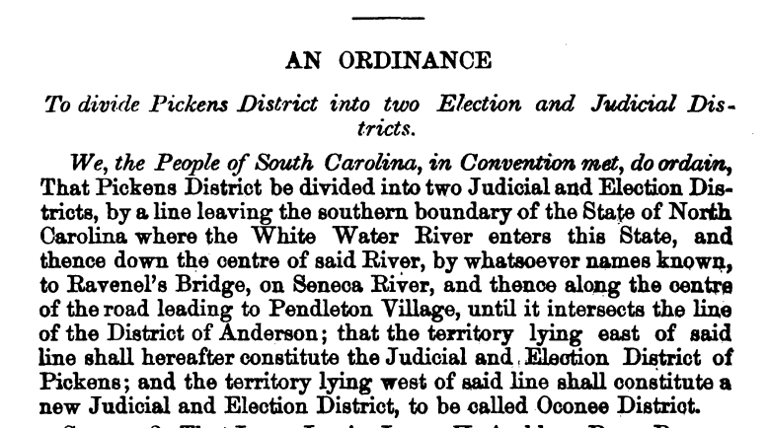
Becoming County Seat
Notes:
Following the Civil War, South Carolina was tasked with writing a new State Constitution. Prior to the war, Oconee was part of the Pickens District (modern day Pickens and Oconee Counties). Oconee had long been lobbying the State for its own district or county, citing problems with the size and terrain of the Pickens District. Citizens of the more distant parts of the District faced enormous difficulty traveling to Pickens Courthouse to conduct business. Oconee’s delegates to the South Carolina Constitutional Convention seized their opportunity and lobbied hard for their own county. In the end, their efforts were successful and the Pickens District was divided into Pickens and Oconee Counties along the Keowee River. The newly established Oconee County needed a seat of government and a courthouse. Walhalla, being the only established town at the time and also being very centrally located, was chosen. Plans for a new courthouse began at once.

Slide 12
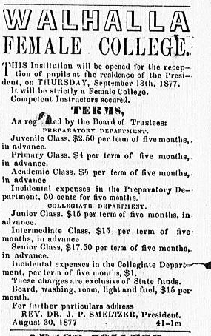
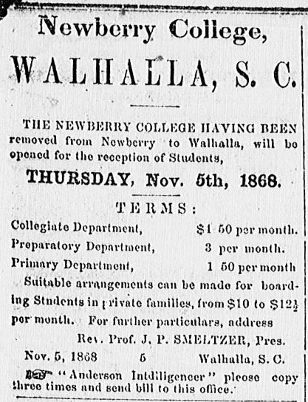
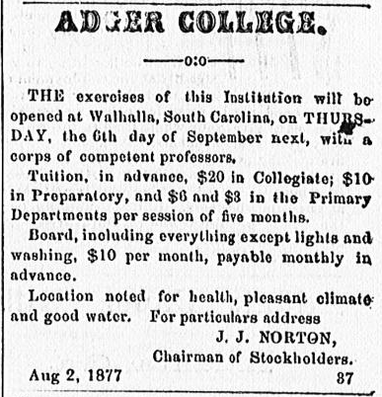
Colleges
Notes:
Walhalla was home to several colleges. Due to the damage caused by the Civil War, Newberry College temporarily relocated to Walhalla for 11 years following the war. Walhalla Female College added educational opportunities for young women in the area. When Newberry College returned to Newberry, SC, Walhalla was left wanting for higher education. Adger College was established to fill the vacancy left by Newberry College. Evidence of this history remains today in street names like College Street. For more information about Walhalla’s colleges please view the “Education in Oconee” presentation.

Slide 13
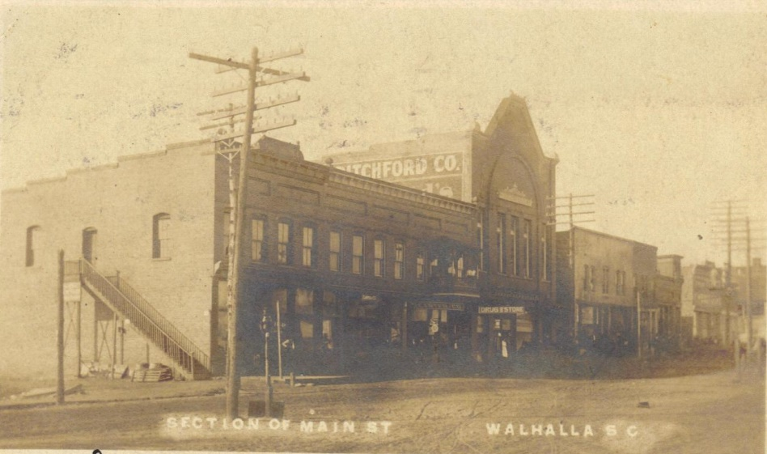
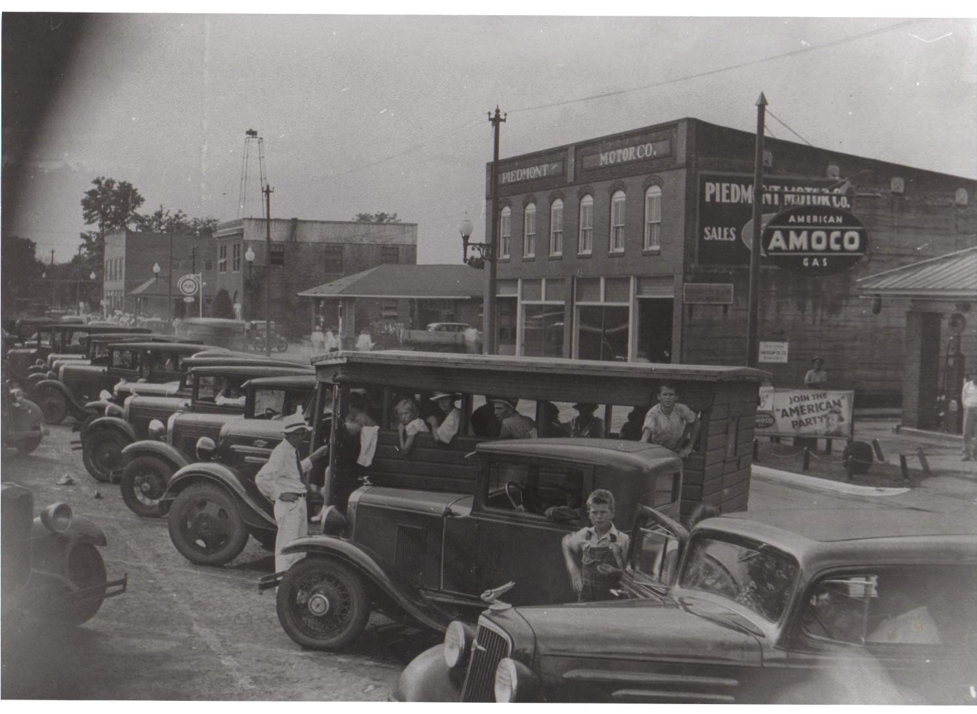
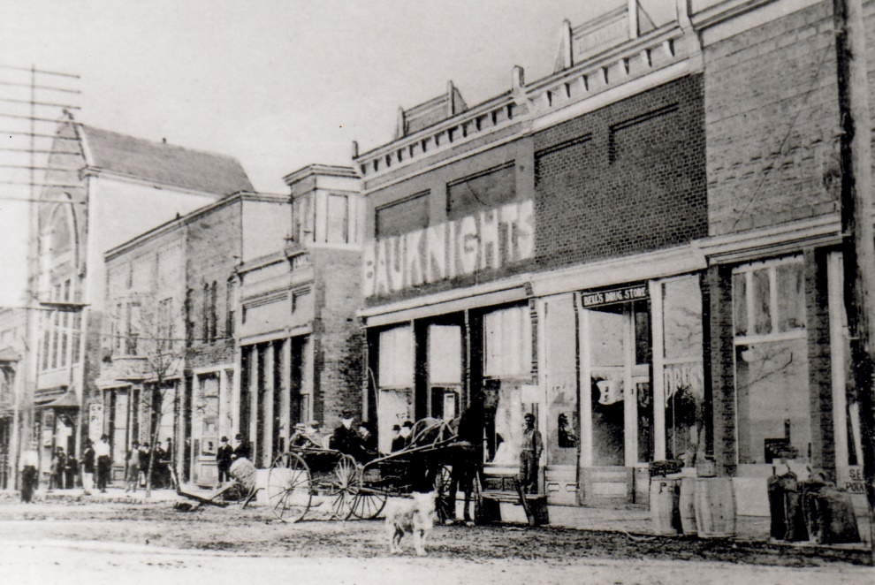
Business
Notes:
Walhalla’s Main Street has been home to many businesses throughout the town’s history. Large mercantile shops like that of C.W. Pitchford (top photo) stood out, literally, above the rest. Public services like police and fire departments were also located among the smaller merchants on Main Street. Originally designed for wagon traffic, Walhalla’s Main Street has adapted many times over the years as automobiles became more prevalent and as Main Street became a state highway.
Photo bottom left: Main Street looking West. Photo bottom right: Main Street looking East.

Slide 14
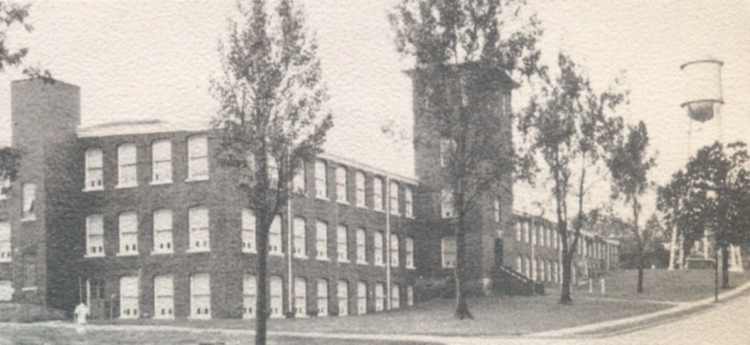
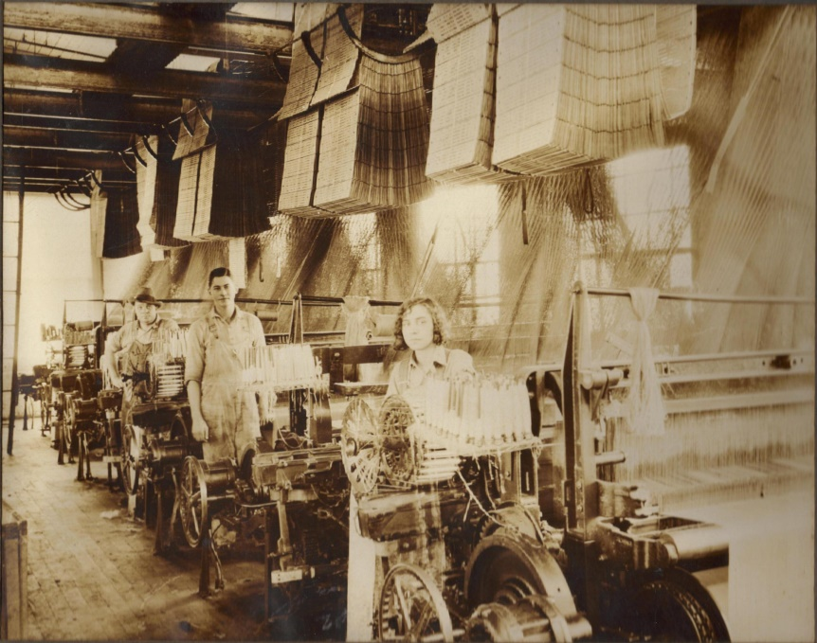
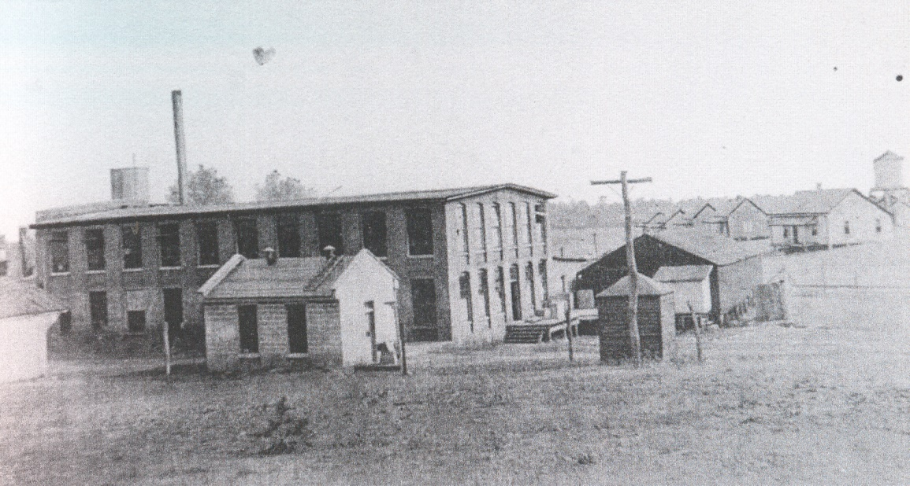
Industry
Notes:
Throughout the 20th century, textile manufacturing was the main industry in Walhalla (and all of Oconee County). Walhalla was home to 2 textile mills. Photo top right: Walhalla Cotton Mill/Victor-Monaghan/Chicopee/Avondale Mill (now demolished – was located at corner of S. John Street and E.S. Broad Street). Photo bottom right: Oconee Knitting Mill/Hetrick/Cone/Kenneth Mill (now demolished – was located at corner of S. Earle Street and Kenneth Street).
Photo left: workers inside Hetrick Mill. For more information about Oconee’s textile industry please view the “Textiles in Oconee County” presentation.

Slide 15
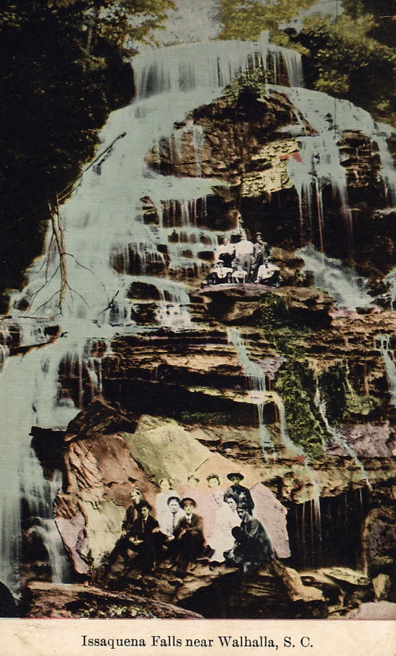
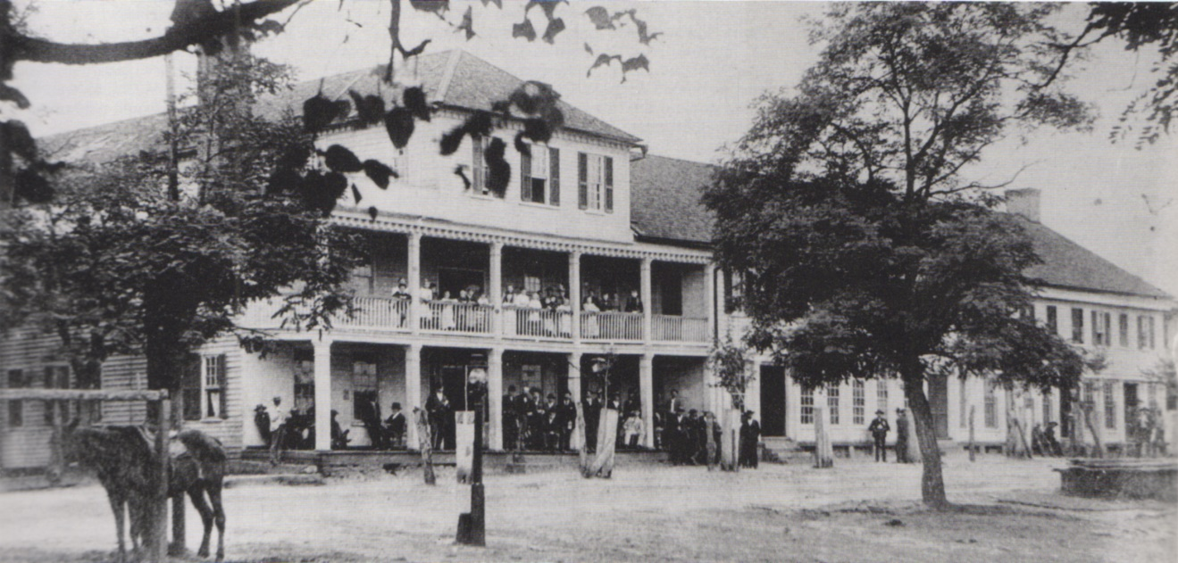
Tourism
Notes:
Today, tourism seems like Walhalla’s newest economy, but visitors and tourists have long flocked to Walhalla for its natural beauty and temperate climate.
Photo left: the Biemann Hotel (now demolished – was located at the corner of S. Catherine Street and E. Main Street). Photo right: postcard showing tourists at Issaqueena Falls.

Slide 16
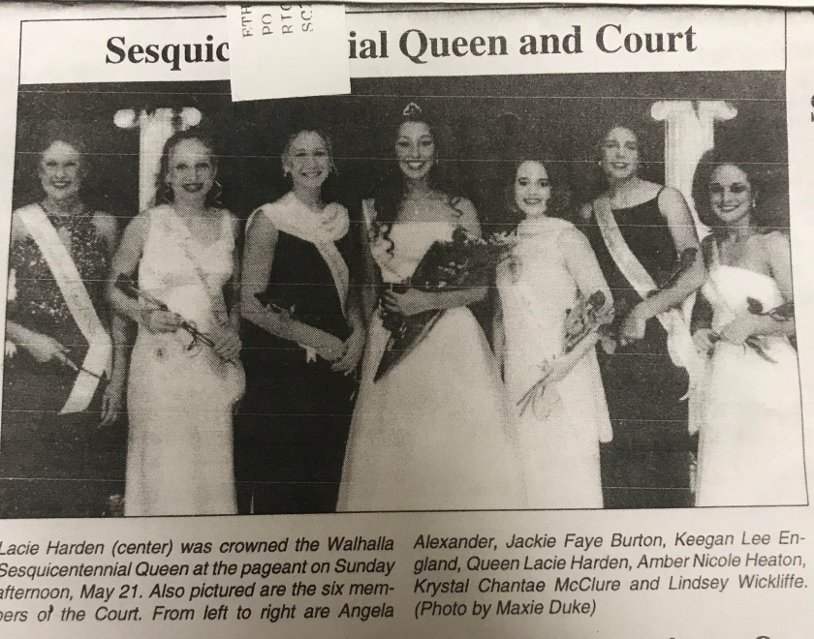
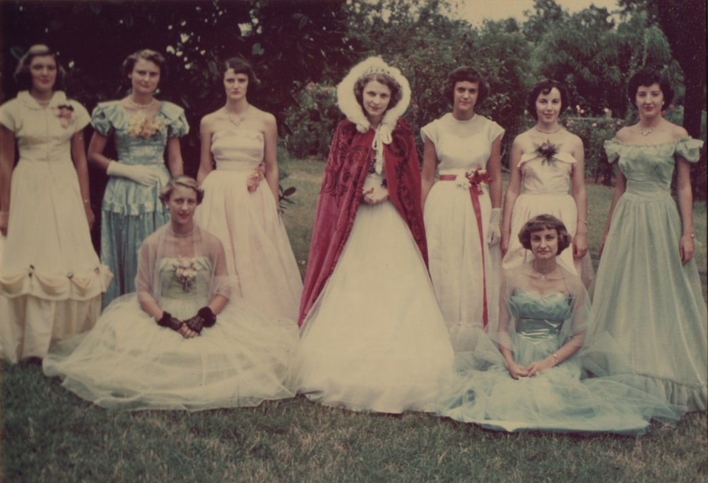
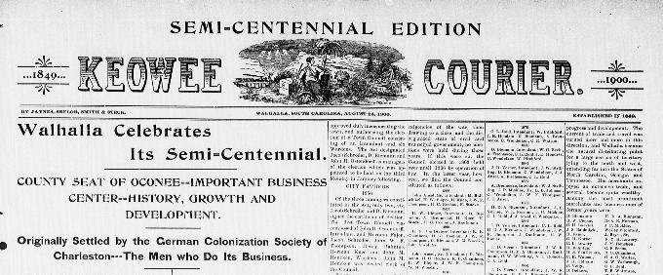
Walhalla at 50, 100, 150
Notes:
Walhalla extensively celebrated its 50th (semi-centennial), 100th (centennial) and 150th (sesquicentennial) birthdays.
Photo left: Walhalla Sesquicentennial Queen and Court (2000), Photo right: Walhalla Centennial Queen and Court (1950), bottom center: Semi-Centennial Keowee Courier edition.

Slide 17
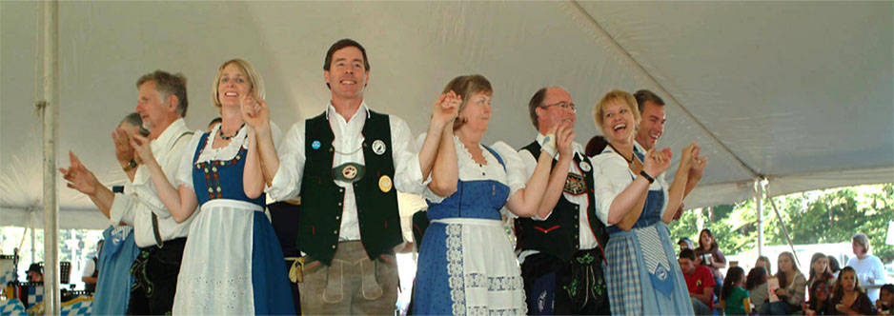
Oktoberfest
Notes:
To celebrate its German heritage, the city of Walhalla began hosting its own Oktoberfest in 1979. It has been held on the 3rd weekend of October every year since.

Slide 18


Walhalla in Popular Culture
Notes:
Walhalla/Valhalla is often portrayed in popular culture thanks to comic book characterizations like Thor and other popularizations of Norse mythology.

Slide 19
Other Walhallas
Walhalla, Australia
Walhalla, Germany
Walhalla, Michigan
Walhalla, North Dakota
Notes:
Other Walhallas can be found around the world. Use the links above to compare and contrast Walhallas.

