Slide 1

History of Lake Keowee
Jennifer Moss
Assistant Curator/Education Specialist
Oconee History Museum

Slide 2
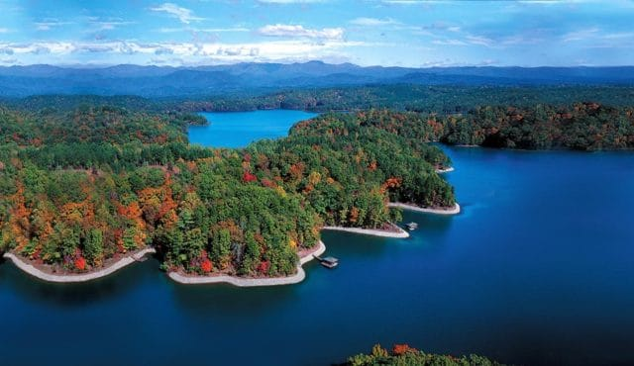
Lake Keowee
Notes:
The coming together of the Toxaway and Whitewater rivers once made the Keowee River, that would eventually become Lake Keowee.

Slide 3
The Cherokee
Notes:
Cherokee established villages along the fertile Keowee River valley.
The Keowee River was a main river for transportation and trade during the 1700s.

Slide 4
Keowee
Notes:
Keowee means “Place of the Mulberry”
Keowee was once the capital of the Cherokee Lower Towns
Initial contact with European explorers with the Cherokee was around 1690
In 1721 Keowee Town is documented to have had a population of 168 men, 155 women, and 127 children.
In 1760 most of the Cherokee villages were burned by Colonel Archibald Montgomery during the Cherokee War.
In May 1777 the Treaty of DeWitt’s Corner the Cherokees ceded much of their South Carolina lands.
In November 1785 the Treaty of Hopewell ceded the remaining Cherokee land to the government.

Slide 5
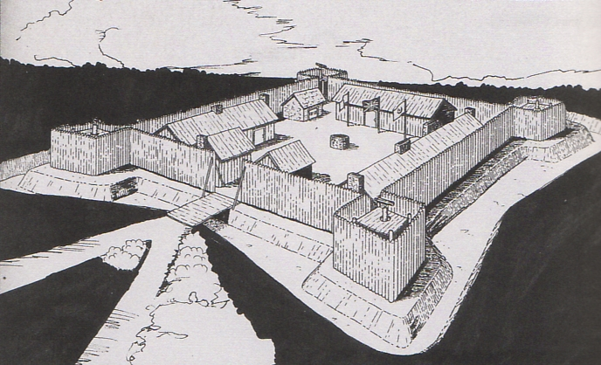
Fort Prince George
Notes:
SC Governor James Glen began building the fort across the river from Keowee in 1753 in part to protect the lower Cherokees from the French moving into the area, and to put more security behind continuing trade with the Cherokee.
The fort’s interior living area was about 100 square feet and was only occupied by 12 men at any given time.

Slide 6
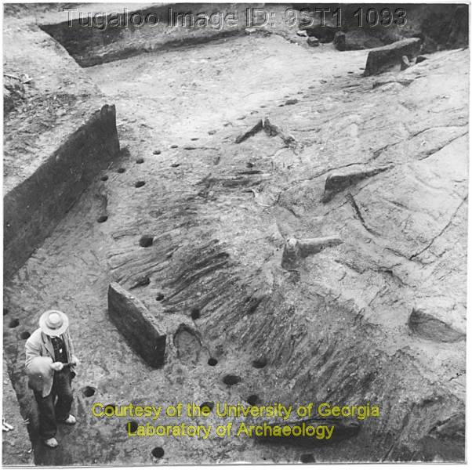
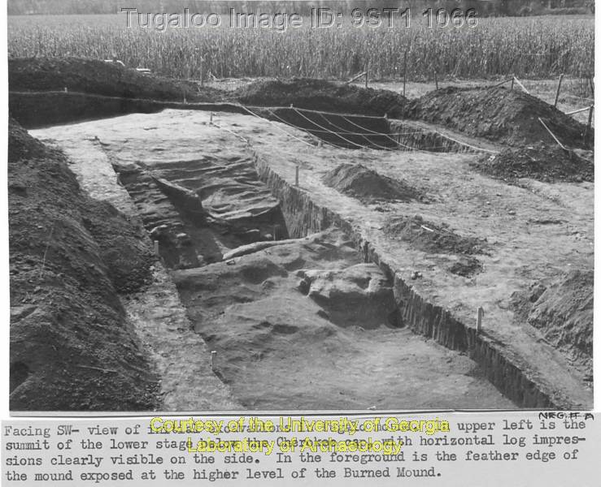
Fort Prince George
Notes:
An excavation of the site occurred 18 months before the area was flooded for the Keowee-Toxaway Project
Excavation wasn’t completed because of the flooding of the area
Found several buildings, a moat, an earthen wall and a palisade
Also discovered 3 Native American skeletons and the skeleton of the fort’s commander, Lt. Richard Coytmore.

Slide 7
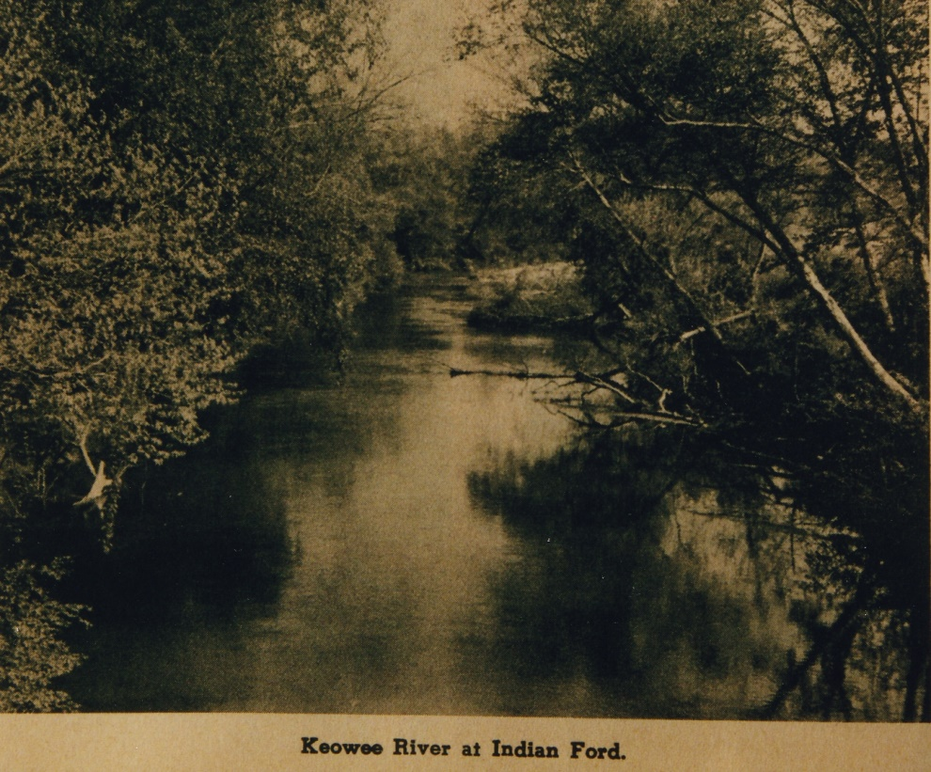
Keowee River Valley
Notes:
In 1784 the first deeds were issued to white settlers along the Keowee. General Andrew Pickens and John Ewing Calhoun were among the first.
Many descendants of the first families in the Keowee River Valley owned the same land up until they were forced to relinquish their lands due to the construction of the lake.
The Keowee River abounded with resources and the new settlers developed a penchant for commerce. Timber and cotton were harvested, lead and other minerals including gold were mined, and of course lots of good corn liquour was produced.

Slide 8
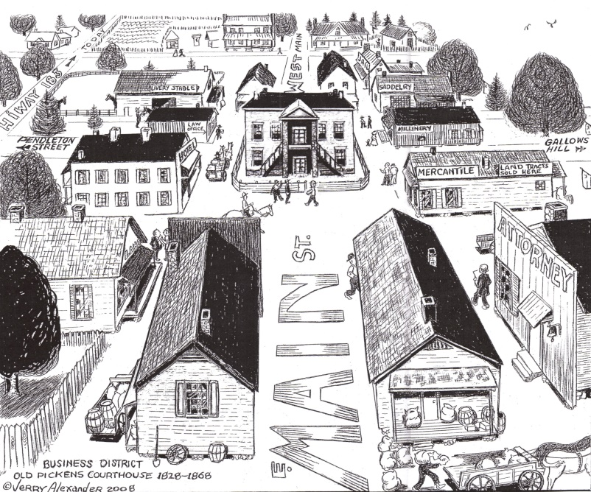
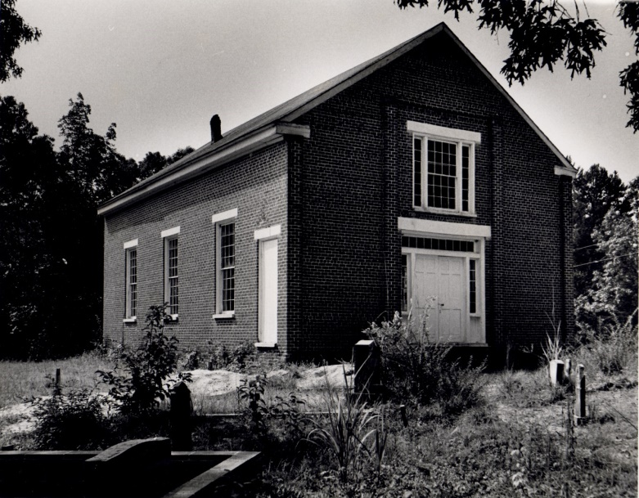
Old Pickens
Notes:
In 1826, the Pendleton District was divided into the Pickens and Anderson Districts
Pickens, or as we refer to it now as Old Pickens, was established along the banks of the Keowee River
The courthouse was completed in 1828, the Presbyterian Church 1830
In the 1840s the area around Pickens was said to have had 1600 residents
Hotels, schools, and other industry popped up around the area
Pleasant Alexander House was moved to High Falls County Park shortly after the damming of Lake Keowee
All that’s left of the town is the Old Pickens Presbyterian Church
In 1868 the town of Pickens was moved 14 miles due to the division of the Pickens District into Oconee and Pickens Counties.
The Great Charleston earthquake of 1886 cracked the brick wall at Old Pickens Church.

Slide 9
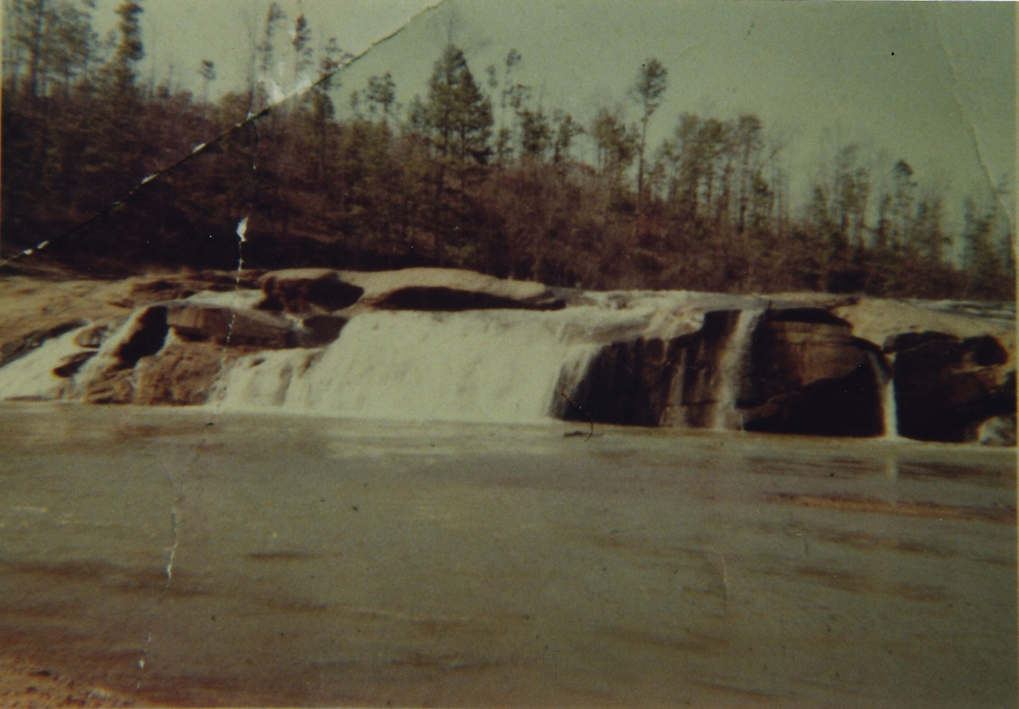
High Falls
Notes:
Located about a mile and a half from where the bridge is now at Keowee Key
Popular swimming area because of the big sandy beach

Slide 10
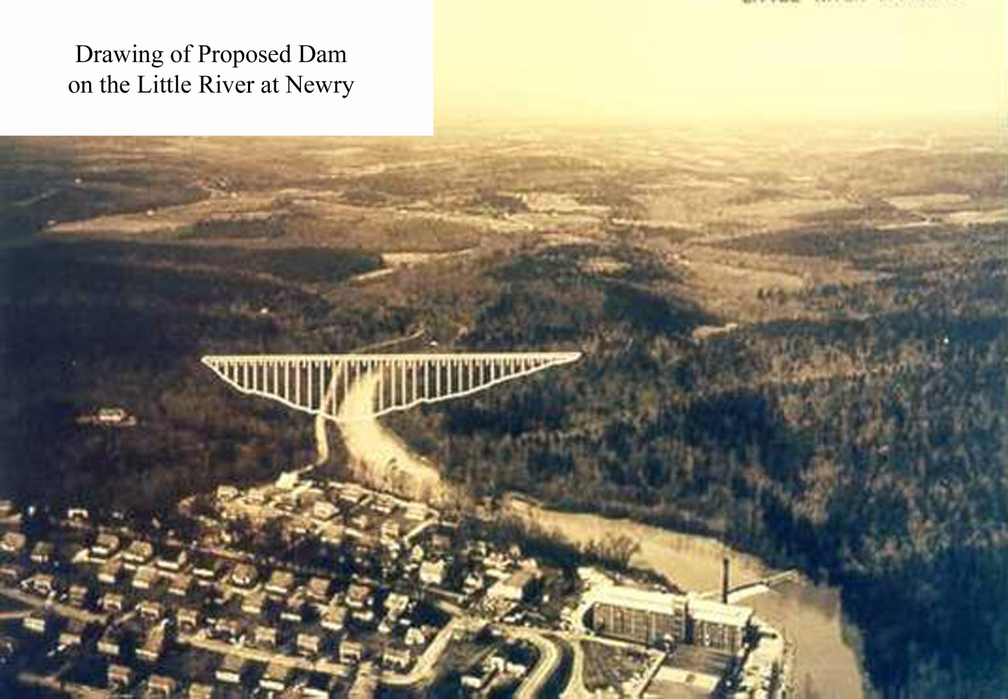
Little River
Notes:
Newry and Courtenay Mill was built along the Little River
The Little River helped power the mill at Newry for textile production
Newry was almost lost to the lake but Duke Power instead constructed a dike to control the waters of the Little River.

Slide 11
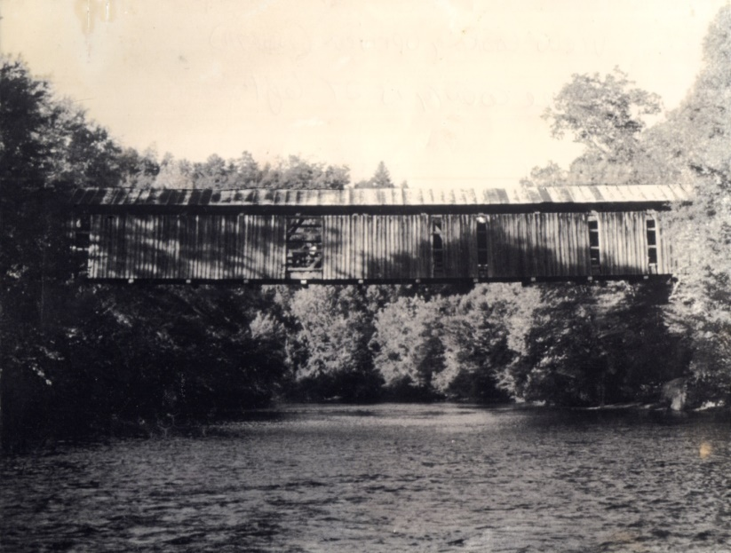
Bridges
Notes:
Many of Oconee County’s covered bridges were removed for the construction of the lakes.
Photo: Chapman’s Bridge (Salem).

Slide 12
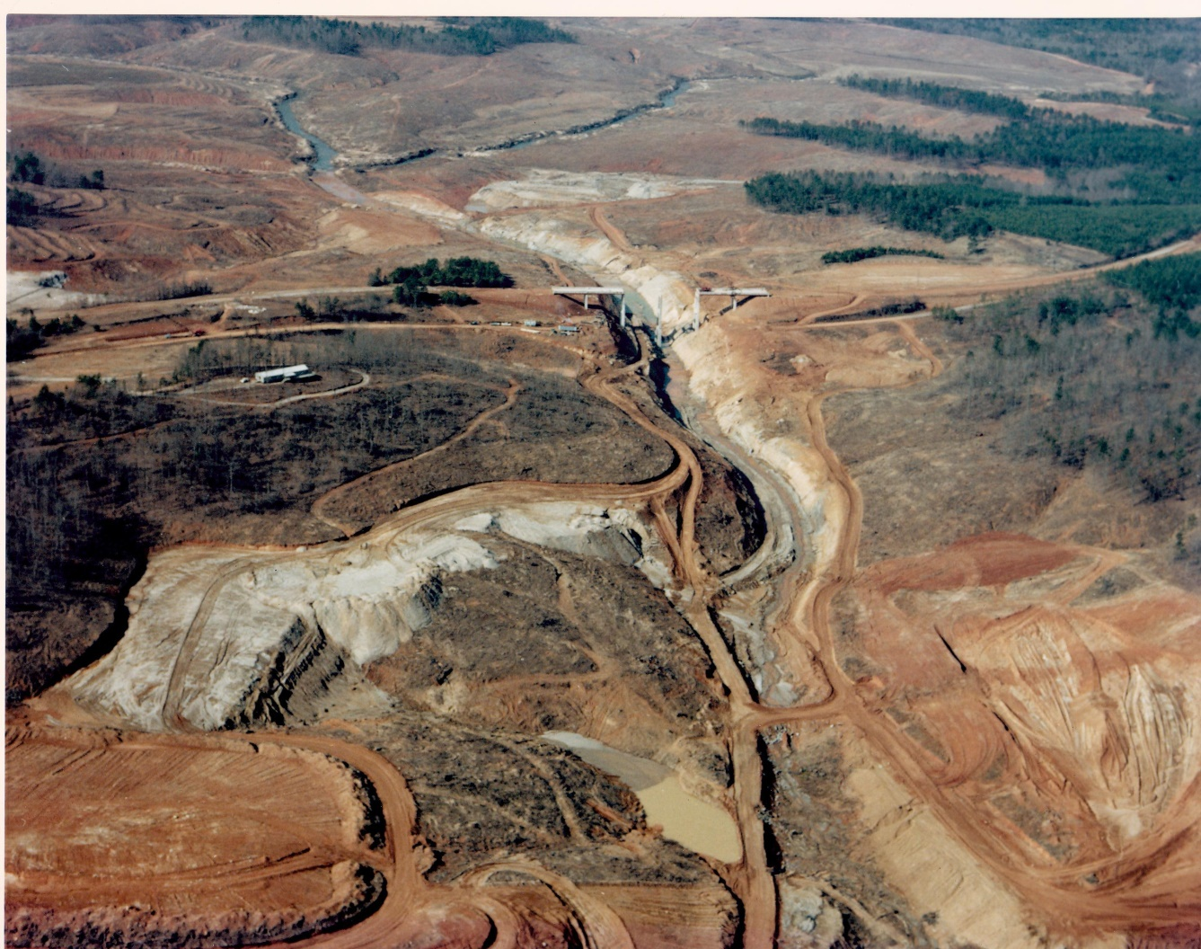
Keowee-Toxaway Project
Notes:
Post World War II boom caused an increase of population and demand for power. The Keowee River Valley would pay the ultimate price for that boom.
Farming in the Keowee River Valley, as it had been for over 150 years was a dying way of life.
Serious planning began in 1962, although Duke had purchased much of the mountain property years earlier
In 1963 the South Carolina Land and Timber Company was formed to acquire the land for the Keowee-Toxaway Project, this company eventually became Crescent Land and Timber, a Duke subsidiary, in 1969.
The project was mostly secretive until 1965 when Duke President William McGuire announced plans for hydroelectric and steam generating facilities and the associated lakes at a luncheon at the Clemson House on January 2, 1965.

Slide 13
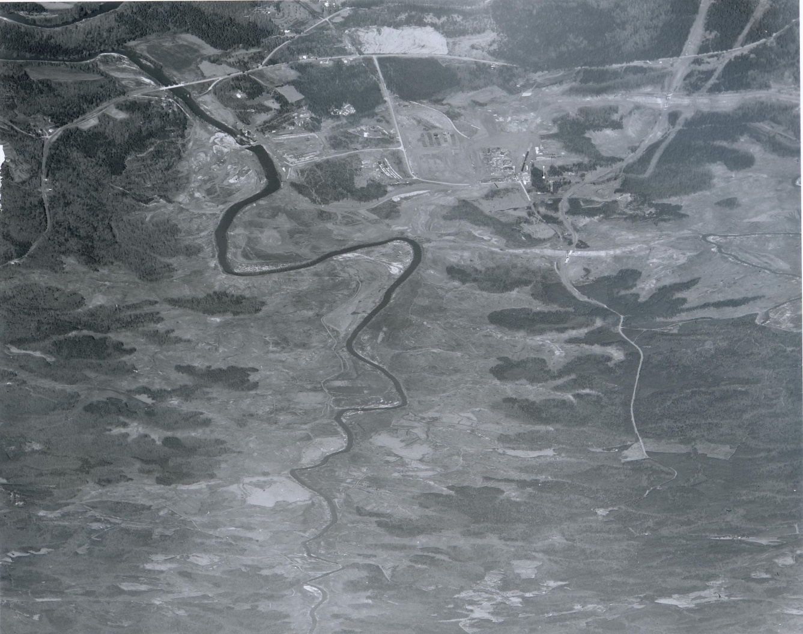
Duke Power
Notes:
After the approval of the application by the Federal Energy Regulatory Commission, Duke began the massive task of preparing the area for dam construction and the formation of Lakes Keowee and Jocassee. There were extensive road and bridge relocations, and buildings, churches, cemeteries, and hundred of families were relocated.
Timber cutters claimed some of the huge trees that populated the area. Some trees were over 200 feet tall and as large as 7 feet in diameter.
Duke preserved a small area north of Lake Jocassee, the Coon Branch Natural Area, which has since been expanded.

Slide 14
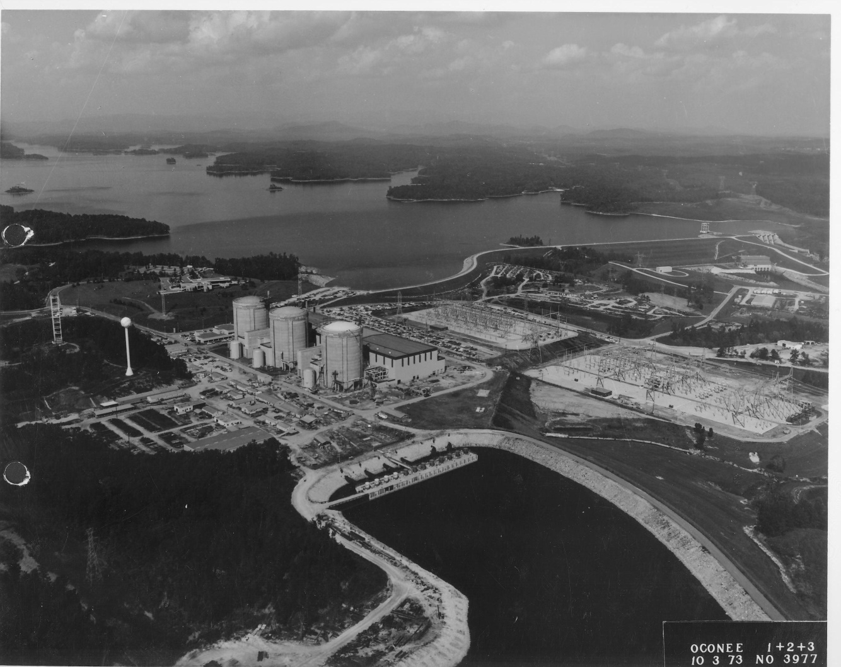
Duke Power
Notes:
Duke began construction of the project’s nuclear plant in 1967
The Keowee-Toxaway Visitors Center, now the World of Energy, opened its doors on July 1, 1969. It was constructed to educate the local population about the project and what was to be affected.
The first of the 3 units of the Oconee Nuclear Station began operation in 1973 with the other two going online at 1974.
Oconee Nuclear uses Lake Keowee as a cooling element. The lake is also a power source for the Keowee Hydroelectric Station.
Duke Power donated land for High Falls and South Cove County Parks as a way to give back to the community and to have more public access to the lake.

Slide 15

Lake Keowee Today
Notes:
Lake Keowee has a shoreline of about 300 miles and covers 18,400 surface acres
A majority of Lake Keowee has been developed.
In 1972 Realtec and Crescent announced plans for the first resort community on 1600 acres of land along the lake. The original name for the area is called Lake Keowee Community, later in 1973 the name was changed to Keowee Key.
Lake Keowee has attracted people from all over the country to relocate here…really a realtor’s dream place!

Slide 16

www.oconeehistorymuseum.org

