Slide 1

History of Westminster, SC
Jennifer Moss
Assistant Curator/Education Specialist
Oconee History Museum

Slide 2
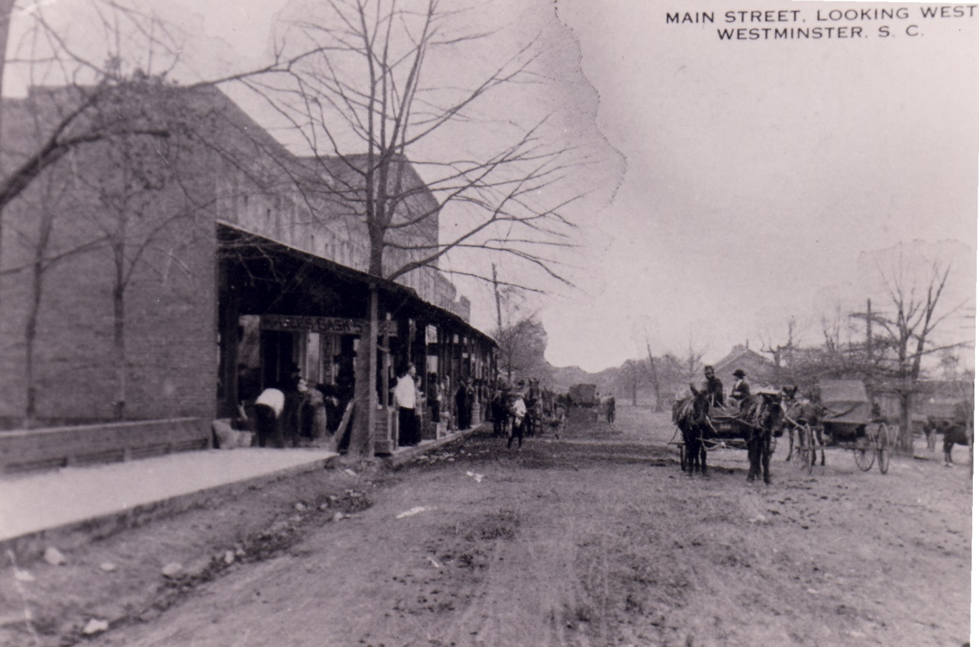
Westminster

Slide 3
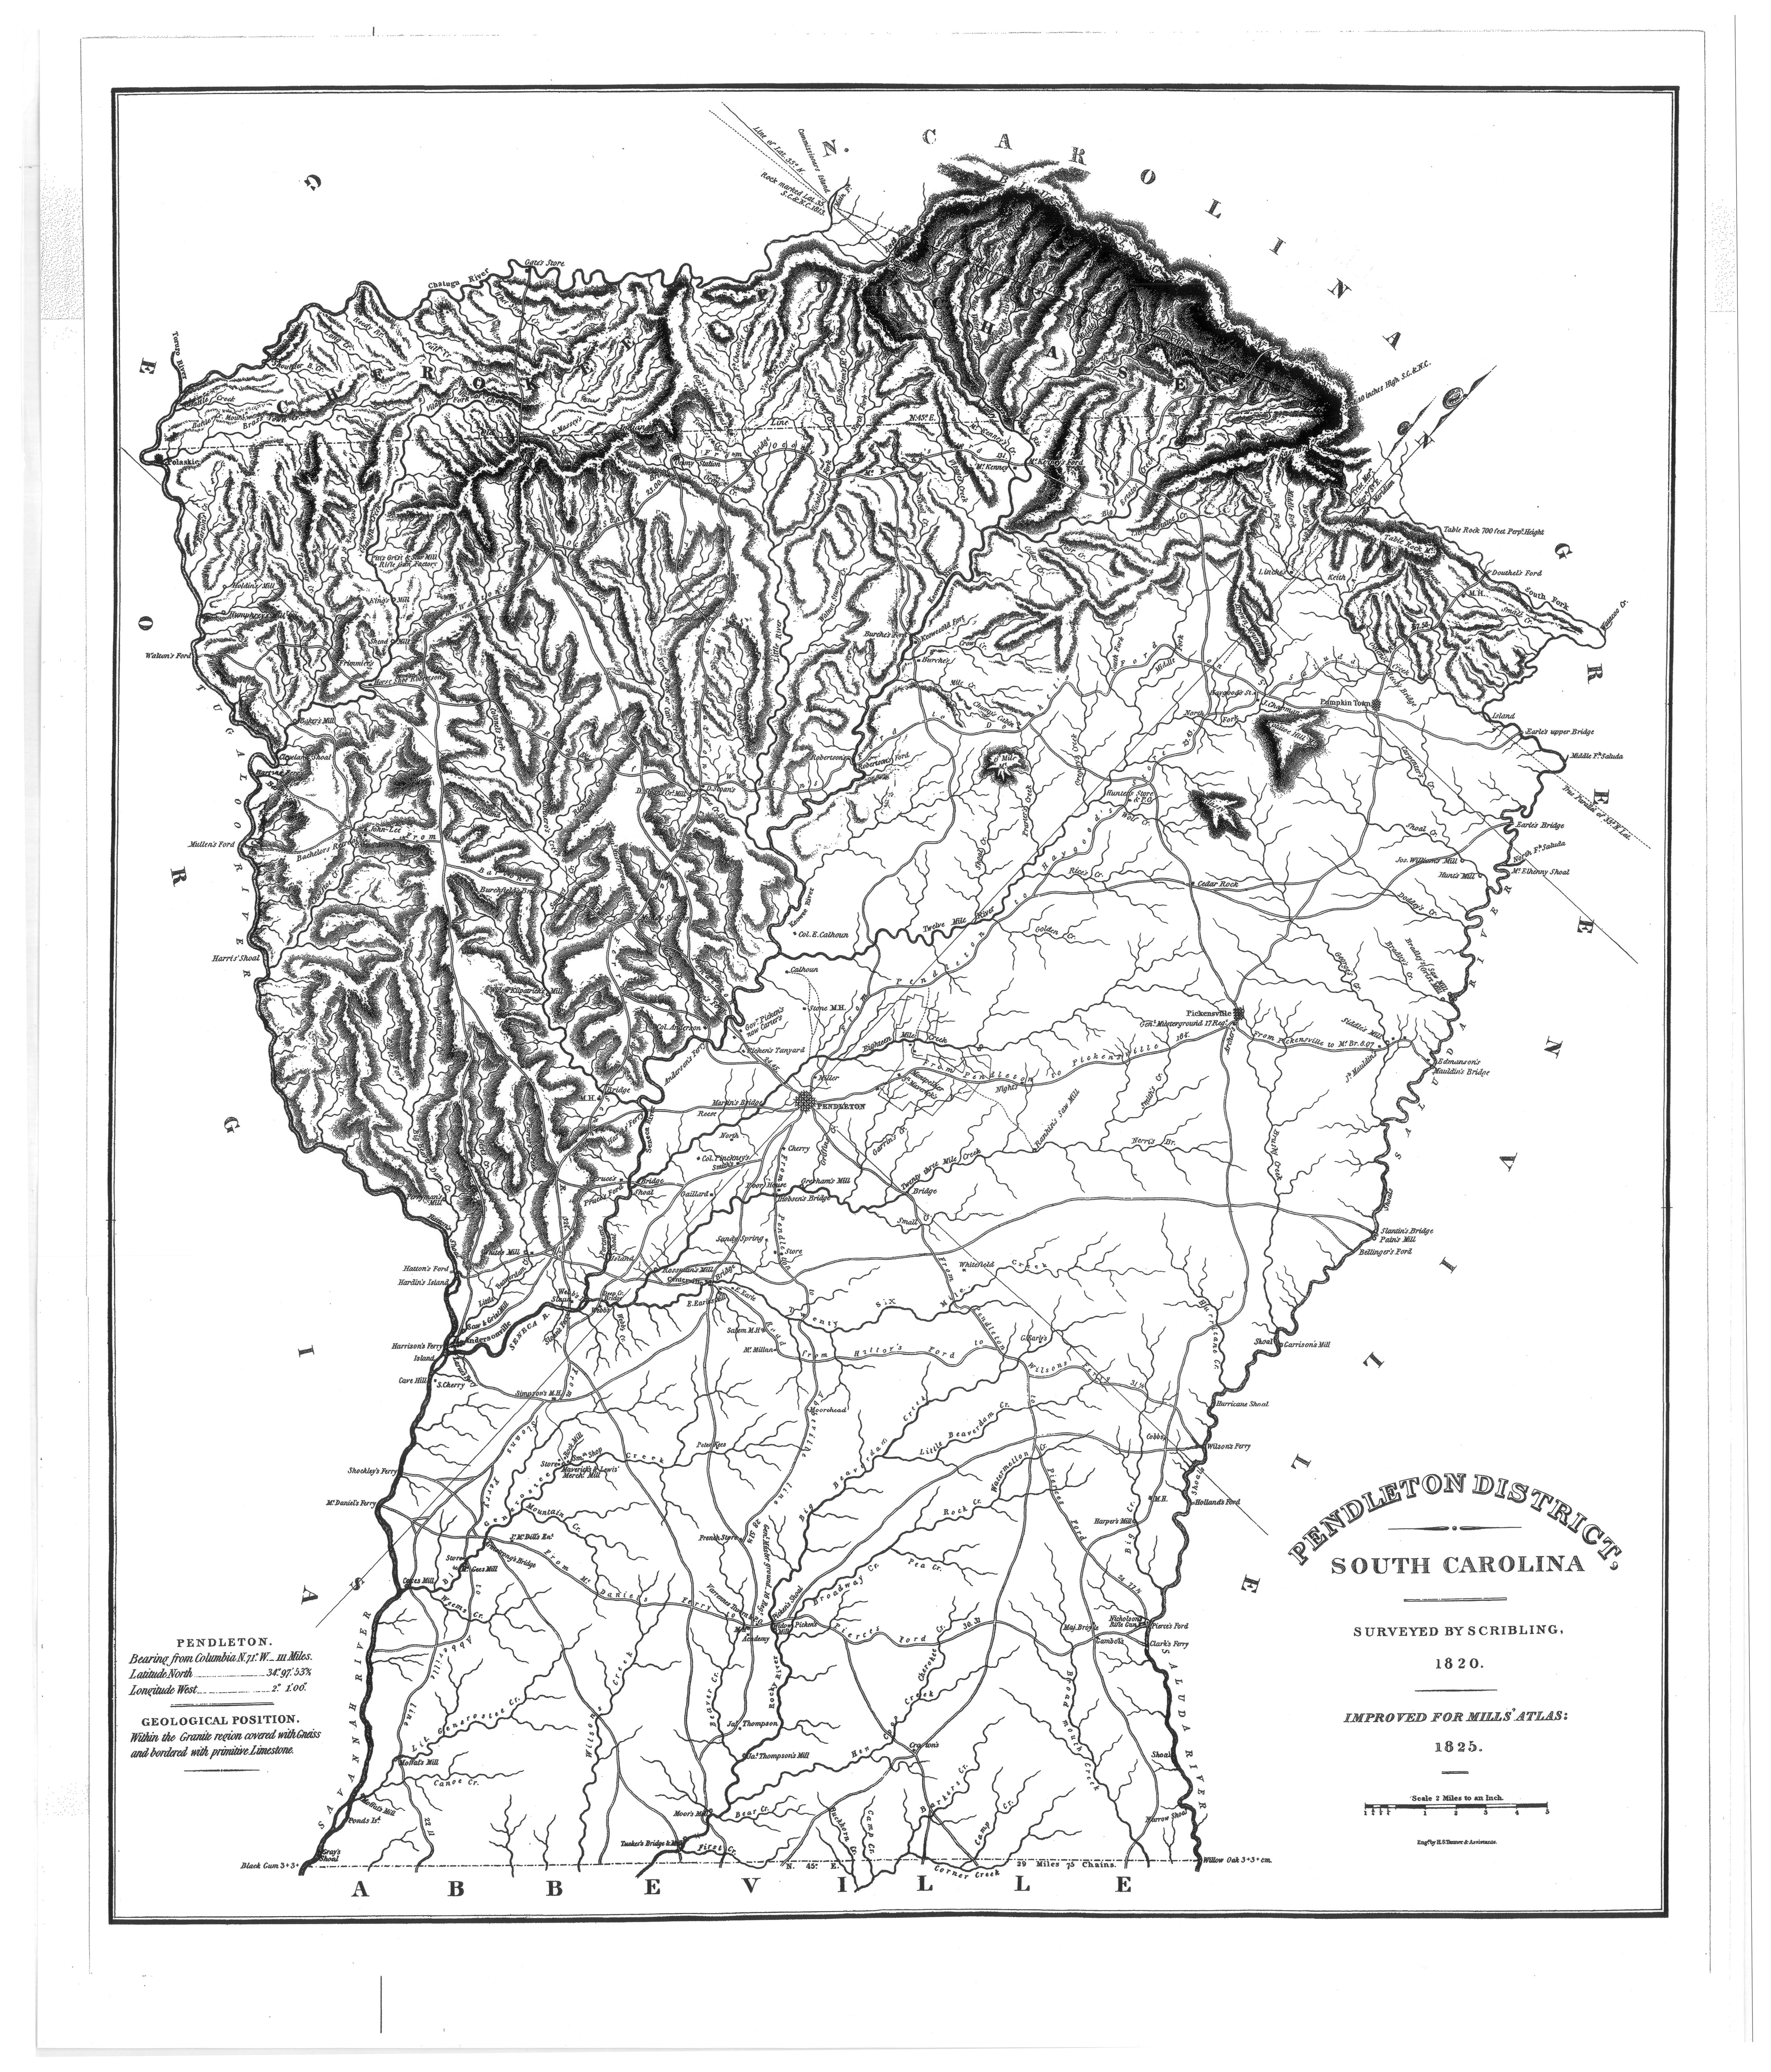
Before the Railroad
Notes:
Up until the late 1700s, the Cherokee dominated this landscape. No Cherokee towns are directly documented in Westminster, but the outer areas of Chauga, Tugaloo, Toxaway, Brasstown, etc… existed as part of the Cherokee lower towns.
After the American Revolution and into the early 1800s settlers came into the area to start farms.
In 1803 a missionary, Reverend Andrew Brown, established a Presbyterian church in a log building on 7 acres of land donated by Oliver Green. The location is in the approximate area of First Baptist Church. He named it Westminster Presbyterian Church after Westminster Abbey in England. Later, it became a Union church where other religious denominations met on Sundays.
Other small local communities were being established Bachelor’s Retreat in 1827, Fair Play 1833, Colonels Fork 1850, Richland 1854.
Most of this area consisted of small farms with a church and/or post office in the community.

Slide 4
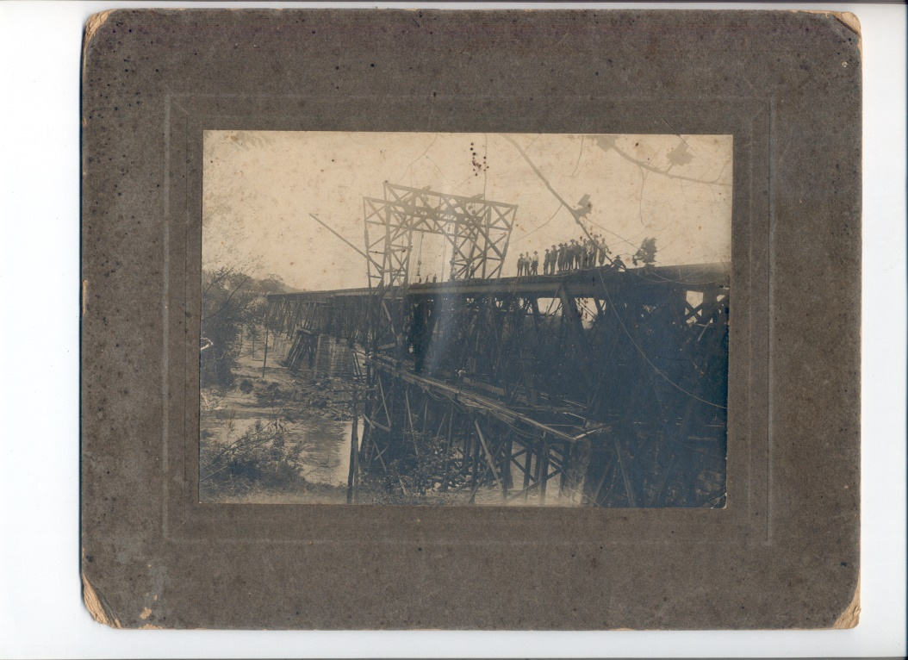
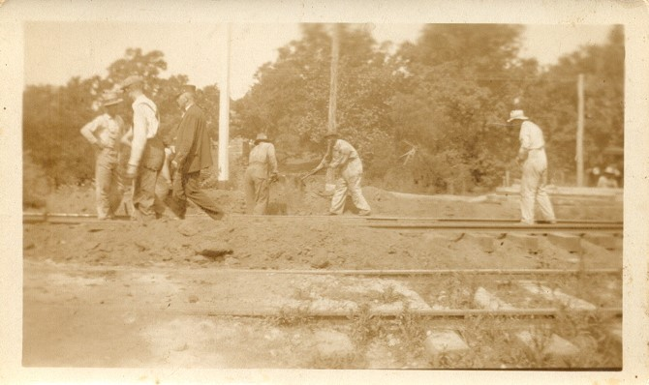
The Coming of the Railroad
Notes:
After the Civil War, the Airline Railroad was constructed to make a direct connection from Richmond, VA, to Charlotte, NC, to Atlanta, GA.
Surveying for the Westminster portion of the railroad occurred in 1868-69, shortly after Oconee County was officially established in 1868.
Albert Zimmerman and his brother and brother-in-law were contracted to clear a 100-foot right of way for the railroad.
In 1873, the railroad was nearly complete except for the bridge over the Tugaloo River. People and freight had to be carried across the river by ferry to an awaiting train on the other side.
In 1874 the first railway depot opened.
As the railroad neared completion people were jubilant for all the prosperity that the railroad was going to bring the area.

Slide 5
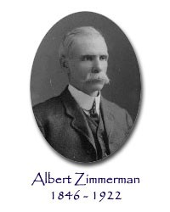
Albert Zimmerman: Founder
Notes:
Without the steadfast work of Albert Zimmerman, Westminster would not have existed.
In 1866 he moved to the Coneross area of Oconee from Newberry, SC, after serving in the Confederate Army in the Civil War.
His family did a lot to clear the railroad right of way.

Slide 6
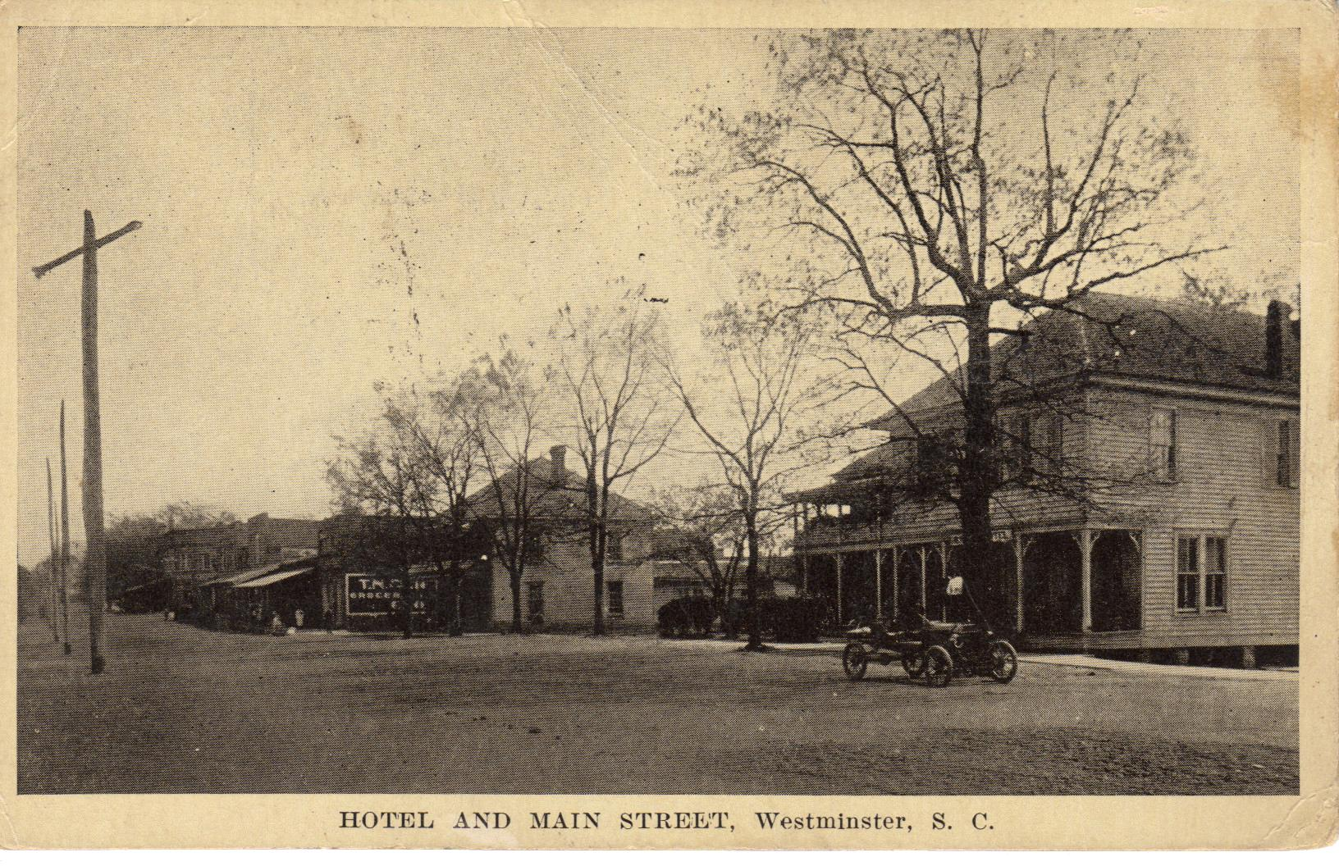
Formation of the Town
Westminster was incorporated on March 17, 1875
Notes:
As the railroad was finishing completion, prospects were good to build a town.
Dr. James Johns and Zimmerman bought 25 acres of land from Robert Stuckey and surveyed it out into streets and town lots.
Zimmerman built the first house and the first store in Westminster.
Westminster was incorporated March 17, 1875.
Albert Zimmerman served as the first Mayor of Westminster.

Slide 7
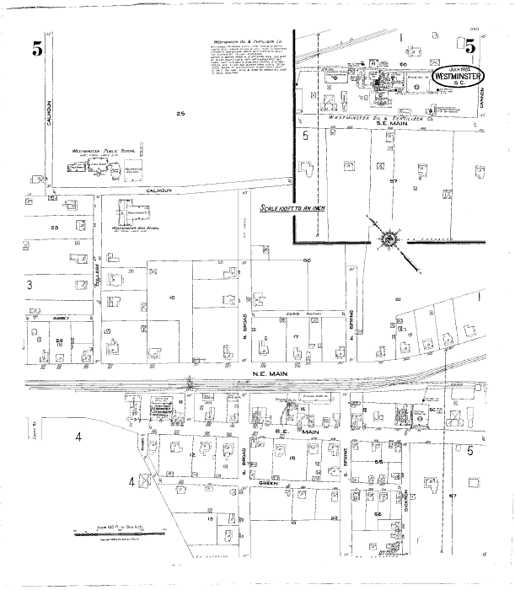
1924 Sanborn Map

Slide 8
Westminster Firsts
1st Post Office opens in 1874
First store owned by Dr. Johns and Albert Zimmerman opens in 1875
First textile mill, Southern Shuttle and Bobbin, opens in 1895
First town park opens in 1902
First electric substation constructed in 1915
In 1918 double tracks on the railroad were completed and 4 underpasses were built
Main St was first paved in 1925
First SC Apple Festival was held in 1961

Slide 9
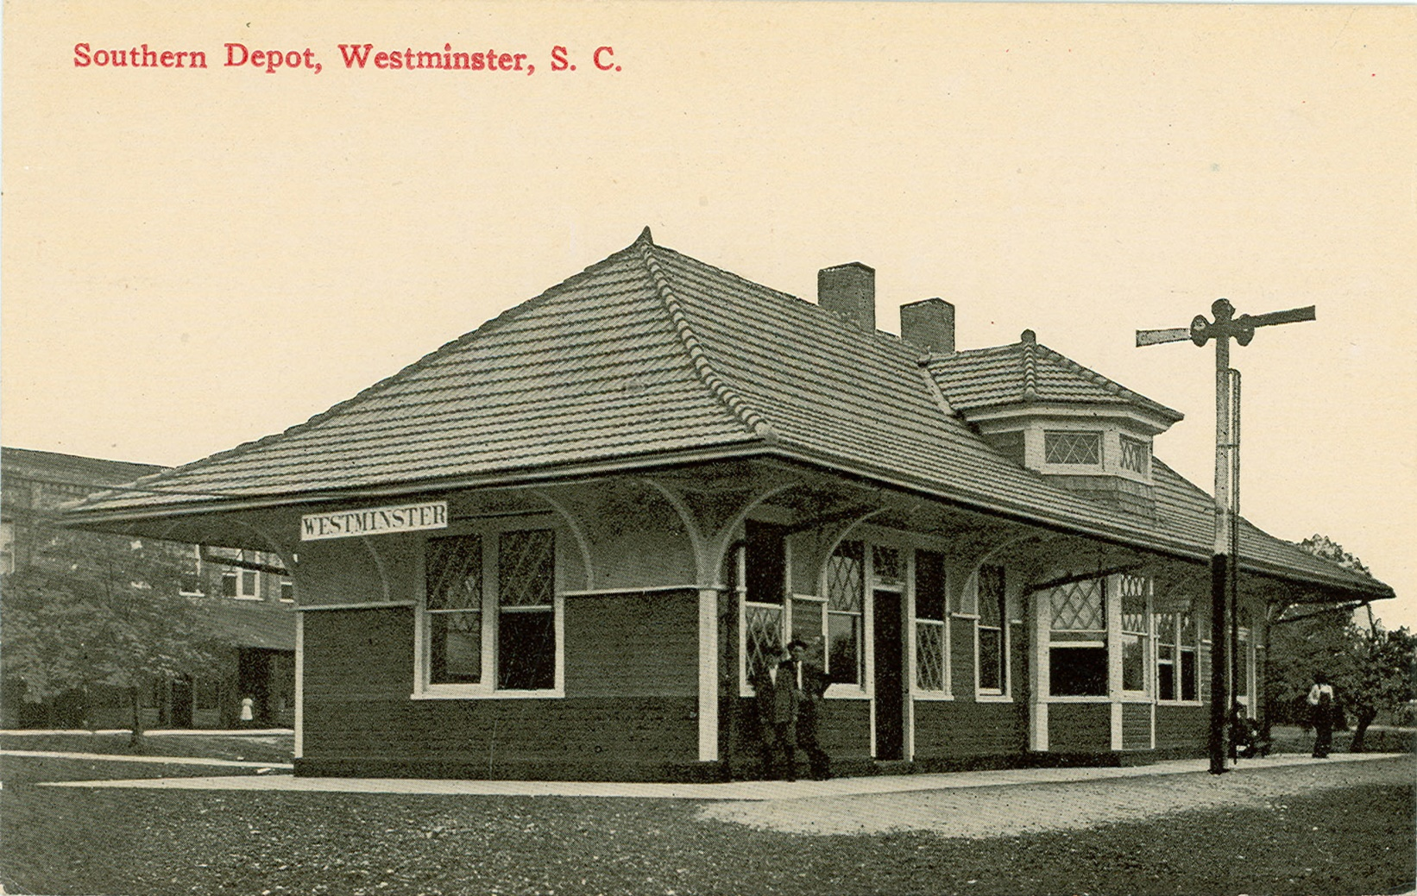
The Depot
Notes:
Original depot was constructed in 1885.
Passenger services were discontinued in 1970.
In 2006, the building that was constructed in 1916 was burned down by an arsonist. The community really wanted to restore the building so funds were raised to recreate this beautiful building.
The Southern Railway was the main line for freight and passengers in the early 1900s.

Slide 10
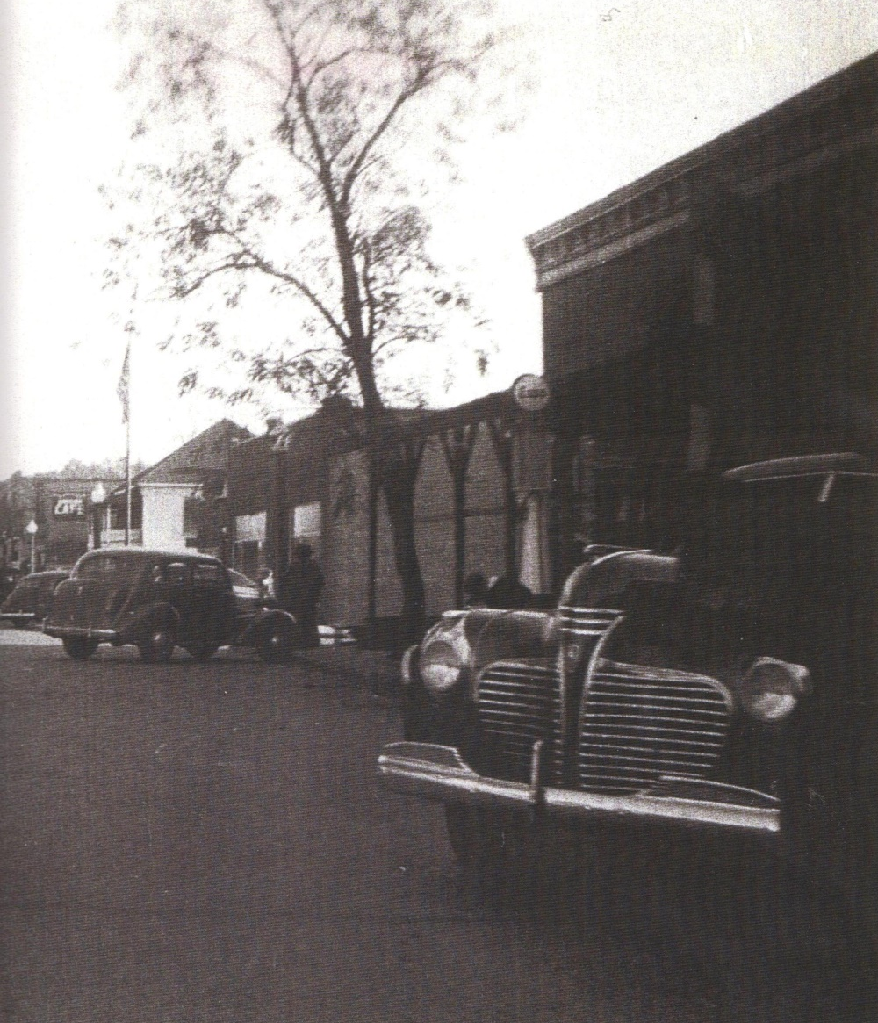
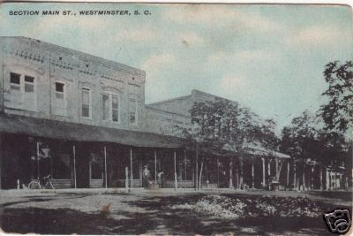
Downtown
Notes:
From the late 1800s to the late 1900s Westminster had a bustling downtown. With the railroad located across from the core commercial district, it made Westminster the place to go.
Movie theaters - the Broxy
Newspapers: Westminster Banner was the first newspaper. Eventually, the Tugaloo Tribune opened in 1929, and in1952 it was sold to Seneca Journal. In 1953 the Westminster News began.
5&10 (five & dime) stores like Harper’s
Piedmont Motor Company was the first car dealership in Westminster.

Slide 11
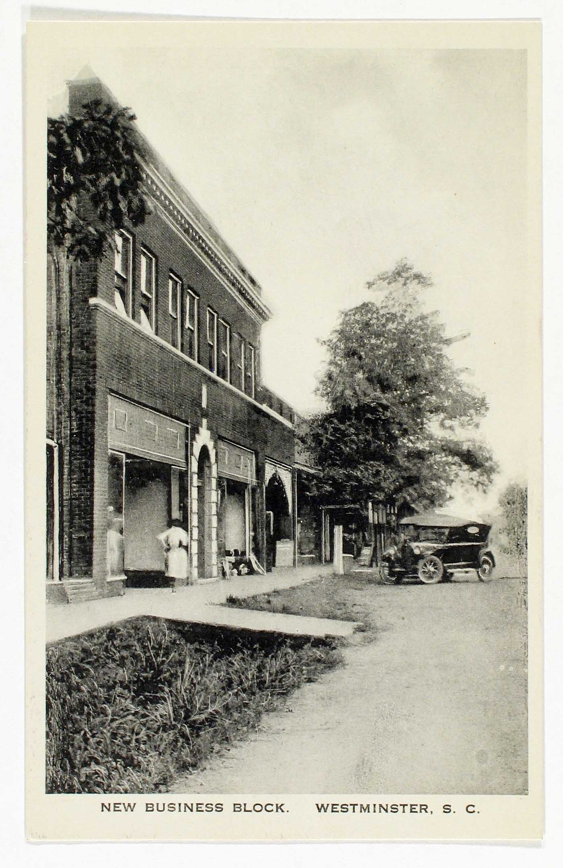
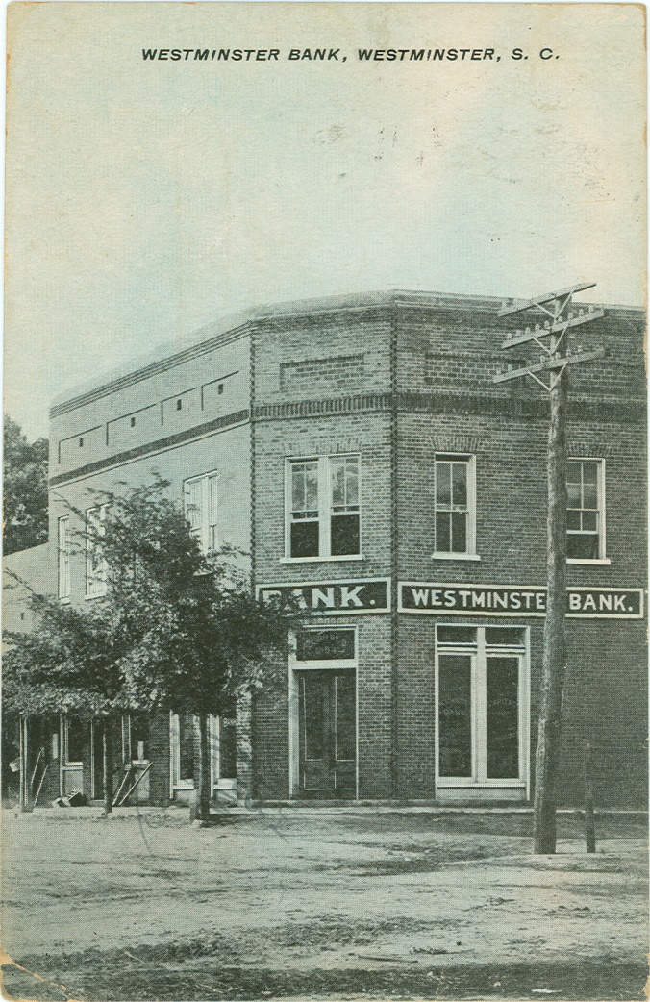
Downtown
Notes:
England’s General Store was owned by the England family since the early 1900s. Owned by W.L. “Luke” and then by his son W.J. “Dub”, the store was a cornerstone in the downtown area. Dub never sold the last of anything so when he stopped buying merchandise to sell, the store became a museum of sorts.
Stonecypher Drug Store opened in 1901 and was led by the first licensed pharmacist in Westminster, J. Henry Stonecypher. Along with his brother, C. Henley, the drug store thrived and they were famed for developing a medicine for babies called Easy Teether. Later this pharmacy became Crystal Drugs, and then it was purchased by Dr. Samuel Moon and became Moon’s Drug Store.
Hotels located downtown: Mathewson Hotel, Mineral Springs Hotel, England Boarding House

Slide 12
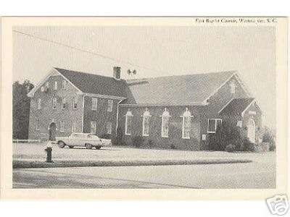
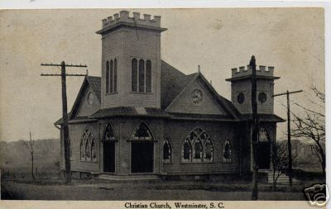
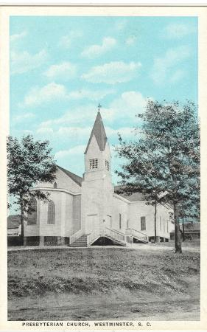
Churches
Notes:
Westminster Christian Church founded by Albert Zimmerman sometime before 1910. It was located on the corner of Retreat and Augusta Streets. Services lagged after the death of Zimmerman and in the 1930s the structure was torn down.
First Baptist was formed in 1831, and was remnant of the original church founded by Andrew Brown in the early 1800s.
Westminster Presbyterian Church was founded in 1882. They conducted services in the Methodist church until the structure was completed in 1884.

Slide 13
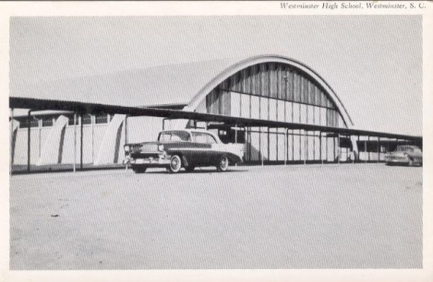
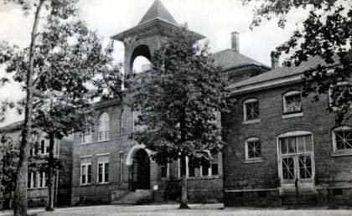
Schools
Notes:
In 1869 children attended school in a wooden building near where Walhalla and Abbey Streets meet today.
The Bell Tower School was built in 1903 and was razed in the 1920s.
Current College Street School complex began construction in the 1920s. The school housed the high school until 1957 when the more modern Westminster High School was built.
Westminster High School served the city children until 1982 when Westminster and Oakway High Schools combined to be called West-Oak High School.
The Westminster Colored School was built as a two-room building in the early 1900s on Broad Street. In 1952 the upper grades consolidated with East End High School in Seneca. Westminster schools were totally integrated in 1969
The Westminster Rosenwald School was completed in 1925 and was located on Butler Street. It was razed in the 1950s and Hillcrest Elementary was constructed on the same site
The Retreat Rosenwald is located beside Pleasant Hill Baptist Church along Highway 24.

Slide 14
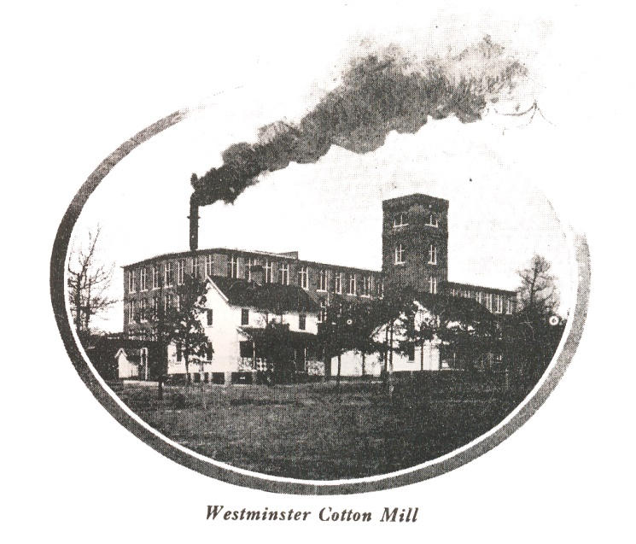
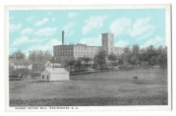
Mills
Notes:
Cheswell Manufacturing Company started its cotton mill business in 1900.
W.E. Cheswell was superintendent at Newry at the same time he was founding his own mill in Westminster.
In 1908 Oconee Mill took up the operations of the Cheswell Mill.
Oconee Mill was in operation from 1908-1937.
In 1938 Beacon industries took over production in the plant and remained an important employer in the town until 2002.
For more information about the textile industry in Oconee County view the “Textiles in Oconee” presentation.

Slide 15
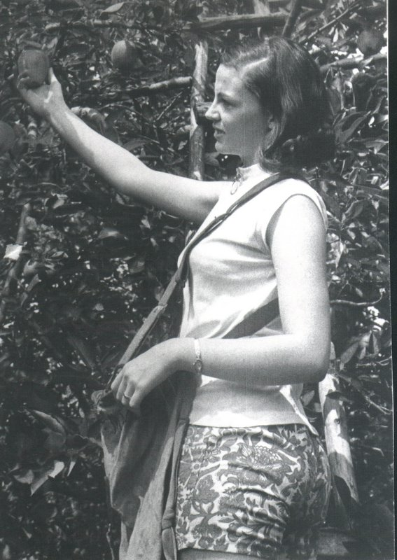
Why Apples Are Important to Westminster
Notes:
Apple Festival was started in 1961 by Cecil Sandifer.
Dignitaries from all over the state would come to participate in the parades.
Apples were an important agricultural industry in Oconee County. Apples grow very well in the nice mountain soil around the Long Creek and Westminster areas.
Oconee’s climate allowed for apples to be on the market well before other apple producing areas.
In the 1980s, several bad frost seasons along with mass refrigeration sent Oconee apple industry into a downturn.
For more information about the apple industry in Oconee see the “Edible History: Apples in Oconee” presentation.

Slide 16
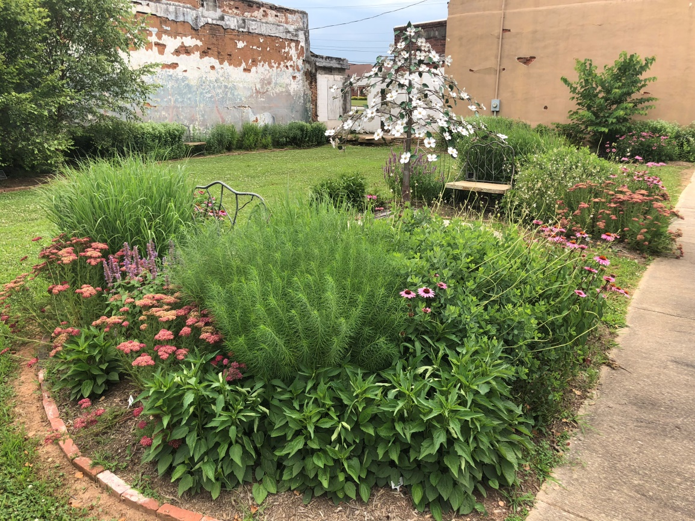
Westminster at Present
Notes:
Although the city has experienced tough times since several industrial plants have closed, the city is poised for revitalization and community growth.
Organizations like the Westminster Area Historic Preservation Society, Oconee History Museum, Rotary Club, and the Lazy Daisy Garden Club help in revitalize the town and preserve its history and character.
New organizations like the Westminster Music Center and Gateway Arts Center bring new people in to town through arts and culture.

