Slide 1

education in Oconee
Leslie Hagerty – Director/curator

Slide 2
“Upon the subject of education, not presuming to dictate any plan or system respecting it, I can only say that I view it as the most important subject that we, as a people, can be engaged in.”
- Abraham Lincoln

Slide 3
Growth at a glance
Population of Pickens District in 1850 = 16,904
  14 people per square mile
  40 schools serving 280 students
1857 = 50 schools
1877 – 1,132 students
1889 – 74 schools
1906 – 5,788 students
1923 – 12 one-teacher, 24 two-teacher, 11 three-teacher, 7 four-teacher, 5 five-teacher, 7 six or more-teacher, 5 high schools for 5,513 students
Notes:
Prior to 1868, Oconee County was part of the Pickens District (comprised of modern day Pickens and Oconee Counties). The Pickens District was the westernmost part of South Carolina, and as such it was sparsely populated. This sparse population spread over a vast distance made education difficult. Most families educated children in the home. As the population grew and communities developed, parents were able to take a more communal approach to educating neighboring children. Small school houses were constructed in communities by pooling the resources of local residents. Teachers were recruited and hired in the same manner.

Slide 4
Free schools
1811 – SC establishes free public schools based on population
1868 - School tax + poll tax to fund public free schools
1870 – SC statewide “school law” & infrastructure
1885 – Limited ages of students to 6-21
1895 – public schools were required to segregate
1897 – provide students with text books at cost
1899 – required school to be open at least 3 months
Debates regarding teacher training, religious teachings, and general effectiveness of free school
Notes:
A formal education system developed slowly in South Carolina. Areas with sufficient populations were the first to benefit from the establishment of public schools. Early public schools faced many issues, including debates over teacher training, religious teachings, and general effectiveness. Communities wanted to retain their rights to decide these issues for themselves, but as they became more dependent on State funding decisions were often left to the State. Schools in rural communities also had difficulties with student attendance. This was due to the agrarian lifestyle of many families who depended on everyone in the family to help during planting and harvesting seasons. Travel to school could also be difficult for students in rural areas, especially in geographically diverse areas like Oconee County.

Slide 5
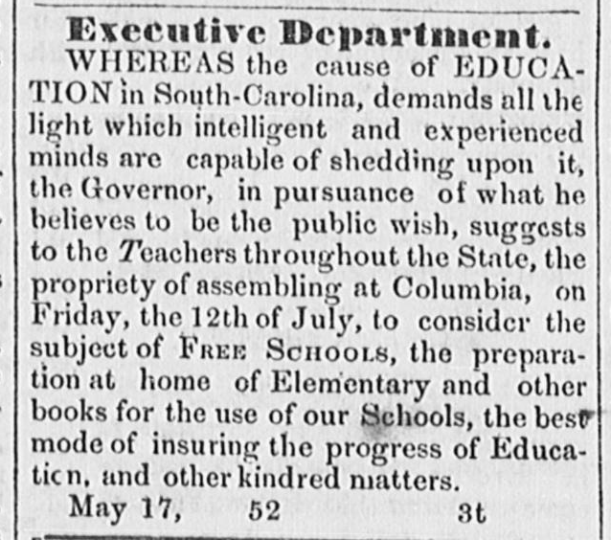
Notes:
These clippings from the Keowee Courier illustrate the growing concern over developing a state-wide education system in South Carolina.

Slide 6
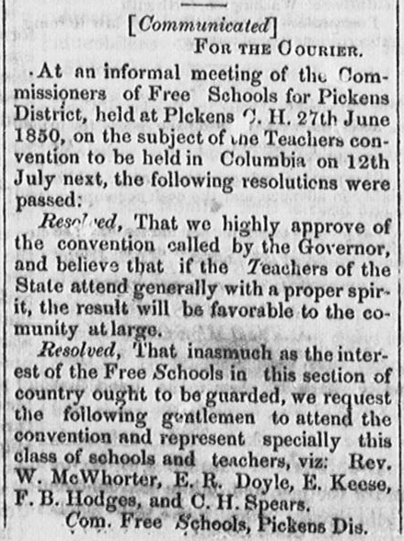

Slide 7
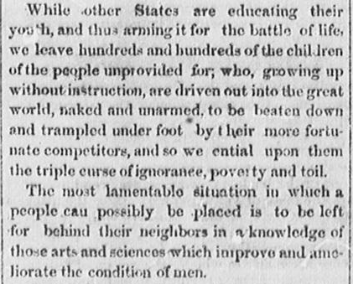

Slide 8
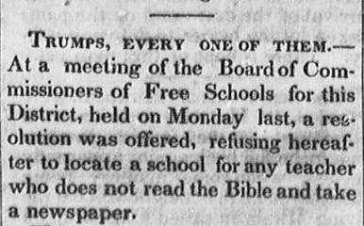

Slide 9
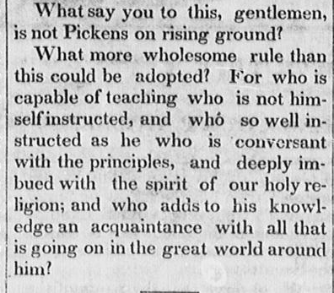

Slide 10
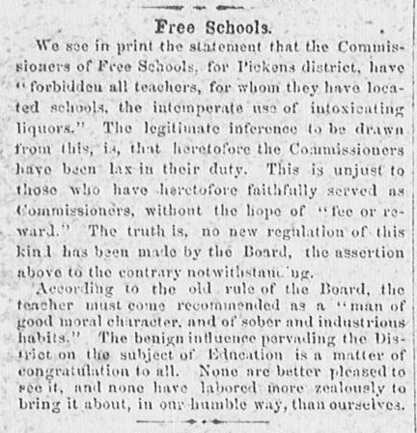

Slide 11
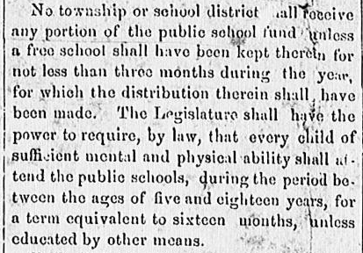

Slide 12
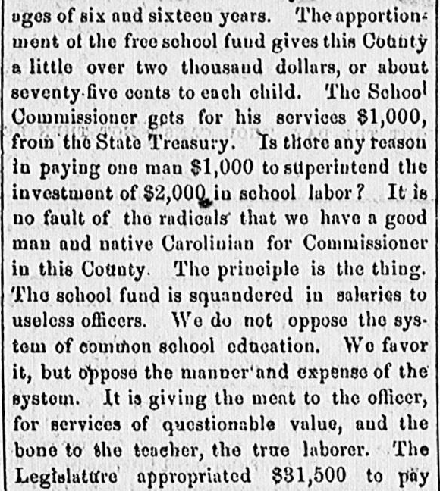

Slide 13
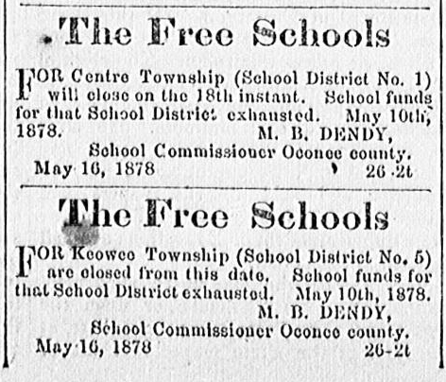

Slide 14
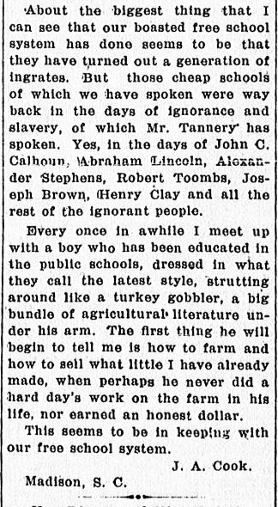
Notes:
As you can see from the news clippings, public schools faced many of the same debates that schools engage in today. Funding, attendance, religious teachings, teacher training, and overall effectiveness were all top issues.

Slide 15
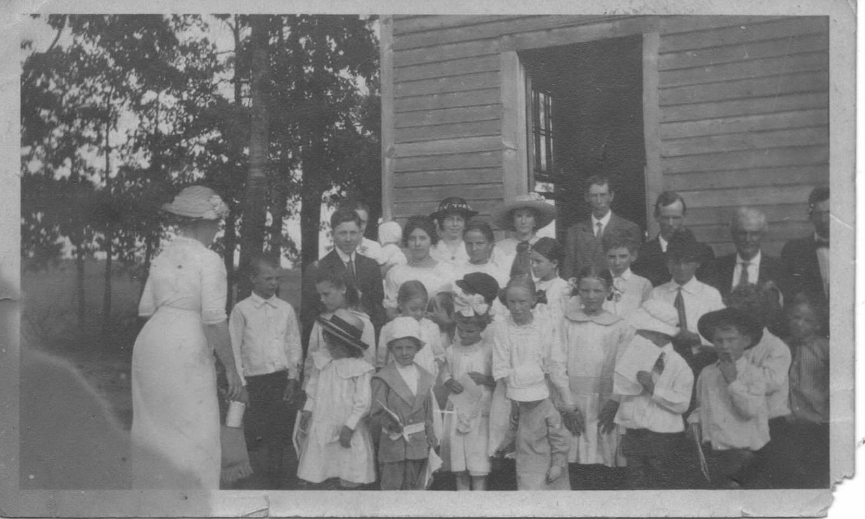
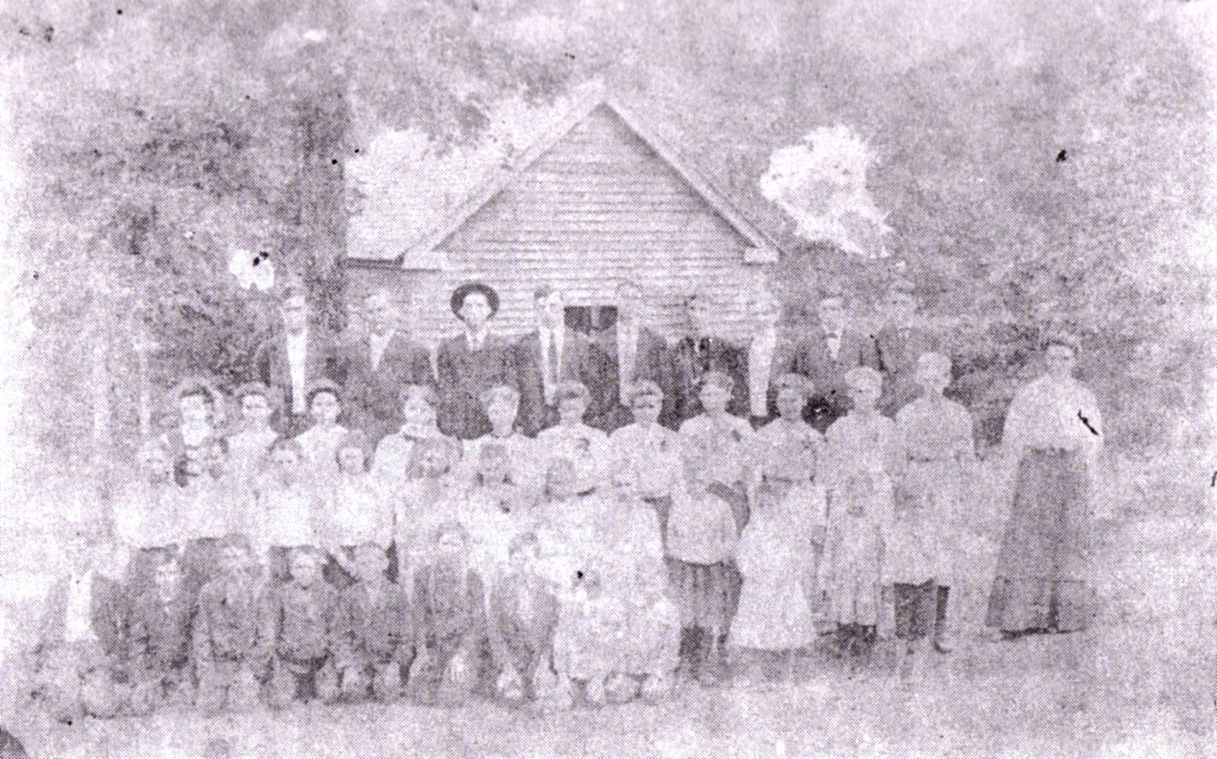
Bethlehem School
Blackjack School
Notes:
These photos of Oconee County schools reflect the size of their local communities and their community’s commitment to educating their children despite the many hardships of living in a rural area like Oconee County. School houses were often small, minimally furnished, and functionally designed. Schools were segregated in the same ways that most communities were. Students of all ages attended at the same time, often making self-paced progress through their grades. Students had daily chores to keep the school clean, warm, and maintained.

Slide 16
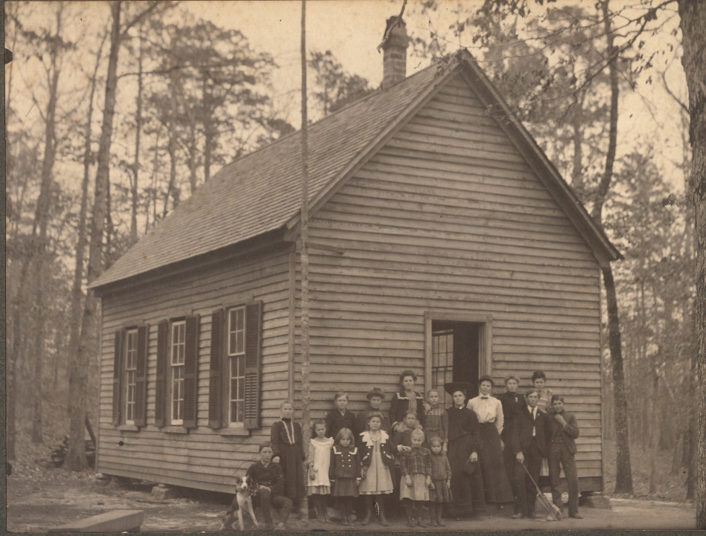
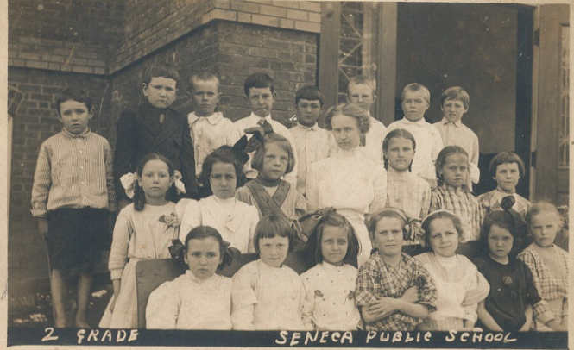
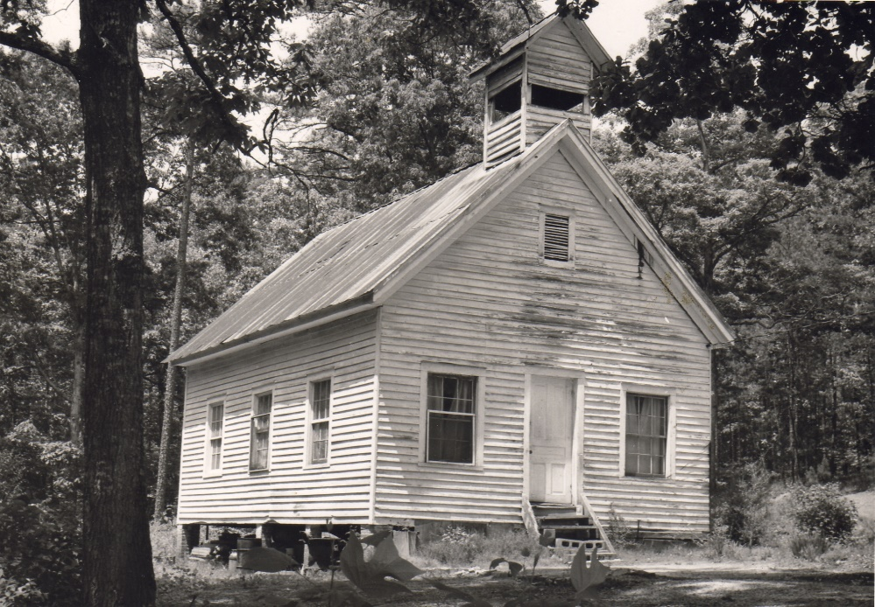
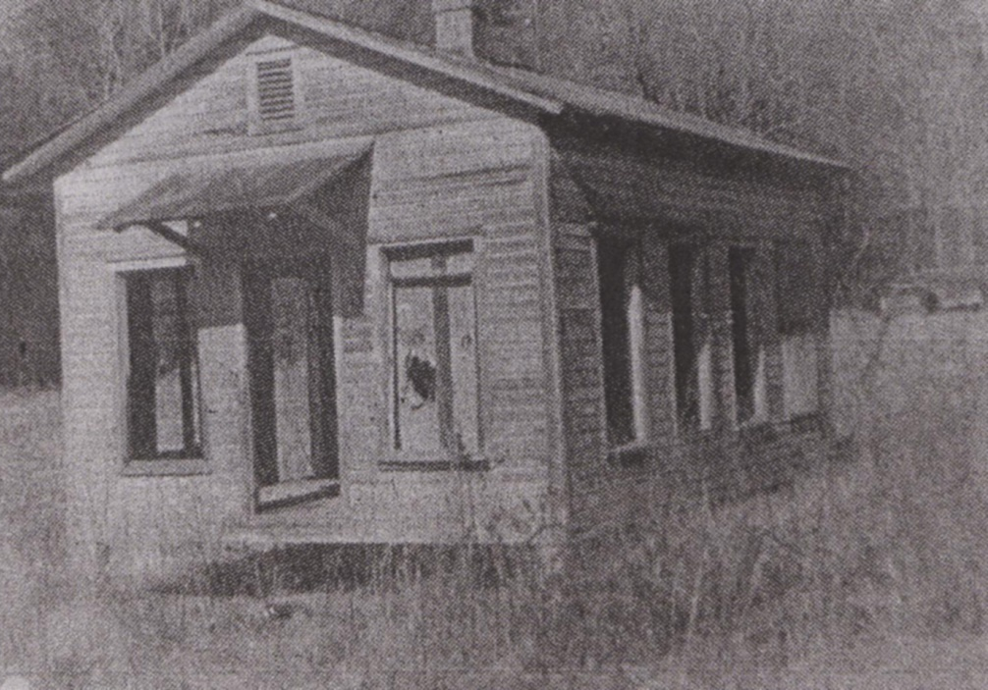
Seneca Public School (top)
Block School @ Tabor (bottom)
Bear Swamp School (top)
Butts School (bottom)

Slide 17
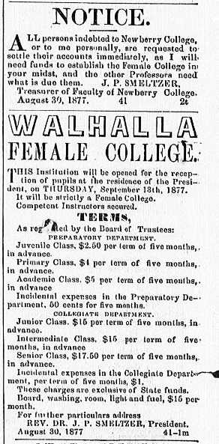
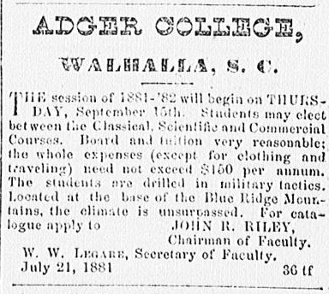
colleges
Walhalla Female College
  1877-1887
Newberry College (Lutheran)
  1868-1877
Adger College (Presbyterian)
  1877 – 1888
Clemson College
  1889 – 1968
Notes:
Despite being very remote and rural, Oconee County was able to offer a remarkable amount of advanced educational opportunities. Walhalla was home to Walhalla Female College, which primarily trained teachers. Newberry College relocated to Walhalla after the Civil War due to damage at their Newberry SC location. Walhalla was chosen because of its Lutheran affiliations. When Newberry College relocated back to Newberry, Walhalla was left wanting for a college. Adger College filled this need for over a decade. Soon thereafter Clemson College was founded in Oconee County as a military college with an agricultural focus.

Slide 18
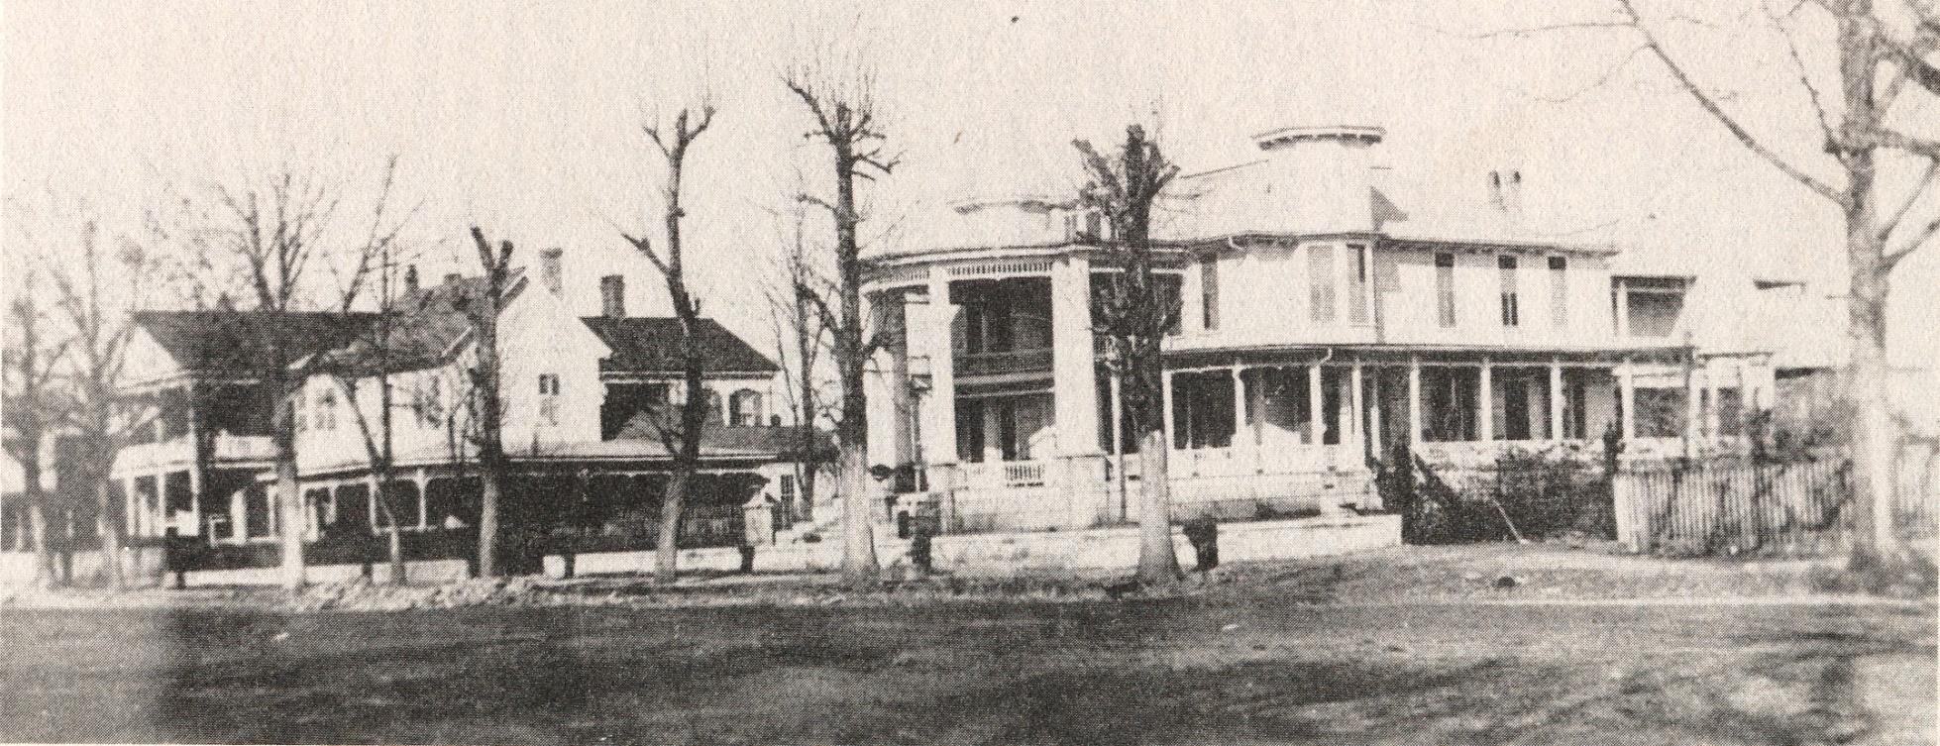
Notes:
Photo: Walhalla Female College

Slide 19
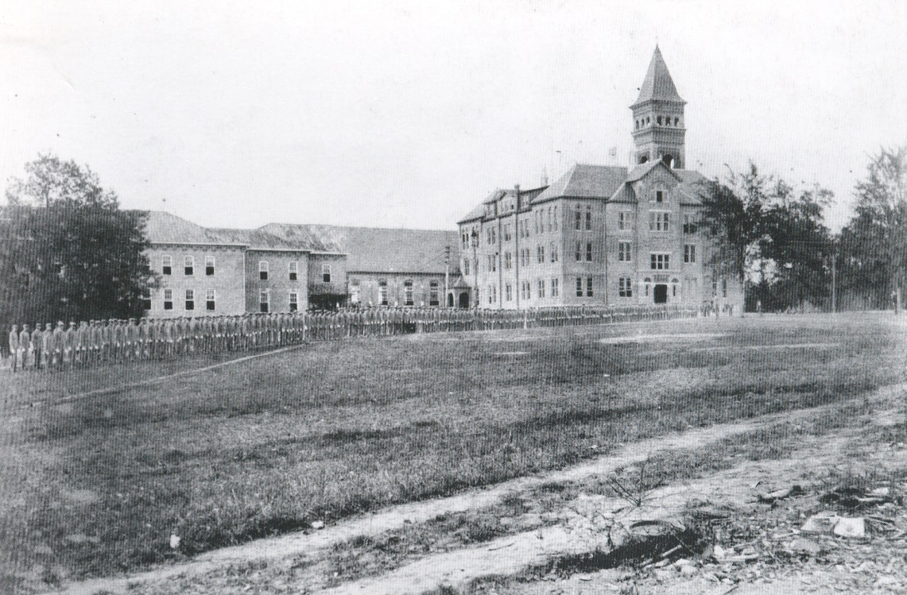
Notes:
Photo: Tillman Hall at Clemson College

Slide 20
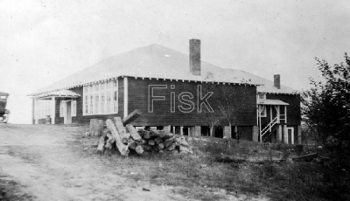
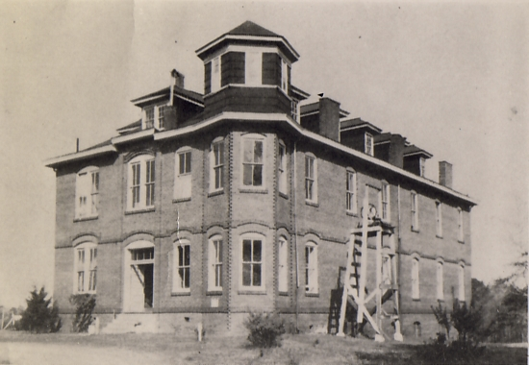
“Separate but equal”
Access to free schools
Rosenwald Schools
Seneca Institute/Junior College – 1899-1939
Blue Ridge High School
Notes:
Schools in Oconee County were segregated just as most communities in Oconee County were. Most of these segregation was cemented by State law. Nonetheless, Oconee County’s minority communities made remarkable strides by offering basic and advanced education to students. At least 10 “Rosenwald Schools” were constructed in Oconee County. These schools were constructed using matching grant funds provided by Julius Rosenwald who had became wealthy through the Sears-Roebuck Company. Seneca Institute/Junior College offered advanced education to African-American students during the height of the Jim Crow era. Later, Blue Ridge High School became the only high school in Oconee County for African-American students. Oconee County schools were integrated in 1969, and Blue Ridge High School was closed.

Slide 21
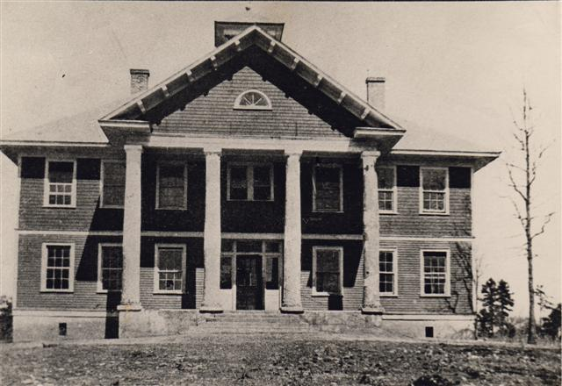
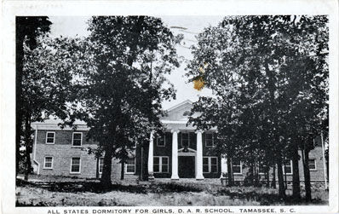
20th Century Strides
Mill schools
Correspondence Schools for trades
1907 – SC allowed some High Schools
1914 - 1956 – Long Creek Academy
1917 – Tamassee DAR School
Notes:
During the 20th century, many other educational offerings became available throughout Oconee County. Most textile mill companies provided schools in mill villages. Correspondence Schools (by mail) offered training in specific trades. Public high schools began to develop as populations expanded. Long Creek Academy (today Whitewater Outfitters) provided advanced education opportunities in the mountains of Oconee. The Tamassee DAR School also developed as a way to board and educate underprivileged children in Oconee’s mountain regions.

Slide 22
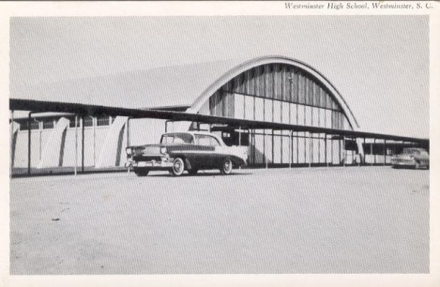
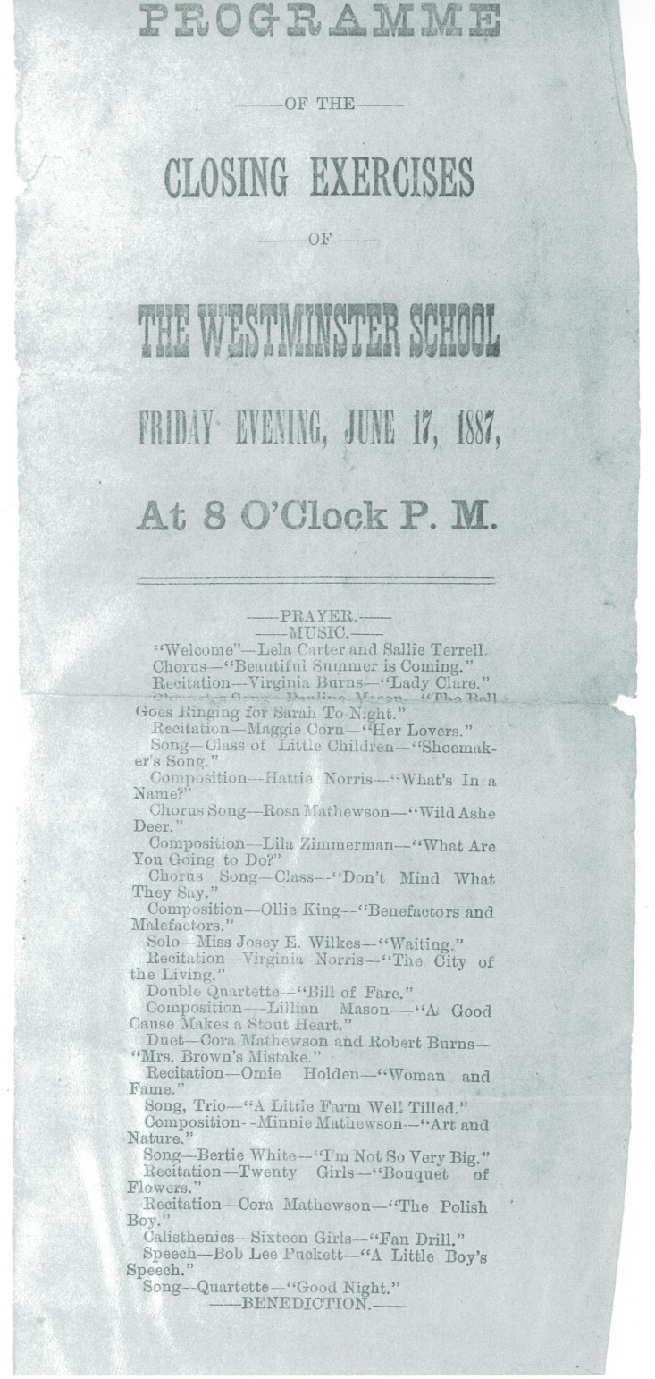
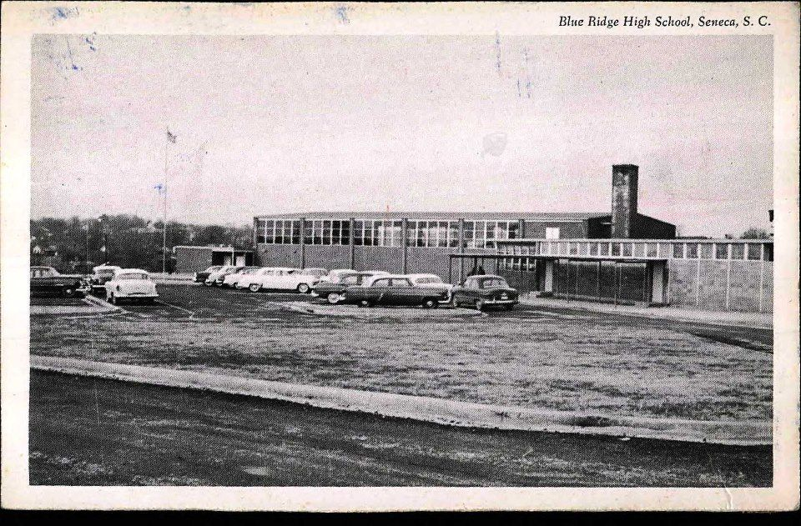
Notes:
Top: Westminster High School
Bottom: Blue Ridge High School – Seneca

Slide 23
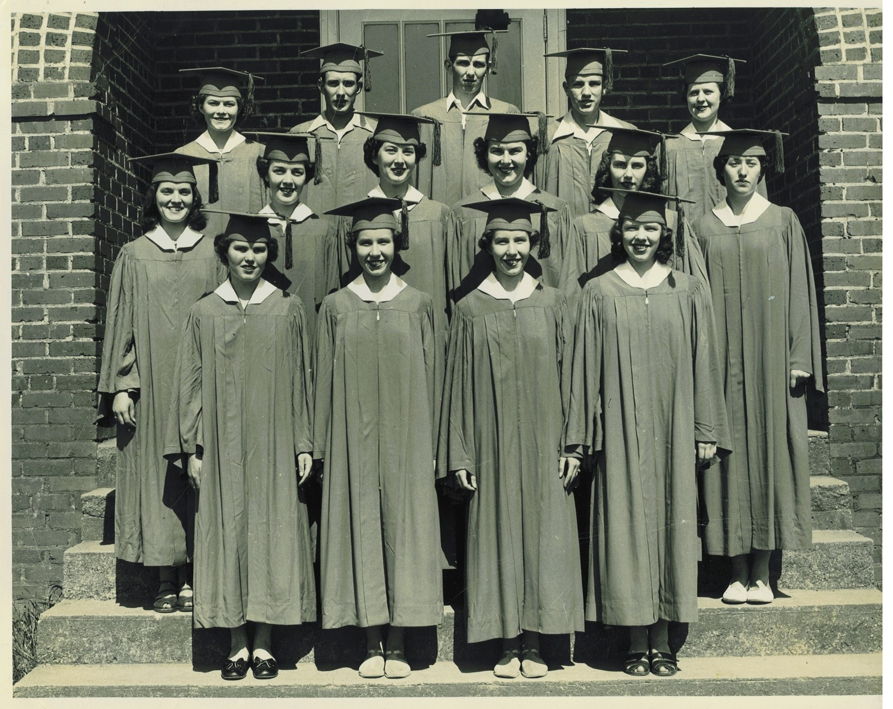
Notes:
Photo: Oakway High School graduates c.1940s

Slide 24
Modern schools in oconee
School Consolidation
  Fair Play High School closed 1963
  Keowee High School closed 1965
  Tamassee + Salem = Tamassee-Salem in 1965
  Blue Ridge High School integrated and closed in1969
  Westminster + Oakway = West-Oak in 1983
  Tamassee-Salem High School closed in 2016
10 elementary schools
3 middle schools
3 high schools
3 specialized schools
Total student enrollment = 10,666
Notes:
Oconee County high schools developed in many communities as populations grew. Many of these high schools consolidated with others during the middle of the 20th century, resulting in the 3 high schools we have today – West-Oak, Seneca, and Walhalla. Many of the former high schools were converted to elementary schools or middle schools.

Slide 25
Did you know???
Seneca High School’s 1st yearbook was called the Akachee (1925).
Seneca High School burned in 1970.
Walhalla High School’s mascot briefly changed to the Red Devils due to a shortage of purple dye.

